Slide 1
Text Classification on Customer Complaint Messages

Slide 2
Business Problem
Major Bank wants to use Natural Language Processing to increase efficiency in its customer service process
Text based messages sent from customers need to be classified into 7 categories for automatic routing:
Bank Service
Credit Card
Credit Reporting
Debt Collection
Loan
Money Transfers
Mortgage

Slide 3
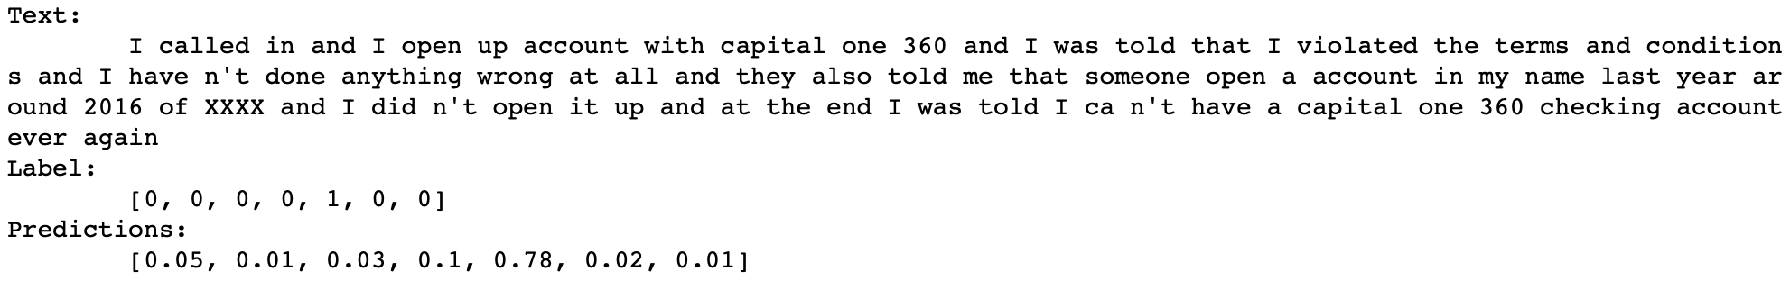
Our Data
Data
Features: Text of customer messages
Labels: Departments
Outputs
Probabilities for each label
Example

Slide 4
Text Pre-Processing
Issue: Messages contain punctuation in various and inconsistent ways
Presents challenge when using words as features
Solution: Strip punctuation, remove contractions
Sensitive information has been censored to ‘XX…X’
Various information is all represented identically losing useful information
Solution:
XX/XX/XXXX -> ‘date’
$ XX -> ‘dollar’
% XX -> ‘percentage’
XX Bank -> ‘bank’

Slide 5
Features from Text: One-Hot-Vectors & Bags-of-Words
Example: “My loan is due”, “My dog ate my mortgage records”
Word Representation (One-Hot)
Words -> Categorical Variables
Vector of size |V|
One dimension is ‘hot’ (set to 1)
Document Representation (Bag-of-Words)
Vector of size |V|
Combination of One-Hot vectors of words in the passage
Values denote presence/count of words in document
Word | Feature1 | Feature2 | Feature3 | Feature4 | Feature5 | Feature6 | Feature7 | Feature8
 | ate | dog | due | is | loan | mortgage | my | records
ate | 1 | 0 | 0 | 0 | 0 | 0 | 0 | 0
dog | 0 | 1 | 0 | 0 | 0 | 0 | 0 | 0
due | 0 | 0 | 1 | 0 | 0 | 0 | 0 | 0
is | 0 | 0 | 0 | 1 | 0 | 0 | 0 | 0
loan | 0 | 0 | 0 | 0 | 1 | 0 | 0 | 0
mortgage | 0 | 0 | 0 | 0 | 0 | 1 | 0 | 0
my | 0 | 0 | 0 | 0 | 0 | 0 | 1 | 0
records | 0 | 0 | 0 | 0 | 0 | 0 | 0 | 1
Feature1 | Feature2 | Feature3 | Feature4 | Feature5 | Feature6 | Feature7 | Feature8
ate | dog | due | is | loan | mortgage | my | records
0 | 0 | 1 | 1 | 1 | 0 | 1 | 0

Slide 6
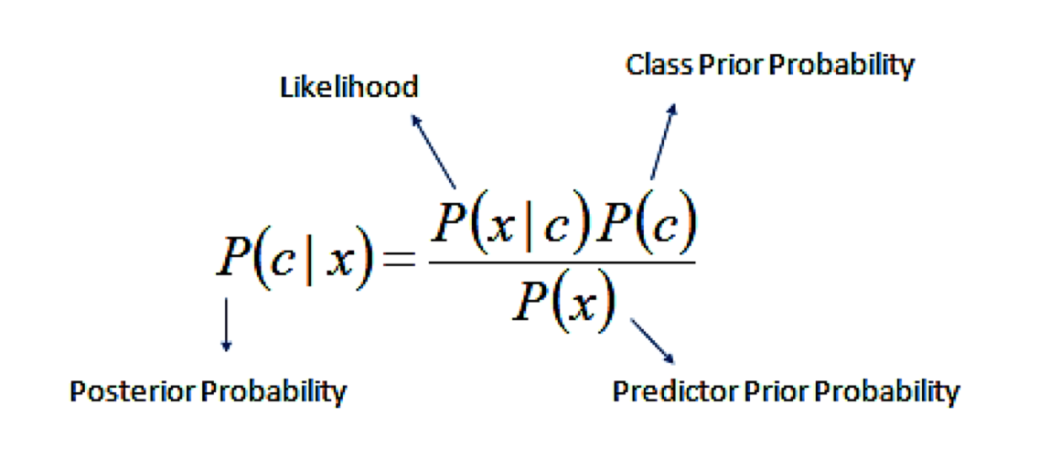
Naïve Bayes

Slide 7
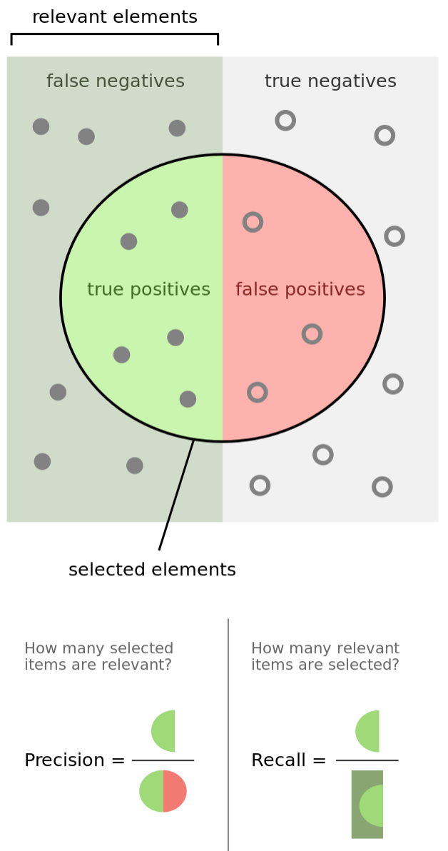
Model Evaluation Metrics
Models return probabilities of classification labels
Internal teams determine threshold probabilities
Business impact of misclassification
Availability of moderator resources
Single Value Model Evaluation Metric
F-score
Harmonic mean of precision and recall
Imbalanced data

Slide 8
Model Performance of Naïve Bayes
Label | precision | recall | f1-score | support
bank_service | 0.8 | 0.78 | 0.79 | 2007
credit_card | 0.75 | 0.8 | 0.78 | 2955
credit_reporting | 0.88 | 0.87 | 0.88 | 8123
debt_collection | 0.84 | 0.83 | 0.84 | 6147
loan | 0.81 | 0.78 | 0.8 | 3103
money_transfers | 0.9 | 0.55 | 0.69 | 474
mortgage | 0.88 | 0.95 | 0.91 | 4027
avg/total | 0.84 | 0.84 | 0.84 | 26836
Problems:
One-Hot-Encodings:
Encodings do not capture any semantic or syntactic information about the words they represent
“my loan is due“ vs. “my mortgage is due”
sim(‘loan’, ‘mortgage’) = sim(‘loan’, ‘dog’) = 0
Model cannot generalize contexts
Bag-Of-Words:
Ordering information is lost
“I am not able to log in. The system is bad” vs. “I am able to log in. The system is not bad”

Slide 9
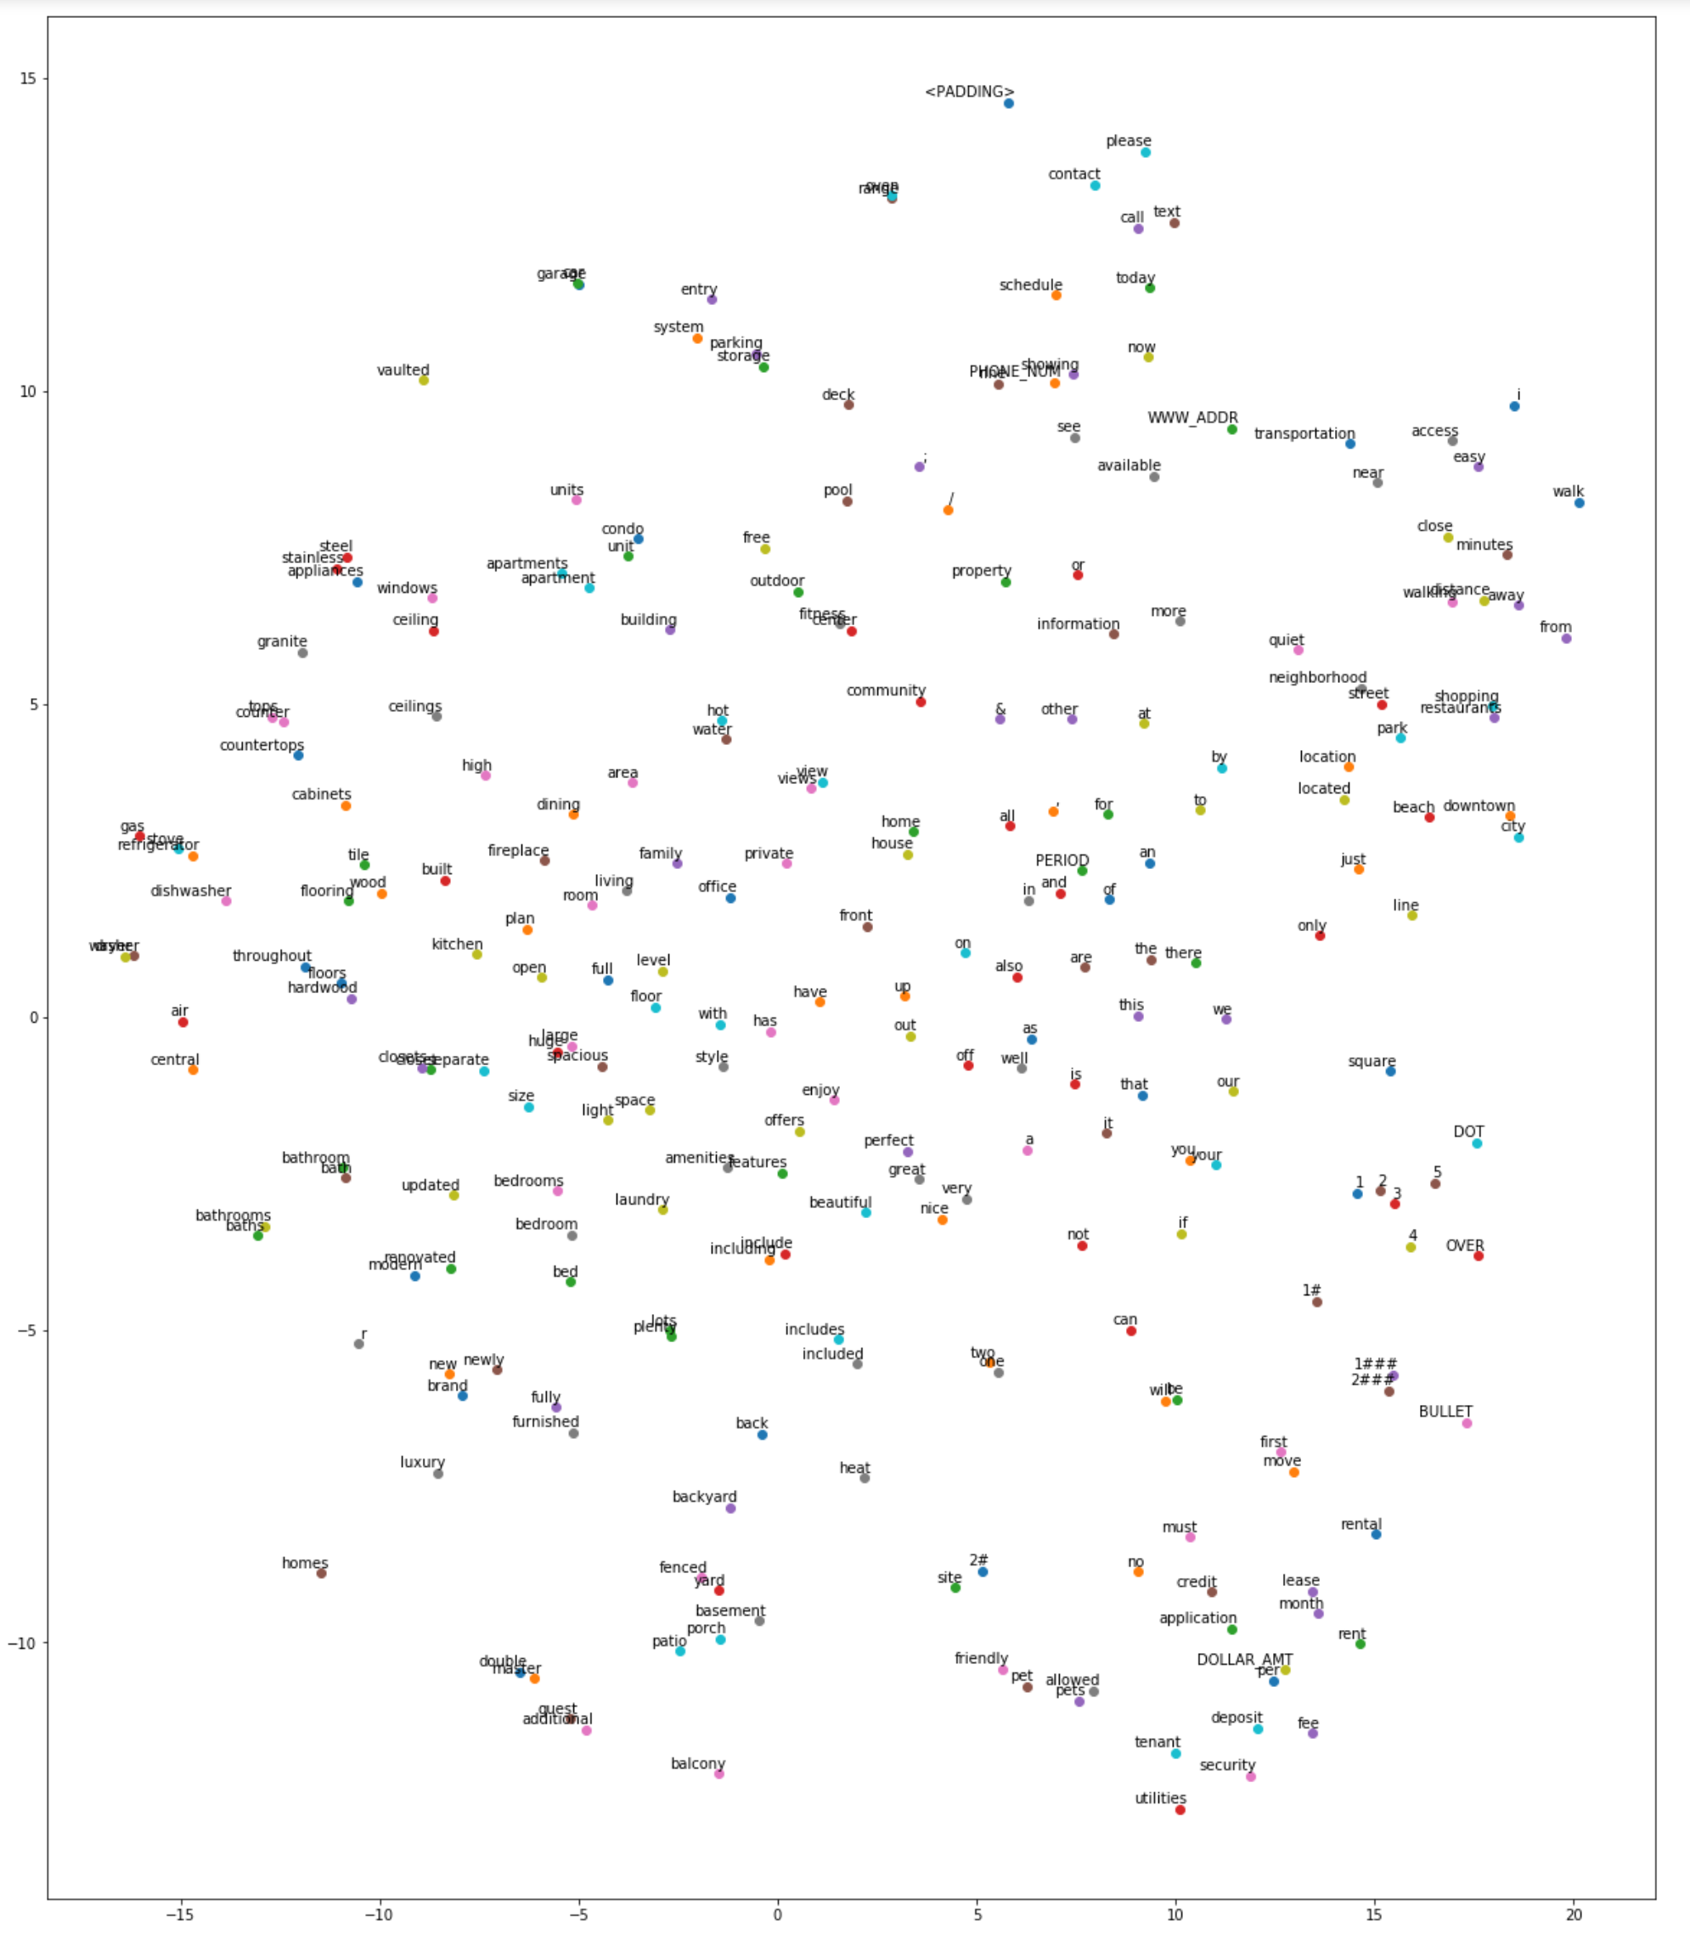
Distributed Word Embeddings
Words are represented as real-valued vectors of user defined dimensionality
v_{loan} = [0.59,0.58,0.05,0.56]
v_{mortgage} = [0.58,0.59,0.1,0.53]
v_{dog} = [0.15,0.25,0.93,0.21]
Similar words have similar vector representations
sim(‘loan’, ‘mortgage’) >> sim(‘loan’, ‘dog’)
Allows generalizability
Embedding Creation Methods
Predict word pairs that occur in close proximity in text
Word2Vec
GloVe
Learned as part of LSTM network

Slide 10
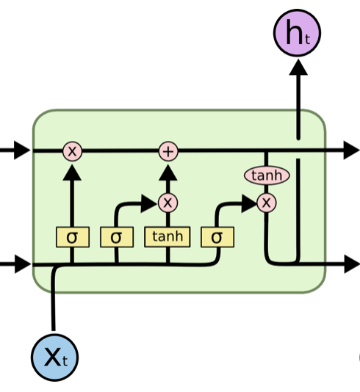
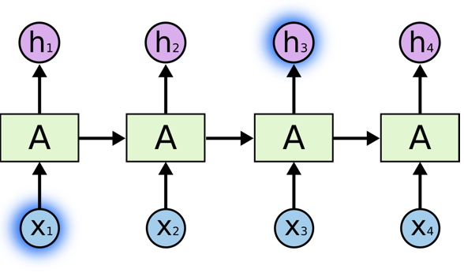
LSTM
Recurrent Neural Networks can learn historical data.
LSTM can better handle long term dependency issue.
* images are from Chris Olah’s blog

Slide 11
Model Performance of LSTM
labels | precision | recall | f1-score | support
bank_service | 0.82 | 0.79 | 0.8 | 2007
credit_card | 0.81 | 0.8 | 0.8 | 2955
credit_reporting | 0.85 | 0.88 | 0.87 | 8123
debt_collection | 0.85 | 0.82 | 0.84 | 6147
loan | 0.84 | 0.79 | 0.81 | 3103
money_transfers | 0.78 | 0.73 | 0.75 | 474
mortgage | 0.89 | 0.95 | 0.92 | 4027
avg/total | 0.85 | 0.85 | 0.85 | 26836
LSTM performance is better in virtually every case
Particularly in ‘money_transfers’
LSTM model much smaller in size than Naïve Bayes (30MB vs 600MB)
Naïve Bayes much faster to train (~5min vs 2 hours)

Slide 12
Areas of Future Improvement
Improved tokenization and text-preprocessing
Regular Expression Filtering
Lemmatizing / Stemming
Increased number tokenizing
Hyper-parameter search
Naïve Bayes
Alpha level (word count smoothing)
LSTM
Embedding Dimensionality
Regularization (Dropout, L2)
Architecture Search
Data set enrichment/class balancing
Synthetically enrich minority (money transfer) class
Weighted loss functions
Alternative deep learning architectures:
CNN model

Slide 13
Questions?

