Slide 1



R E S E A R C H P R E S E N T A T I O N · 2 0 2 6 A C 0 4
01
Can a Disposable Mask
Be Reused?
A qualification review of hot-water decontamination
and charge regeneration
Wang D. et al. · Engineering 6 (2020) 1115–1121 · Beijing University of Chemical Technology
PRESENTED BY 甲 · 乙 · 丙 · 丁

Slide 2
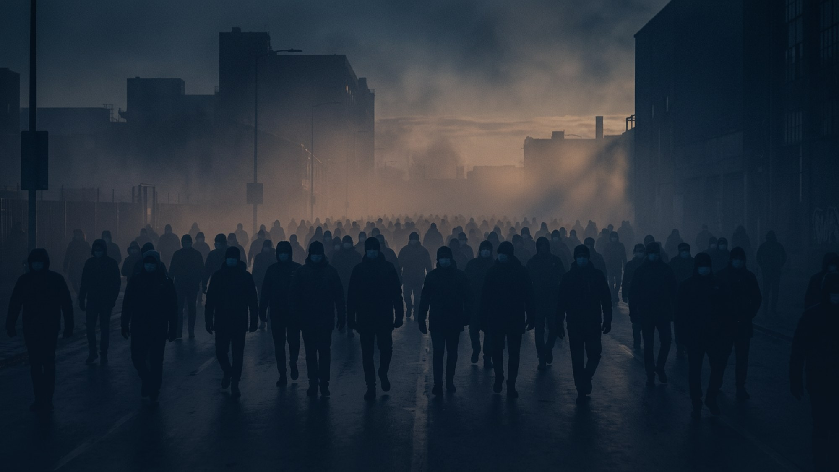
0 1 · C O N T E X T
Why This Matters
In early 2020 a disposable mask stopped being disposable — it became a strategic resource.
8
MILLION MASKS / DAY
CHINA · JANUARY 2020
Total mask production in China
Reported for 23 January 2020
1.4
BILLION PEOPLE
The population that supply had to cover
The demand–supply gap was enormous
3
DAYS TO ACCEPT
From submission to acceptance
Received 26 May · Accepted 29 May 2020
So the question became urgent: is there a way to make one mask last longer — safely?
QUALIFICATION REVIEW · WANG ET AL. 2020 · ENGINEERING 6, 1115–1121
SPEAKER 甲
02 / 13

Slide 3

0 2 · F R A M E W O R K
Three Questions for a Qualification Review
This paper is not a discovery. It is a qualification campaign — and any review must answer three questions.
01
02
03
KILL?
FILTER?
SURVIVE?
Does the procedure actually inactivate the virus?
Does the mask still capture particles afterwards?
Does it hold up after real hours of wear?
QUALIFICATION REVIEW · WANG ET AL. 2020 · ENGINEERING 6, 1115–1121
SPEAKER 甲
03 / 13

Slide 4
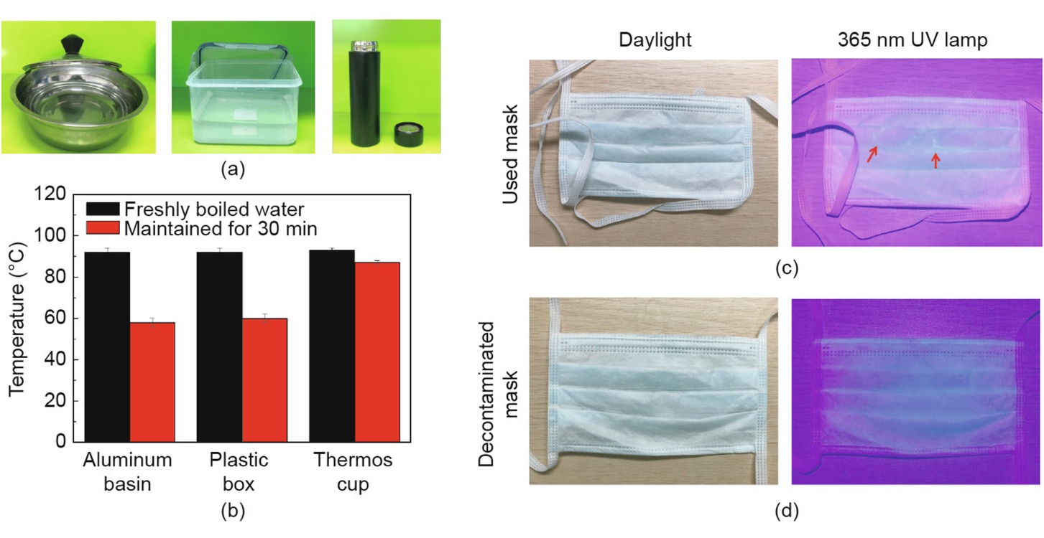
0 3 · M E T H O D
The Procedure
Two steps, no chemicals, no special equipment.
56 °C water, then a hair dryer.
STEP 01 · SOAK
56 °C
FOR 30 MINUTES
The envelope protein of the virus denatures and the virus loses its ability to infect.
STEP 02 · DRY
10
MINUTES, HAIR DRYER
Recharges the melt-blown filter layer with static electricity.
Fig. 1 — Household containers, water temperature over 30 min, and a used mask under 365 nm UV light, before and after treatment. Wang et al. (2020).
NO CHEMICALS · NO SPECIAL EQUIPMENT · DOABLE IN A KITCHEN
QUALIFICATION REVIEW · WANG ET AL. 2020 · ENGINEERING 6, 1115–1121
SPEAKER 乙
04 / 13

Slide 5

0 4 · M E T H O D
Does the Water Stay Hot Enough?
THE TARGET
56
100
90°C
90°C
90°C
85°C
80
60°C
60°C
56 °C required
°C — FOR 30 MINUTES
60
40
Boiling water starts near 90 °C in all three containers.
After 30 minutes the basin and the lunch box are still around 60 °C; the thermos holds 85 °C.
The requirement is met with things people already own.
20
0
Aluminium
basin
Plastic
lunch box
Stainless
thermos cup
WATER TEMPERATURE (°C)
Three everyday containers — and the water is still hot enough after half an hour.
QUALIFICATION REVIEW · WANG ET AL. 2020 · ENGINEERING 6, 1115–1121
SPEAKER 乙
05 / 13

Slide 6

0 5 · M E T H O D
The Hidden Problem: Static Charge
Hot water kills the virus — and it also destroys the charge that makes the mask work.
New mask
100%
WHY IT MATTERS
Electrostatic adsorption is the only mechanism that captures nano-sized particles while keeping the mask easy to breathe through.
Hot water removes that charge. So the charge has to be put back — that is what the hair-dryer step is for.
Drying fast also stops bacteria from growing inside a wet mask.
Air-dried 10 h
60%
too slow; bacteria can grow in a wet mask
Hair dryer 10 min
90%
fast, and recovers most of the charge
RECOVERY OF ELECTROSTATIC CHARGE ON THE FILTER LAYER
The recipe: hot water, 56 °C, 30 minutes; hair dryer, 10 minutes.
QUALIFICATION REVIEW · WANG ET AL. 2020 · ENGINEERING 6, 1115–1121
SPEAKER 乙
06 / 13

Slide 7

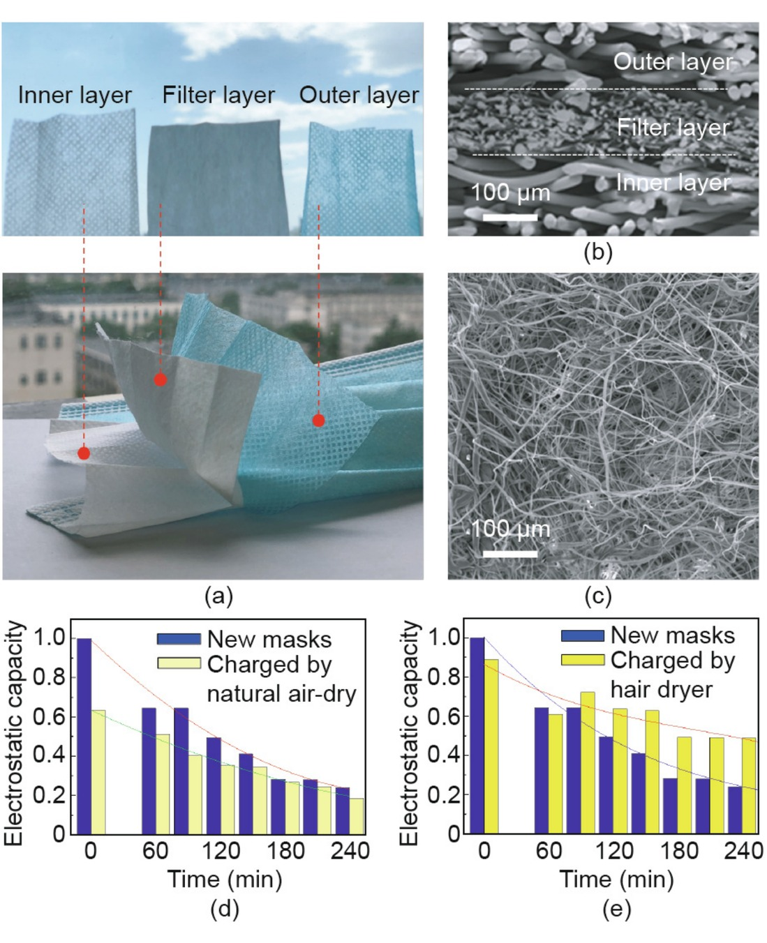
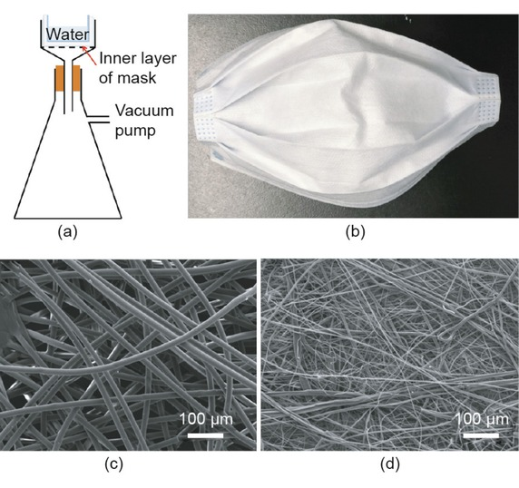
0 6 · S T R U C T U R E
What’s Inside a Mask
Three layers of non-woven fabric — one of them does almost all of the work.
OUTER LAYER
Waterproof non-woven. Blocks liquid droplets sprayed by others.
FILTER LAYER
fibres 1–10 µm
Polypropylene melt-blown, 100–1000 µm thick. This is the working layer.
INNER LAYER
Ordinary non-woven. Absorbs moisture released by the wearer.
The filter layer is where everything happens.
Fig. 3 — waterproof test, SEM
QUALIFICATION REVIEW · WANG ET AL. 2020 · ENGINEERING 6, 1115–1121
SPEAKER 丙
07 / 13

Slide 8

0 7 · M E C H A N I S M
Five Filtration Mechanisms
A mask does not work like a sieve. Five mechanisms act together — one of them dominates.
01
02
03
04
05
Brownian
diffusion
Entrapment
Inertial
collision
Gravity
sedimentation
Electrostatic
adsorption
Random motion drives the smallest particles into fibres.
Particles too large to follow the air stream get stuck.
Heavier particles cannot turn with the air and hit a fibre.
Large particles simply settle out of the airflow.
Charge pulls nano-sized particles in — at almost no cost to breathing resistance.
THE KEY
THE ONE THAT MATTERS — Electrostatic adsorption is the only mechanism that captures nano-sized particles while keeping the mask breathable, and it is exactly the one that hot water destroys.
QUALIFICATION REVIEW · WANG ET AL. 2020 · ENGINEERING 6, 1115–1121
SPEAKER 丙
08 / 13

Slide 9
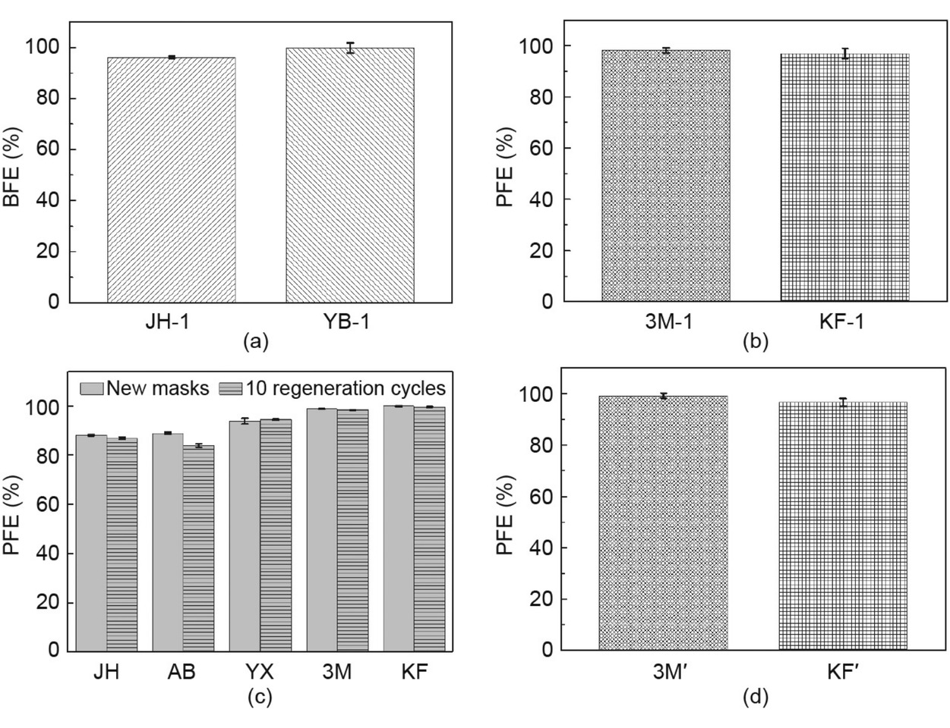
0 8 · E V I D E N C E
Test Results vs Standards
Measured with a TSI 8130 against NaCl aerosol, following the Chinese national standards.
>95
% MEASURED
Bacterial filtration — BFE
Required ≥ 95% · YY/T 0969–2013 · YY 0469–2011
92.3
% MEASURED
Particle filtration — surgical
Required ≥ 30% · YY 0469–2011
>95
% MEASURED
Particle filtration — KN95
Required ≥ 95% · GB 2626–2019
Fig. 4 — BFE and PFE of regenerated masks, performance after 10 cycles, and after sterilisation at 121 °C. Wang et al. (2020).
NaCl aerosol · 0.075 µm · 30 L/min (medical, surgical) · 85 L/min (KN95)
QUALIFICATION REVIEW · WANG ET AL. 2020 · ENGINEERING 6, 1115–1121
SPEAKER 丙
09 / 13

Slide 10

0 9 · D U R A B I L I T Y
After Ten Cycles
10
TEN FULL SOAK-AND-DRY CYCLES
Five brands of masks were put through ten full cycles of hot-water soaking and hair-dryer charging.
Filtration performance barely changed.
Ten cycles — essentially a fatigue-life test for a disposable mask.
PUSHED FURTHER — PRESSURISED STEAM AT 121 °C, 30 MIN
3M 1860
99.2%
95%
min.
KF94
96.6%
QUALIFICATION REVIEW · WANG ET AL. 2020 · ENGINEERING 6, 1115–1121
SPEAKER 丙
10 / 13

Slide 11
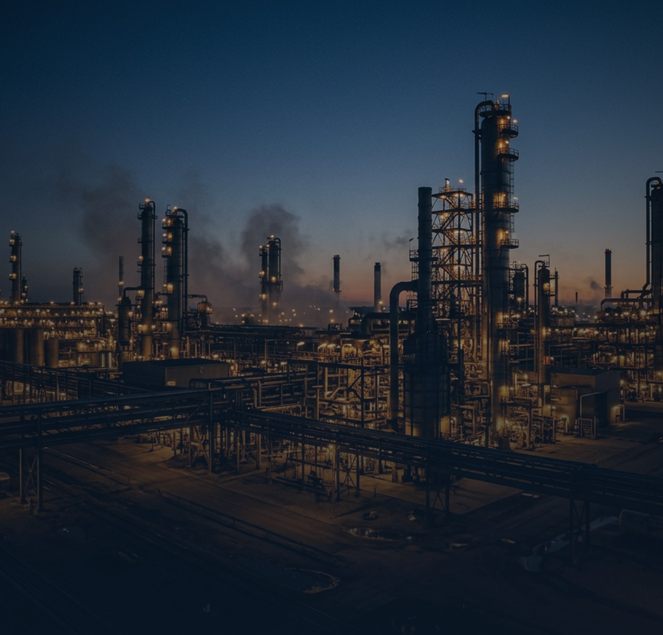
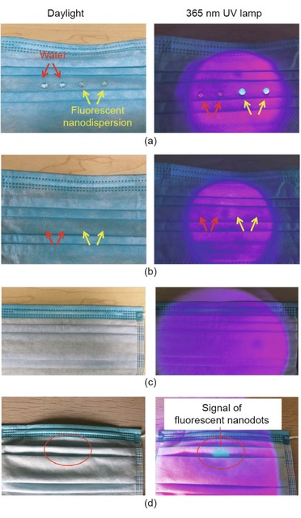
1 0 · F I E L D
Real Wear, Real Factory
Laboratory tests are clean. Real life is not — so the authors ran both.
WATERPROOF
100 mL in 20 s, vacuum 3 min
After 10 cycles: no seepage. SEM shows the fibres intact.
8 HOURS OF REAL WEAR
Surgical vs KN95
Surgical fell by 0.5–12% (15 samples). All 10 KN95 stayed above 95%.
122,500
THE REAL CULPRIT
It is not the hot water
Dirt and oil from the skin change the wettability of the fibres.
Fig. 5 — fluorescent
penetrant inspection
Zhejiang Runtu Co. · over 4,000 staff
20 February – 30 March 2020
One mask per person per day → one mask every three days
FROM THE LAB TO THE FACTORY
Deployed at scale: one company cut mask use to a third in five weeks.
QUALIFICATION REVIEW · WANG ET AL. 2020 · ENGINEERING 6, 1115–1121
SPEAKER 丁
11 / 13

Slide 12
1 1 · V E R D I C T
Verdict: Approved — With Limits
What the evidence supports — and what it simply does not.
P R O V E N
N O T P R O V E N
Hot water plus a hair dryer keeps the filtration performance of disposable, surgical and KN95 masks essentially intact for up to 10 cycles — and it was deployed at scale, with measurable savings.
• Virus killing was never measured directly
• NaCl particles, not the actual virus
• Only six products were tested
• Fit and seal were never tested at all
ONE INCONSISTENCY
In §3.5 the worn KN95 masks were treated with hot water; in the Conclusions the same result is described as pressurised steam at 121 °C. Two different treatments — the conclusion stands, but published papers still need careful reading.
30%
COMPARED TO WHAT?
For surgical masks the required PFE is only 30%. So “92.3%” sounds impressive partly because the bar is low. A good reviewer always asks: impressive compared to what?
QUALIFICATION REVIEW · WANG ET AL. 2020 · ENGINEERING 6, 1115–1121
SPEAKER 丁
12 / 13

Slide 13

”
1 2 · W H Y T H I S P A P E R
Why We Chose This Paper
This is not a discovery. It is a qualification campaign:
set the acceptance criteria, run to N cycles, inspect, then release.
That is exactly what engineers do to turbine blades and filters.
And in an emergency, the best engineering is often not the most advanced —
it is the kind that works with a pot of hot water and a hair dryer.
T H A N K Y O U
QUALIFICATION REVIEW · WANG ET AL. 2020 · ENGINEERING 6, 1115–1121
SPEAKER 丁
13 / 13

