Slide 1

TASTE OF HEAVEN RESTURANT
BRYAN UNIVERSITY
SUN CERRAE
Software Project Manager

Slide 2

TIMELINE
STEP 3
STEP 4
Prototype
Launching
Overview of the project
from start to finish
Week 4 the site was created
Week 7 finish and present website
STEP 1
STEP 2
Brainstorm
Planning
Restaurant ( Taste of Heaven)
came up with a timeline and decide on how many pages will be needed for the site.
timeframe of each key milestone.

Slide 3

Create
Observe
PROCESS
FIRST PROTOTYPE
THE RESULT
Weeks 4&5,6
Week 7 (Capstone)
1
2
3
4
1
Prepare
Start
WEB INFRASTRUCTURE & SERVER DEPLOYMENT
PLANNING
A business process is
a series of steps designed
to produce a product.
Python, Django, Apache & Docker
7 weeks to create site

Slide 4

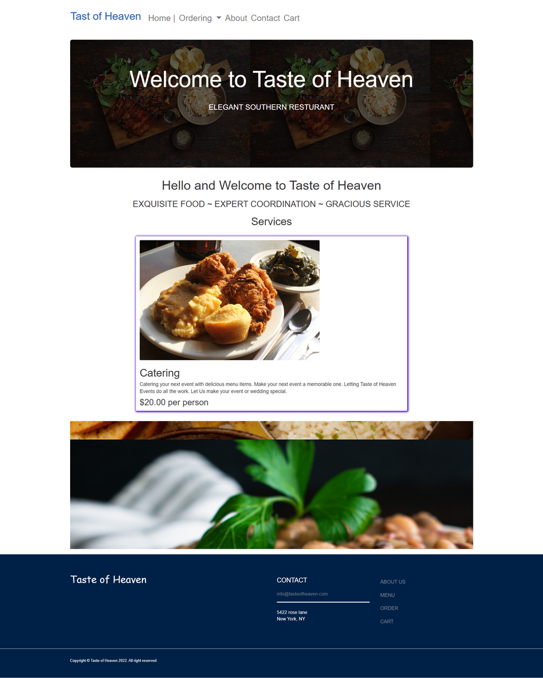


Nav Bar
HOMEPAGE
Greeted by Welcome Page
Services (Catering)
Footer (Email, Address & links to other pages)
Taste of Heaven

Slide 5
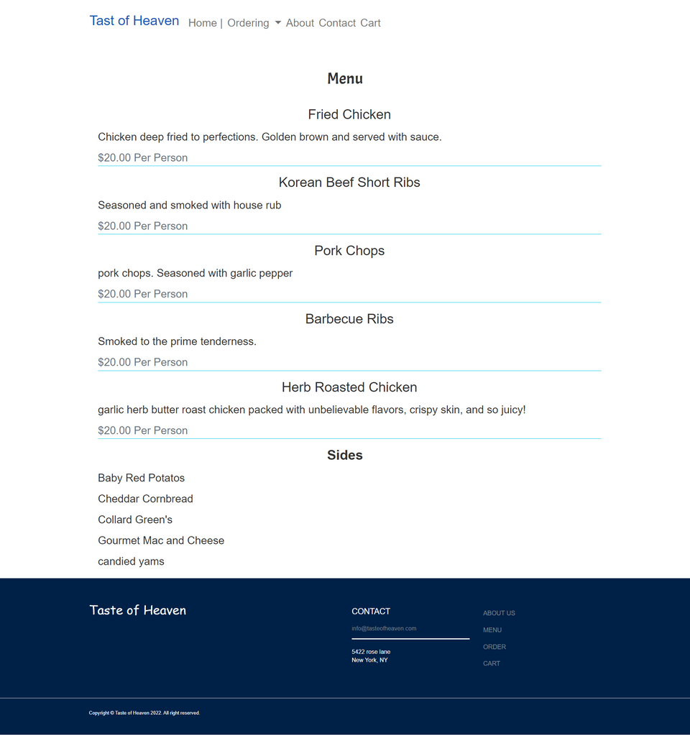
Menu items
MENU
Breakdown of food and sides to order from
Taste of Heaven

Slide 6
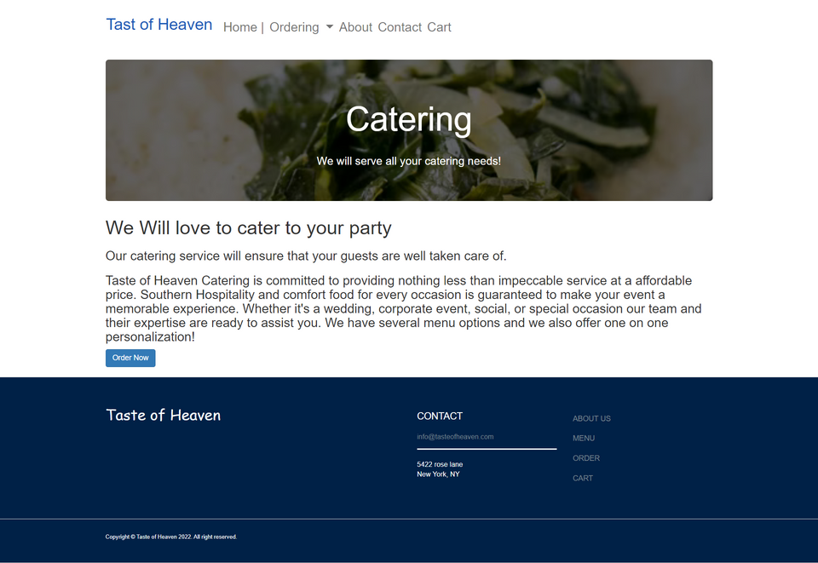
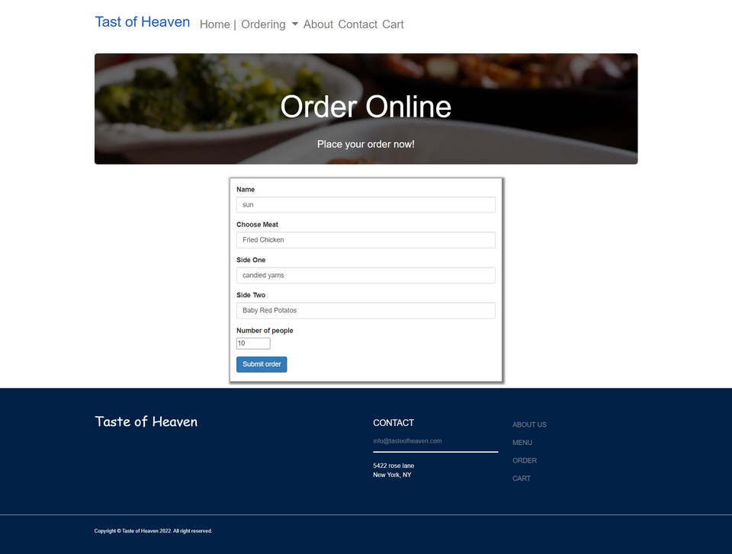
CATERING & ORDER PAGES
Catering page details about the business (wedding, corporate event, social, or special occasion)
Ordering online is used for catering and individual ordering
Taste of Heaven

Slide 7
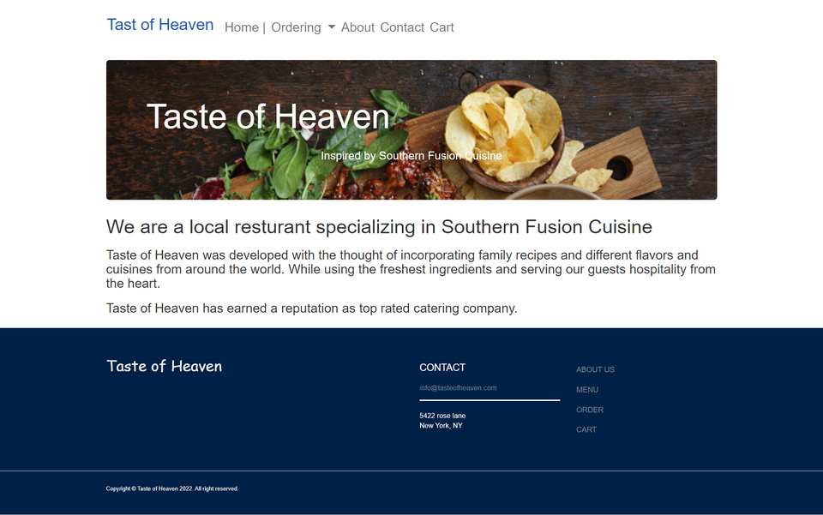
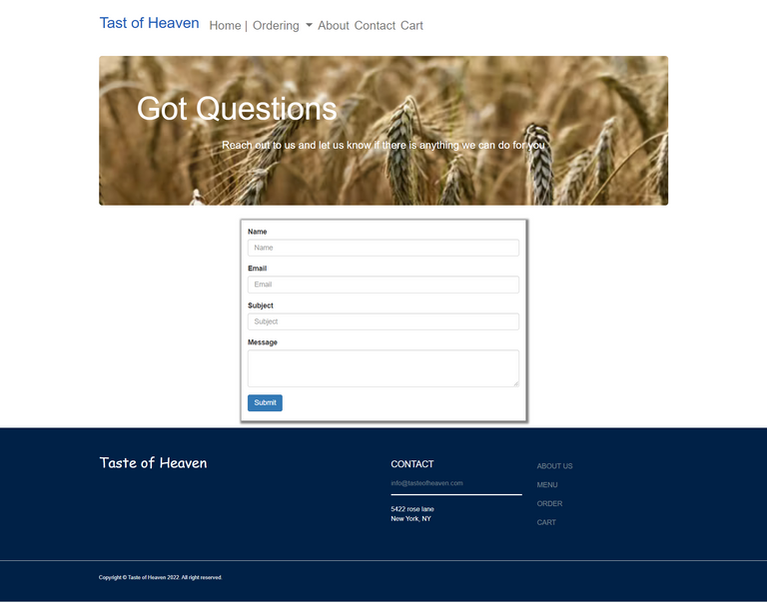
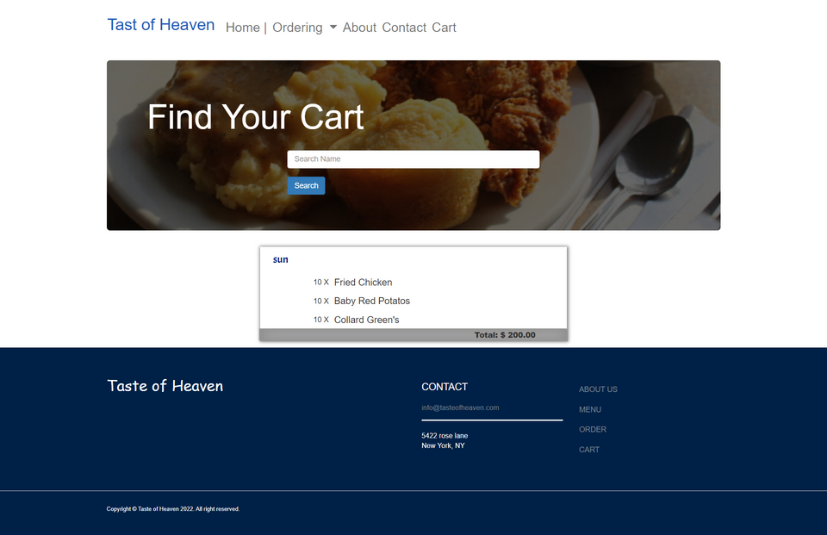
ABOUT,CONTACT & CART
About Company (Taste of Heaven)
Contact Us (fill out form)
Cart (find your order by putting in your name/business)
Taste of Heaven

Slide 8

THANK YOU
for your attention !

