Slide 1
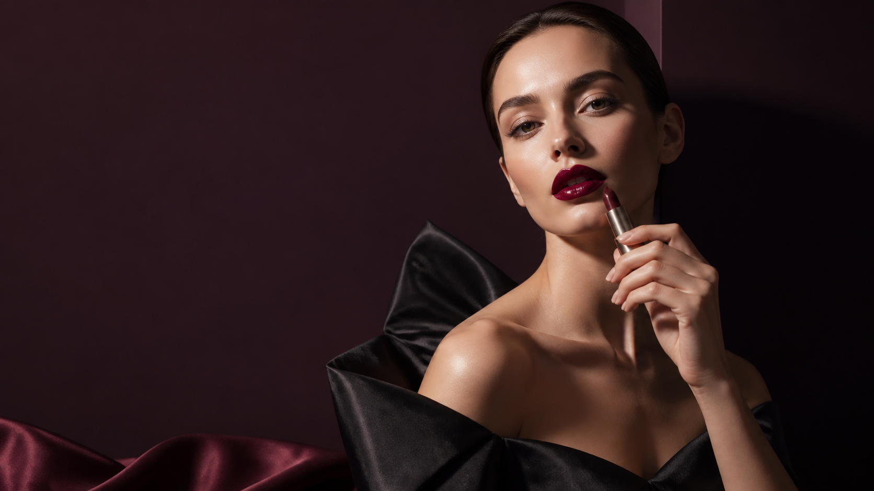
PORTFOLIO CASE / 2026
COUTURE COLOR
OBJECTS OF DESIRE
A couture lipstick collection with a face, a gesture, and a trace.
CONCEPTUAL BEAUTY EDITORIAL / ENGLISH
01

Slide 2
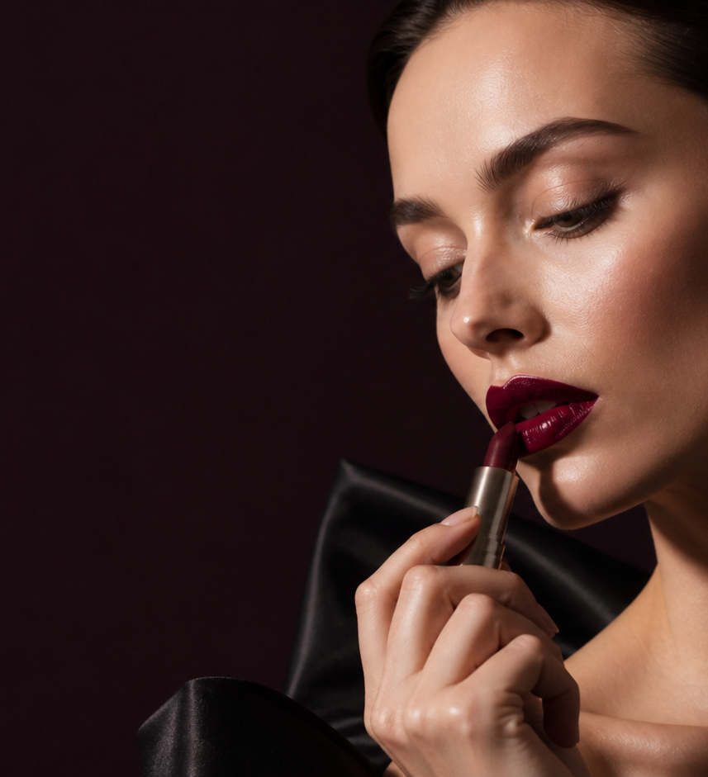
01 / THE PROPOSITION
COLOR IS A COUTURE GESTURE.
Not an accessory to a look — a small, precise object that finishes a point of view.
FORM
PIGMENT
RITUAL
a tailored case
a held intensity
a private finale
COUTURE COLOR / CONCEPT COLLECTION
02

Slide 3
02 / THE CHROMATIC WARDROBE
SIX SHADES. ONE AFTER-DARK SILHOUETTE.
01
02
03
04
05
06
NUDE VEIL
ROSE TAILLEUR
GARNET
VIOLET NOIR
OXBLOOD
BLACK CHERRY
A wardrobe is not a spectrum. It is a sequence of attitudes.
THE COLOR SYSTEM IS ENTIRELY EDITABLE: SWATCHES, NAMES, ROLES, AND ORDER.
COUTURE COLOR / CONCEPT COLLECTION
03

Slide 4
03 / OBJECT GRAMMAR
01 / BULLET
TAILORED TO THE HAND.
an oblique, held edge
The case is conceived as an architecture of proportion, weight, and interruption.
02 / COLLAR
a warm metal pause
03 / CASE
a lacquered vertical
PROPORTION
A narrow column meets a broad base.
COUTURE COLOR / CONCEPT COLLECTION
04

Slide 5
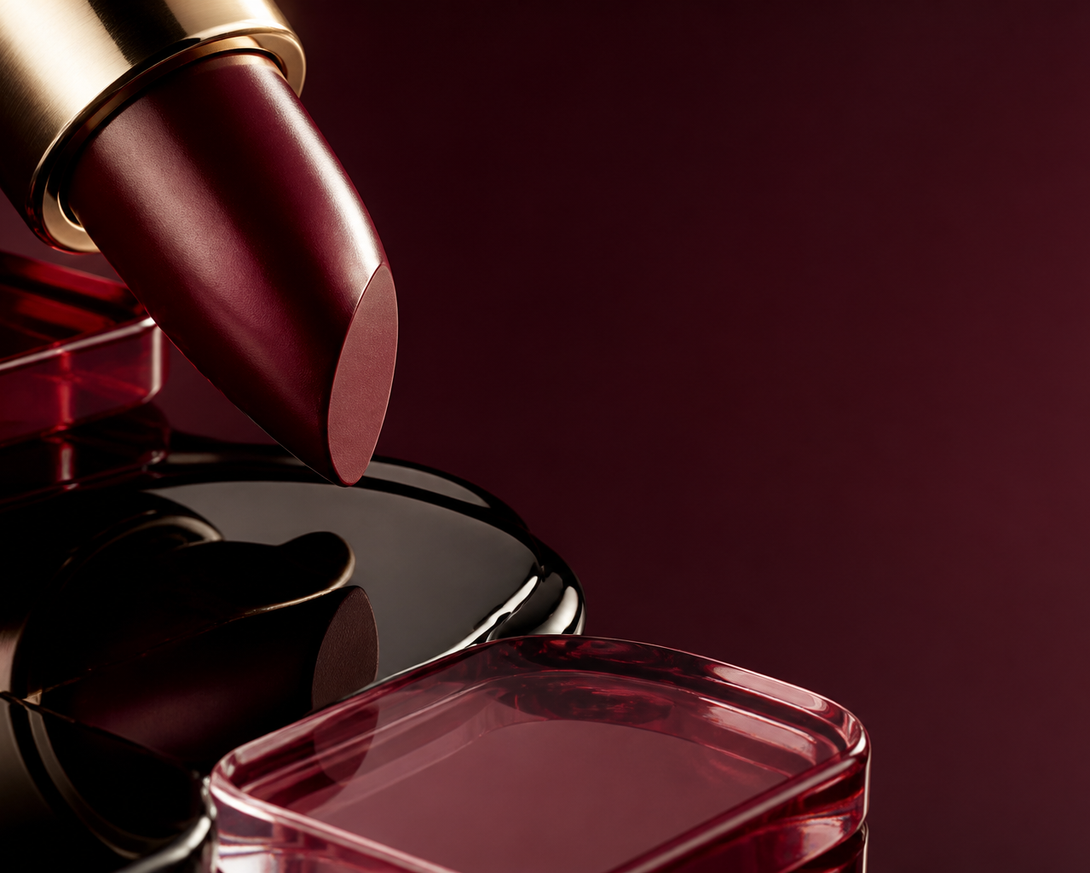
04 / MATERIAL CHOREOGRAPHY
PIGMENT HAS A MEMORY.
01
LACQUER
depth / reflection
02
METAL
weight / temperature
03
PIGMENT
gesture / trace
The material story must be readable before the product is named.
COUTURE COLOR / CONCEPT COLLECTION
05

Slide 6
05 / THE GESTURE
A SINGLE, HELD LINE.
APPLICATION IS THE LAST TAILORING MOVE.
A line that does not decorate. A line that decides.
EDITABLE SVG SWEEP / NATIVE COLOR TRACE
COUTURE COLOR / CONCEPT COLLECTION
06

Slide 7
06 / THE COLLECTION
THREE TONES. THREE POSTURES.
THE NUDE
THE ROSE
THE RED
quiet structure
soft armour
held intensity
COUTURE COLOR / CONCEPT COLLECTION
07

Slide 8
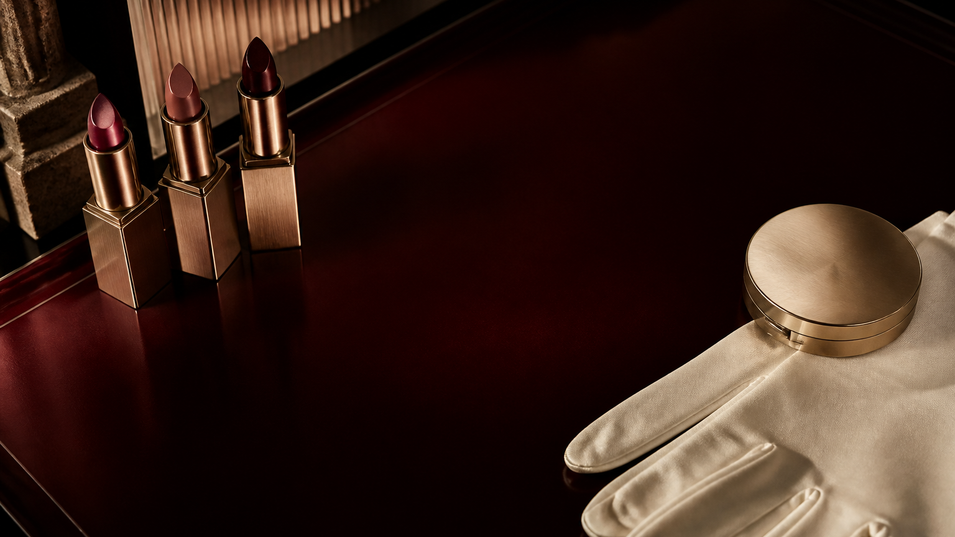
07 / THE RITUAL
A PRIVATE FINAL LOOK.
The collection belongs on a dressing table before it belongs to a campaign.
RETAIL SETTING
Low light. Warm metal. A deliberate pause.
COUTURE COLOR / CONCEPT ONLY
08

Slide 9
08 / EDITORIAL RELEASE
REVEAL, HOLD, LEAVE A TRACE.
I
II
III
IV
THE OBJECT
THE WARDROBE
THE GESTURE
THE RITUAL
a single red form
six intentional shades
one held application
a private finale
A release system built around attention — not fabricated reach, sales, or performance claims.
COUTURE COLOR / CONCEPT COLLECTION
09

Slide 10
09 / CODA
MAKE COLOR A POINT OF VIEW.
Couture is not excess. It is the discipline of deciding what the object needs to say.
COUTURE COLOR / A FICTIONAL PORTFOLIO CASE
All imagery generated for this case. Product language, geometry, and typography remain editable.
COUTURE COLOR / CONCEPT COLLECTION
10

