Slide 1
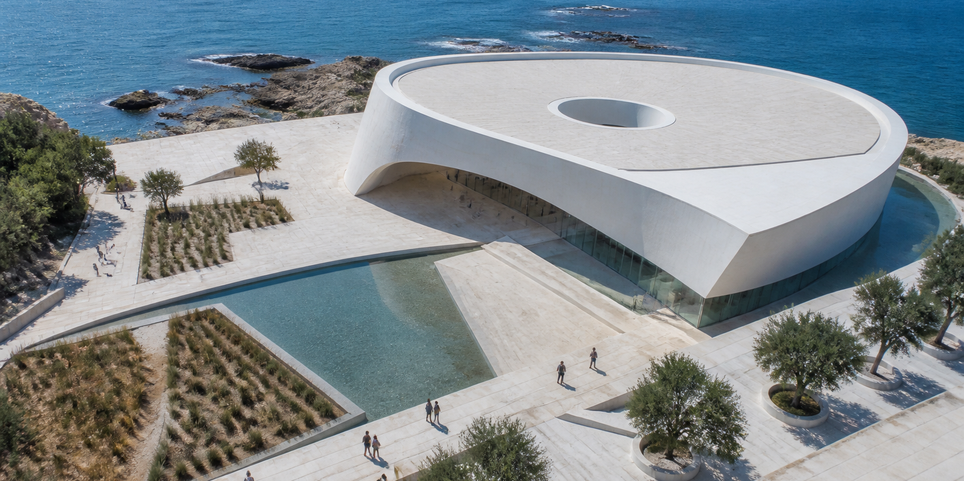
PACIFIC CULTURAL DISTRICT / 2027
HORIZON
COMMONS
A CIVIC PAVILION / CONCEPT BOOK
A generous threshold between
climate, culture and pause.
STUDIO HORIZON / SITE 07 / PACIFIC COAST

Slide 2
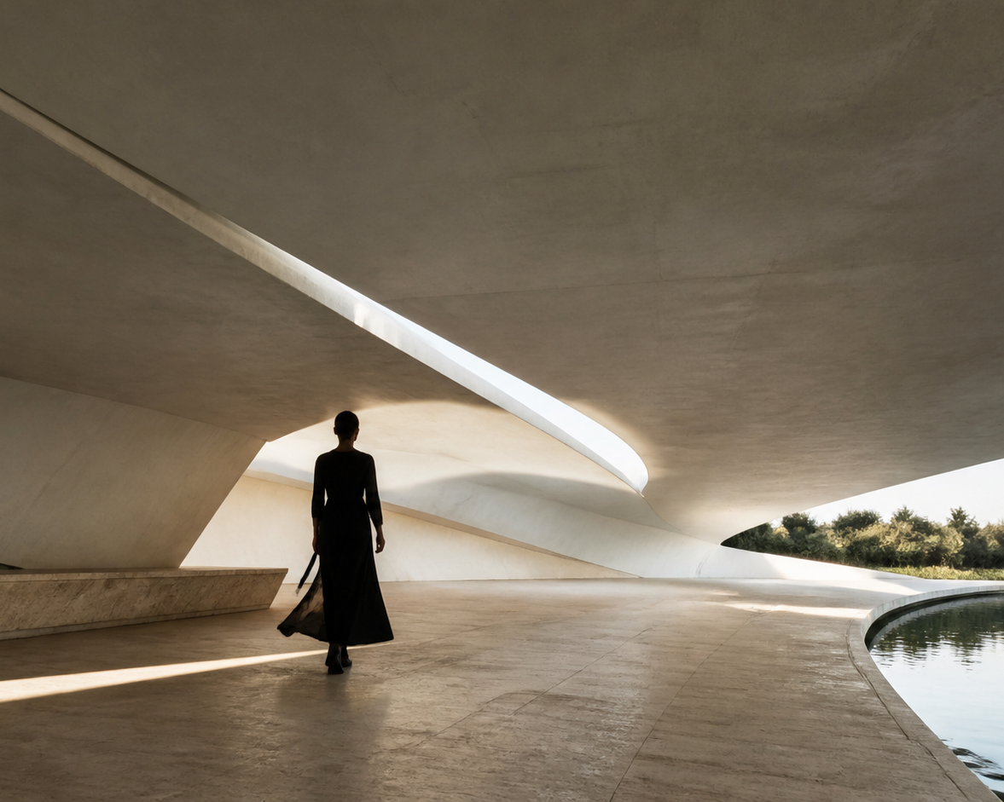
01 / PROPOSITION
The canopy gives the
public room its
temperature, scale
and reason to stay.
SHADE
IS
CIVIC.
THE ROOF IS A CLIMATE DEVICE, NOT AN OBJECT.
2,800 M² / WATER + SHADE + GATHERING / OPEN TO THE HORIZON

Slide 3
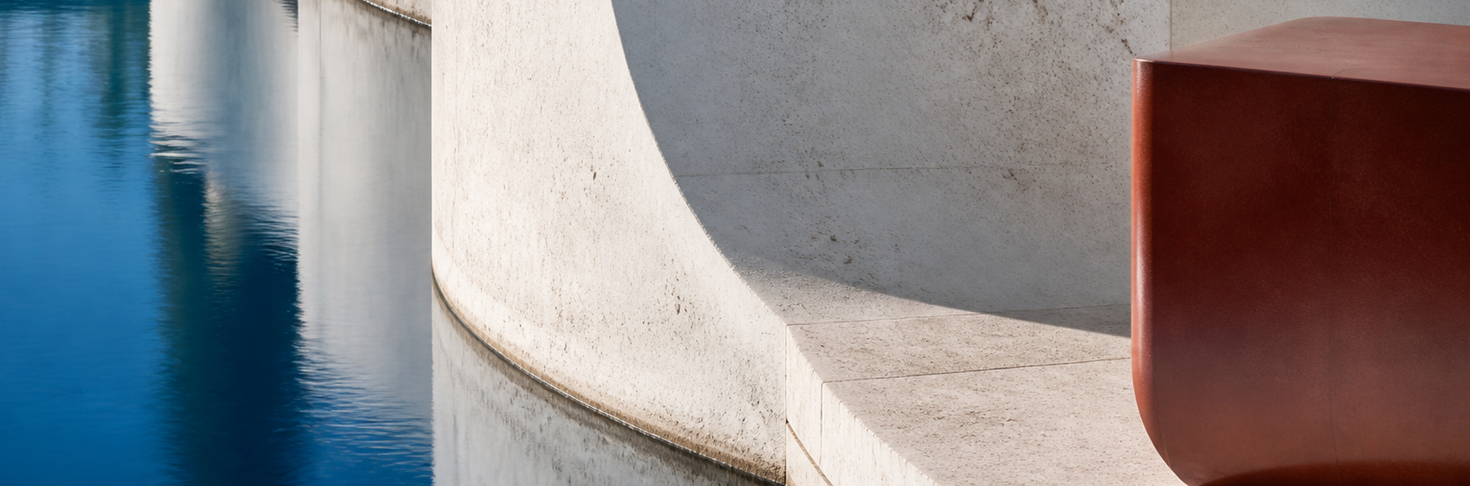
02 / ARRIVAL SEQUENCE
A place unfolds in three pauses.
I
APPROACH
The long edge slows the city before the building begins.
II
CROSSING
A cool shadow makes the act of arrival feel deliberate.
III
RETURN
Water sends the sky back into the room as a quiet civic ritual.

Slide 4
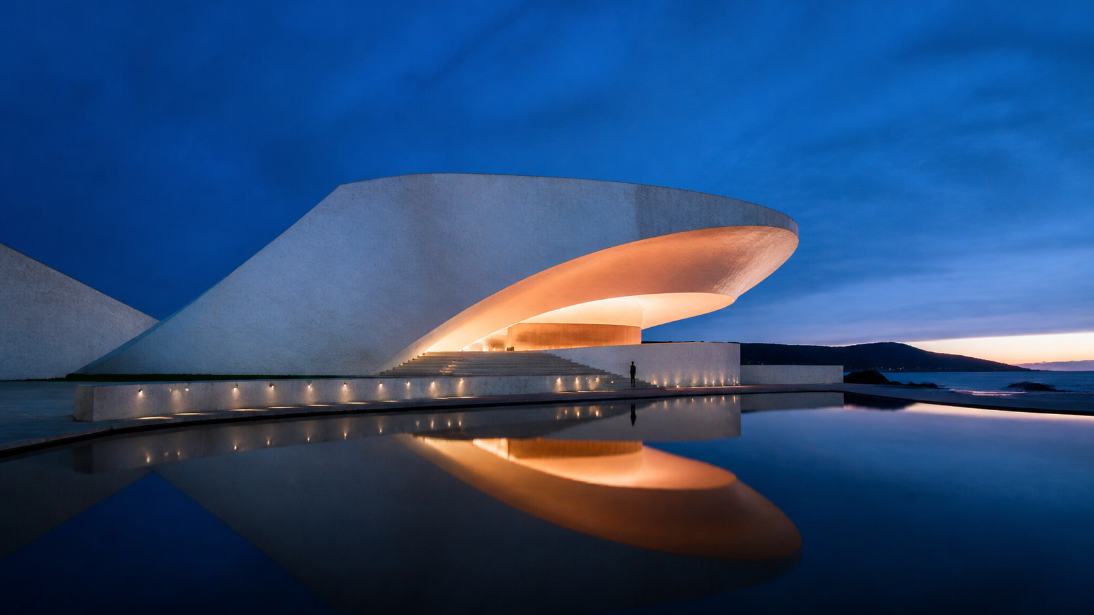
03 / THE INVITATION
MAKE ROOM
FOR RETURN.
The strongest civic gesture is not spectacle.
It is giving people a reason to pause, return, and belong.
STUDIO HORIZON / ARCHITECTURE + PUBLIC LIFE
PACIFIC CULTURAL DISTRICT / CONCEPT BOOK / 2027

