Slide 1
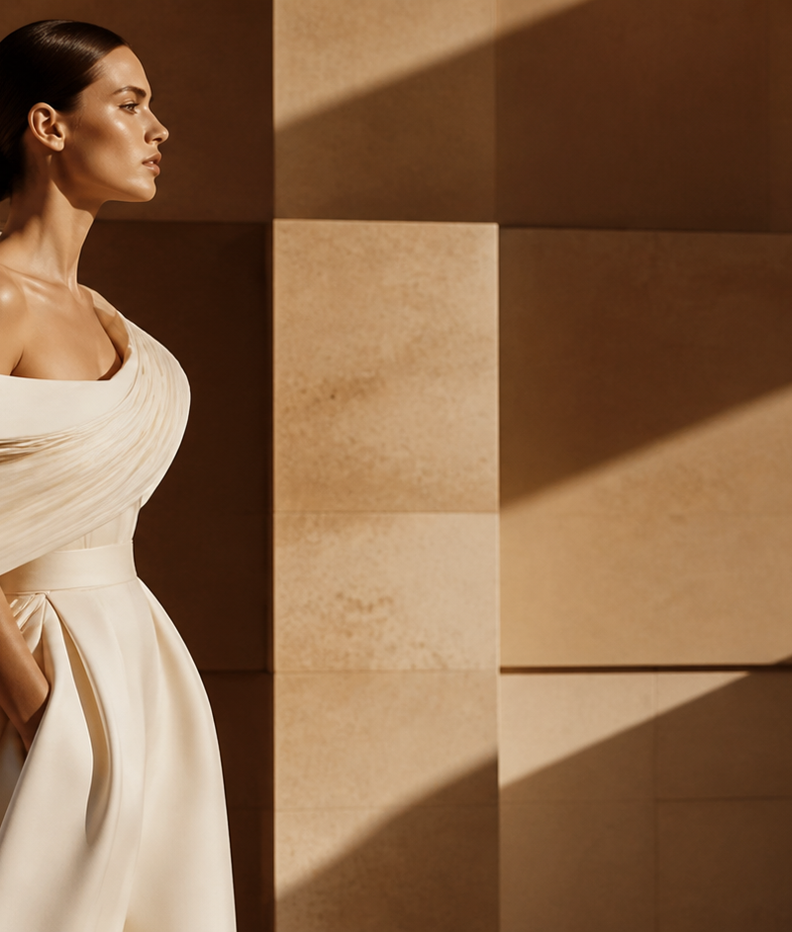
ATELIER NOTES / 01
THE WHITE STUDY
COUTURE IN MOTION
A study of volume,
weight and the hand.
PARIS / SPRING–SUMMER 2027 PRIVATE EDITORIAL EDITION
01
1 / 6

Slide 2
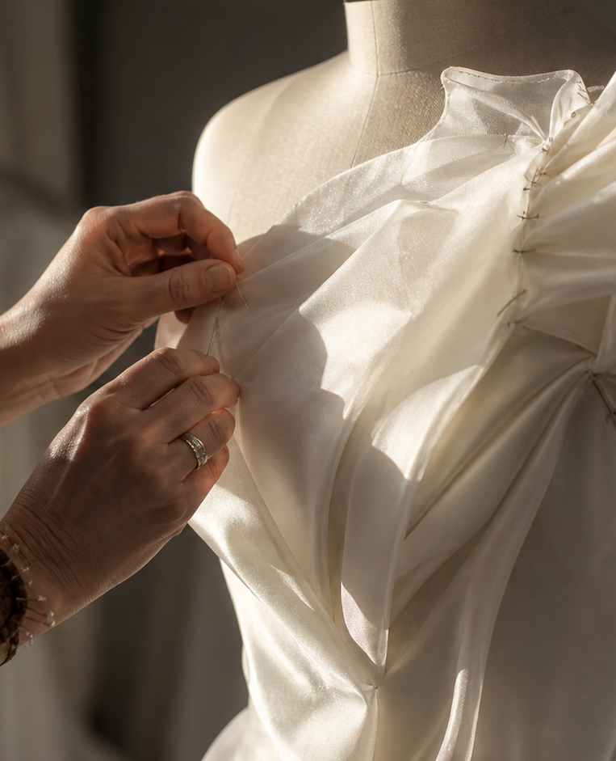
02 / SILHOUETTE STUDY
THE BODY IS THE PATTERN.
Cut on the bias.
Volume released at the shoulder.
HAND-CUT / HAND-FINISHED
A garment begins where the body changes direction.
2 / 6

Slide 3
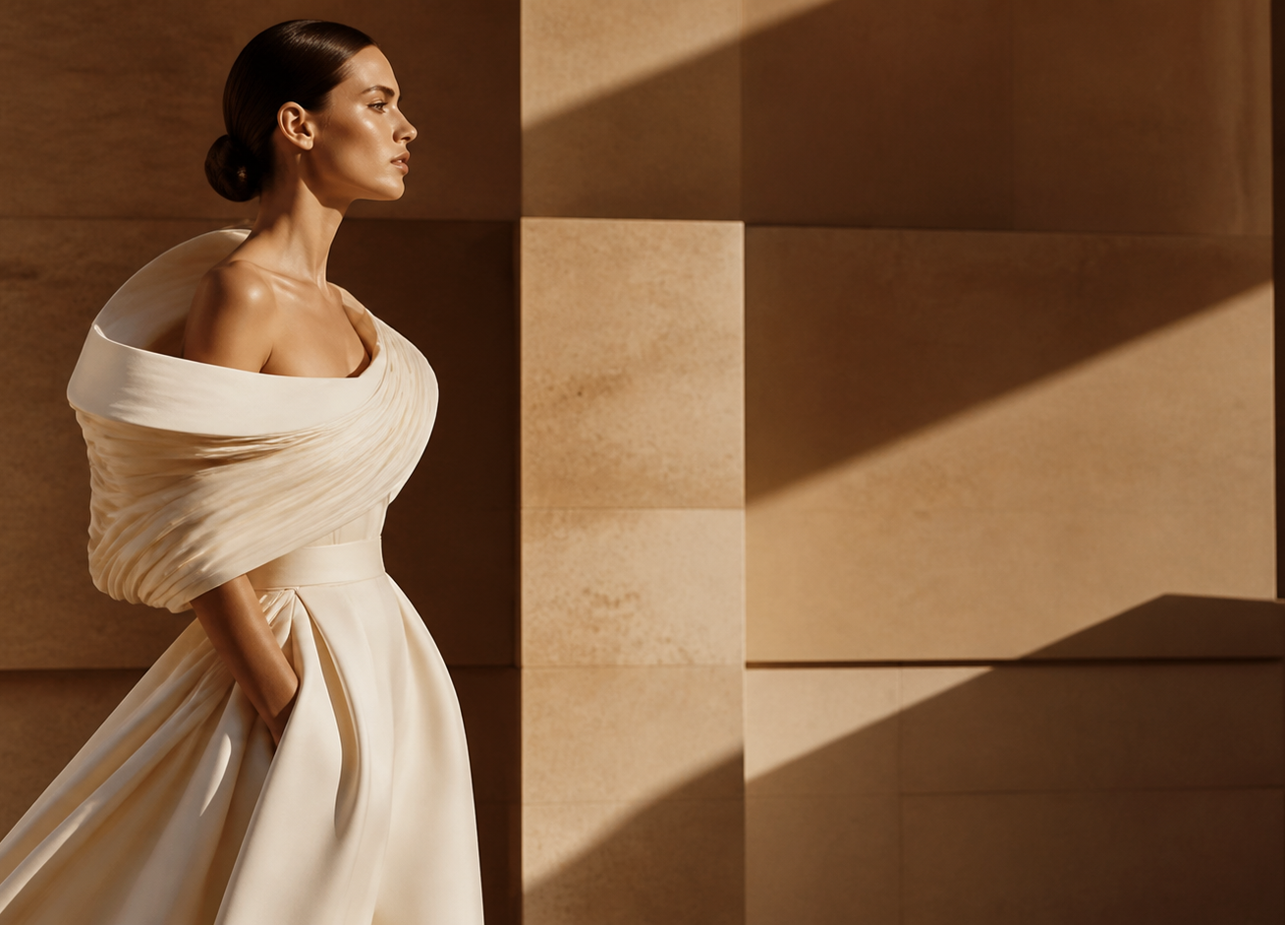
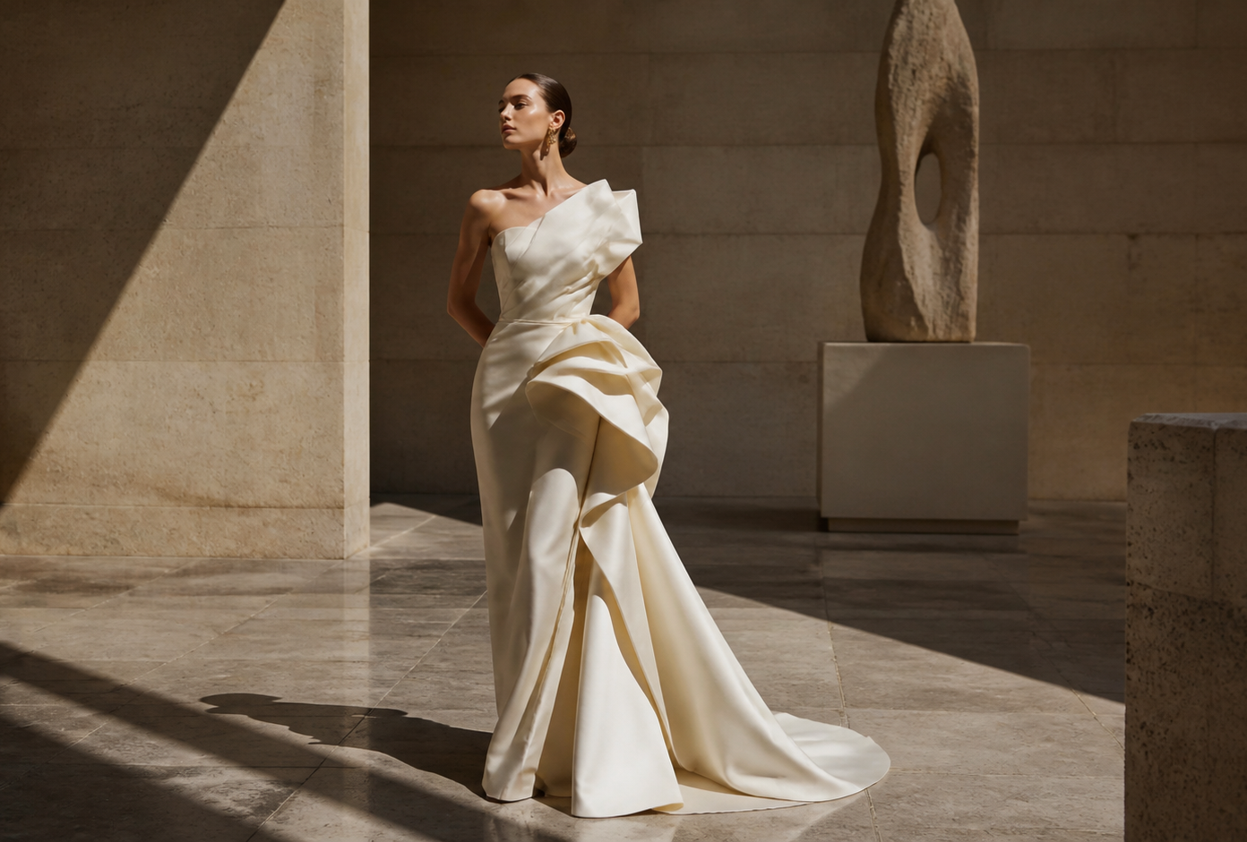
03 / VOLUME STUDY
CUT ON THE BIAS
MOTION IS A METHOD.
01 / SHOULDER LINE
02 / RELEASED VOLUME
3 / 6

Slide 4
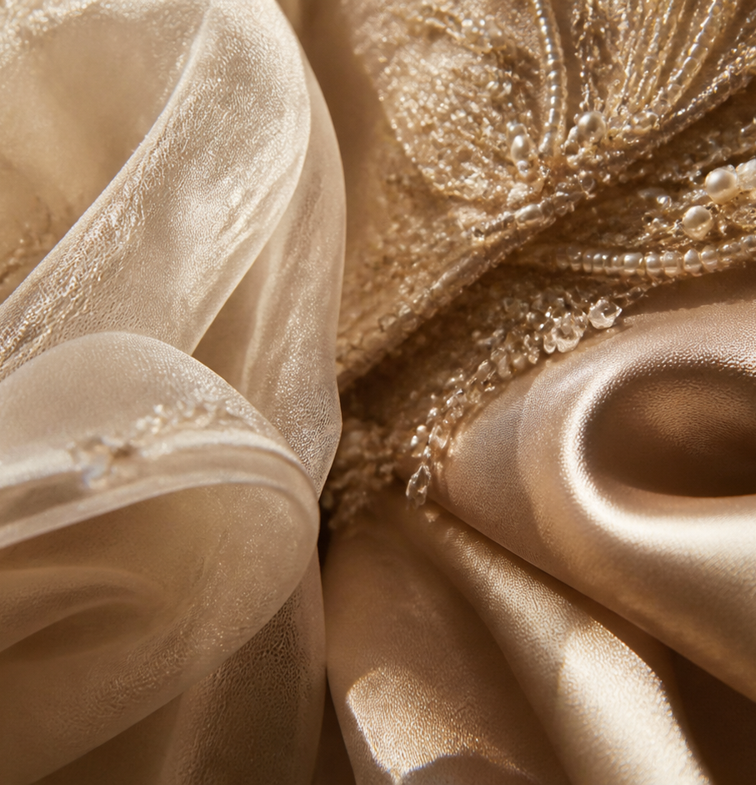
04 / MATERIAL INDEX
LIGHT NEEDS TEXTURE.
01 ORGANZA
AIR / RESISTANCE
02 SATIN
REFLECTION / WEIGHT
03 PEARL
GRAIN / LIGHT
Each surface changes the gesture.
MATERIAL / REFLECTION / WEIGHT / GRAIN
4 / 6

Slide 5
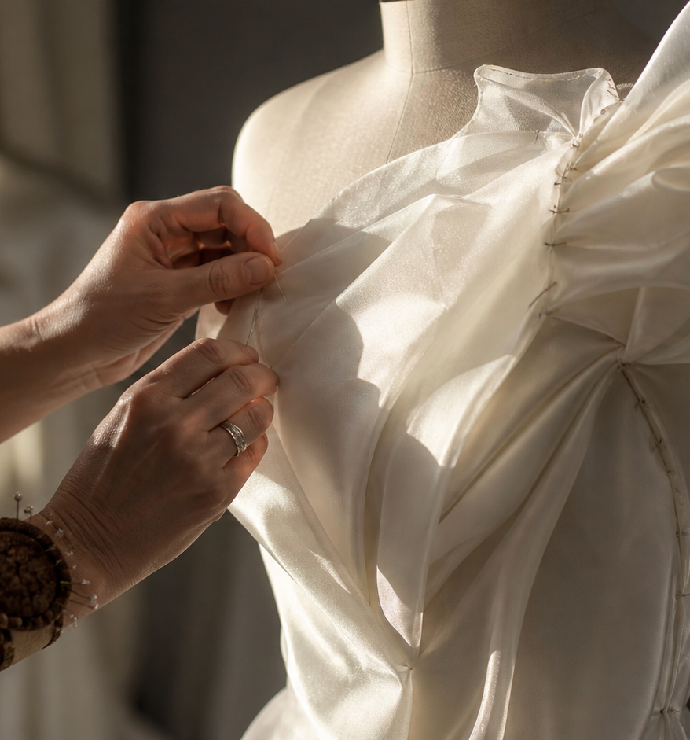
05 / THE HAND
NOT A DRESS. A GESTURE.
Fitting is repetition.
The hand makes the final decision.
PARIS / 19:30 PRIVATE SALON
5 / 6

Slide 6
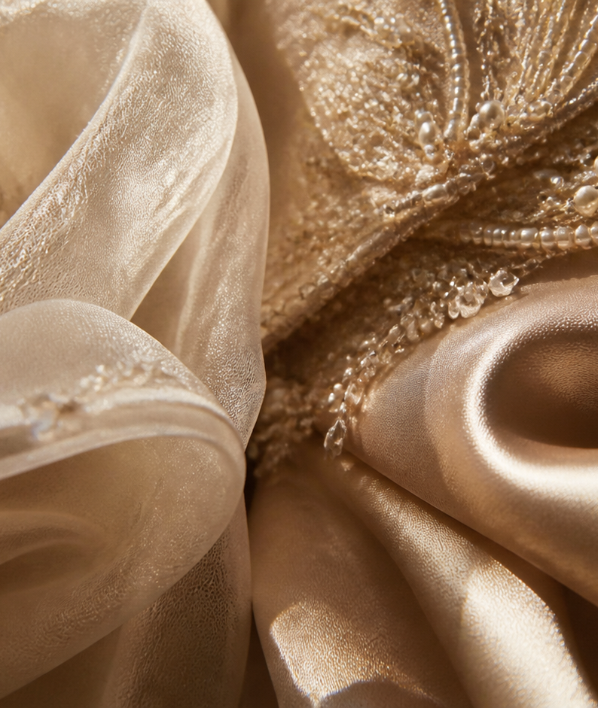
UNFINISHED
THE FINAL FITTING
A garment is never still.
It keeps the memory of the hand.
THE WHITE STUDY — COUTURE / MOTION
6 / 6

