Slide 1
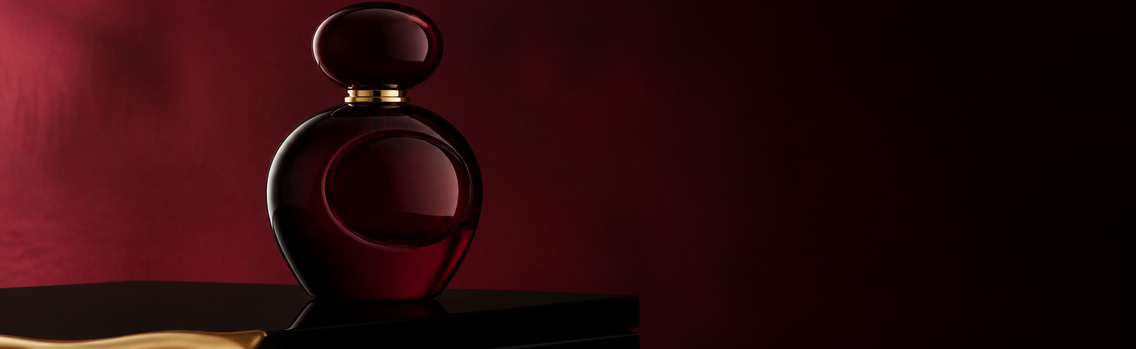
AURELIA NOCTURNE
EXTRAIT DE PARFUM
A perfume atlas for the
last light of the day.
Collected in motion.
Remembered on skin.
50 ML / BERGAMOT — IRIS — SMOKED TEA — CEDAR / AUTUMN 2026

Slide 2
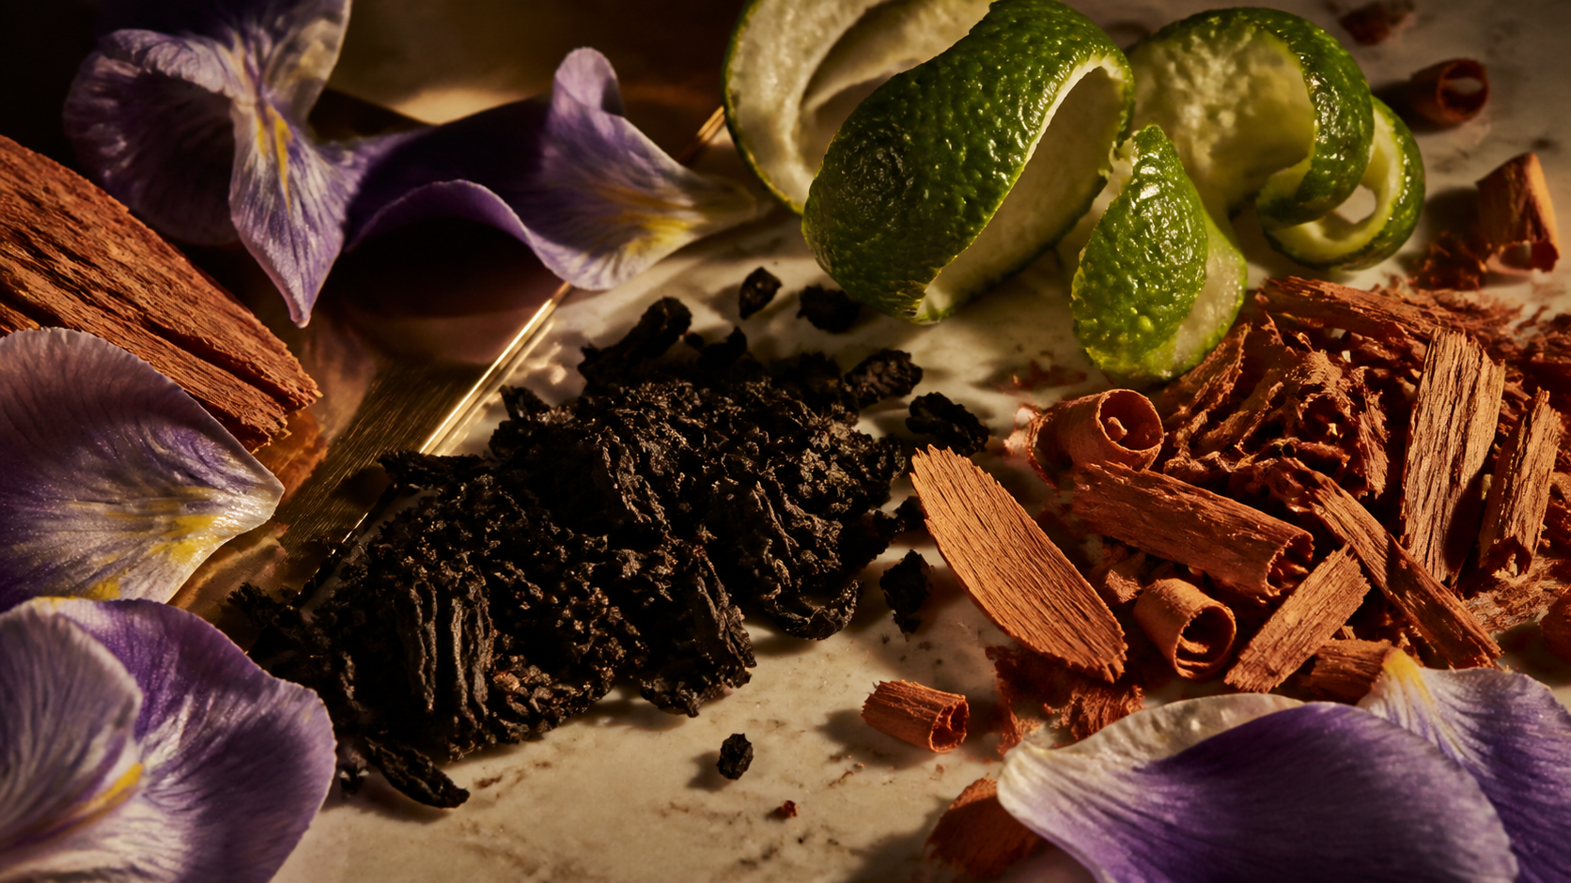
01 / MATERIAL ATLAS
CALABRIA — GRASSE — KASHMIR
THE ROUTE OF THE SCENT
01
02
03
04
Four materials. One
late-afternoon memory.
BERGAMOT
IRIS
TEA
CEDAR
Calabria / light
Florence / powder
Fujian / smoke
Kashmir / grain
AURELIA / THE PERFUME ATLAS / A STUDY OF ORIGIN, EXTRACTION AND MEMORY

Slide 3
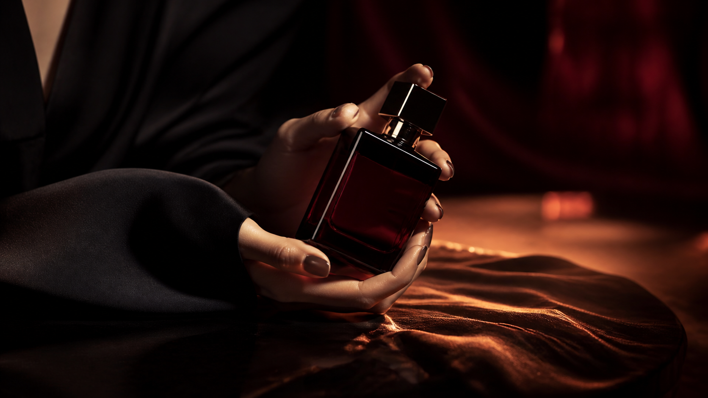
02 / ON THE SKIN
THE RITUAL IS PRIVATE.
A gesture, not a performance.
At close range, the fragrance turns warm.
On fabric, it becomes a private address.

Slide 4
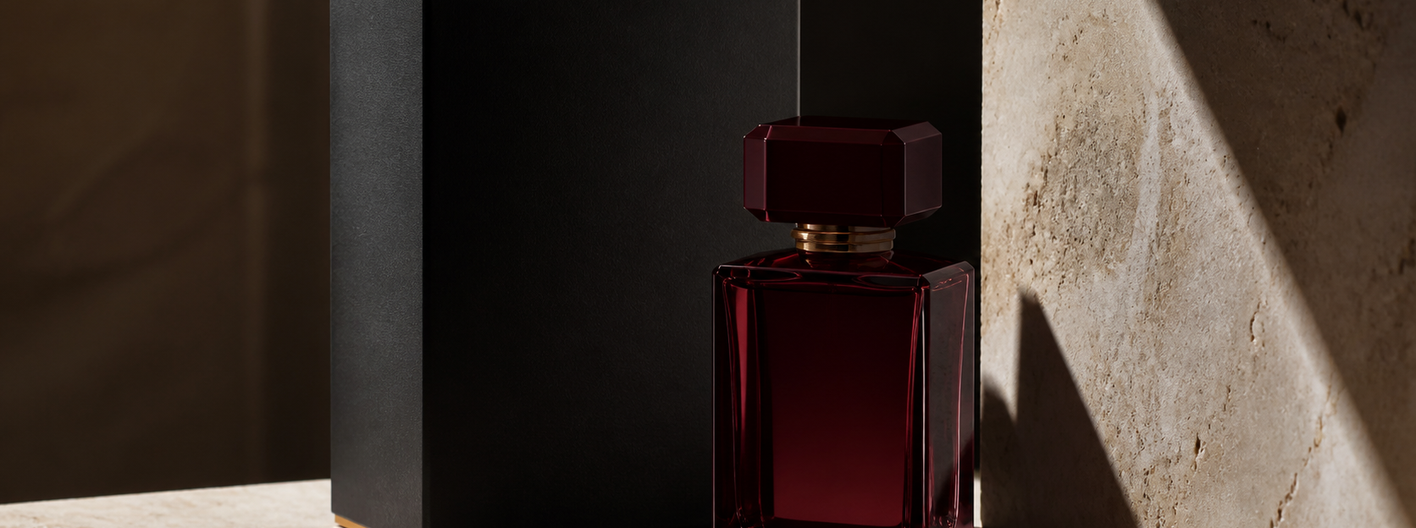
THE OBJECT / DARK GLASS — MATTE CASE — GOLD EDGE — DESIGNED TO TRAVEL
03 / TO KEEP
An object for the return journey.
50 ML / REFILLABLE
MAISON AURELIA / NOCTURNE

