Slide 1
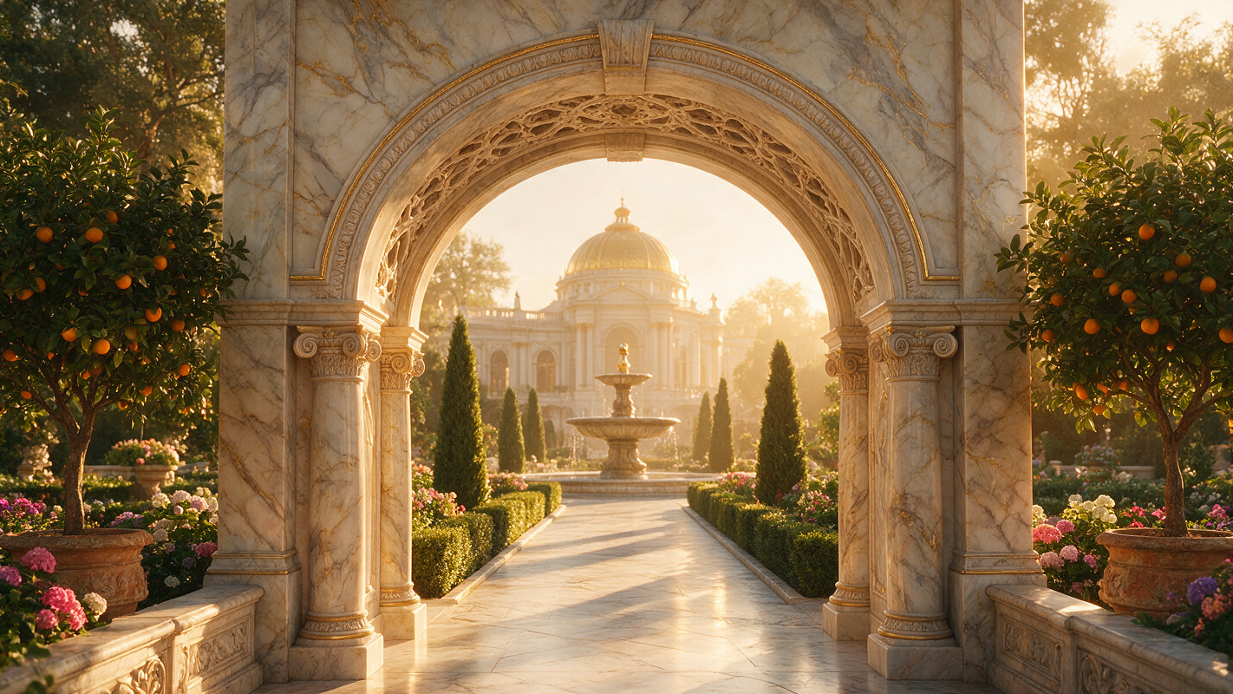
MAISON ÉTERNELLE
Redefining Luxury for the Modern Connoisseur
AUTUMN / WINTER 2026 — BRAND STRATEGY

Slide 2
Brand Philosophy
Heritage Craftsmanship
“
Métiers d’art techniques passed through generations, reimagined for today
Timeless Craft, Modern Soul
Sustainable Luxury
100% traceable sourcing from artisan partners across 14 countries
Digital-First Experience
Where heritage meets contemporary vision
Personal style curation powered by AI, delivered with human touch
Global Expansion
12 new markets with localized brand narratives and cultural sensitivity

