Slide 1
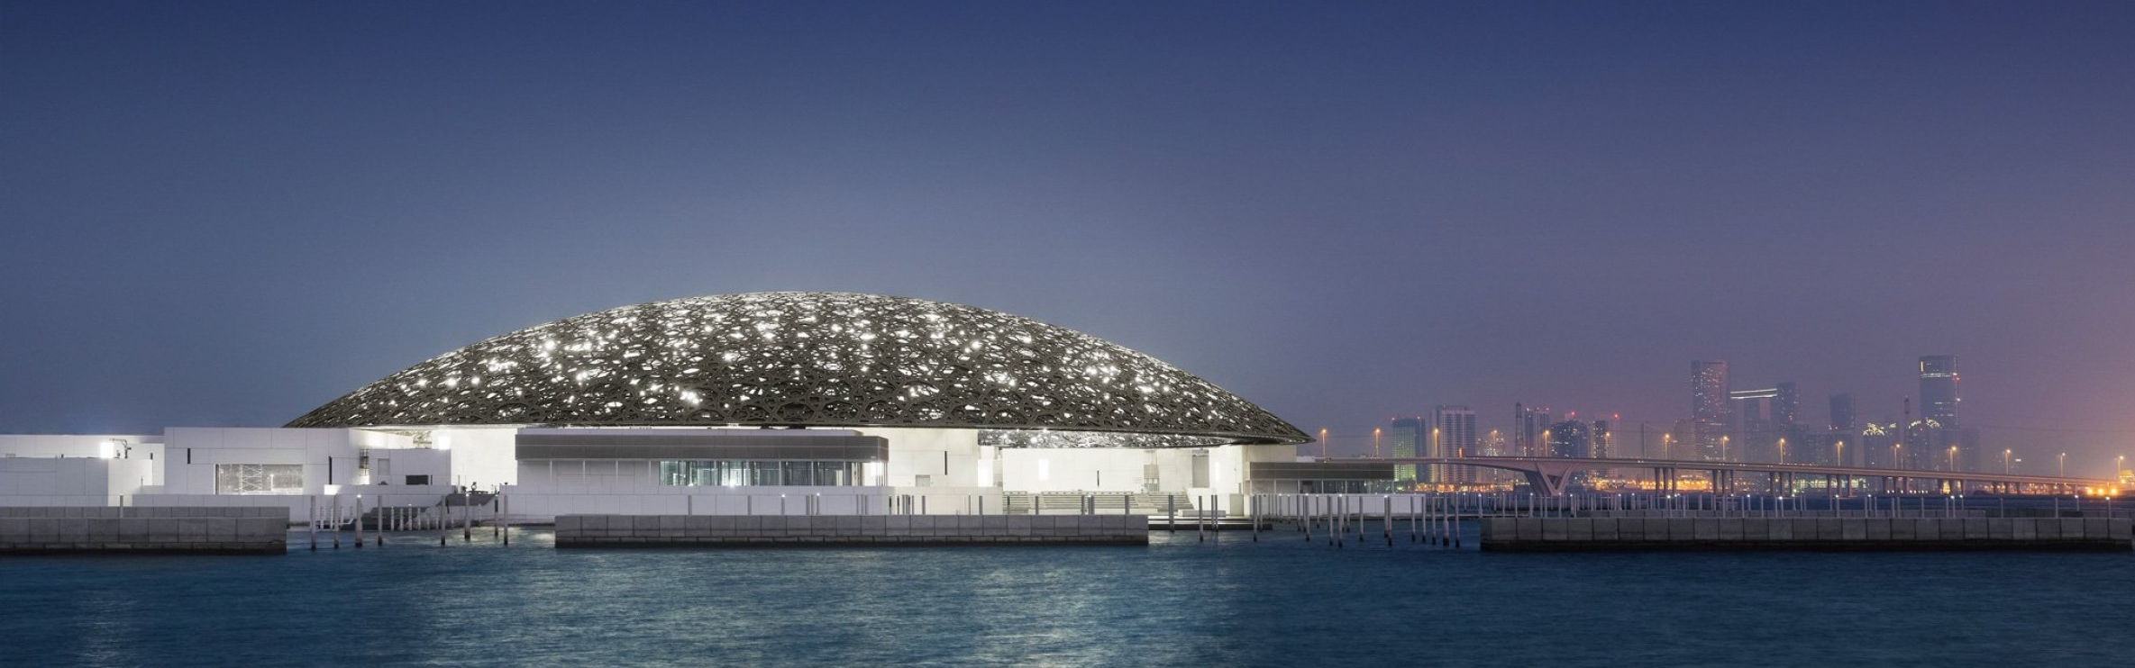
BASELINE / BRAND-ARCHITECTURE / 01
ARCHITECTURAL DOSSIER / 2026
LOUVRE
ABU DHABI
JEAN NOUVEL / 2017
SAADIYAT ISLAND / ABU DHABI, UAE
01
Independent neutral baseline · same case content and page count

Slide 2
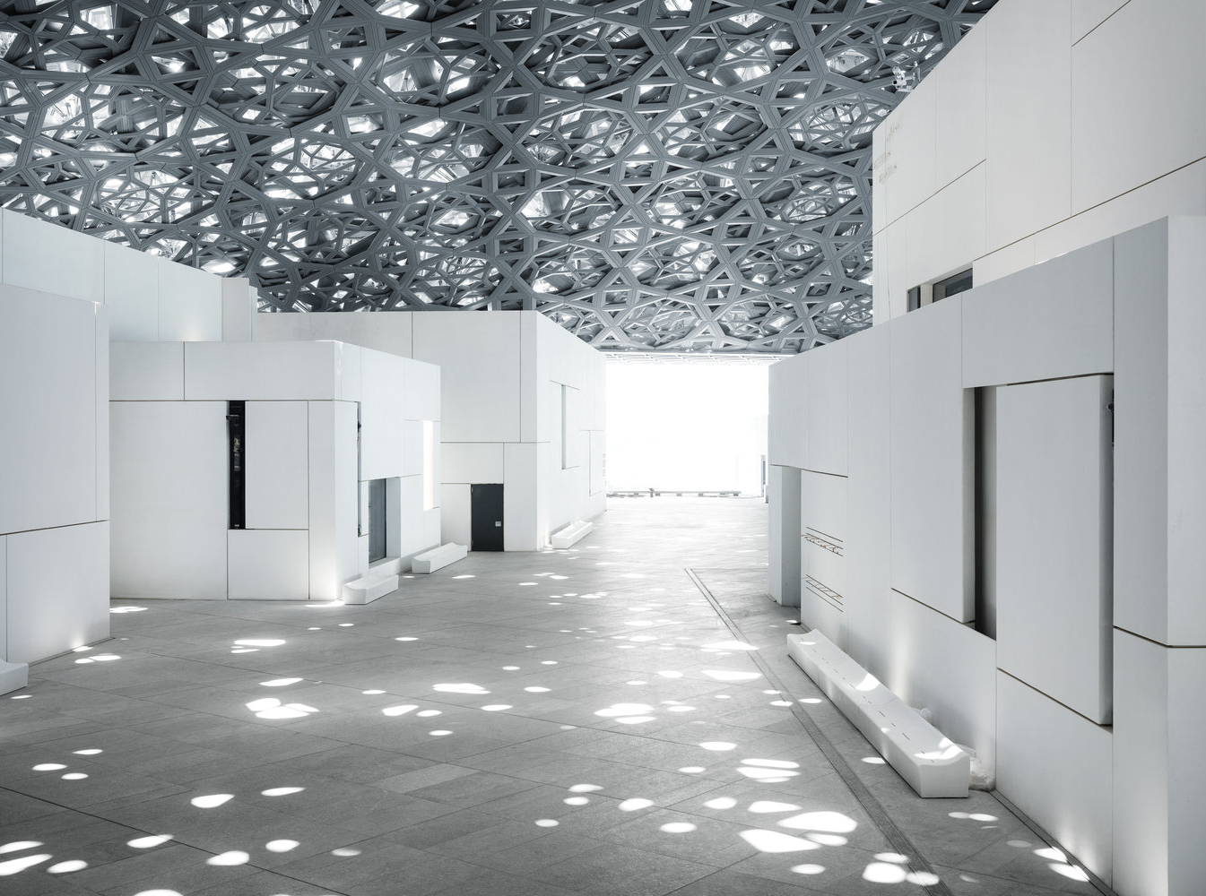
BASELINE / BRAND-ARCHITECTURE / 02
01 / SPATIAL PROLOGUE
RAIN
OF LIGHT
BENEATH A POROUS DOME,
DAYLIGHT BECOMES A
CULTURAL MEDIUM.
The roof does not simply shelter the museum;
it composes its atmosphere.
LOUVRE ABU DHABI
JEAN NOUVEL / 2017
02
Independent neutral baseline · same case content and page count

Slide 3
BASELINE / BRAND-ARCHITECTURE / 03
02 / GEOMETRY AS CLIMATE
THE DOME
AS INSTRUMENT
Four outer layers of stainless steel
meet four inner layers of aluminium.
A geometric canopy filters daylight, shades
the plaza and generates a microclimate below.
SOURCE / LOUVRE ABU DHABI — ARCHITECTURE
03
7,850
STARS IN THE PATTERN
8
OVERLAPPING LAYERS
180 M
DIAMETER OF THE DOME
NEUTRAL VISUAL FIELD
Independent neutral baseline · same case content and page count

Slide 4
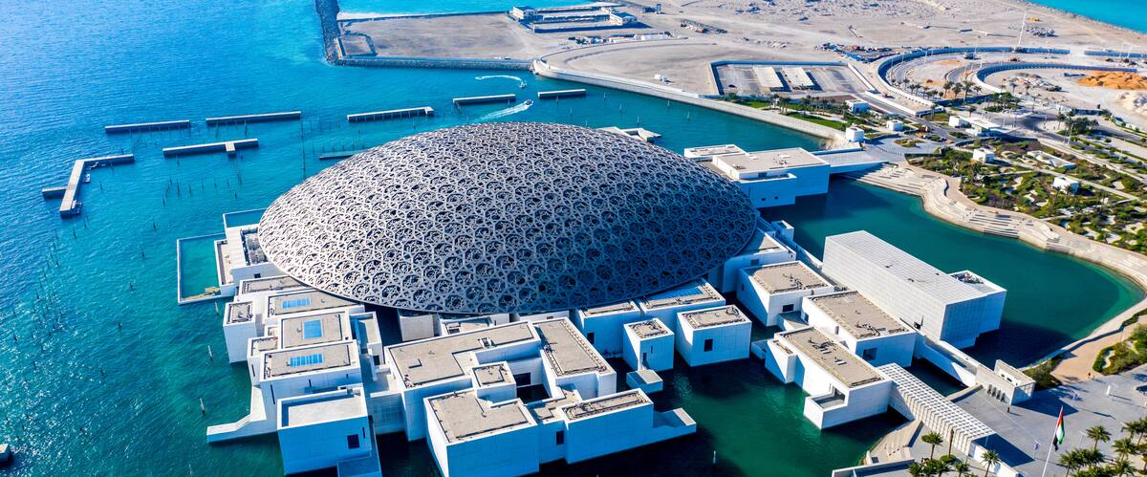
BASELINE / BRAND-ARCHITECTURE / 04
03 / URBAN FIGURE
A MUSEUM CITY / IN THE SEA
ABU DHABI · UAE
55 BUILDINGS
23 ARE GALLERIES
04
Independent neutral baseline · same case content and page count

Slide 5
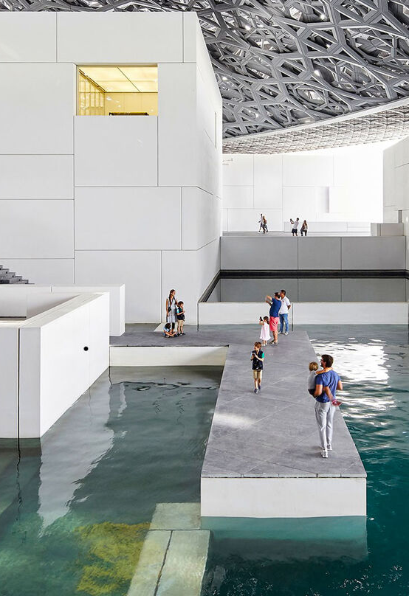
BASELINE / BRAND-ARCHITECTURE / 05
04 / CIVIC INTERIOR
WATER
AS PUBLIC ROOM
Paths cross the water beneath the dome, turning the
museum into a walkable, climate-softened urban room.
Architecture is not an object beside the sea.
It becomes a small city within it.
LAND + SEA
05
SOURCE / LOUVRE ABU DHABI — ARCHITECTURE
Independent neutral baseline · same case content and page count

Slide 6
BASELINE / BRAND-ARCHITECTURE / 06
05 / THERMAL FIELD
SHADE
BECOMES
INFRASTRUCTURE
The canopy filters daylight, reduces heat
and protects the public realm below.
Natural cooling is not an add-on.
It is the spatial idea of the project.
36 M
DOME ABOVE GROUND
7,500 T
DOME WEIGHT
SOURCE / LOUVRE ABU DHABI — ARCHITECTURE
06
NEUTRAL VISUAL FIELD
Independent neutral baseline · same case content and page count

Slide 7
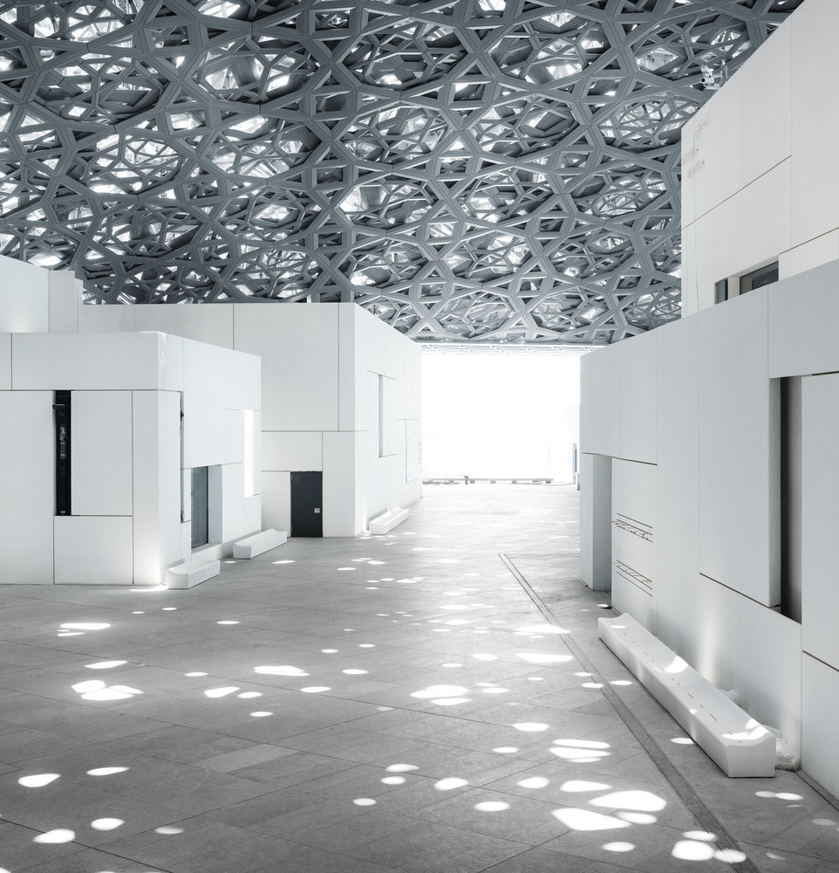
BASELINE / BRAND-ARCHITECTURE / 07
06 / SPATIAL SEQUENCE
WALK / PAUSE / RETURN
A MUSEUM DESIGNED AS A JOURNEY
01 / FILTERED DAYLIGHT
02 / CITY + SEA
03 / CIVIC WATERROOM
THREE ATMOSPHERES, ONE CONTINUOUS ROOF.
07
Independent neutral baseline · same case content and page count

Slide 8
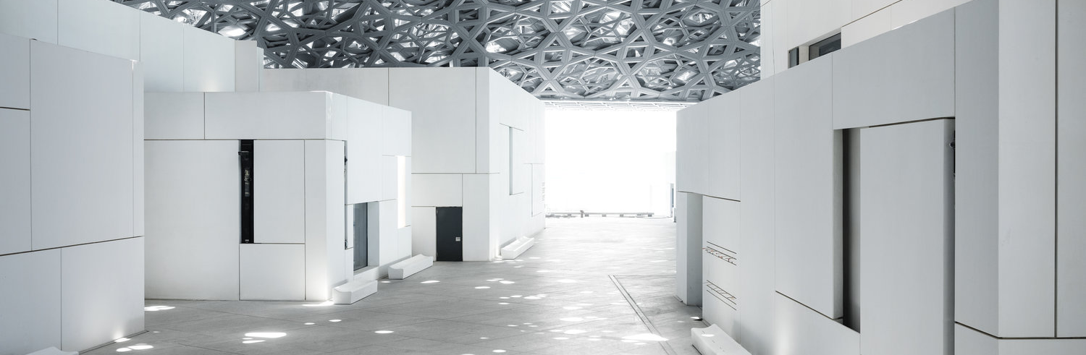
BASELINE / BRAND-ARCHITECTURE / 08
07 / MATERIAL LOGIC
MATERIAL IS A FILTER
Steel, aluminium and patterned voids work as a single
optical instrument between sky and ground.
8 LAYERS
4 STAINLESS STEEL / 4 ALUMINIUM
The roof permits daylight
without excessive heat or wind.
SOURCE / LOUVRE ABU DHABI — ARCHITECTURE
08
Independent neutral baseline · same case content and page count

Slide 9
BASELINE / BRAND-ARCHITECTURE / 09
08 / ARCHITECTURAL POSITION
A WELCOMING WORLD
OF LIGHT, SHADOW,
REFLECTION AND CALM.
A museum-city that belongs to its geography
without becoming a literal interpretation of it.
JEAN NOUVEL / ARCHITECT
SOURCE / LOUVRE ABU DHABI — ARCHITECTURE
09
NEUTRAL VISUAL FIELD
Independent neutral baseline · same case content and page count

Slide 10
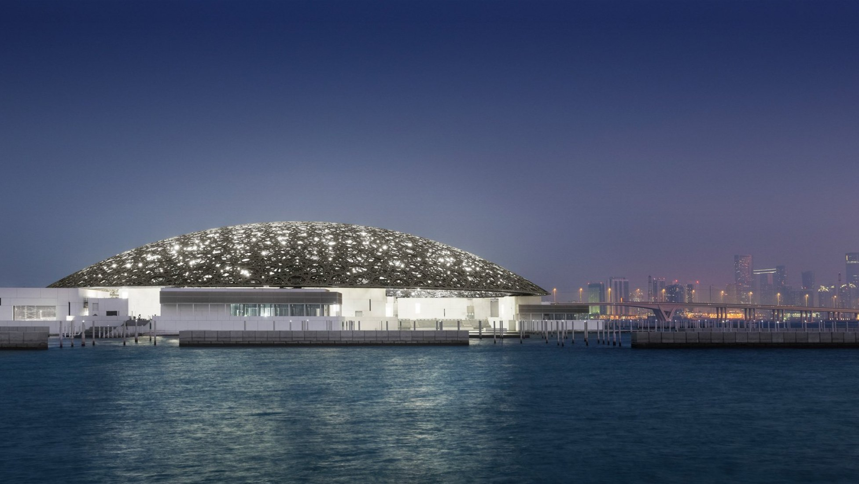
BASELINE / BRAND-ARCHITECTURE / 10
09 / CODA
LOUVRE ABU DHABI / SAADIYAT ISLAND
LIGHT.
WATER.
CITY.
A common sky turns architecture
into a public cultural landscape.
END OF STUDY
10
Independent neutral baseline · same case content and page count

