Slide 1

BASELINE / SCIENTIFIC-EVIDENCE / 01
PAPER CASE 03 / BIOTECH ATLAS
SINGLE-CELL
CAR T ATLAS
How a persistent clinical phenotype
becomes a cell-state hypothesis.
Bai et al. · Nature 634 · 702–711 · 2024
82 patients · 695,819 analyzed cells
CONCEPTUAL COVER VISUAL
CLINICAL / CELLULAR / PRECLINICAL
DOI 10.1038/s41586-024-07762-w
Independent neutral baseline · same case content and page count

Slide 2
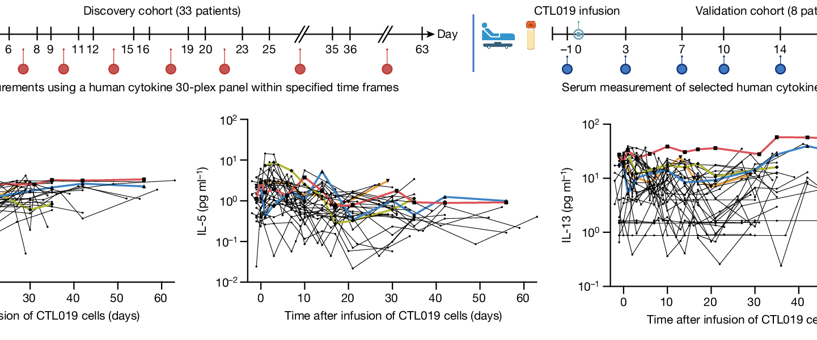
BASELINE / SCIENTIFIC-EVIDENCE / 02
01 / CLINICAL PERSISTENCE
The clinical signal is unusually long-lived
Before asking what the cell is, establish how long it remains clinically visible.
2 / 12
ATLAS / 03
Source figure / Fig. 4a–b · longitudinal serum measurements
PERSISTENCE READOUT
8.4
years
median BCA-L duration
The phenotype is not a single
measurement—it is a longitudinal trace.
OBSERVATION
long B-cell aplasia
QUESTION
what sustains the state?
NEXT
single-cell atlas
Evidence anchor: BCA-L group median BCA duration 8.4 years. Clinical persistence is the entry point, not the conclusion.
Independent neutral baseline · same case content and page count

Slide 3
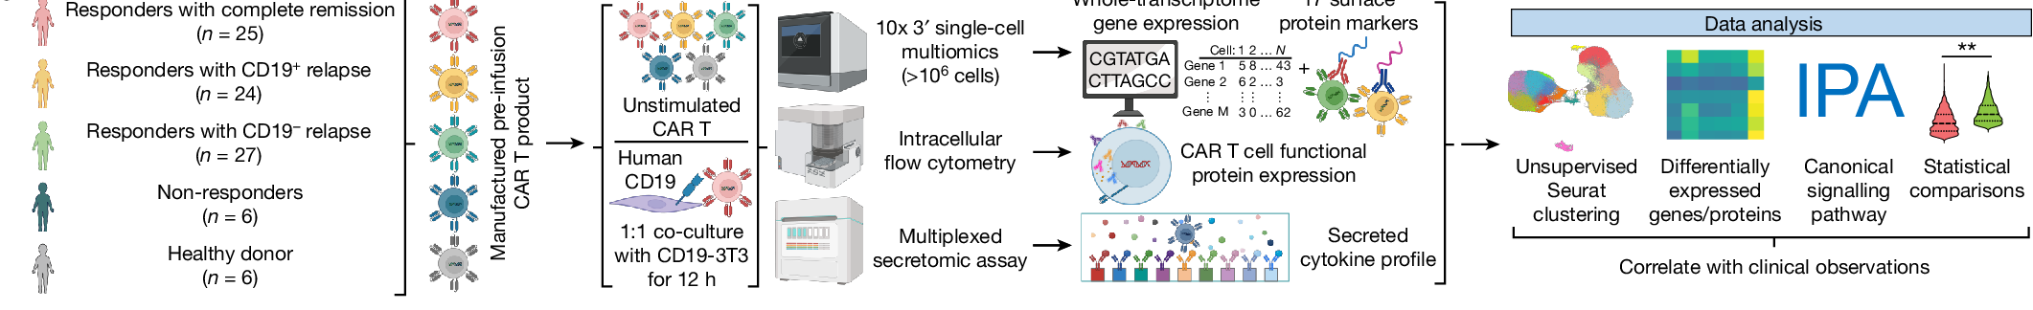
BASELINE / SCIENTIFIC-EVIDENCE / 03
02 / STUDY DESIGN
One cohort becomes a multi-omic research system
The paper connects patient persistence to a measured cell-state atlas through five linked readout layers.
3 / 12
ATLAS / 03
01
PATIENT
COHORT
82 ALL patients
+ 6 healthy donors
02
CAR T
PRODUCT
manufactured
CAR T cells
03
SINGLE-CELL
MULTIOMICS
10x 3′ assay
>10⁶ cells
04
FUNCTIONAL
READOUTS
flow · secretomics
ATAC
05
CLINICAL
CORRELATION
17 clusters
BCA strata
Source figure / Fig. 1a · cohort → measurement layers → data analysis
THE SYSTEM OUTPUT
695,819
analyzed cells
17 cell states · 5 BCA strata
Clinical observation becomes measurable state space.
Source figure / Fig. 1a. The pipeline is editorially redrawn; cohort and assay facts remain tied to the paper.
Independent neutral baseline · same case content and page count

Slide 4
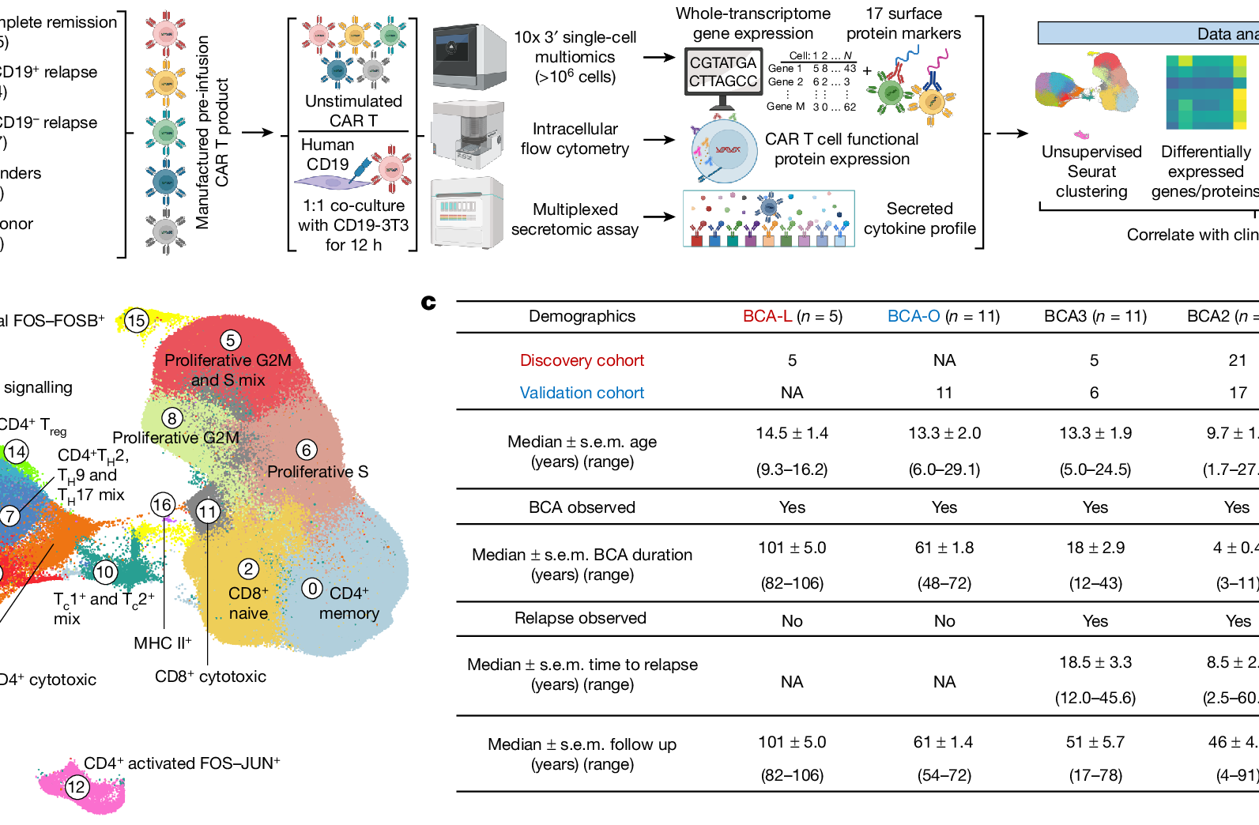
BASELINE / SCIENTIFIC-EVIDENCE / 04
03 / CELL ATLAS
695,819 cells resolve into 17 states
The UMAP is the map from which the later mechanistic claims depart.
4 / 12
ATLAS / 03
Fig. 1b / UMAP + cluster annotation
695,819
analyzed cells
17
cell states
ATLAS READOUT / FOUR STATE FAMILIES
NAIVE
CYTOTOXIC
REGULATORY
PROLIFERATIVE
Design principle: preserve the paper’s cluster colors; use blue annotations to explain the map.
Source figure / Fig. 1b. Cell labels and original color encoding are preserved.
Independent neutral baseline · same case content and page count

Slide 5
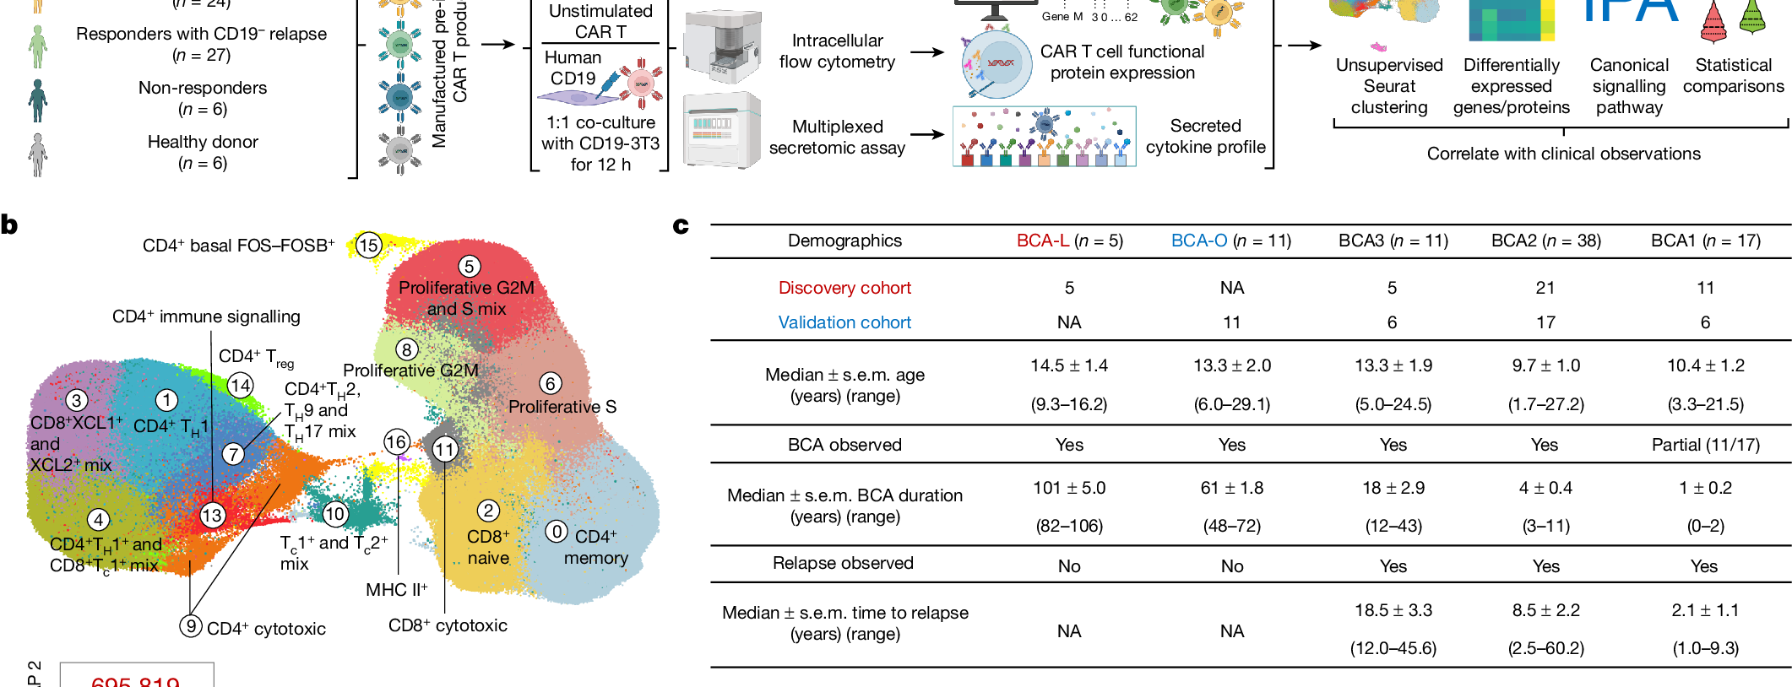
BASELINE / SCIENTIFIC-EVIDENCE / 05
04 / PERSISTENCE
Persistence is a gradient, not a binary
BCA strata create the clinical axis reused across the paper.
5 / 12
ATLAS / 03
Fig. 1c / demographics and follow-up
PERSISTENCE GRADIENT
BCA-L
101
BCA-O
61
BCA3
18
BCA2
4
BCA1
1
BCA-L / LONGEST
n = 5 · 101 months
no relapse observed
BCA1 / SHORTEST
n = 17 · 1 month
relapse observed
INTERPRETATION
Persistence is a continuum with a clinical gradient, not a yes/no label.
Source figure / Fig. 1c. Duration values shown are the paper’s reported values; units are months in the source table.
Independent neutral baseline · same case content and page count

Slide 6
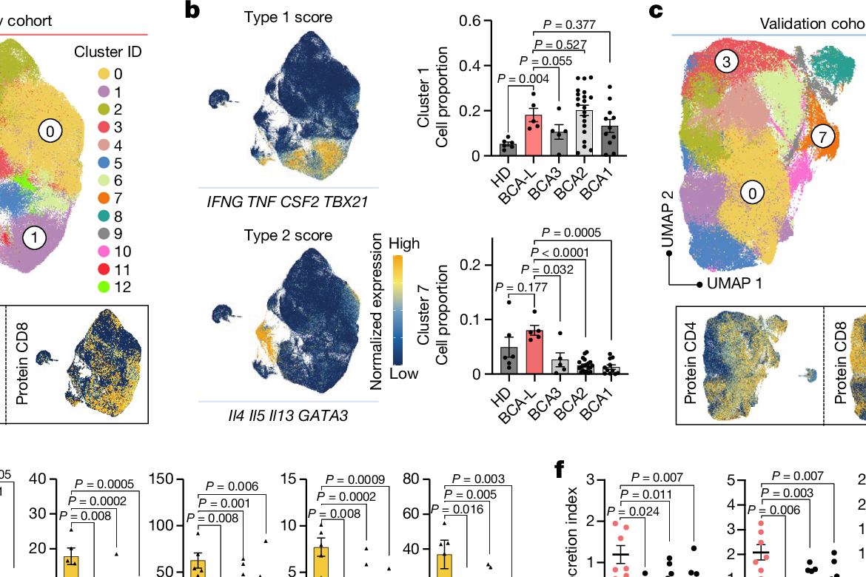
BASELINE / SCIENTIFIC-EVIDENCE / 06
05 / TYPE 2 STATE
The long-remission state reads as type 2
Four orthogonal readouts point to the same biological state.
6 / 12
ATLAS / 03
Fig. 2a–d / type 2 score
Fig. 2e–f / secretion
Fig. 2g–j / ATAC + GATA3
PERTURBATION
GATA3 / STAT6
repeat stimulation
→ tumour-cell lysis
TYPE 2 SIGNATURE
IL4 · IL5 · IL13
GATA3
enriched in the long-remission group
EVIDENCE RULE / CONVERGENCE
TRANSCRIPTOME
SECRETION
CHROMATIN
→ one coherent type 2 state
Source figure / Fig. 2. Direct paper panels used as evidence modules; interpretation is newly organized.
Independent neutral baseline · same case content and page count

Slide 7
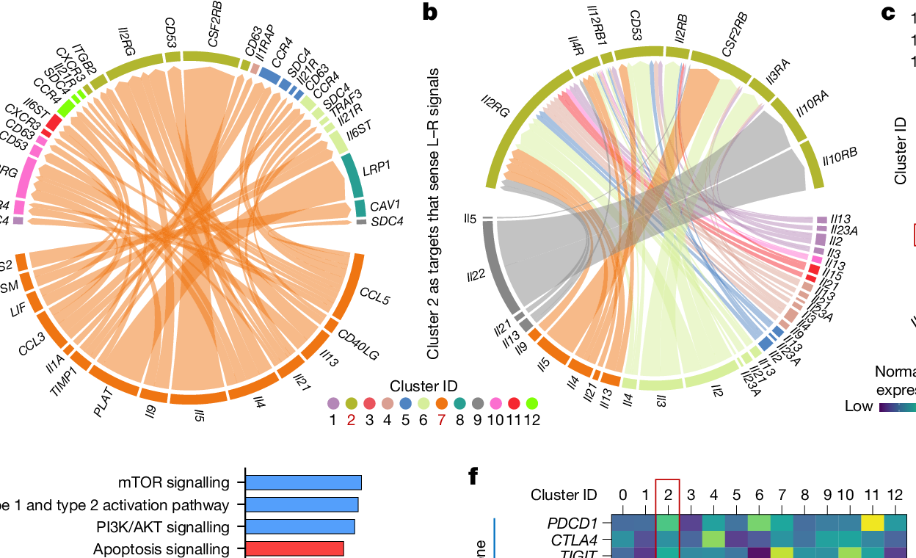
BASELINE / SCIENTIFIC-EVIDENCE / 07
06 / MECHANISM
Cluster 2 is the pressure point
The paper moves from association to a candidate regulatory interaction network.
7 / 12
ATLAS / 03
Fig. 3a–b / ligand–receptor network
Fig. 3c–d / cluster 2 and DEGs
13.9%
cluster 2 proportion
STATE
type 2
signal
cluster 2
proliferation
EDITABLE MECHANISM SUMMARY
Type 2 function → cluster 2 → dysfunctional subpopulation
CLAIM BOUNDARY
Candidate mechanism
not a complete causal proof
Source figure / Fig. 3. Network diagrams and cluster 2 readouts are reproduced; the causal wording is deliberately bounded.
Independent neutral baseline · same case content and page count

Slide 8
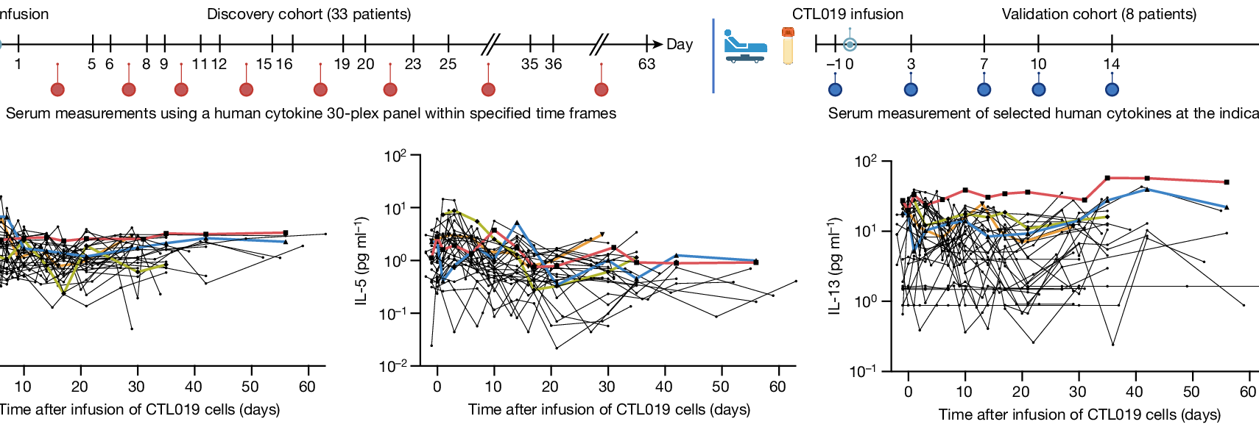
BASELINE / SCIENTIFIC-EVIDENCE / 08
07 / SECRETOME
The serum trace keeps the biology longitudinal
A state is more credible when it survives time, not just a snapshot.
8 / 12
ATLAS / 03
Fig. 4a–b / collection timeline + time series
345
measurements
30
cytokines
33
patients
Fig. 4c–e / cytokine windows + heatmap
TYPE 2 WINDOW
IL-4 · IL-5 · IL-13
serial evidence across days 1–63
33 discovery + 8 validation patients
Source figure / Fig. 4. Longitudinal panels are retained; the surrounding blue modules explain scale and timing.
Independent neutral baseline · same case content and page count

Slide 9
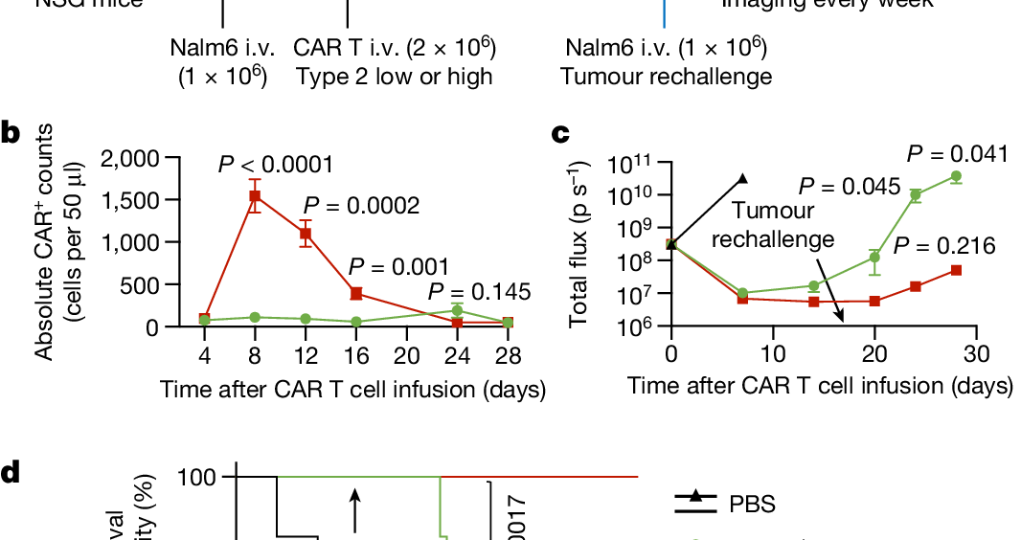
BASELINE / SCIENTIFIC-EVIDENCE / 09
08 / IN VIVO TEST
Type 2-high cells pass the recall test
The state is tested as function, not merely described as phenotype.
9 / 12
ATLAS / 03
Fig. 5a–c / mouse sequence + expansion
Fig. 5d / survival after rechallenge
IN VIVO SEQUENCE
−7
Nalm6
0
CAR T
17
rechallenge
24–28
imaging
READOUT
Type 2-high cells expand more and show stronger recall in the reported model; selected readouts n=5 mice.
EVIDENCE BOUNDARY
Preclinical model supports function; it does not establish clinical efficacy.
Source figure / Fig. 5. Experimental evidence is shown with the preclinical boundary kept explicit.
Independent neutral baseline · same case content and page count

Slide 10
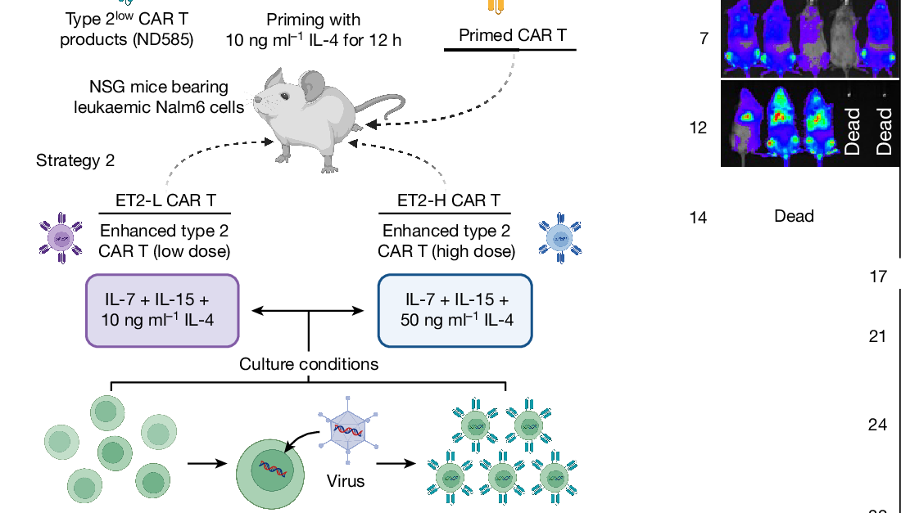
BASELINE / SCIENTIFIC-EVIDENCE / 10
09 / ENGINEERING
IL-4 turns the state into a design lever
The final figure converts a cell-state hypothesis into a manufacturing strategy.
10 / 12
ATLAS / 03
Fig. 6a / priming and ET2-L/H strategies
Fig. 6b / in vivo imaging
10
ng ml⁻¹
50
ng ml⁻¹
Fig. 6c–d / expansion + survival
DESIGN OPTIONS
priming: 10 ng ml⁻¹ / 12 h
ET2-L: 10 · ET2-H: 50
controlled manufacturing exposure
INTERPRETATION
Promising engineering lever
still bounded by model and study design
Source figure / Fig. 6. Concentrations and group labels remain tied to the paper; the design framing is editorialized.
Independent neutral baseline · same case content and page count

Slide 11
BASELINE / SCIENTIFIC-EVIDENCE / 11
10 / EVIDENCE CHAIN
The argument is strongest when each layer stays distinct
Do not collapse clinical association, mechanism and intervention into one claim.
11 / 12
ATLAS / 03
01
OBSERVED
CLINICAL
8.4-year persistence
Fig. 1 / 4
02
RESOLVED
CELLULAR
type 2 state
Fig. 2
03
PROPOSED
MECHANISM
cluster 2 network
Fig. 3
04
TESTED
PRECLINICAL
recall + IL-4
Fig. 5 / 6
READING RULE
Clinical persistence anchors the story; cellular evidence resolves the state; mechanism remains a candidate; preclinical work tests the direction.
Evidence boundary: association → state definition → candidate explanation → functional test / engineering lever
A rigorous research presentation makes evidence type and evidence boundary visible on the same page.
NEUTRAL VISUAL FIELD
Independent neutral baseline · same case content and page count

Slide 12
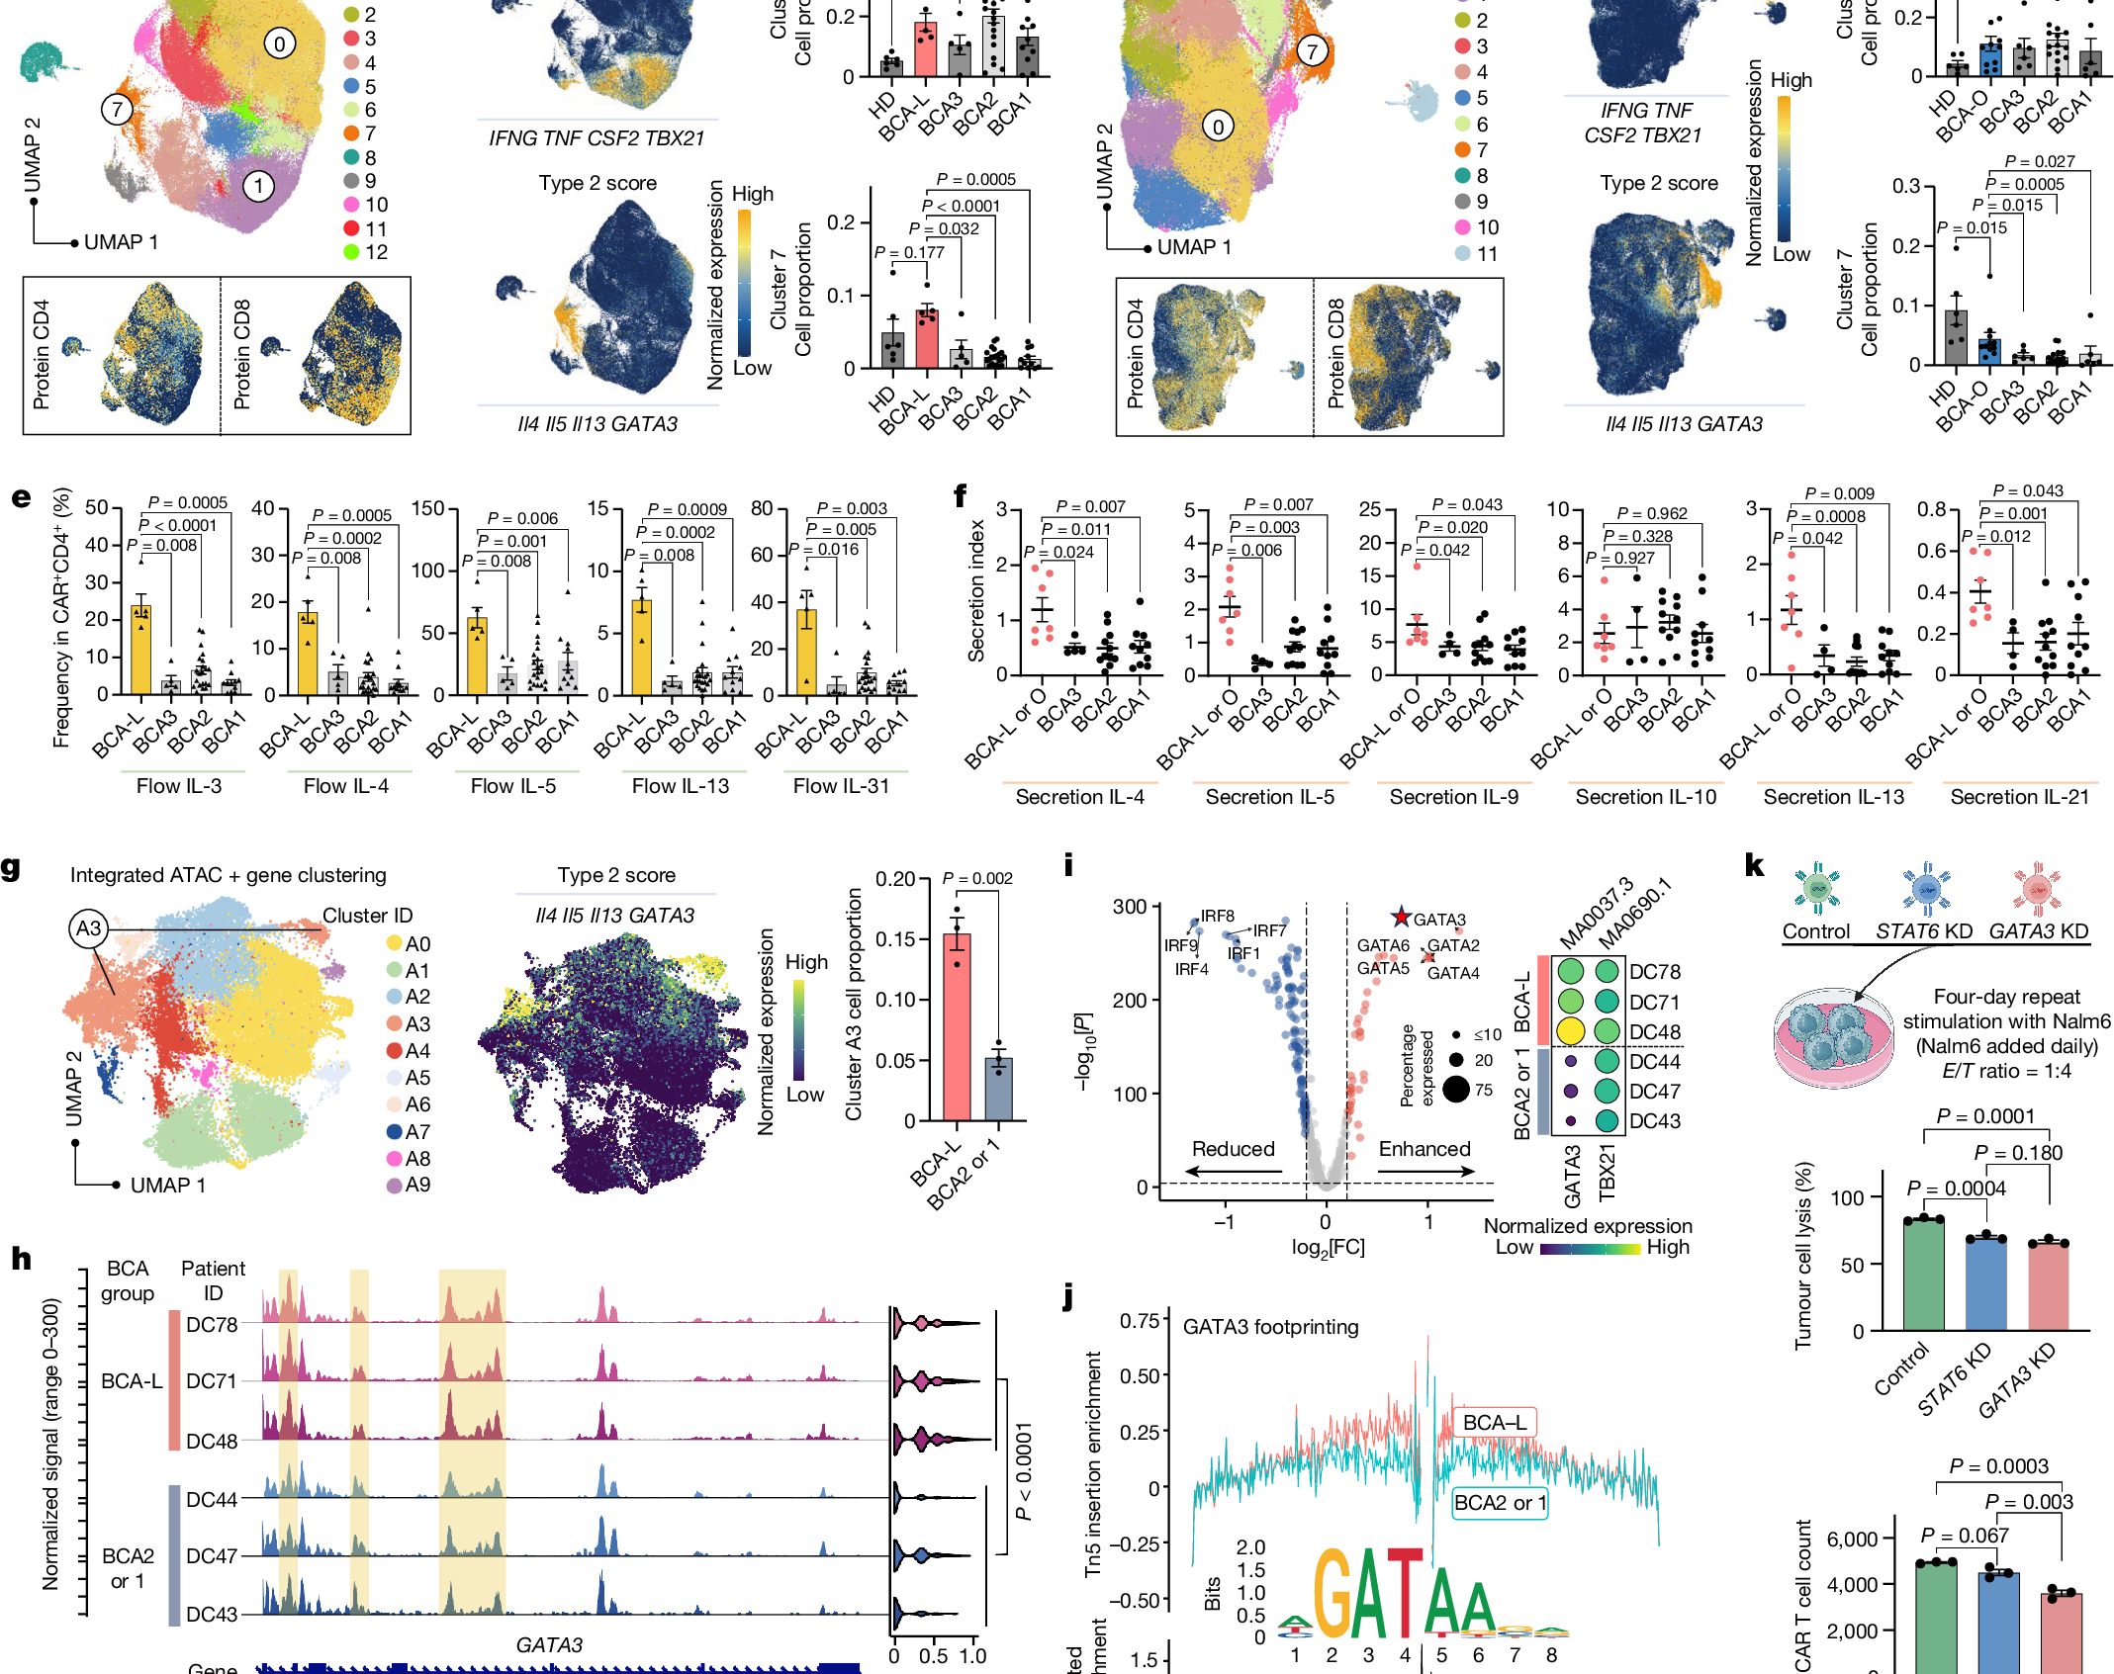
BASELINE / SCIENTIFIC-EVIDENCE / 12
THE TAKEAWAY
Type 2 function
may sustain fitness.
A durable clinical phenotype
becomes a recognizable cell state,
a candidate circuit and an engineering lever.
A strong research story shows its figures—and its limits.
Fig. 2
Fig. 3
Fig. 6 / engineering strategy
Bai et al. · Nature 634 · 702–711 · 2024
Independent neutral baseline · same case content and page count

