Slide 1

PAPER CASE 03 / BIOTECH ATLAS
SINGLE-CELL CAR T ATLAS
How a persistent clinical phenotype becomes a cell-state hypothesis.
Bai et al. · Nature 634 · 702–711 · 2024
82 patients · 695,819 analyzed cells
CONCEPTUAL COVER VISUAL
CLINICAL / CELLULAR / PRECLINICAL
DOI 10.1038/s41586-024-07762-w

Slide 2
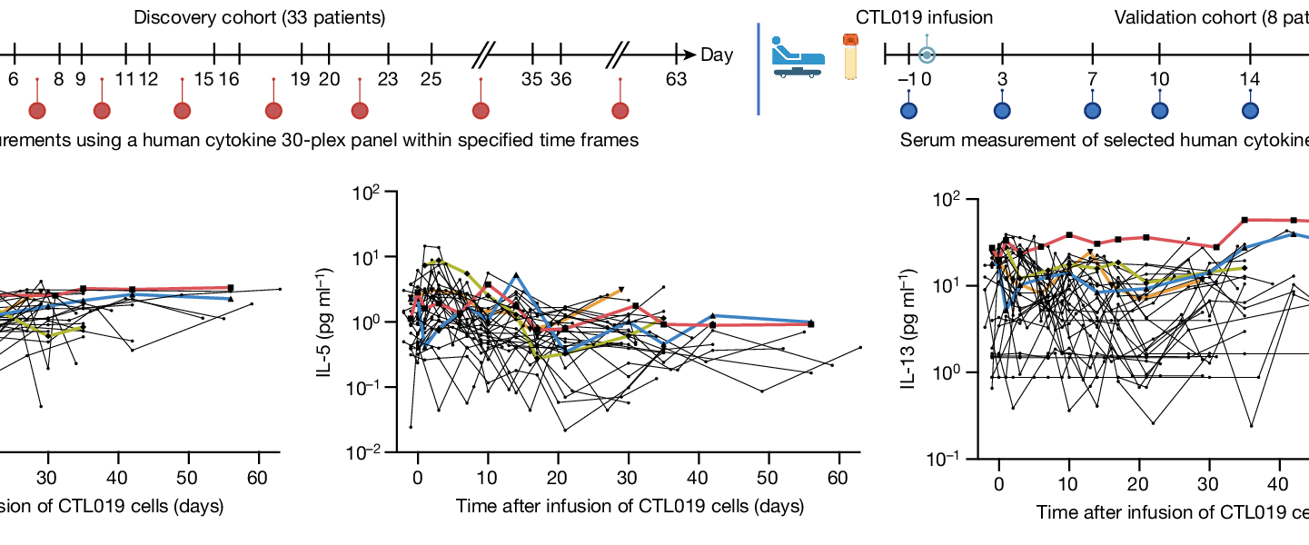
01 / CLINICAL PERSISTENCE
ATLAS / 03
The clinical signal is unusually long-lived
Before asking what the cell is, establish how long it remains clinically visible.
PERSISTENCE READOUT
8.4
years
median BCA-L duration
The phenotype is not a single
measurement—it is a longitudinal trace.
Source figure / Fig. 4a–b · longitudinal serum measurements
OBSERVATION
long B-cell aplasia
QUESTION
what sustains the state?
NEXT
single-cell atlas
2 / 12
Evidence anchor: BCA-L group median BCA duration 8.4 years. Clinical persistence is the entry point, not the conclusion.

Slide 3
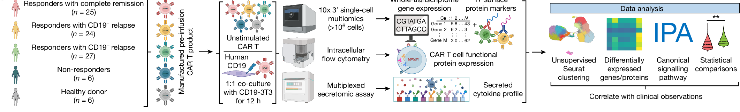
02 / STUDY DESIGN
ATLAS / 03
One cohort becomes a multi-omic research system
The paper connects patient persistence to a measured cell-state atlas through five linked readout layers.
01
02
03
04
05
PATIENT COHORT
CAR T PRODUCT
SINGLE-CELL MULTIOMICS
FUNCTIONAL READOUTS
CLINICAL CORRELATION
82 ALL patients
+ 6 healthy donors
manufactured
CAR T cells
10x 3′ assay
>10⁶ cells
flow · secretomics
ATAC
17 clusters
BCA strata
THE SYSTEM OUTPUT
695,819
analyzed cells
17 cell states · 5 BCA strata
Source figure / Fig. 1a · cohort → measurement layers → data analysis
Clinical observation becomes measurable state space.
3 / 12
Source figure / Fig. 1a. The pipeline is editorially redrawn; cohort and assay facts remain tied to the paper.

Slide 4
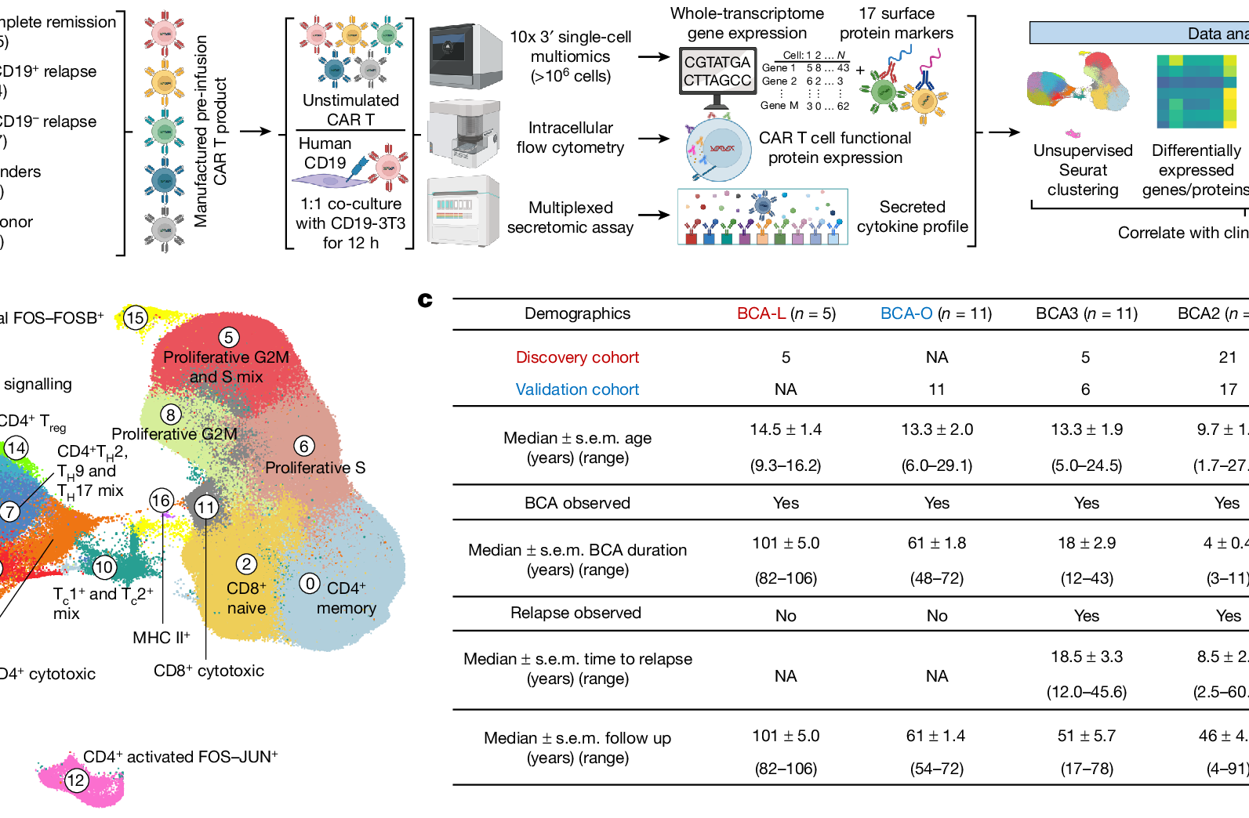
03 / CELL ATLAS
ATLAS / 03
695,819 cells resolve into 17 states
The UMAP is the map from which the later mechanistic claims depart.
695,819
17
analyzed cells
cell states
ATLAS READOUT / FOUR STATE FAMILIES
NAIVE
CYTOTOXIC
REGULATORY
PROLIFERATIVE
Fig. 1b / UMAP + cluster annotation
Design principle: preserve the paper’s cluster colors; use blue annotations to explain the map.
4 / 12
Source figure / Fig. 1b. Cell labels and original color encoding are preserved.

Slide 5
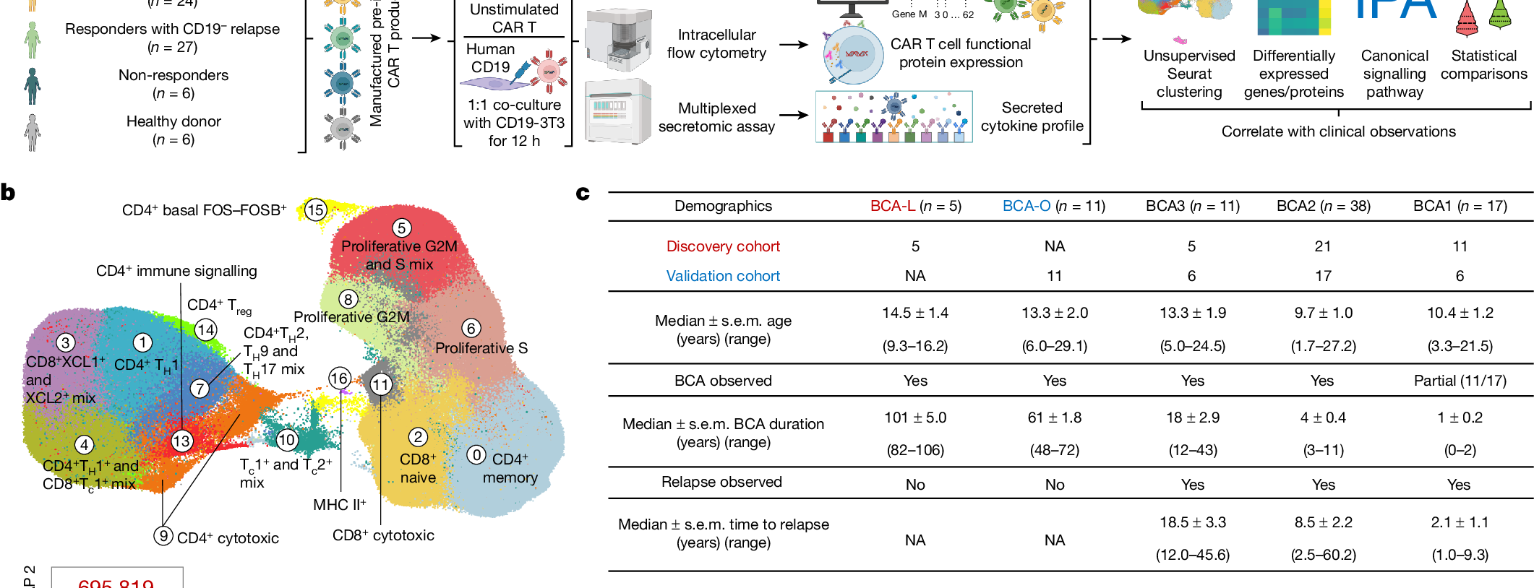
04 / PERSISTENCE
ATLAS / 03
Persistence is a gradient, not a binary
BCA strata create the clinical axis reused across the paper.
BCA-L / LONGEST
BCA1 / SHORTEST
n = 5 · 101 months
no relapse observed
n = 17 · 1 month
relapse observed
Fig. 1c / demographics and follow-up
PERSISTENCE GRADIENT
INTERPRETATION
101
61
18
4
1
BCA-L
BCA-O
BCA3
BCA2
BCA1
Persistence is a continuum with a clinical gradient, not a yes/no label.
5 / 12
Source figure / Fig. 1c. Duration values shown are the paper’s reported values; units are months in the source table.

Slide 6
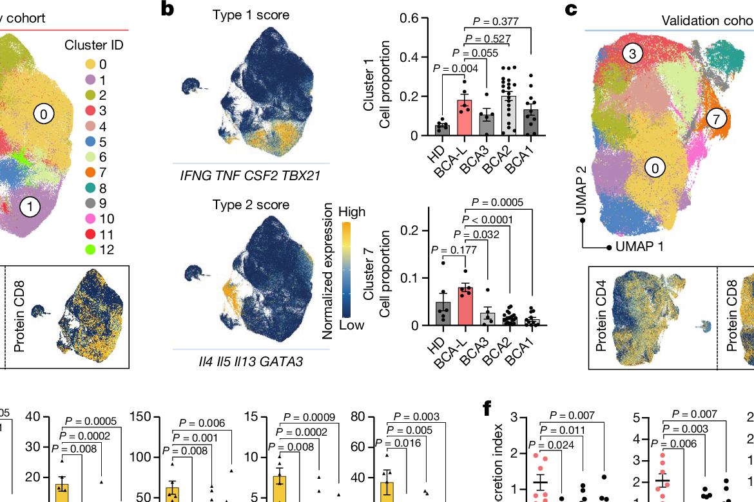
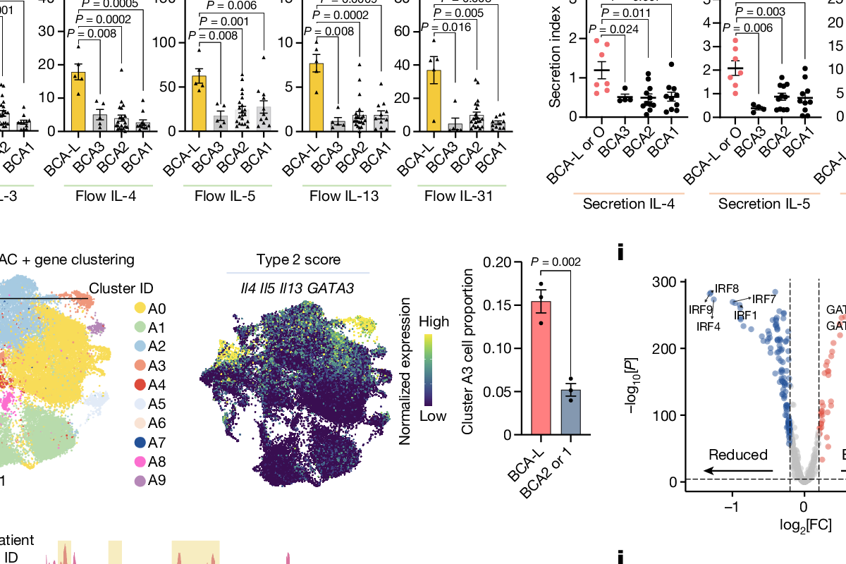
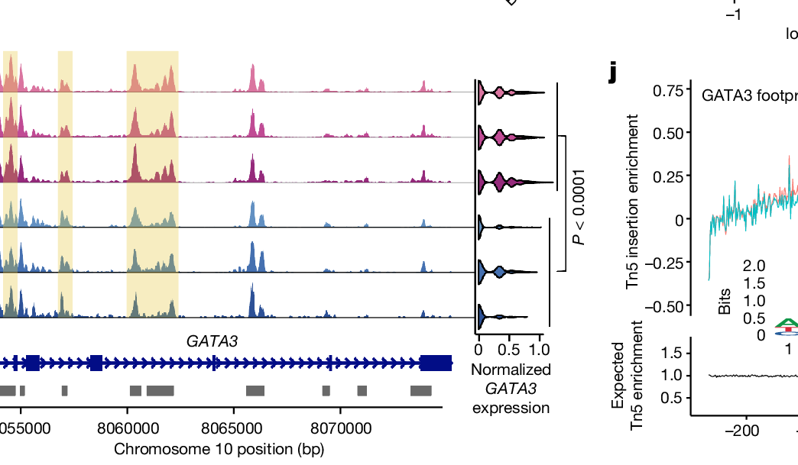
05 / TYPE 2 STATE
ATLAS / 03
The long-remission state reads as type 2
Four orthogonal readouts point to the same biological state.
TYPE 2 SIGNATURE
IL4 · IL5 · IL13
GATA3
enriched in the long-remission group
Fig. 2a–d / type 2 score
Fig. 2e–f / secretion
PERTURBATION
EVIDENCE RULE / CONVERGENCE
GATA3 / STAT6
TRANSCRIPTOME
SECRETION
CHROMATIN
repeat stimulation
→ tumour-cell lysis
→ one coherent type 2 state
Fig. 2g–j / ATAC + GATA3
6 / 12
Source figure / Fig. 2. Direct paper panels used as evidence modules; interpretation is newly organized.

Slide 7
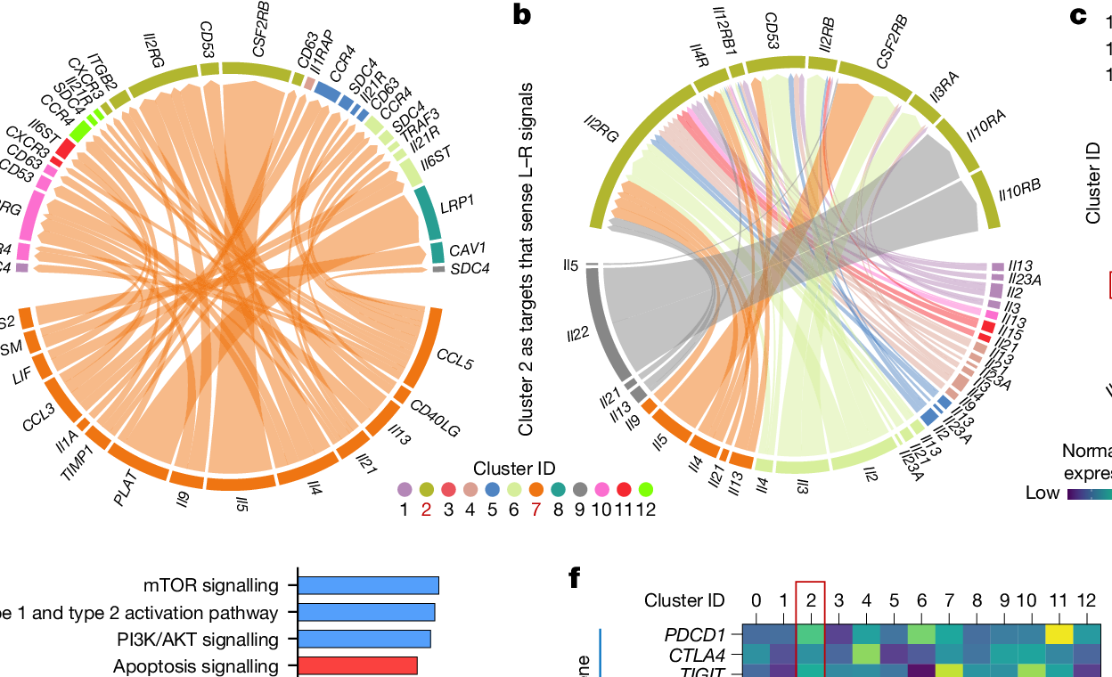
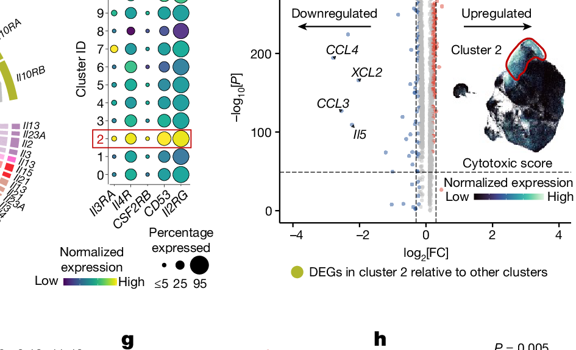
06 / MECHANISM
ATLAS / 03
Cluster 2 is the pressure point
The paper moves from association to a candidate regulatory interaction network.
13.9%
STATE
cluster 2 proportion
type 2
signal
cluster 2
proliferation
Fig. 3a–b / ligand–receptor network
Fig. 3c–d / cluster 2 and DEGs
EDITABLE MECHANISM SUMMARY
CLAIM BOUNDARY
Candidate mechanism
not a complete causal proof
Type 2 function → cluster 2 → dysfunctional subpopulation
7 / 12
Source figure / Fig. 3. Network diagrams and cluster 2 readouts are reproduced; the causal wording is deliberately bounded.

Slide 8
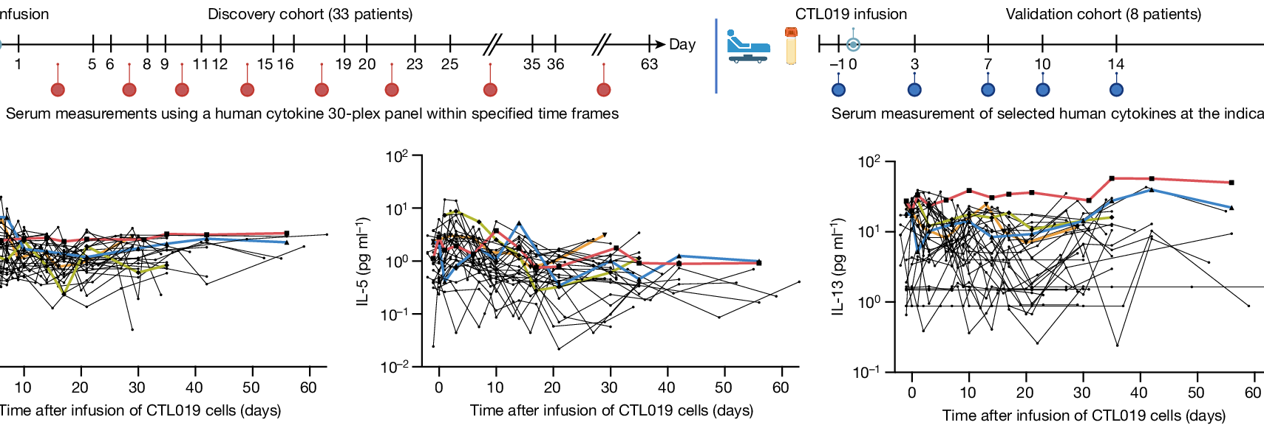
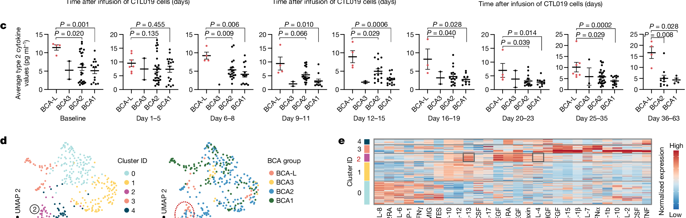
07 / SECRETOME
ATLAS / 03
The serum trace keeps the biology longitudinal
A state is more credible when it survives time, not just a snapshot.
345
30
33
measurements
cytokines
patients
Fig. 4a–b / collection timeline + time series
TYPE 2 WINDOW
IL-4 · IL-5 · IL-13
serial evidence across days 1–63
33 discovery + 8 validation patients
Fig. 4c–e / cytokine windows + heatmap
8 / 12
Source figure / Fig. 4. Longitudinal panels are retained; the surrounding blue modules explain scale and timing.

Slide 9
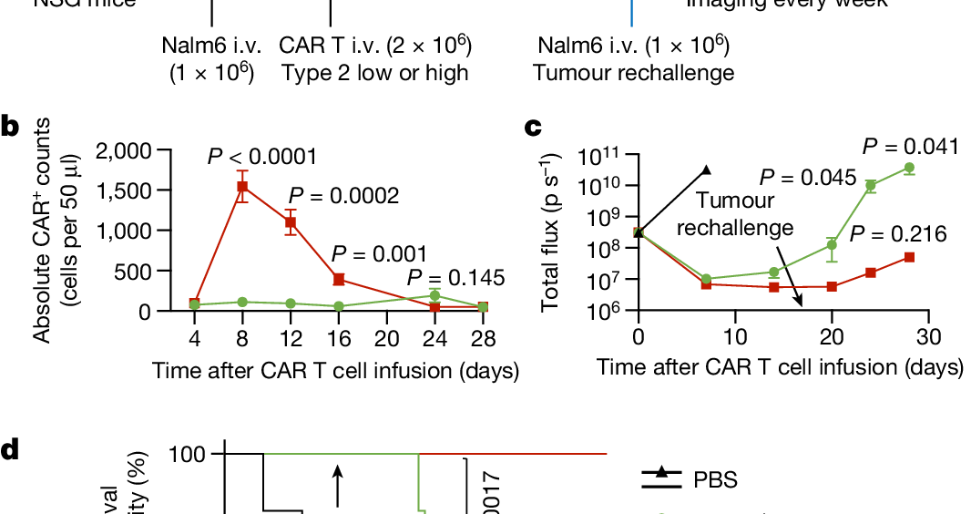
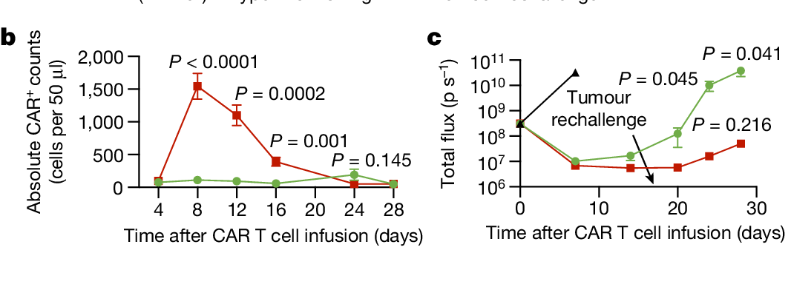
08 / IN VIVO TEST
ATLAS / 03
Type 2-high cells pass the recall test
The state is tested as function, not merely described as phenotype.
IN VIVO SEQUENCE
−7
0
17
24–28
Nalm6
CAR T
rechallenge
imaging
READOUT
Fig. 5a–c / mouse sequence + expansion
Type 2-high cells expand more and show stronger recall in the reported model; selected readouts n=5 mice.
EVIDENCE BOUNDARY
Preclinical model supports function; it does not establish clinical efficacy.
Fig. 5d / survival after rechallenge
9 / 12
Source figure / Fig. 5. Experimental evidence is shown with the preclinical boundary kept explicit.

Slide 10
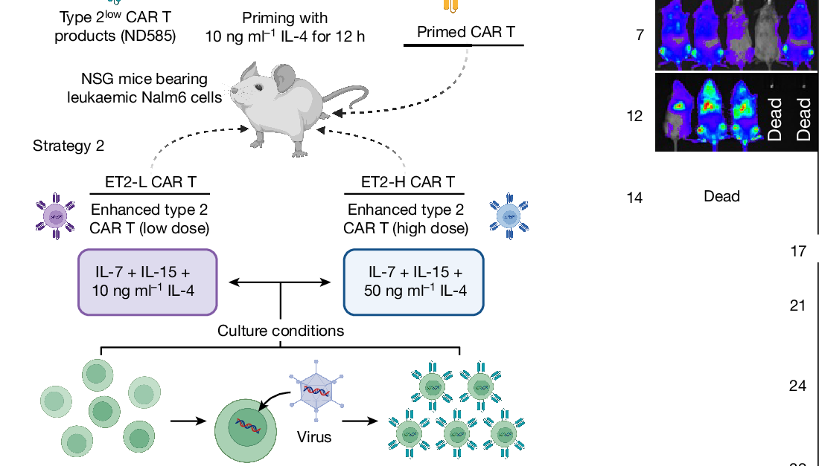
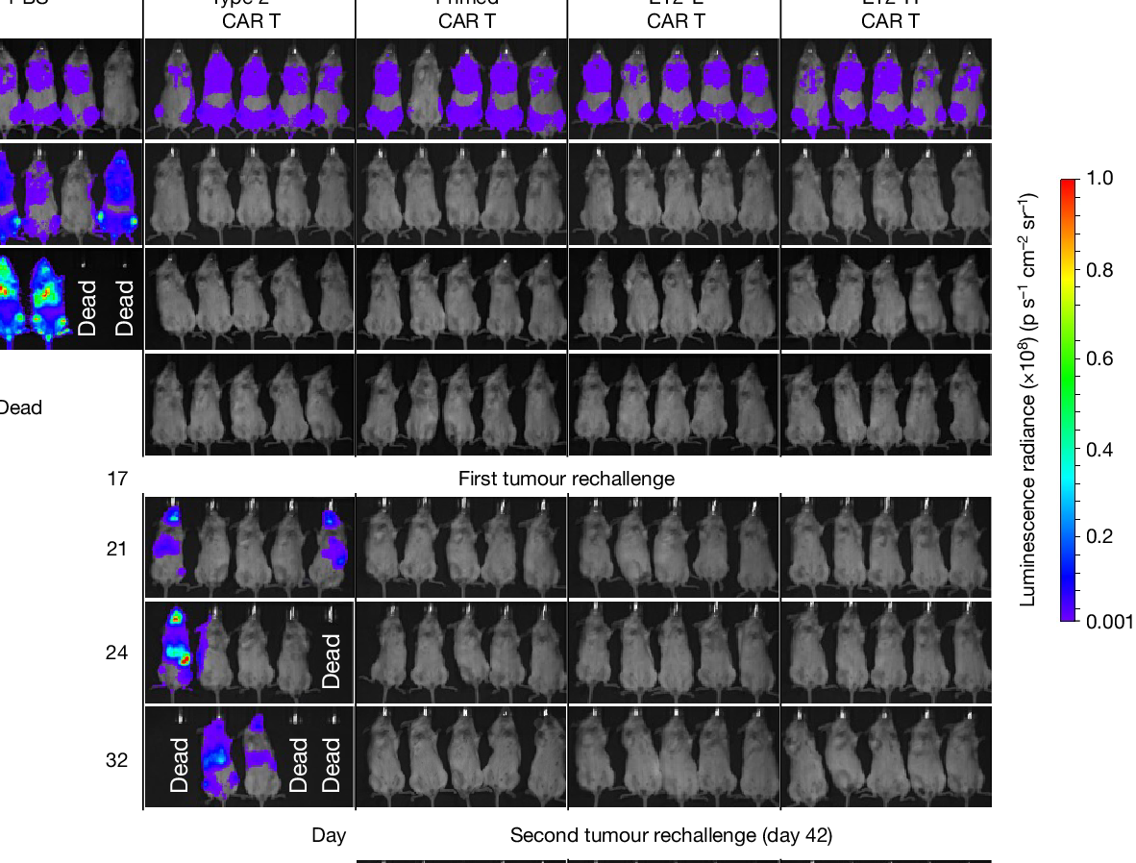
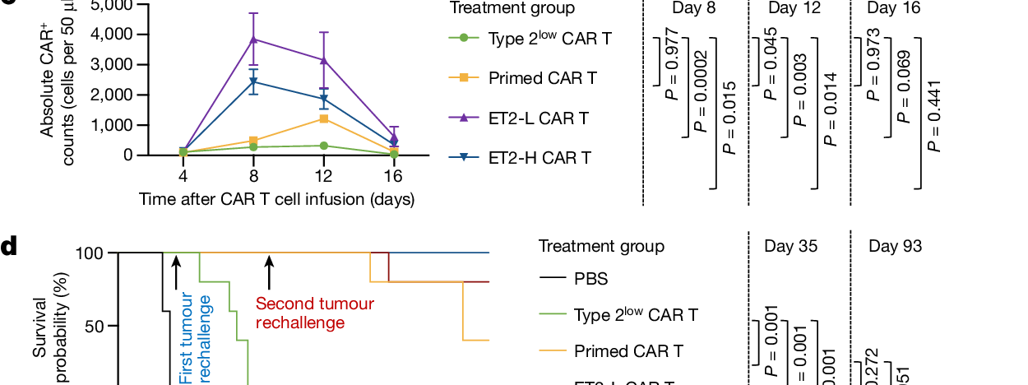
09 / ENGINEERING
ATLAS / 03
IL-4 turns the state into a design lever
The final figure converts a cell-state hypothesis into a manufacturing strategy.
10
50
ng ml⁻¹
ng ml⁻¹
Fig. 6a / priming and ET2-L/H strategies
Fig. 6b / in vivo imaging
DESIGN OPTIONS
INTERPRETATION
priming: 10 ng ml⁻¹ / 12 h
ET2-L: 10 · ET2-H: 50
controlled manufacturing exposure
Promising engineering lever
still bounded by model and study design
Fig. 6c–d / expansion + survival
10 / 12
Source figure / Fig. 6. Concentrations and group labels remain tied to the paper; the design framing is editorialized.

Slide 11
10 / EVIDENCE CHAIN
ATLAS / 03
The argument is strongest when each layer stays distinct
Do not collapse clinical association, mechanism and intervention into one claim.
01
02
03
04
OBSERVED
RESOLVED
PROPOSED
TESTED
CLINICAL
CELLULAR
MECHANISM
PRECLINICAL
8.4-year persistence
type 2 state
cluster 2 network
recall + IL-4
Fig. 1 / 4
Fig. 2
Fig. 3
Fig. 5 / 6
READING RULE
Clinical persistence anchors the story; cellular evidence resolves the state; mechanism remains a candidate; preclinical work tests the direction.
Evidence boundary: association → state definition → candidate explanation → functional test / engineering lever
11 / 12
A rigorous research presentation makes evidence type and evidence boundary visible on the same page.

Slide 12
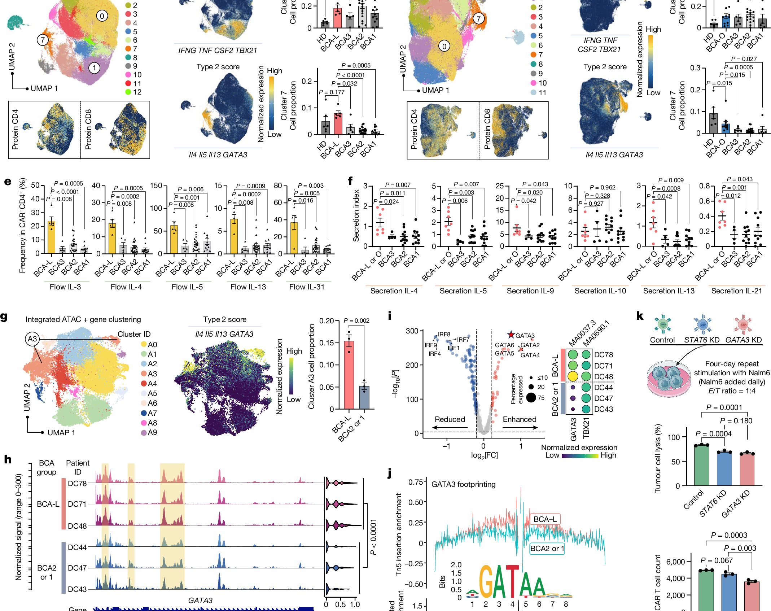
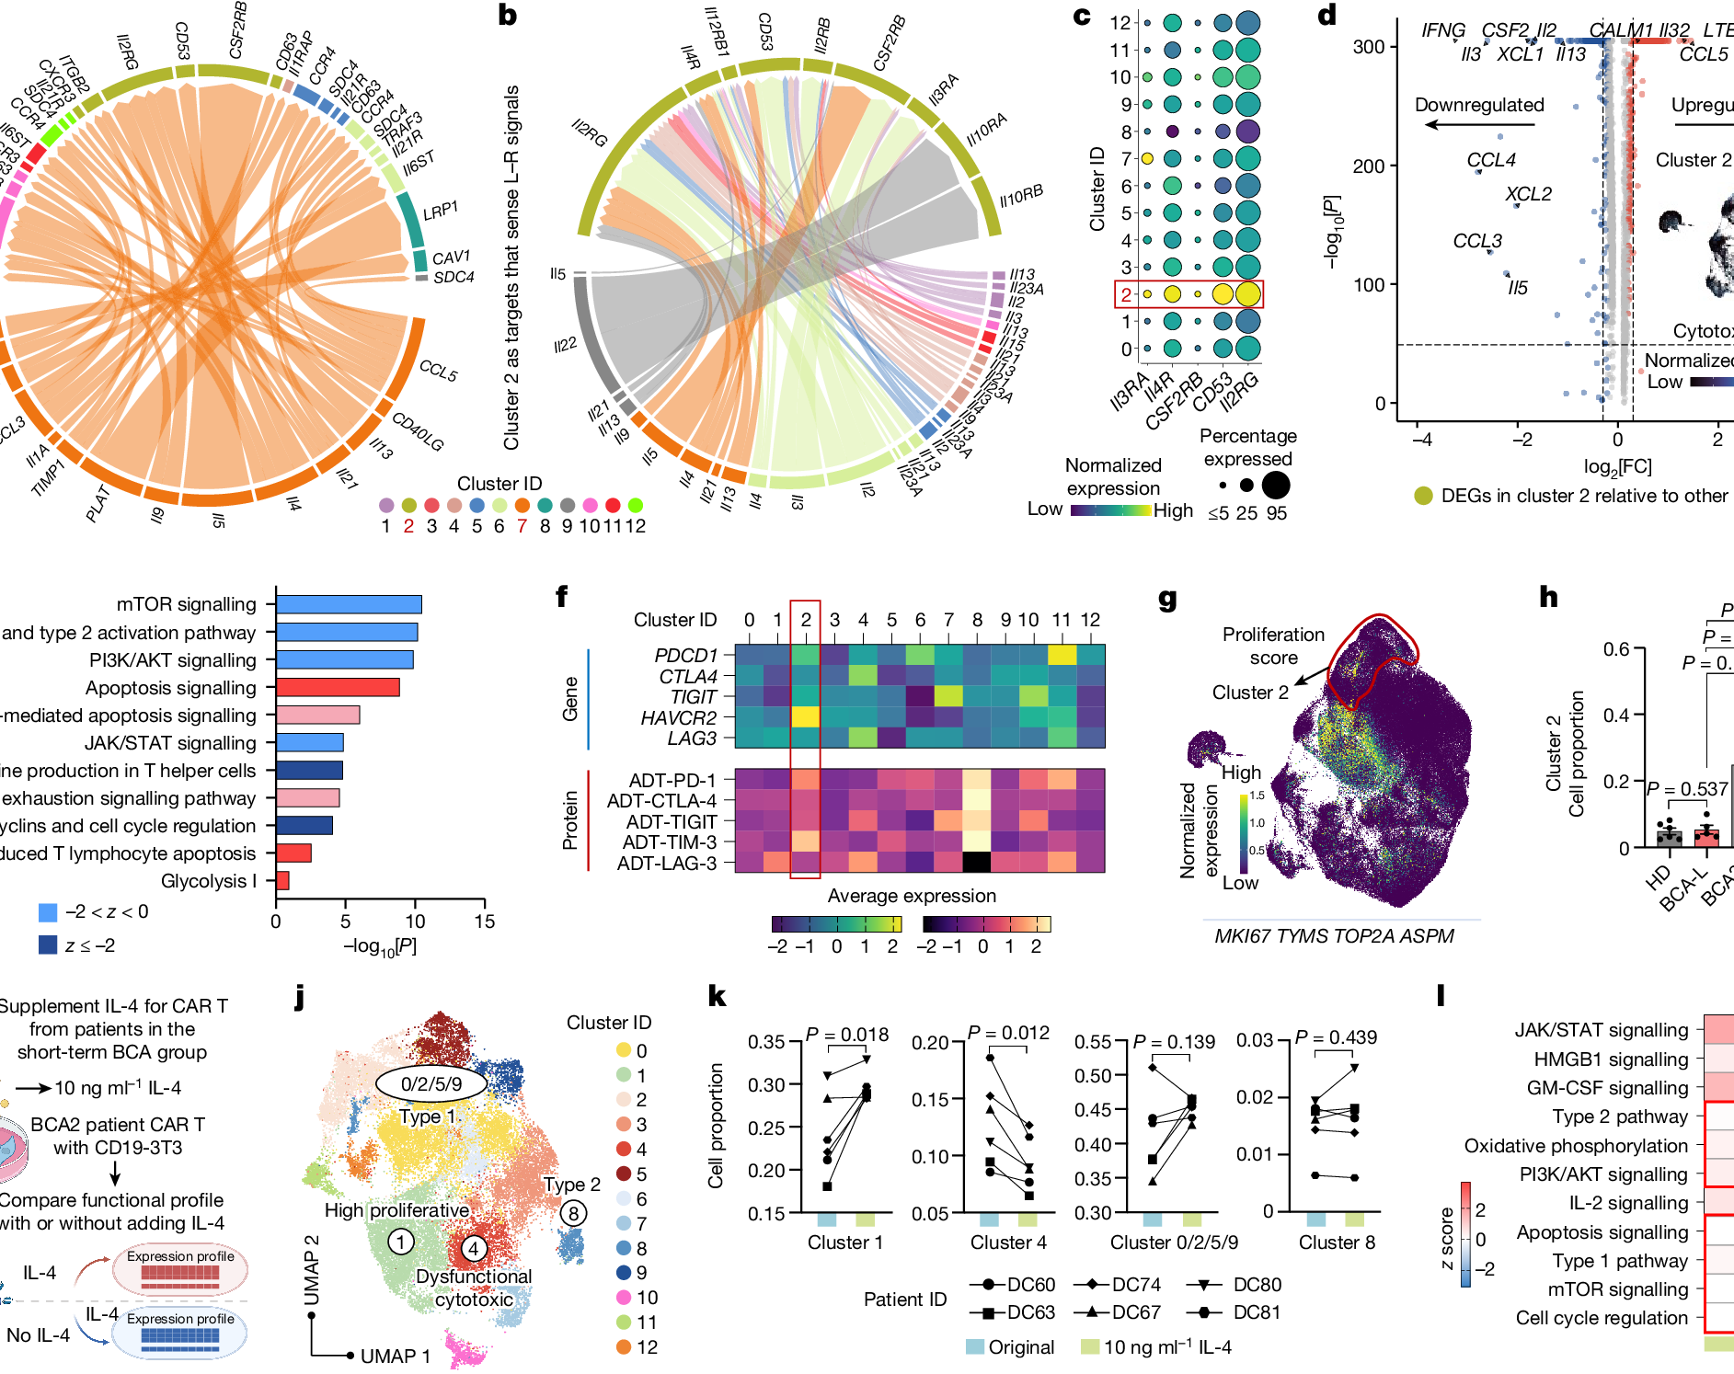
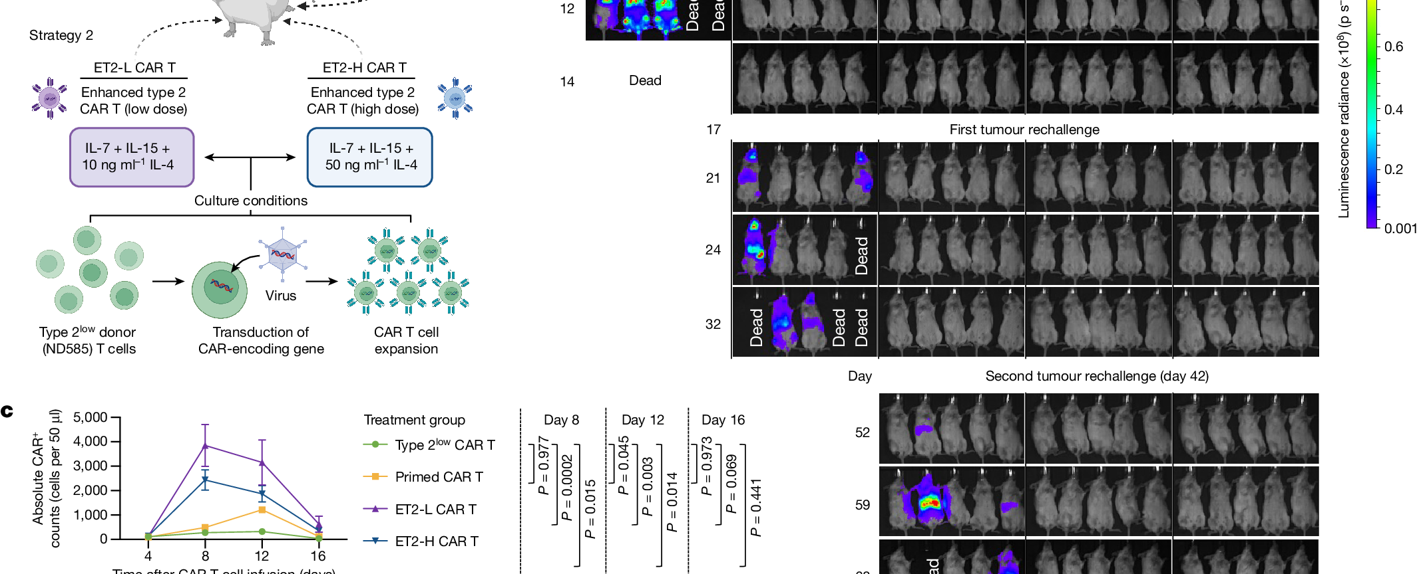
THE TAKEAWAY
Type 2 function may sustain fitness.
A durable clinical phenotype
becomes a recognizable cell state,
a candidate circuit and an engineering lever.
Fig. 2
Fig. 3
A strong research story shows its figures—and its limits.
Fig. 6 / engineering strategy
Bai et al. · Nature 634 · 702–711 · 2024

