Slide 1
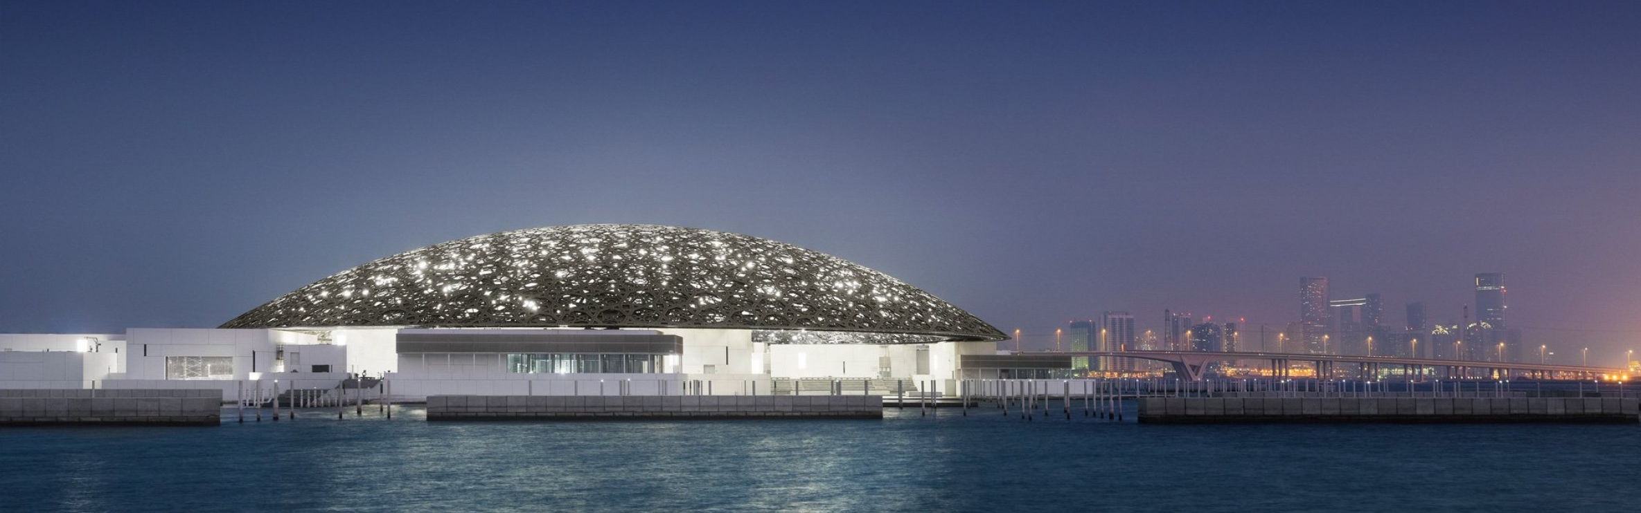
ARCHITECTURAL DOSSIER / 2026
LOUVRE ABU DHABI
JEAN NOUVEL / 2017
SAADIYAT ISLAND / ABU DHABI, UAE
01

Slide 2
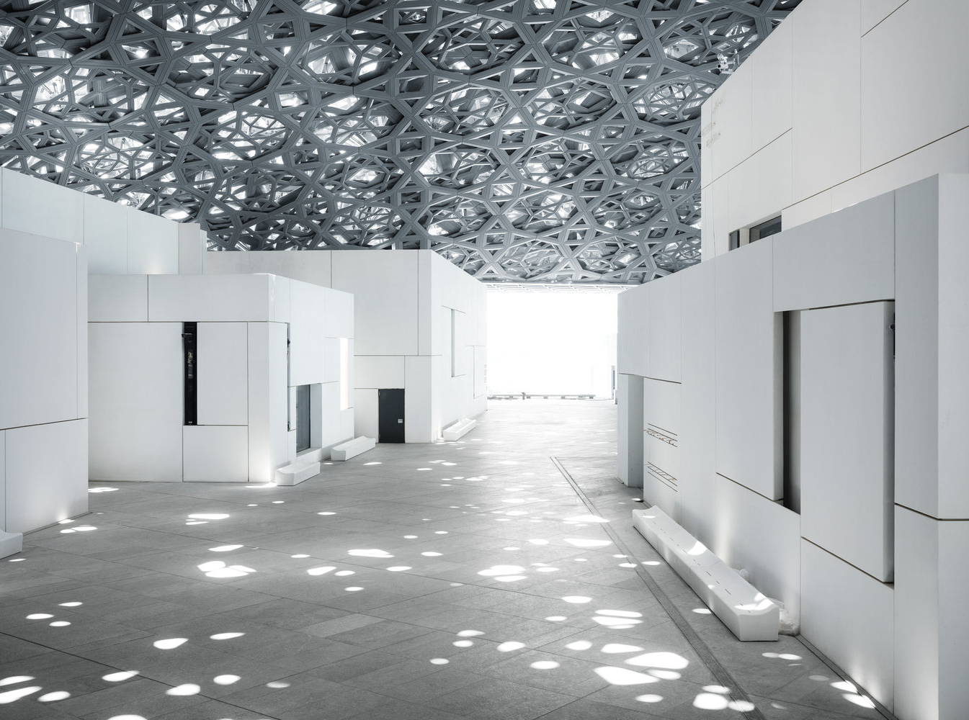
01 / SPATIAL PROLOGUE
RAIN OF LIGHT
BENEATH A POROUS DOME, DAYLIGHT BECOMES A CULTURAL MEDIUM.
The roof does not simply shelter the museum; it composes its atmosphere.
02
LOUVRE ABU DHABI
JEAN NOUVEL / 2017

Slide 3
02 / GEOMETRY AS CLIMATE
THE DOME AS INSTRUMENT
Four outer layers of stainless steel meet four inner layers of aluminium.
A geometric canopy filters daylight, shades the plaza and generates a microclimate below.
7,850
8
STARS IN THE PATTERN
OVERLAPPING LAYERS
SOURCE / LOUVRE ABU DHABI — ARCHITECTURE
03
180 M
DIAMETER OF THE DOME

Slide 4
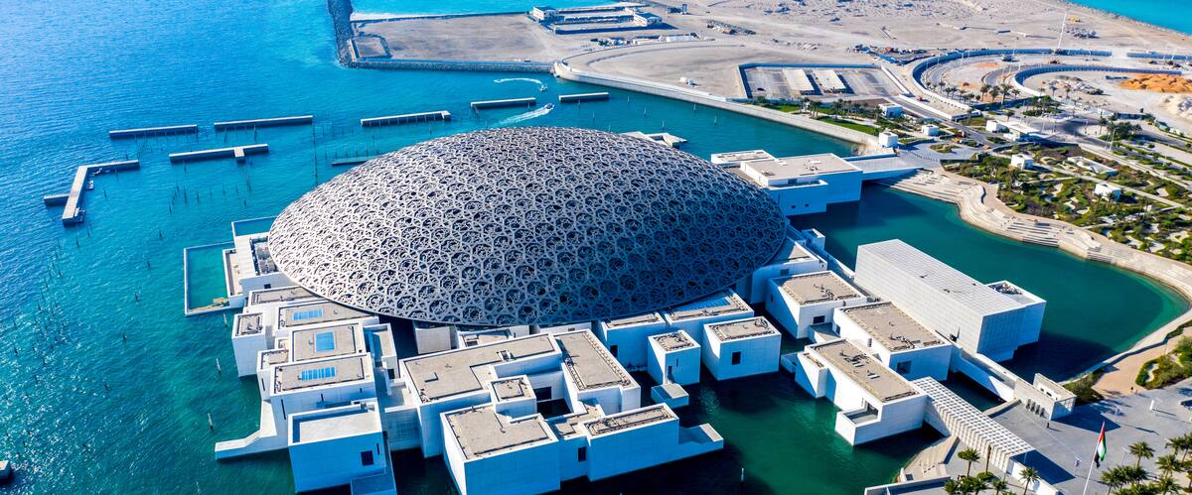
03 / URBAN FIGURE
A MUSEUM CITY / IN THE SEA
ABU DHABI · UAE
55 BUILDINGS
23 ARE GALLERIES
04

Slide 5
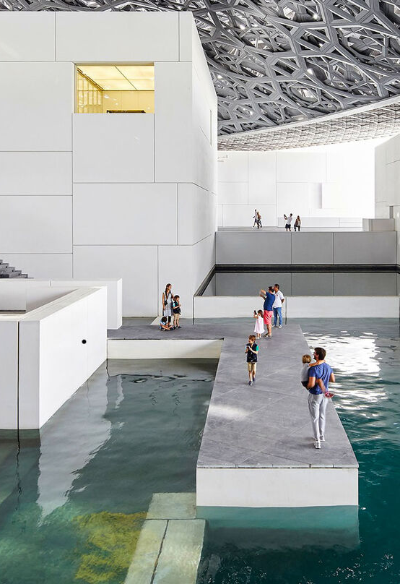
04 / CIVIC INTERIOR
WATER AS PUBLIC ROOM
Paths cross the water beneath the dome, turning the museum into a walkable, climate-softened urban room.
Architecture is not an object beside the sea. It becomes a small city within it.
05
LAND + SEA
SOURCE / LOUVRE ABU DHABI — ARCHITECTURE

Slide 6
05 / THERMAL FIELD
SHADE BECOMES INFRASTRUCTURE
The canopy filters daylight, reduces heat and protects the public realm below.
Natural cooling is not an add-on. It is the spatial idea of the project.
36 M
7,500 T
DOME ABOVE GROUND
DOME WEIGHT
SOURCE / LOUVRE ABU DHABI — ARCHITECTURE
06

Slide 7
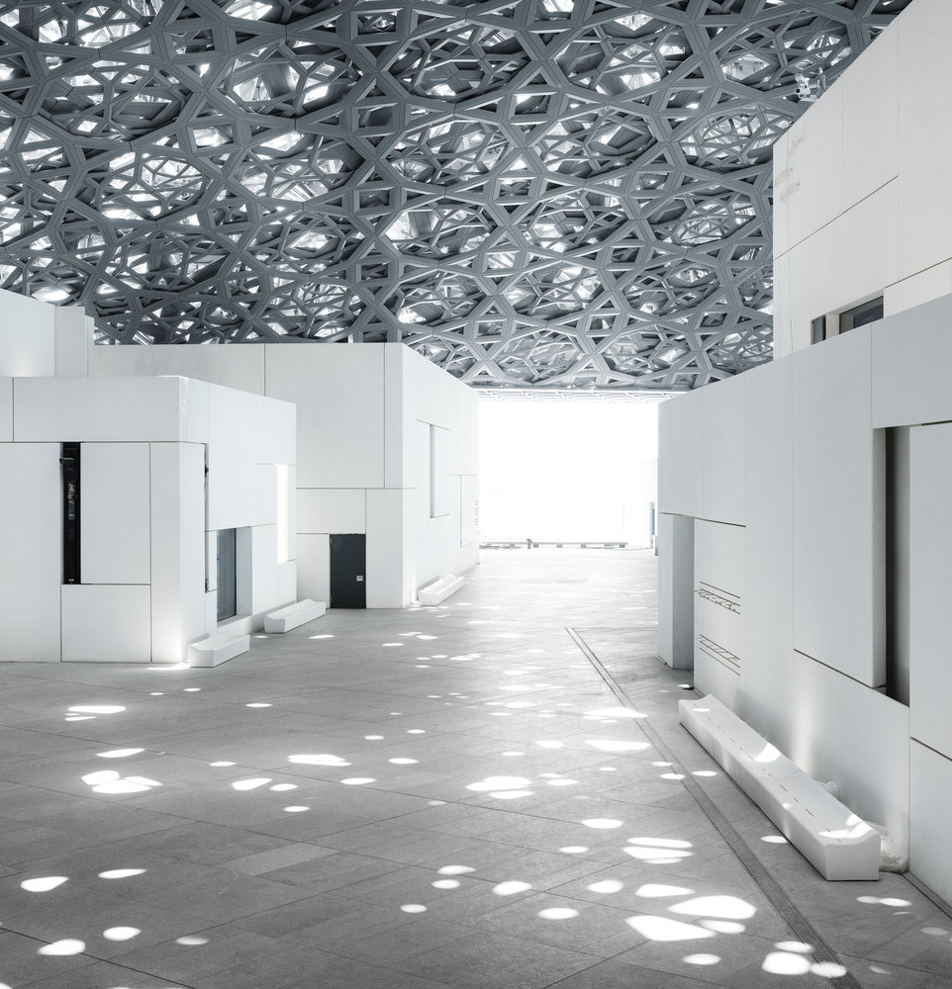
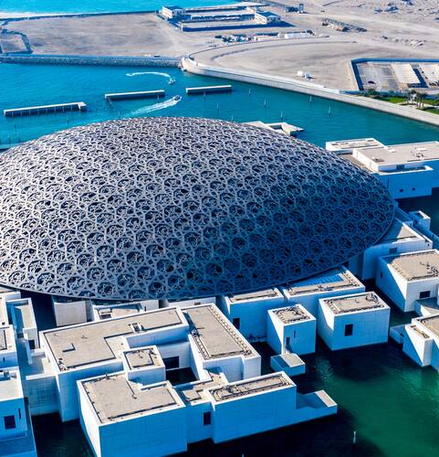
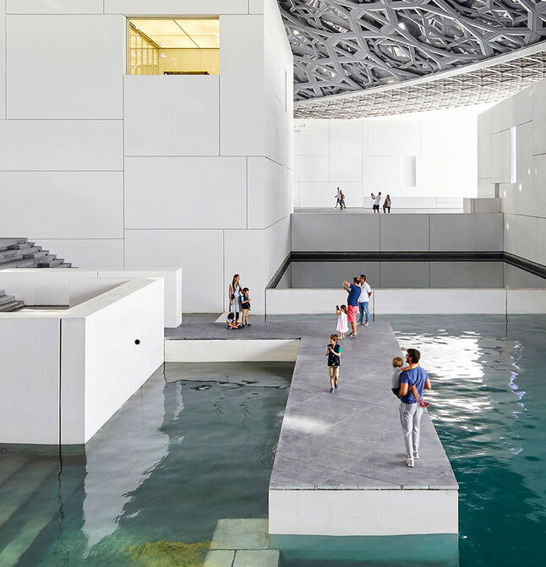
06 / SPATIAL SEQUENCE
WALK / PAUSE / RETURN
A MUSEUM DESIGNED AS A JOURNEY
01 / FILTERED DAYLIGHT
02 / CITY + SEA
03 / CIVIC WATERROOM
07
THREE ATMOSPHERES, ONE CONTINUOUS ROOF.

Slide 8
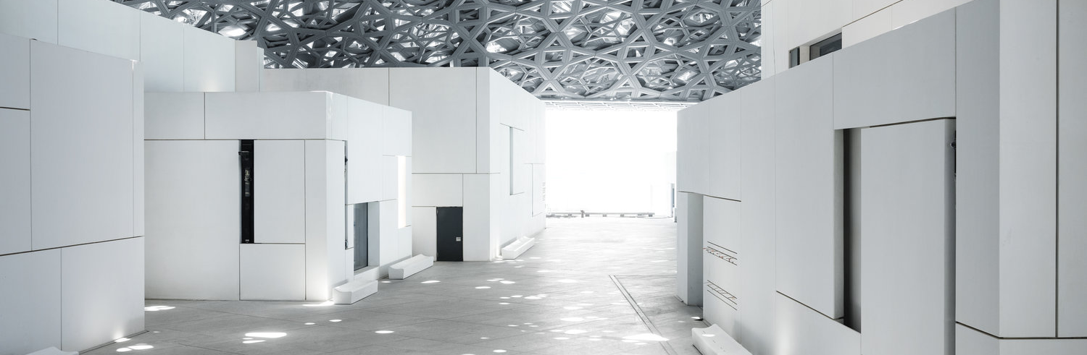
07 / MATERIAL LOGIC
8 LAYERS
MATERIAL IS A FILTER
4 STAINLESS STEEL / 4 ALUMINIUM
The roof permits daylight without excessive heat or wind.
Steel, aluminium and patterned voids work as a single optical instrument between sky and ground.
SOURCE / LOUVRE ABU DHABI — ARCHITECTURE
08

Slide 9
08 / ARCHITECTURAL POSITION
A WELCOMING WORLD OF LIGHT, SHADOW, REFLECTION AND CALM.
A museum-city that belongs to its geography without becoming a literal interpretation of it.
JEAN NOUVEL / ARCHITECT
SOURCE / LOUVRE ABU DHABI — ARCHITECTURE
09

Slide 10
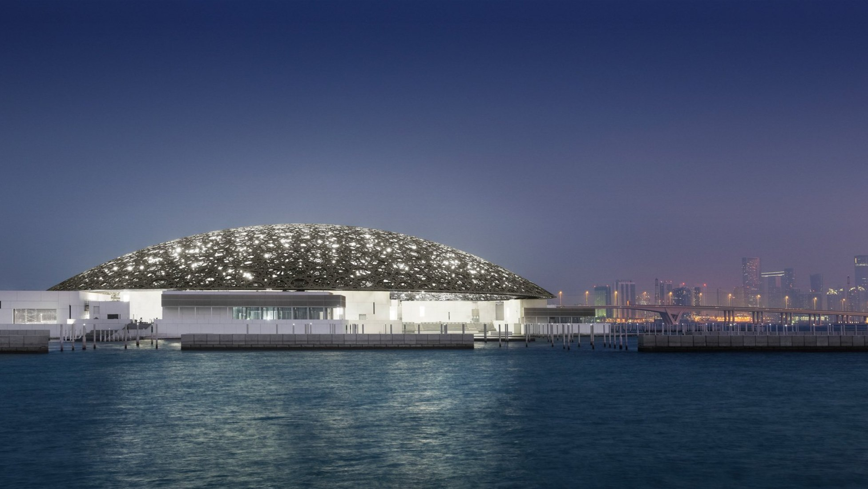
09 / CODA
LIGHT. WATER. CITY.
A common sky turns architecture into a public cultural landscape.
LOUVRE ABU DHABI / SAADIYAT ISLAND
END OF STUDY
10

