Slide 1
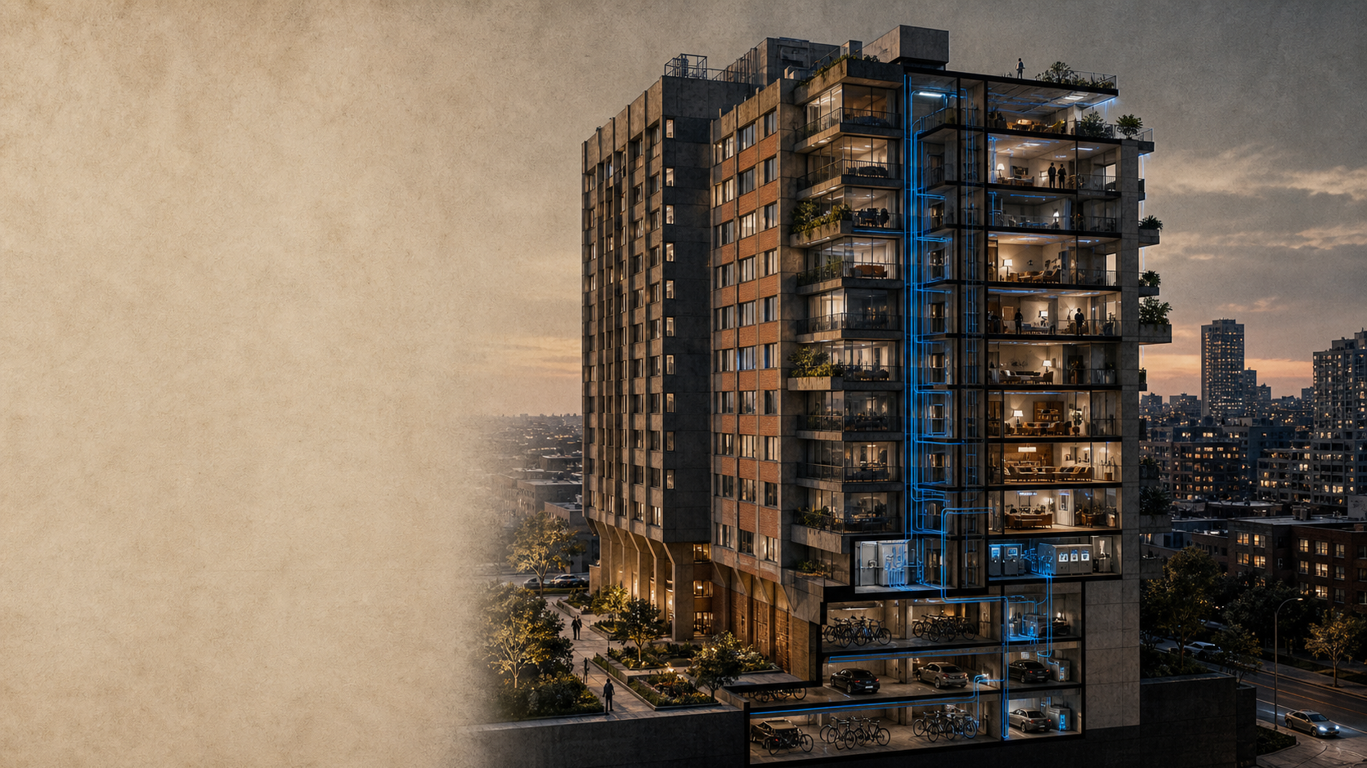
URBAN SYSTEMS / CASE 07
VERTICAL CITY RETROFIT
The next city is not built from scratch. It is upgraded in place.
A strategy for aging high-rise housing
envelope · energy · shared space · care
CONCEPTUAL HERO VISUAL / NOT A REAL PROJECT
VERTICAL CITY RETROFIT · 2026

Slide 2
01 / THE VISIBLE PROBLEM
CITY / 01
An aging tower is a stack of hidden pressures
The façade is only the visible layer; the retrofit brief begins where energy, access, and care intersect.
SECTIONAL DIAGNOSIS / EXISTING CONDITION
THE RETROFIT BRIEF
Upgrade the whole section.
HEAT
envelope loss
A façade-only fix can lower heat loss,
but it cannot repair the social and
operational systems around the home.
ACCESS
lift + threshold
PRESSURE INDEX / ILLUSTRATIVE
CARE
isolated shared space
THERMAL
86
ACCESS
62
ENERGY
plant at end-of-life
SOCIAL
74
The unit of change is the building section.
2 / 14
Scenario framing is illustrative; visual language separates diagnosis from future intervention.

Slide 3
02 / SYSTEMS MAP
CITY / 01
One tower, five systems
The retrofit is not a façade package. It is a coordinated intervention across the whole vertical section.
EXPLODED AXONOMETRIC / OPERATING SECTION
FROM BUILDING TO OPERATING MODEL
01
ENVELOPE
thermal skin
Value appears in the connections.
02
ENERGY
plant + distribution
The same section can reduce loss,
restore access, and create care capacity.
03
MOBILITY
lift + threshold
04
SHARED SPACE
lobby + terrace
05
CARE
neighbourhood support
The tower behaves like a city when its layers work together.
ONE SECTION / FIVE OPERATING LAYERS
3 / 14
Conceptual axonometric; system labels define the retrofit vocabulary and are not measured project outcomes.

Slide 4
03 / DELIVERY PATH
CITY / 01
The intervention moves in five deliberate steps
A retrofit succeeds when each move unlocks the next one without interrupting the life of the building.
OCCUPIED-BUILDING SEQUENCE
05
04
ADAPT
03
SHARE
02
OPEN
operate and learn
01
WRAP
activate common life
MEASURE
repair the threshold
data + feedback
reduce loss first
terrace + care
baseline the whole section
lift + lobby
envelope + plant
thermal + social
THE DELIVERY TEST
Can the building become more comfortable, more connected, and more useful while people remain inside it?
The sequence is the value proposition: reduce loss → restore access → create shared capacity → learn through operation.
4 / 14
Conceptual delivery path; stage logic is a strategy hypothesis, not a measured project schedule.

Slide 5
04 / ENERGY CONSTRAINT
CITY / 01
Energy is the first constraint
Before adding new capacity, reduce the amount of energy the building needs to perform everyday life.
ILLUSTRATIVE LOAD INDEX / EXISTING = 100
THE STRATEGIC READ
Reduce loss before adding capacity.
EXISTING
100
uncoordinated demand
WRAP
68
envelope first
A plant upgrade can improve
efficiency; an envelope upgrade
changes the demand itself.
REWIRE
54
plant + controls
SHARE
47
01
DEMAND
lower the peak
shared load / care
02
CAPACITY
right-size the plant
0
25
50
75
100
03
RESILIENCE
keep options open
Illustrative sequence: reduce loss → rewire capacity → share the gain.
The first retrofit is a demand decision.
5 / 14
Illustrative load index for visual explanation only; not a measured building-energy result.

Slide 6
05 / SHARED GROUND
CITY / 01
The ground floor is the social switch
A small change at the threshold can turn circulation space into shared civic capacity.
GROUND-FLOOR PLAN / BEFORE → AFTER
01 / EXISTING
02 / SHARED GROUND
sealed threshold
porous threshold
OPEN
lobby / parking edge / no shared program
lobby / care / terrace / flexible room
Movement passes through. Nothing stays.
Movement meets. Something can happen.
The retrofit does not only improve the envelope; it increases the number of useful encounters the building can support.
6 / 14
Conceptual plan comparison; program labels describe a strategy hypothesis, not a built project outcome.

Slide 7
06 / DAILY LIFE
CITY / 01
A vertical city is measured in moments
The retrofit succeeds when the building supports more useful moments across an ordinary day.
DAY STORYBOARD / OCCUPIED BUILDING
FROM MOVEMENT TO CAPACITY
07:30
12:15
17:45
20:30
22:00
01
02
03
04
05
LEAVE
MEET
RETURN
CARE
REST
threshold becomes legible
lobby becomes shared ground
lift becomes a social hinge
terrace becomes visible support
comfort becomes quiet infrastructure
A retrofit is not finished when the construction ends; it is finished when daily life has more room to work.
7 / 14
Conceptual day storyboard; moments describe intended user experience, not measured post-occupancy results.

Slide 8
07 / ARCHETYPES
CITY / 01
There is no single retrofit
The right depth depends on capital, disruption, and the amount of shared capacity the building needs to recover.
THREE INTERVENTION DEPTHS
SELECTION LOGIC
Depth follows shared need.
Light protects.
Deep reconnects.
District shares.
Choose the smallest intervention that changes the operating model.
LIGHT
DEEP
DISTRICT
protect
reconnect
share
skin + controls
skin + threshold + care
building + neighbourhood
8 / 14
Conceptual archetypes; intervention depth and labels are strategic options, not project specifications.

Slide 9
08 / PHASING
CITY / 01
The building stays occupied while the work moves
Construction phasing is part of the design: every intervention must have a resident-safe next move.
RESIDENT-IN-PLACE PHASING
0
6
12
18
24
MONTHS
01
PREPARE
survey + resident pact
02
WRAP
envelope + plant
03
OPEN
thresholds + shared ground
04
LEARN
operate + adjust
RESIDENT IMPACT
noise / access
temporary disruption
permanent capacity
9 / 14
Conceptual phasing sequence; durations and impacts are illustrative planning assumptions.

Slide 10
09 / ECONOMICS
CITY / 01
Sequence changes the economics
The same interventions can produce different value depending on what happens first.
ILLUSTRATIVE VALUE BRIDGE / INDEX
THE ECONOMIC READ
Order is a financial lever.
+100
Reduce peak demand.
Right-size capacity.
Invest in shared use.
+82
+22
SENSITIVITY / WHAT MOVES FIRST
WRAP
REWIRE
CAPEX
high
-24
-16
DISRUPTION
medium
BASE
SHARE
VALUE
SHARED VALUE
later
Illustrative index: demand reduction creates the headroom for shared capacity.
10 / 14
Illustrative value bridge; no project IRR, payback, or measured savings are being claimed.

Slide 11
10 / DECISION
CITY / 01
Choose by trade-off, not by score
A credible retrofit brief makes the conflicts visible before it recommends a depth.
OPTION MATRIX / STRATEGIC FIT
HIGH
THE DECISION RULE
Pick the option that changes the system.
SHARED VALUE
DISTRICT
share
Light: minimum disruption
Deep: balanced value
District: maximum capacity
DEEP
reconnect
LOW
LIGHT
LOW
MEDIUM
HIGH
Trade-offs are not a weakness; they are the decision.
protect
CAPITAL + DISRUPTION
11 / 14
Conceptual option matrix; positions express strategic trade-offs, not a quantified project ranking.

Slide 12
11 / OPERATING MODEL
CITY / 01
The retrofit needs an operator
Capital can upgrade the building once; an operating model keeps the new capacity useful.
ACTORS / FLOWS / ACCOUNTABILITY
RESIDENTS
ENERGY TEAM
feedback
BUILDING OPERATOR
performance
measure / maintain / adapt
OWNER
CARE PARTNERS
capital
ACCOUNTABILITY LOOP
services
data → decision → maintenance → lived outcome → new data
12 / 14
Conceptual operating model; actor roles describe the governance hypothesis for a retrofit programme.

Slide 13
12 / DELIVERY
CITY / 01
A 36-month path with evidence at every gate
The programme becomes investable when each horizon has a decision, an owner, and proof of progress.
THREE HORIZONS / FOUR GATES
DIAGNOSE
DELIVER
OPERATE
0
12
24
36
MONTHS
MONTHS
MONTHS
MONTHS
baseline + resident pact
wrap + open + share
measure + adapt
G1
G2
G3
G4
brief locked
pilot signed off
shared space live
evidence review
A gate is not a date. It is a decision supported by evidence.
13 / 14
Conceptual 36-month path; milestones and gates are illustrative programme design assumptions.

Slide 14
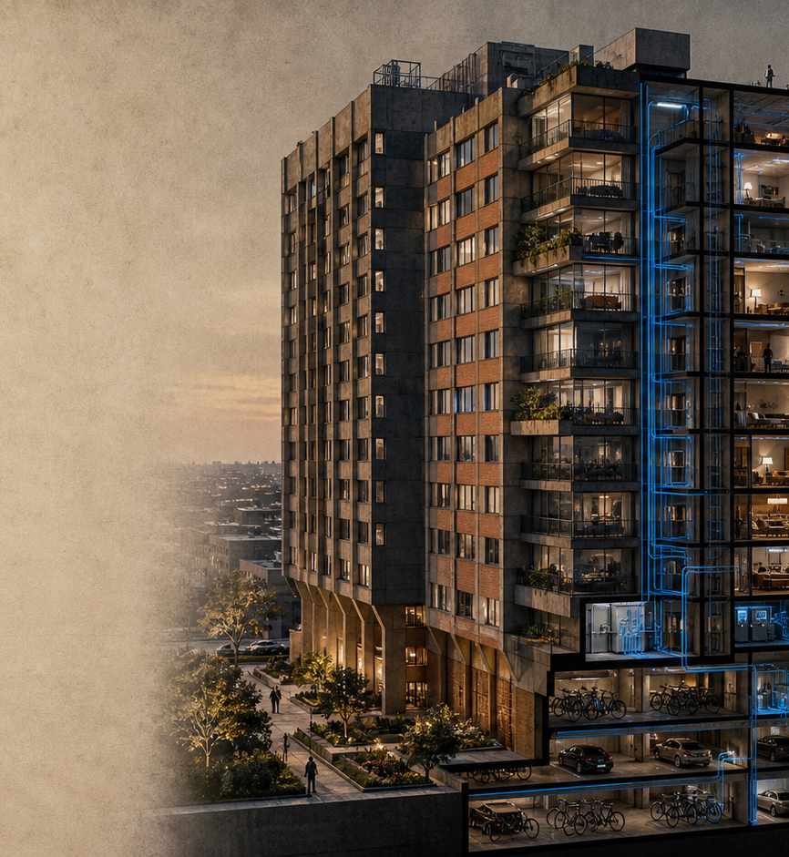
THE TAKEAWAY / CASE 07
Upgrade in place. Keep life in place.
A retrofit becomes strategic when
the building is treated as a connected
vertical city—not a façade project.
01
Reduce loss before adding capacity.
02
Design the shared ground.
03
Operate the new capacity.
CONCEPTUAL HERO VISUAL / NOT A REAL PROJECT
VERTICAL CITY RETROFIT · 2026

