Slide 1

Introducing NeuralForge SDK
NeuralForge — Innovation that delivers

Slide 2

The problem is bigger than you think
Slow Training: Weeks to train production models
GPU Costs: Cloud training costs are exploding
Deployment Gap: Lab models don't work in production

Slide 3
One-Click Model Deployment
Eliminates: Weeks to train production models
Eliminates: Cloud training costs are exploding
Eliminates: Lab models don't work in production

Slide 4
Built for how you actually work
Auto-optimized inference
Built-in model monitoring
Zero-config scaling

Slide 5
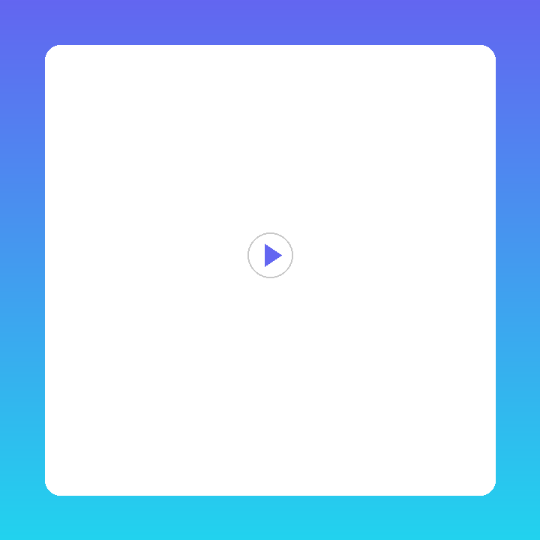
See NeuralForge SDK in action
Step 1: Connect your data sources with one click
Step 2: Configure intelligent workflows visually
Step 3: Watch AI optimize and deliver results

Slide 6
“
This platform transformed how we operate. We went from weeks of manual work to minutes.
VP of Operations, Fortune 500 Company

Slide 7
Simple, transparent pricing
Start free. Scale as you grow.
Simple, transparent pricing

Slide 8
Try NeuralForge SDK free
Free tier available. No credit card required.
Try NeuralForge SDK free

