Slide 1
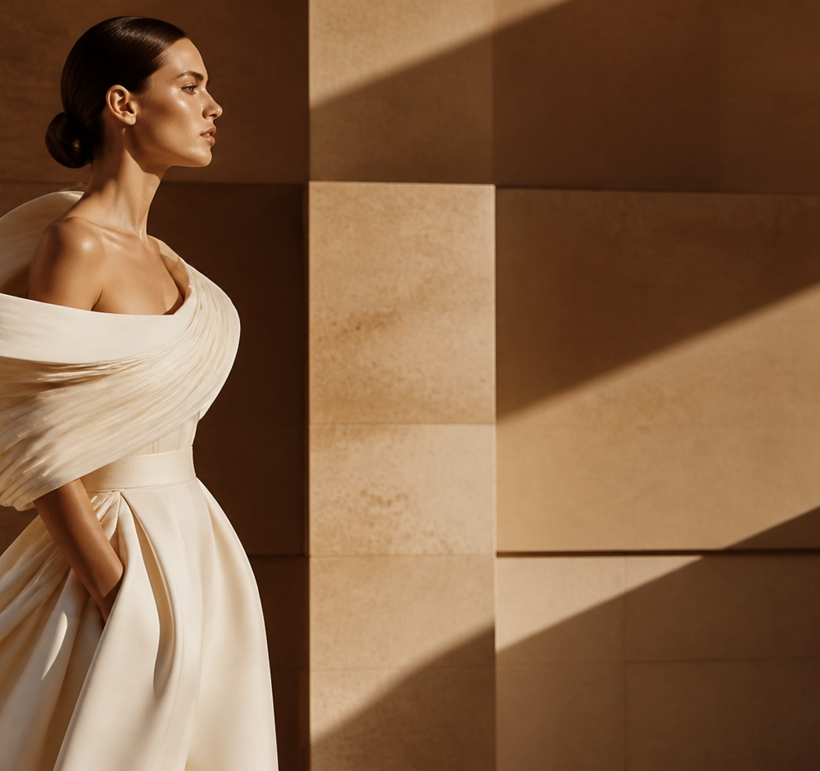
THE WHITE STUDY
ATELIER NOTES / 01
01
COUTURE
IN MOTION
A study of volume, weight and the hand.
PARIS / SPRING–SUMMER 2027
PRIVATE EDITORIAL EDITION
NOT A DRESS. A GESTURE.

Slide 2
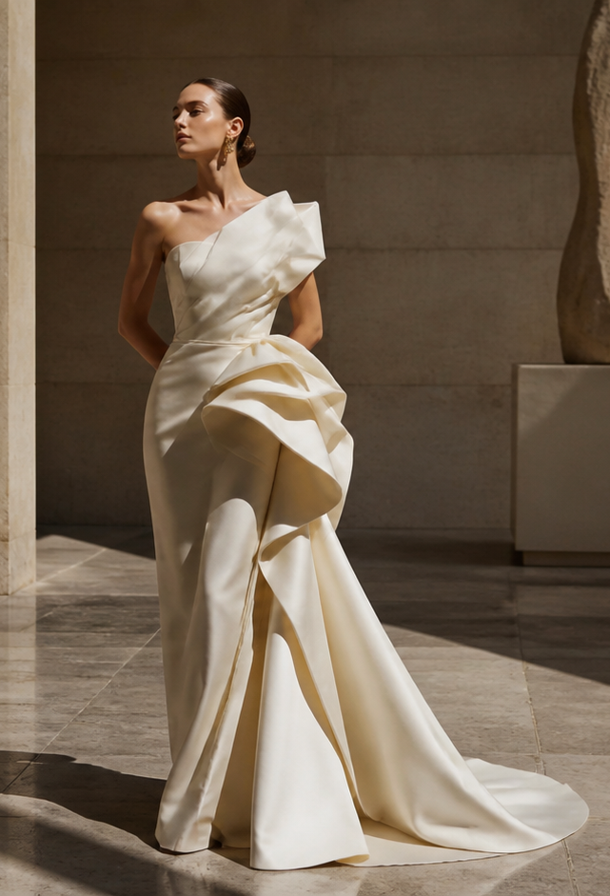
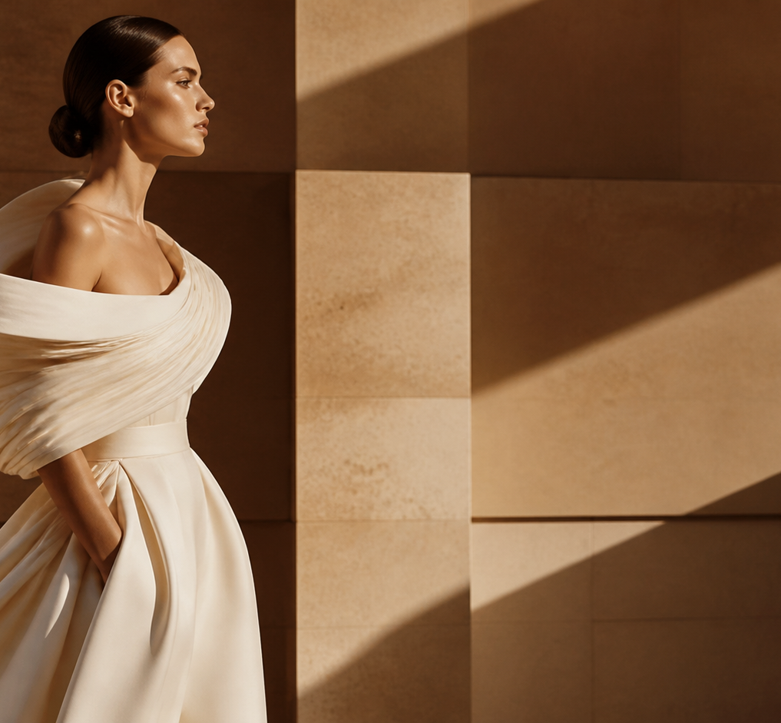
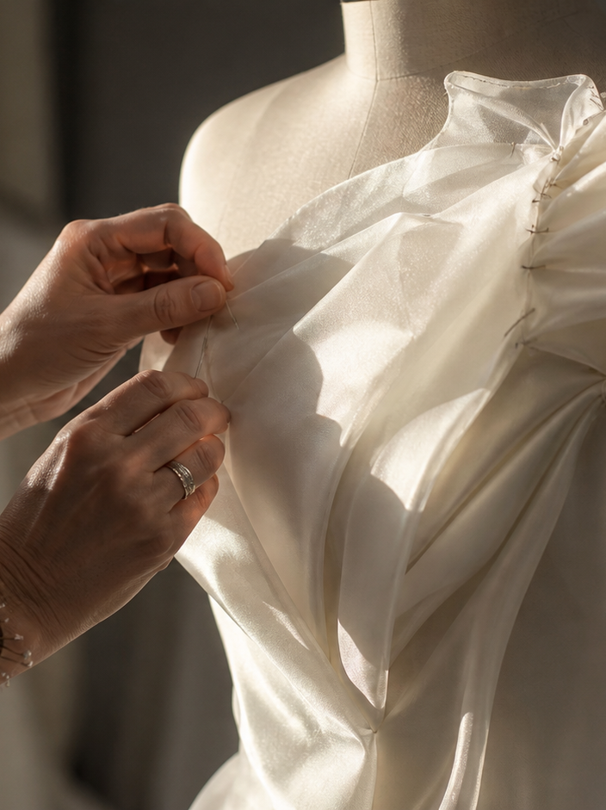
THE BODY IS THE PATTERN.
02 / SILHOUETTE STUDY
02 / RELEASED VOLUME
CUT
ON THE BIAS
01 / SHOULDER LINE
HAND-CUT / HAND-FINISHED

Slide 3
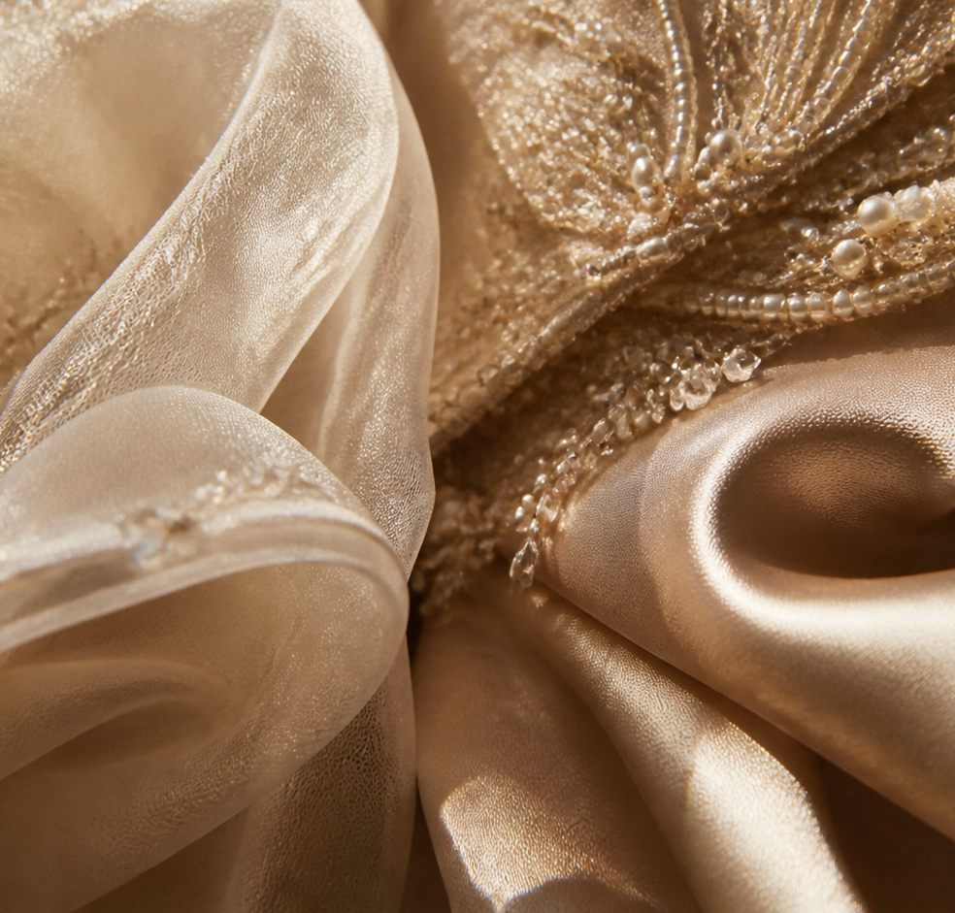
03 / MATERIAL INDEX
03
LIGHT NEEDS TEXTURE.
01 ORGANZA
AIR / RESISTANCE
02 SATIN
REFLECTION / WEIGHT
03 PEARL
GRAIN / LIGHT

Slide 4
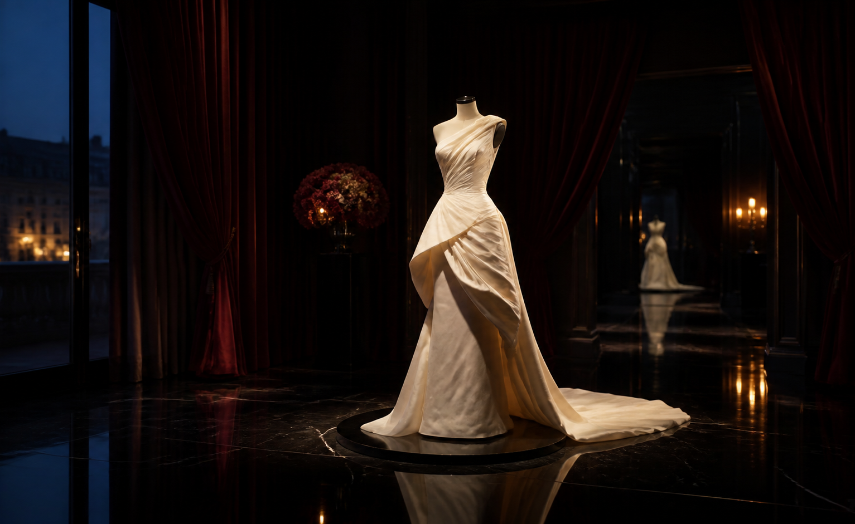
UNFINISHED
EDITION 01 COUTURE / MOTION
THE FINAL FITTING
A garment is
never still.
PARIS / 19:30
PRIVATE SALON / SEPTEMBER 2027
THE WHITE STUDY — A COUTURE EDITORIAL

