Slide 1
AQFP
Chenyin Sun
USTC
2022.10.28

Slide 2
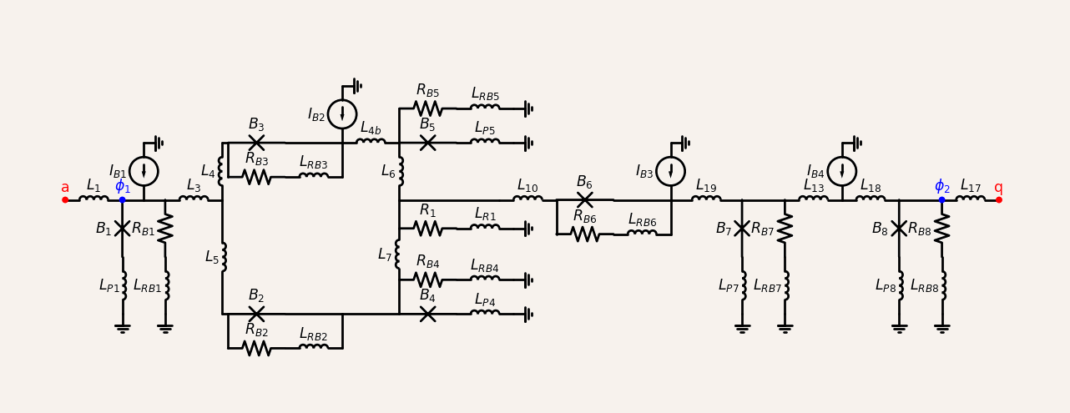
SFQDC Schematic Circuit of ColdFlux Project
Input
Output

