Slide 1
Comparative Study On Distributed Training Strategies

Slide 2
Introduction
Distributed training strategies involve parallelizing machine learning model training across multiple devices or nodes, allowing for more efficient processing of large datasets.
It utilizes data parallelism, model parallelism, or hybrid approaches to distribute the workload.
It efficiently distributes computation tasks to optimize GPU, CPU resources.
Distributed training is crucial for handling large datasets and complex models efficiently.

Slide 3
REAL-WORLD IMPACT AND Its applications
Deep learning models, especially in fields like natural language processing are becoming increasingly complex. Distributed training allows these models to scale across multiple devices or nodes.
Industries such as healthcare, finance often deal with large-scale datasets. Distributed training is vital in these domains for developing accurate predictive models.
In the field of research ,distributed training facilitates global collaboration. Researchers can jointly work on large-scale experiments, share resources, and collectively train models without being limited by geographical constraints.

Slide 4

PROJECT GOAL
Our project has the following goals:
To assess the impact of Without MPI on training efficiency.
Evaluate the training performance using four different strategies: without MPI, with MPI, Mirrored Strategy, and custom data parallelism .

Slide 5

DATASET DESCRIPTION
Fashion-MNIST is a dataset of Zalando's article images, consists of 60,000 training examples and 10,000 test examples.
Each example is a 28x28 grayscale image, associated with a label from 10 classes.
The dataset is designed to serve as a drop-in replacement for the original MNIST dataset, providing a more diverse and challenging set of images for machine learning benchmarks.

Slide 6
WORK PLAN AND PROGRESS
Project Overview: Utilized the Fashion MNIST dataset as the basis for the project. Focused on comparing training times using four different strategies without MPI, with MPI, Mirrored Strategy, and custom data parallelism.
Implementation Progress: Successfully implemented each strategy.
Training and Evaluation: Trained models for each strategy, specifying the number of epochs and other relevant parameters. Evaluated models primarily based on training time.
Results and Findings: Presented results highlighting the training times achieved for each strategy.

Slide 7
1. WITHOUT MPI
In the Without MPI approach, the model is trained without using Message Passing Interface (MPI).
The code follows a sequential training approach. It includes data normalization, model definition, and training without distributing across multiple nodes.
This method may face limitations in scalability when dealing with larger datasets or computationally intensive models due to the absence of parallel processing.

Slide 8
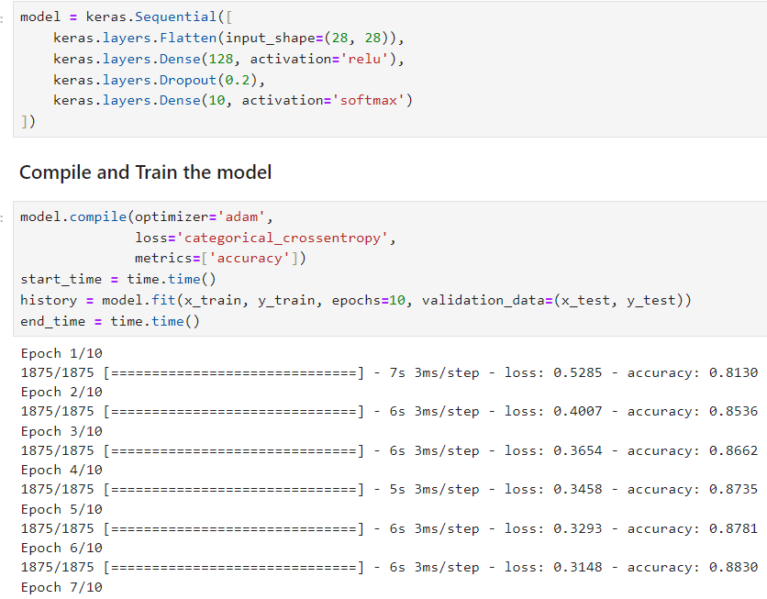
WITHOUT MPI

Slide 9
2. WITH MPI
We utilize MPI for message passing to efficiently distribute the dataset across multiple nodes in a parallelized training setup.
The code incorporates MPI to split both data and labels among nodes, facilitating collaborative training.
Through MPI-based parallelization, the code optimizes resource utilization by distributing the workload among nodes, improving overall efficiency.

Slide 10
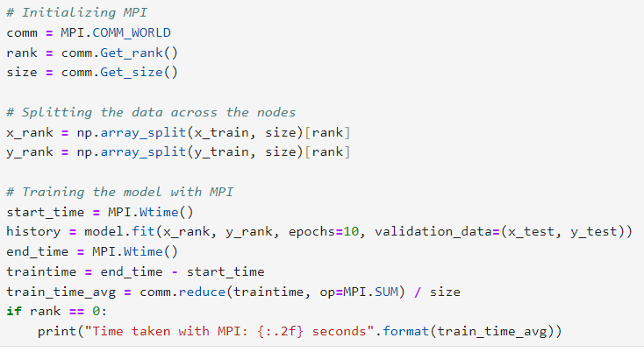
WITH MPI

Slide 11
3. MIRRORED STRATEGY
The Mirrored Strategy is a distribution strategy in TensorFlow designed for synchronous data parallelism.
The strategy involves replicating the entire model on each GPU, and each replica processes a fraction of the input data. After each batch, the gradients are calculated independently on each replica, and then the model's parameters are synchronized across all replicas.

Slide 12
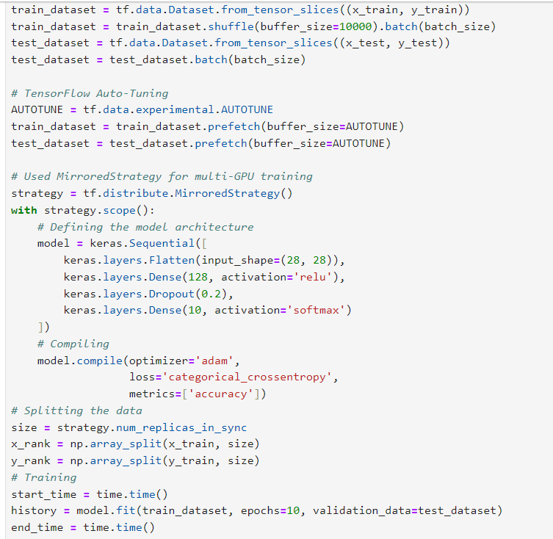
Mirrored strategy

Slide 13
4. Custom data parallelism
Custom Data Parallelism involves manually distributing and training a model across multiple accelerators or devices. TensorFlow's MirroredStrategy is used, and a custom training loop is defined for parallelized training.
The training time is explicitly measured using time stamps before and after the training loop to understand the performance of the custom parallelization approach.
It allows for more flexibility in memory management, enabling efficient use of resources.

Slide 14
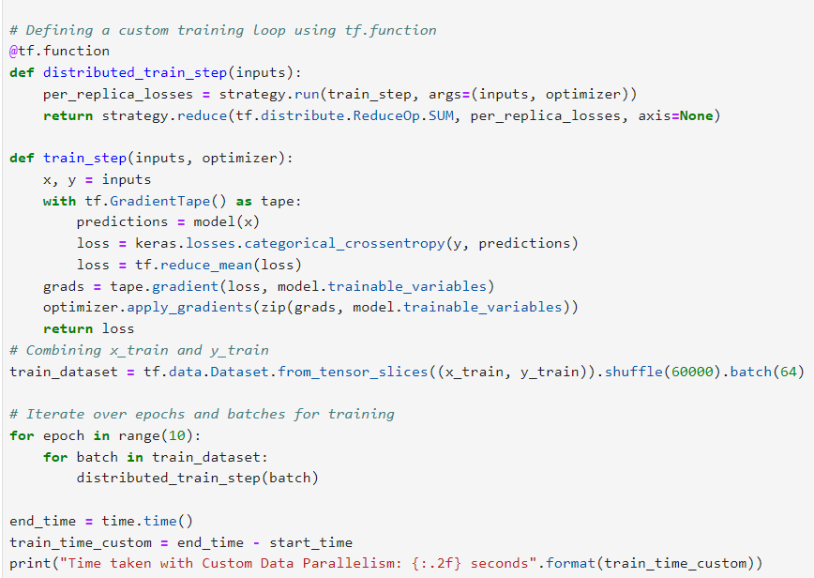
CUSTOM DATA PARALLELISM

Slide 15
RESULTS
Method | Training time(seconds)
Without MPI | 46.18
With MPI | 35.49
Mirrored Strategy | 29.21
Custom data parallelism | 17.46

Slide 16
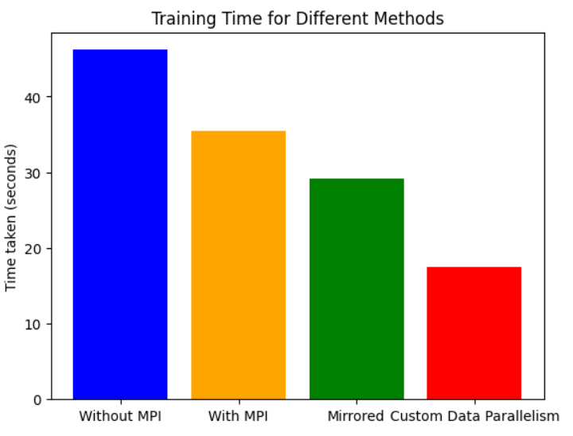
VISUALIZING RESULTS

Slide 17
conclusion
Among the evaluated methods, Custom Data Parallelism demonstrates the most efficient training, with the shortest training time.
Mirrored strategy, designed for synchronous training on multiple GPUs, exhibited good scalability providing a balanced performance.
Comparing MPI and non-MPI approaches, it's evident that utilizing MPI resulted in a reduced training time , indicating the positive impact of message passing for distributed training.
The Fashion MNIST dataset is relatively small, so the difference between the training time of our methods is also very less. With larger datasets, we might see clearer distinctions in training efficiency among the strategies.

Slide 18
References
CNN with Tensorflow|Keras for Fashion MNIST | Kaggle
https://www.tensorflow.org/api_docs/python/tf/distribute/MirroredStrategy
https://www.tensorflow.org/guide/distributed_training
1603.02339v2.pdf (arxiv.org)

Slide 19


