Slide 1
Insights into Global Terrorism
By
Santhoshi Priya Sunchu -02131881

Slide 2

Introduction
Main objective is to identify and understand the evolution of global terrorism trends from 1970 to 2017, using over 180,000 documented incidents.
Utilizing a comprehensive dataset from Kaggle, covering various aspects of terrorism including attack type, location, fatalities, and group involvement.
Employing statistical methods including classification of attacks by severity, trend analysis through scatter plots, and predictive modeling via linear regression.

Slide 3
Dataset Description
Global terrorism database is maintained by organizations like START at the University of Maryland.
It contains over 180,000 instances of terrorist attacks worldwide, spanning from 1970 to 2017.
Each incident is represented by multiple attributes detailing various aspects, including perpetrators, victims, and outcomes.
Some features include Event ID, Date, Year, Month, Longitude, Latitude, Motive, Target type, Weapon type etc.
It serves as a valuable resource for understanding global terrorism patterns, trends, and characteristics, informing policy decisions and counterterrorism efforts.

Slide 4
Data Preprocessing
We have categorized terrorist attacks based on casualty counts into three groups: minor, small, and major.
Using the pd.cut() function, attacks with 0 to 2 casualties are labeled minor, 3 to 10 casualties as small, and over 10 casualties as major. This classification helps understand the severity of attacks for subsequent analysis.
The. dropna() method is employed to remove any rows containing incomplete or missing data.

Slide 5
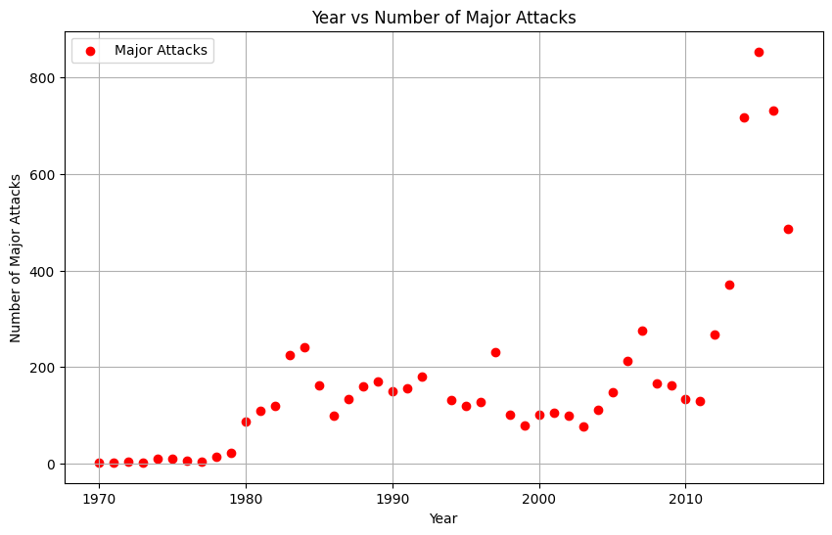
Scatter plot for Major Attacks
Major terrorist attacks saw a significant increase from the 1980s to the early 1990s, marked by numerous attacks in some years.
There was a notable decline in major attacks from the mid-1990s to the early 2000s.
Post-2000, another substantial increase occurred, particularly around the mid-2000s and early 2010s, suggesting fluctuation potentially linked to global events, or terrorist group actions.

Slide 6
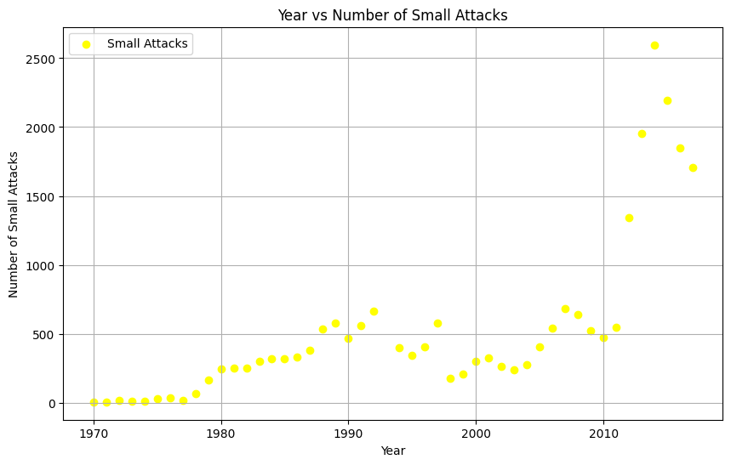
Scatter plot for Small Attacks
Small-scale terrorist attacks showed a gradual increase from the 1970s to the late 1990s, peaking around the mid-1990s.
In the 2000s, there was fluctuation in the number of attacks, with a slight decline towards the late 2000s.
The early 2010s witnessed another noticeable increase in attacks.

Slide 7
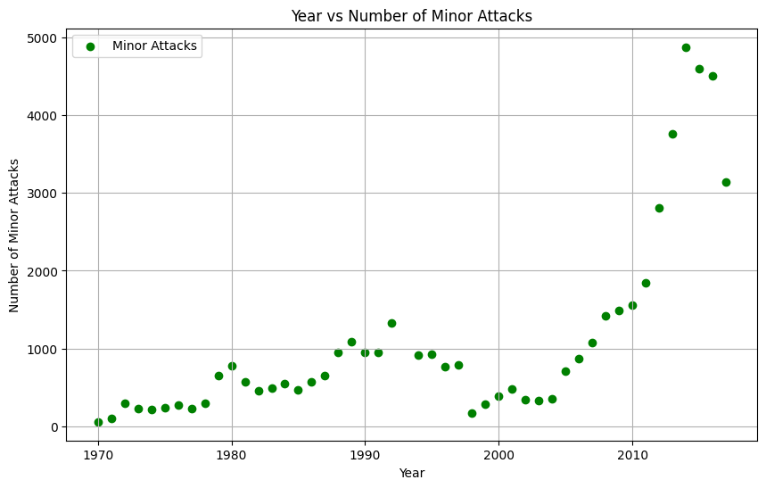
Scatter plot for Minor Attacks
Minor terrorist attacks showed a gradual increase from the 1970s to the late 1990s, although the numbers remained relatively low compared to later years.
Around the early 2000s, there was a slight dip in minor attacks, but from the mid-2000s onwards, there was a significant increase, with sharp spikes in the late 2000s and early 2010s.
This rise in minor attacks might be attributed to changes in tactics or improved reporting methods.

Slide 8
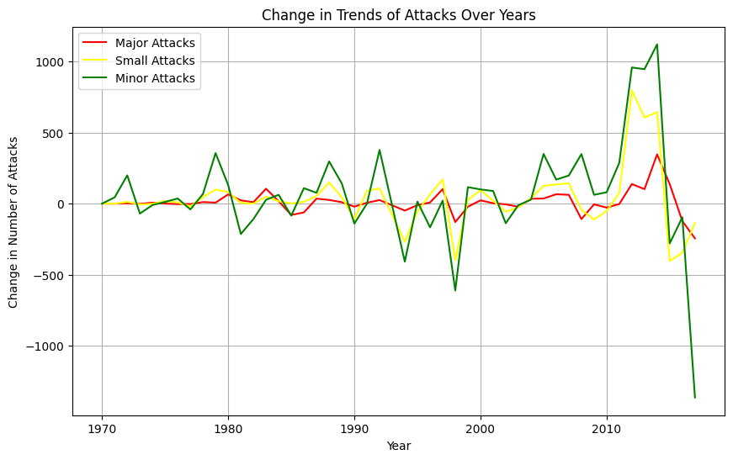
Change in Trends
The graph depicts fluctuations in major, small, and minor terrorist attacks over the years, highlighting significant spikes in major attacks in the mid-1980s, early 2000s, and early 2010s, followed by declines.
Small attacks show moderate fluctuations, with notable increases in the early 1990s and mid-2000s, and a sudden rise and drop in the 2010s.
Minor attacks exhibit gradual changes until the mid-2000s, followed by a steady increase peaking sharply in the 2010s, then a sudden decline.

Slide 9
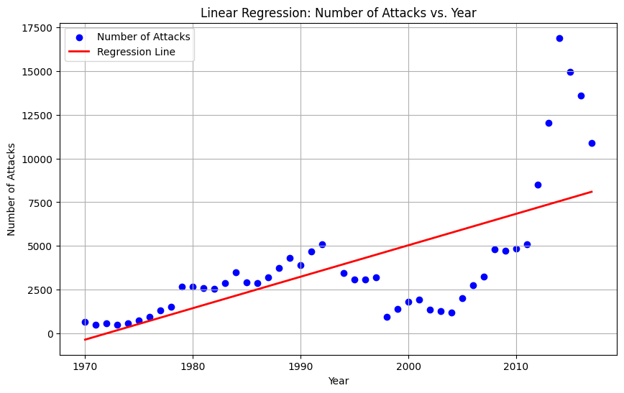
Linear Regression Analysis
The red line represents the linear regression line, indicating the overall trend in the data across the years. It suggests a consistent rise in the number of attacks over the displayed period, reflecting a growing trend.
The coefficient of 180.046 indicates the slope of the regression line, signifying that for each year that passes, there is an average increase of approximately 180.046 attacks.

Slide 10
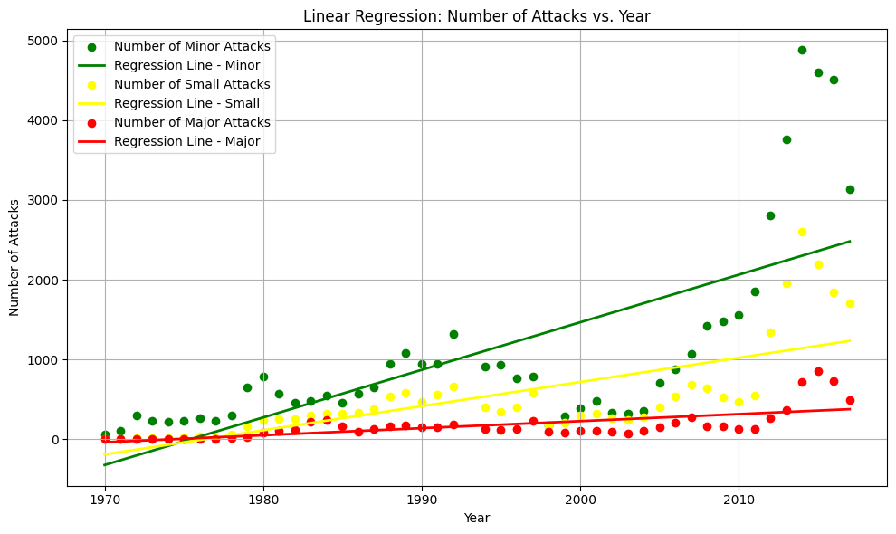
Linear Regression Analysis
Minor attacks demonstrate a consistent upward trend over time, with the regression coefficient indicating an average increase of approximately 59.63 attacks per year.
Small attacks exhibit a steady upward trend. On average, there is an increase of approximately 30.28 small attacks per year.
Major attacks remain relatively stable and low in comparison to the other categories, with a slight upward trend indicated by the regression coefficient of approximately 8.83 attacks per year on average.

Slide 11
Conclusion :
The analysis of the data reveals a concerning trend of increasing terrorist attacks over the decades, particularly evident from the late 1990s onwards.
The observed fluctuations and spikes in terrorist activity indicate the dynamic nature of terrorism.
As evidenced by the regression analysis, the consistent rise in terrorist attacks emphasizes the urgency of collaborative efforts among governments.

Slide 12

12

