Slide 1

MUSIC RECCOMENDATION SYSTEM

Slide 2
AGENDA
Introduction
Dataset Information
Relative Work
Problem Definition
Methodology
Experimental Setting
Results
Future Work and Conclusion

Slide 3
Introduction/BACKGROUND INFORMATION
What is this project about? Creating a music recommendation system using advanced data mining techniques.
Why is this important?
The sheer volume of available music makes it challenging for users to discover tracks that resonate with their preferences.
A personalized recommendation system enhances user engagement and satisfaction by delivering tailored music experiences.
It bridges the gap between user preferences and the overwhelming diversity of musical options available.
What’s the approach? Analyze features like valence, energy, and popularity with cutting-edge algorithms.
How are we doing it? By leveraging Python, tools like Jupyter Notebook, and techniques like clustering and dimensionality reduction.
What’s the impact? Revolutionizing the way users interact with music through data-driven insights.

Slide 4
DATASET INFORMATION
Main Dataset : Contains track-level features, including attributes like valence, energy, danceability, and popularity.
Artist Dataset: Aggregated data for artists with features such as acousticness, tempo, and instrumentalness.
Key Features:
Valence: Measures the musical positivity of a track.
Danceability: Indicates the suitability of a track for dancing based on tempo and rhythm.
Energy: Represents the intensity and activity of a song.
Popularity: Measures the track’s popularity among listeners.
Source: https://www.kaggle.com/datasets/vatsalmavani/spotify-dataset/data

Slide 5
RELATIVE WORK AND ALTERNATIVE APPROACHES
RELATIVE WORK :
Spotify’s Hybrid Model
Combines collaborative filtering, NLP, and audio analysis for personalized recommendations.
Last.fm Collaborative Filtering
Uses user activity and listening habits to suggest tracks based on community-driven insights.
ALTERNATIVE APPROACHES :
Content-Based Filtering
Analyzes track features (e.g., tempo, energy) for personalized but less diverse recommendations.
Deep Learning Models
Extracts audio features with CNNs for advanced and pattern-driven recommendations.
APPROACH USED :
Clustering with K means and Dimensionality Reduction with PCA(Principal Component Analysis) and t-SNE.

Slide 6
Problem Definition
Objective: To design an intelligent music recommendation system leveraging advanced data mining techniques to deliver relevant, tailored music suggestions and enhance user engagement.
Challenges: Overcoming the complexity of diverse user preferences, large datasets, ensuring scalability, and providing real-time analysis.
Goal: Deliver personalized, accurate, and scalable music recommendations that improve user experience globally through innovative algorithms.

Slide 7
PROPOSED METHODOLOGY
Dataset loading and pre-processing
Imported necessary libraries, including pandas, numpy, sklearn, and matplotlib.
Loaded track-level and artist-level datasets for analysis.
Checked and confirmed no missing values in the selected features.
Feature Selection and Normalization
Selected key features such as acousticness, danceability, energy, valence, tempo, and popularity for analysis.
Normalized numerical features using StandardScaler to ensure uniformity.
Analyzed correlations among features and visualized them using a heatmap.
Clustering and Dimensionality Reduction
Applied K-Means clustering to group similar tracks based on musical attributes.
Determined the optimal number of clusters using the Elbow Method.

Slide 8
Iteratively updated cluster centroids until convergence to ensure accurate grouping.
Assigned cluster labels to tracks, identifying groups with distinct musical characteristics.
Ensured scalability and efficiency by fine-tuning the clustering algorithm.
Explored cluster assignments to understand feature patterns and differences between groups.
Visualization and Interpretation
Used Principal Component Analysis (PCA) to reduce dimensionality while retaining essential variance.
Visualized clusters on a 2D plane after dimensionality reduction for better interpretability.
Plotted feature distributions for each cluster to understand their unique attributes.
Developed detailed visualizations of correlations, relationships, and track groupings using Matplotlib.
Enhanced cluster insights by adding color-coded visual representations for clarity.

Slide 9
Proposed solution
Integration of Existing Work
Incorporated techniques like K-Means clustering and PCA, which are widely used in data analysis, to enhance the accuracy and scalability of the system.
Leveraged insights from related works (e.g., Spotify’s hybrid approach) to refine feature selection and clustering strategies.
Adapted standard preprocessing techniques, such as feature scaling and normalization, to improve clustering performance.
Our New Framework
Developed a tailored recommendation pipeline combining clustering results and user preferences to deliver personalized music suggestions.
Integrated advanced visualizations to interpret cluster characteristics and improve system transparency for end users.
Designed a modular architecture for future integration of additional datasets and new features.

Slide 10
K MEANS CLUSTERING
K-Means is an unsupervised machine learning algorithm used for partitioning data into kkk clusters. It aims to group similar data points together while minimizing the variance within each cluster.
The algorithm is iterative and converges to a local minimum.
It works best when the clusters are roughly spherical and evenly sized.
The value of k (number of clusters) needs to be specified in advance.
K-Means is widely used in customer segmentation, market research, image compression, pattern recognition, and recommendation systems.

Slide 11
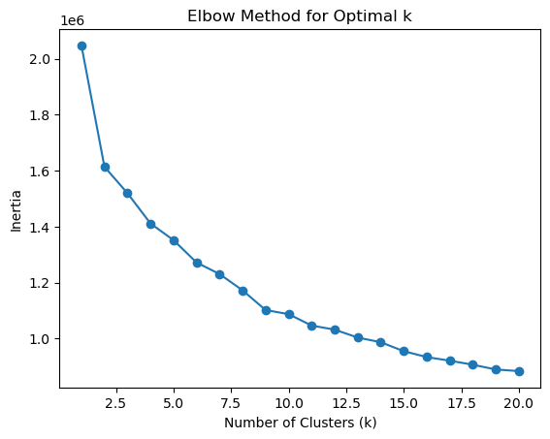
ELBOW METHOD VISUALIZATION
The Elbow Method identifies the optimal number of clusters by analyzing the inertia, which decreases as the number of clusters increases.
The "elbow" point, where the rate of decrease slows significantly, is observed at k = 4, suggesting it as the optimal number of clusters.
Selecting k = 4 ensures a balance between model accuracy and computational efficiency.

Slide 12
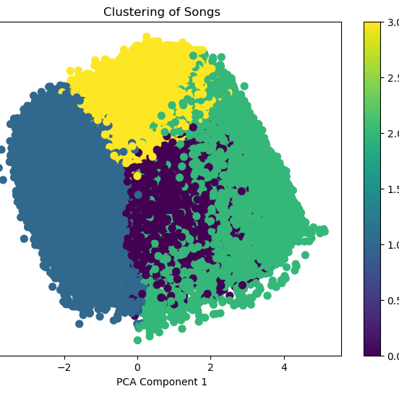
Key Insights from Song Clustering
Demonstrated clustering of songs using numerical features reduced to two dimensions via PCA.
PCA reduces high-dimensional feature space into two components (PCA1 and PCA2) for easier visualization and interpretation.
Different clusters are represented in the scatter plot with distinct colors, showing clear grouping of similar songs.
Highlights separable groups, indicating distinct characteristics among the song clusters based on the selected features.

Slide 13
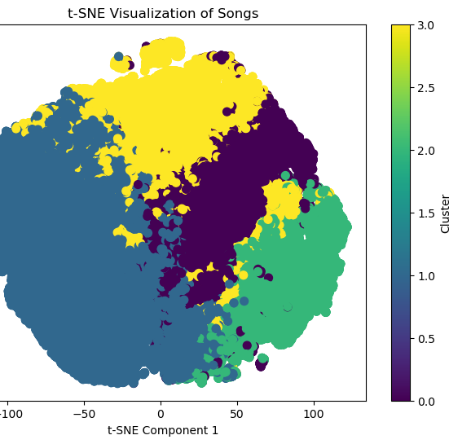
t- SNE Visualizations Highlights
The t-SNE algorithm projects high-dimensional song features into a 2D space while preserving local relationships, enabling better visualization of clusters.
The plot clearly shows distinct clusters using color coding, revealing patterns and groupings in the song data based on feature similarity.
This visualization aids in understanding the structure of the dataset and highlights how songs with similar features are grouped together.
Unlike PCA, t-SNE captures non-linear relationships in the data, making it ideal for visualizing complex structures and uncovering hidden patterns in the song features.

Slide 14
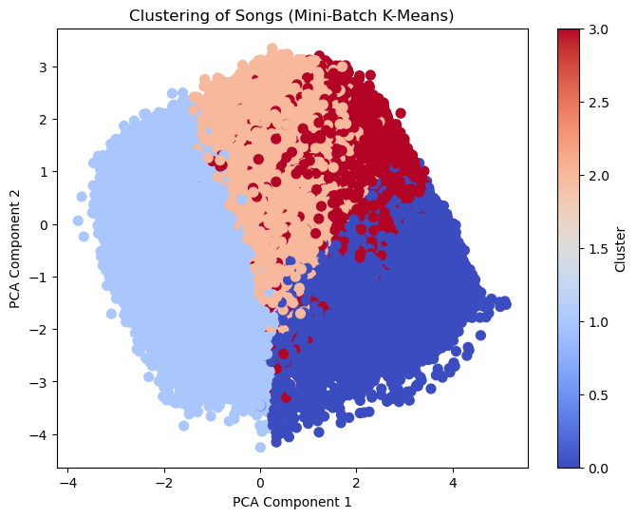
Mini- Batch K-Means Clustering Visualization
The visualization uses Mini-Batch K-Means, which is optimized for large datasets by processing data in smaller batches, ensuring faster and more efficient clustering.
PCA reduces the dataset to two components (PCA1 and PCA2), allowing for a clear and interpretable 2D visualization of clusters.
The clustering performance was evaluated using the Davies-Bouldin Score and Silhouette Score, highlighting the algorithm's effectiveness in grouping similar songs.
The plot showcases four distinct clusters with visually separable boundaries, emphasizing the variation in song features across clusters.

Slide 15

EXPERIMENTAL SETTING
Used two databases: the main dataset with track-level features like valence, energy, and popularity, and the artist dataset with aggregated data such as acousticness and instrumentalness.
Evaluated results using Silhouette Score and Davies-Bouldin Score for clustering quality.
Davies-Bouldin Score : Lower scores indicate better clustering. The Mini-Batch K-Means algorithm achieved a slightly lower score 1.5157 compared to standard K-Means 1.5293, indicating improved compactness and separation of clusters.
Silhouette Score : Measures how well clusters are separated and how cohesive they are. Both algorithms yielded similar scores ~ 0.21 suggesting moderate cluster quality.

Slide 16
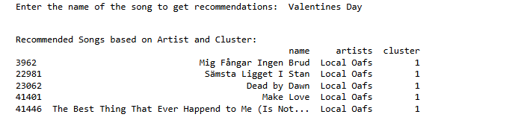
Artist-Based Recommendation System
The function provides song recommendations based on both the artist and the cluster, ensuring the results are tailored to the user's preferences.
Songs are filtered from the same cluster, leveraging clustering algorithms to group similar songs based on features.

Slide 17
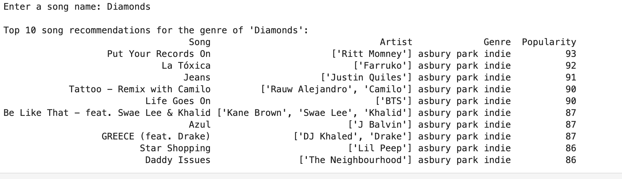
GENRE-Based Recommendation System
Determines the genre of a song by matching its acousticness and tempo with a genre dataset, ensuring precise and relevant genre mapping.
Recommends songs within the identified genre by leveraging audio features and sorting them by popularity to provide users with high-quality and widely-loved options.

Slide 18
Conclusion and Future work
Conclusion : Mini-Batch K-Means effectively clustered the dataset into distinct groups, demonstrating the algorithm's efficiency and suitability for large-scale song data.
The visualization revealed meaningful groupings based on song features, enabling better understanding and segmentation of the dataset.
Future Work : Explore other clustering techniques such as DBSCAN or hierarchical clustering to compare results and identify non-linear patterns.
Enhance the dataset by incorporating additional features like tempo, lyrics sentiment, or genre tags to improve clustering accuracy and relevance.

