Slide 1
Comparative Analysis of Predictive Models in Wine Quality Assessment
By
Santhoshi Priya Sunchu -02131881

Slide 2
Introduction
Objective: To evaluate the effectiveness of various machine learning models, including Logistic Regression, Support Vector Machines (SVM), and Neural Networks, in accurately predicting the quality of wine. This evaluation is based on physicochemical properties such as acidity, sugar content, and alcohol level, among others.
By applying these models to the widely recognized Wine Quality Dataset, we aim to identify which model best predicts wine quality. This involves preprocessing the data, handling imbalanced classes with techniques like SMOTE, scaling features for optimum performance, and assessing each model's accuracy, precision, recall, and F1 score.
In the wine industry, quality control is paramount. Accurately predicting wine quality before reaching consumers can significantly enhance a vintner's ability to ensure only the best products go to market. This predictive capability allows for adjustments in the winemaking process to optimize the quality of the output.

Slide 3
Dataset Description
The Wine Quality Dataset available on Kaggle is a popular dataset that contains the physicochemical properties of red and white variants of Portuguese wine.
There are a total of 6497 instances in the dataset.
The dataset contains 12 input features, including fixed acidity, volatile acidity, citric acid, residual sugar, chlorides, free sulfur dioxide, total sulfur dioxide, density, pH, sulfates, alcohol, and type of wine (red or white).
Each instance is associated with a quality rating, scored between 0 and 10, indicating the quality of the wine.

Slide 4
Data Preprocessing
Data Loading and Splitting the Data:
Using pandas, the Wine Quality dataset was loaded from a CSV file (WineQT.csv).
This dataset doesnot contain any missing values.
The 'Id' column was removed using data.drop(columns='Id', inplace=True). This step cleans the dataset by eliminating columns that do not contribute to the analysis, such as identifiers that have no predictive power.
Splitting Data: The dataset was split into training and testing sets using train_test_split, with 80% of the data allocated for training and 20% reserved for testing.

Slide 5

Methods Used:
Logistic Regression
Neural Networks
Support Vector Machine

Slide 6
Logistic Regression:
Logistic regression is a statistical method used for binary classification, where the target variable is categorical with two levels. It predicts the probability of occurrence of an event by fitting data to a logistic function. In the context of your program, logistic regression is applied to predict the quality of wine based on various features such as acidity, alcohol content, etc
The dataset is loaded using pandas and visualized using histograms to understand the distribution of features.
A heatmap is plotted to visualize the correlation between different features
The 'Id' column is dropped as it's not relevant for modeling and the data is split into features (X) and target (y).

Slide 7
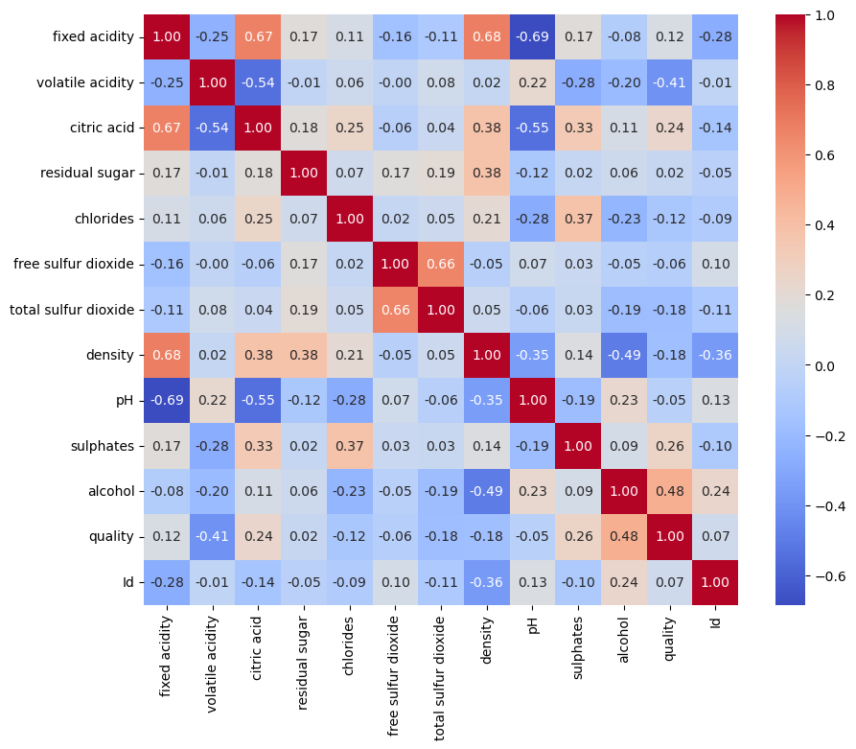
Logistic Regression :
Strong Positive Correlation Between Alcohol and Quality
Notably strong negative correlation (-0.69) between fixed acidity and pH.
Sulphates and alcohol show a positive correlation with quality but not as strong with each other
Correlations help in identifying features that might be redundant or highly predictive. For instance, since alcohol has a strong positive correlation with quality, it could be a key feature in your predictive models.
Understanding which features are strongly correlated helps in simplifying models by removing multicollinearity, which can improve the model’s performance and interpretability.

Slide 8
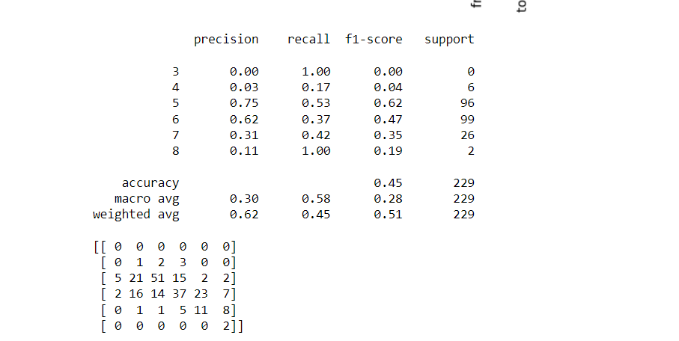
Logistic Regression
The overall accuracy in this report is 0.45, which means the model correctly predicted 45% of the instances in the dataset

Slide 9
Neural Networks:
A neural network is a computational model inspired by the structure and functioning of the human brain. It consists of interconnected nodes, called neurons, organized in layers. Each neuron receives input signals, processes them using an activation function, and passes the result to the next layer. Neural networks are trained using large datasets to learn complex patterns and relationships between inputs and outputs.
In our program, a neural network is a machine learning model designed to predict the quality of wine based on chemical properties
We specified the test size parameter to allocate 20% of the data for testing, leaving the remaining 80% for training.
We set the random state parameter to 42 for reproducibility, ensuring that the split is consistent across runs.

Slide 10
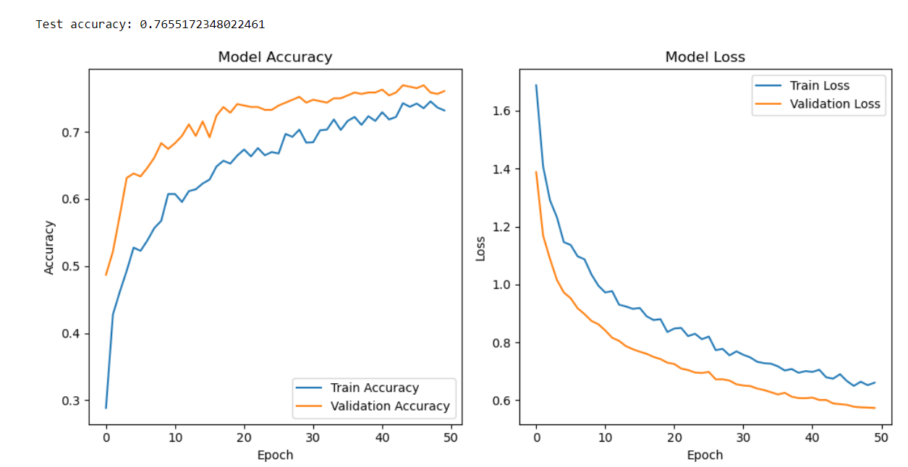
Results:
Achieved a test accuracy of 76.55%, indicating the model's ability to accurately predict wine quality.
Loss value of 0.5709 on the test set reflects the overall model performance.

Slide 11
Support Vector Machine (SVM):
SVM is a supervised learning algorithm used for classification tasks. It aims to find the hyperplane that best separates data points of different classes in a high-dimensional feature space. In this implementation, a linear kernel SVM is utilized.
The SVM model demonstrates moderate performance in predicting wine quality. While it achieves high precision and recall for some classes (e.g., class 0), it exhibits lower performance for others. Further model refinement or exploration of alternative algorithms may be warranted to improve overall accuracy and generalization to unseen data.
The accuracy of the SVM model on the test set is approximately 64.48%. This indicates that the model correctly predicts the quality of wine about 64.48% of the time.

Slide 12
Conclusion :
Among the tested methods, Neural Network exhibited the highest accuracy in predicting wine quality. This highlights the effectiveness of deep learning approaches in capturing complex relationships within the dataset.
Model Suitability: Our findings underscore the importance of selecting appropriate models tailored to the dataset characteristics.
While traditional methods like Logistic Regression provide valuable insights, the superior accuracy achieved by Neural Network suggests its suitability for intricate classification tasks.
Future Considerations:
Moving forward, further exploration could involve fine-tuning the neural network architecture, exploring ensemble methods, or incorporating advanced feature engineering techniques to enhance predictive performance and gain deeper insights into wine quality prediction.

Slide 13
Comparison of Method Accuracy
Methods | Accuracy
Logistic Regression | 0.65
Neural Network | 0.76
Support Vector Machine | 0.64

Slide 14

14

