Slide 1
verilog HDL로
DC motor PWM제어
디지털 회로설계
June 19,2025
by SIKWON

Slide 2
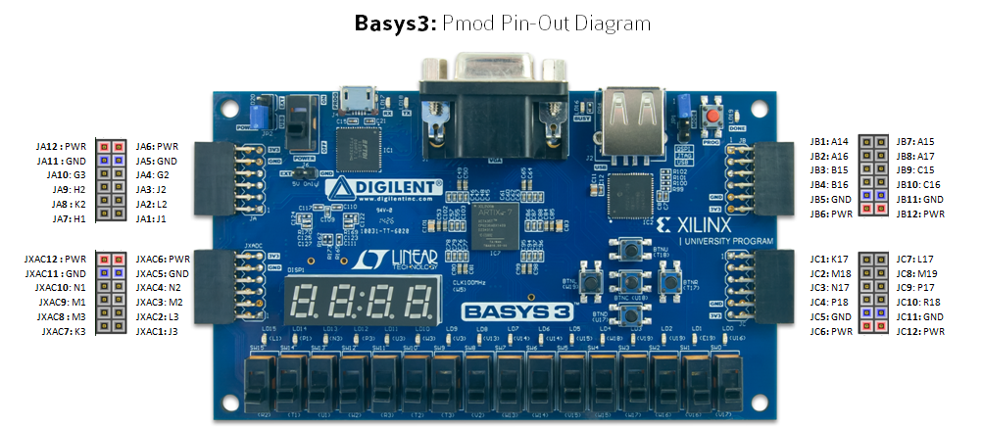
basys3 pmod 포트

Slide 3
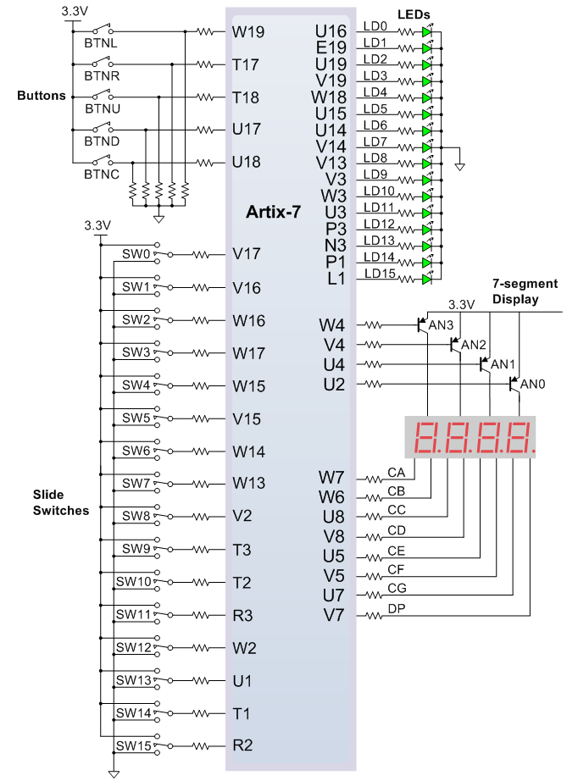
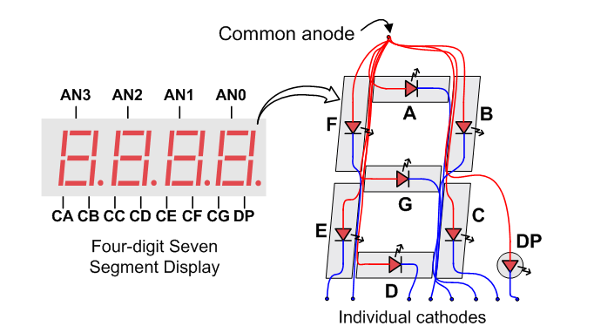
basys3 pmod 포트

Slide 4
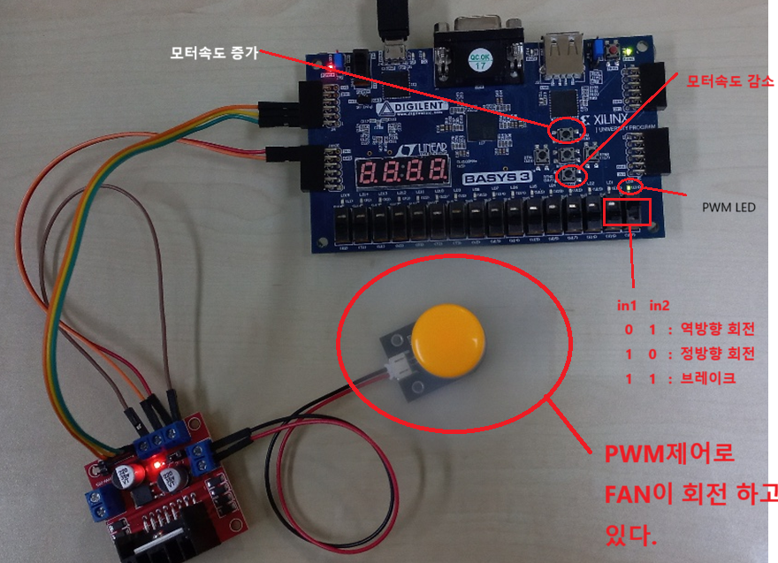
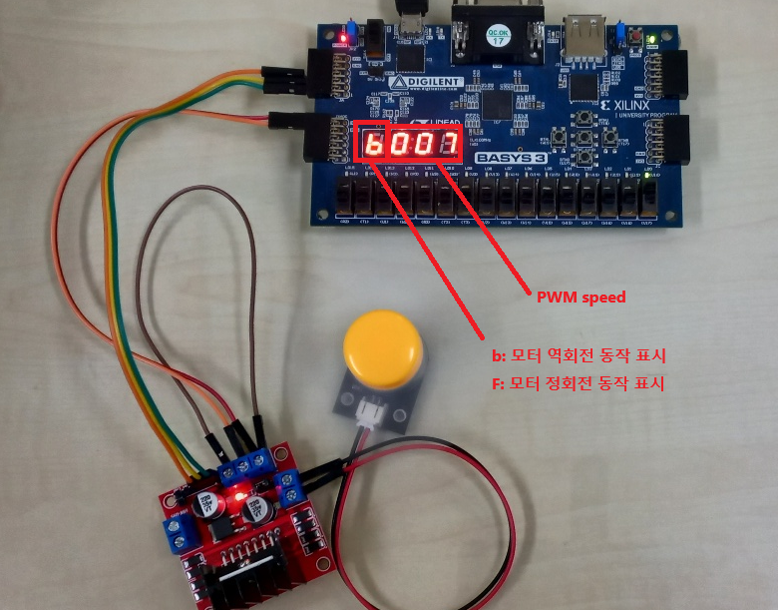
DC Motor PWM control

Slide 5
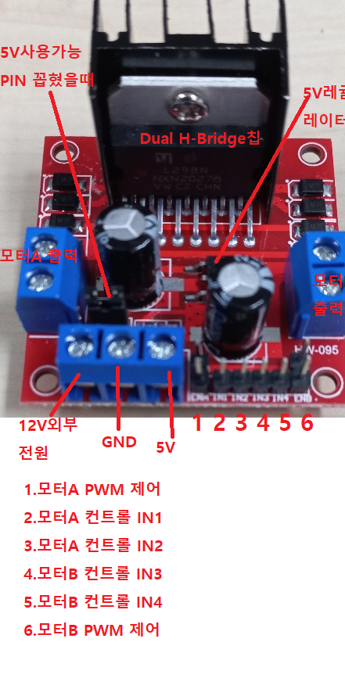
DC Motor PWM control

Slide 6
pwm_dcmotor.v
module pwm_dcmotor (
input clk, // 100MHz clock input
input increase_duty_btn, // input to increase 10% duty cycle
input decrease_duty_btn, // input to decrease 10% duty cycle
input [1:0] motor_direction, // sw0 sw1 : motor direction
output PWM_OUT, // 10MHz PWM output signal
output PWM_OUT_LED,
output [1:0] in1_in2, // motor direction switch sw[0] sw[1]
output [3:0] an, // anode signals of the 7-segment LED display
output [6:0] seg, // cathode patterns of the 7-segment LED display
output dp
/*
in1 in2
0 1 : 역방향 회전
1 0 : 정방향 회전
1 1 : 브레이크
*/
);
wire w_debounced_inc_btn;
wire w_debounced_dec_btn;
wire [3:0] w_DUTY_CYCLE;
debounce_pushbutton u_debounce_pushbutton (
.clk(clk), // 100MHz clock input
.increase_duty_btn(increase_duty_btn), // input to increase 10% duty cycle
.decrease_duty_btn(decrease_duty_btn), // input to decrease 10% duty cycle
.debounced_inc_btn(w_debounced_inc_btn), // debounce inc button
.debounced_dec_btn(w_debounced_dec_btn)
);
pwm_duty_cycle_control u_pwm_duty_cycle_control (
.clk(clk),
.duty_inc(w_debounced_inc_btn),
.duty_dec(w_debounced_dec_btn),
.DUTY_CYCLE(w_DUTY_CYCLE),
.PWM_OUT(PWM_OUT), // 10MHz PWM output signal
.PWM_OUT_LED(PWM_OUT_LED)
);
fnd_display u_fnd_display (
.clock_100Mhz(clk),
.in1_in2(in1_in2),
.display_number(w_DUTY_CYCLE),
.an(an),
.seg(seg),
.dp(dp)
);
assign in1_in2 = motor_direction;
endmodule

Slide 7
debounce_pushbutton.v
`timescale 1ns / 1ps
//----------------- debounce_pushbutton -----------------
module debounce_pushbutton (
input clk, // 100MHz clock input
input increase_duty_btn, // input to increase 10% duty cycle
input decrease_duty_btn, // input to decrease 10% duty cycle
output debounced_inc_btn, // debounce inc button
output debounced_dec_btn
);
wire w_clk4hz_enable; // slow clock enable signal for debouncing FFs
reg[27:0] r_counter_debounce=0; // counter for creating slow clock enable signals
wire w_Q1_DFF1, w_Q2_DFF2;
wire w_Q1_DFF3, w_Q2_DFF4;
reg[1:0] r_motor_dir;
// Debouncing 2 buttons for inc/dec duty cycle
// Firstly generate slow clock enable for debouncing flip-flop (4Hz)
always @(posedge clk)
begin
r_counter_debounce <= r_counter_debounce + 1;
if (r_counter_debounce >= 25000000)
r_counter_debounce <= 0;
end
// 0.00000001sec(10ns) x 25000000 = 0.25sec(250ms)
// 250ms가 되면 4Hz의 1주기를 나타내는 w_clk4hz_enable이 1로 set하여
// DFF의 4Hz clock이 동작 되도록 한다.
assign w_clk4hz_enable = r_counter_debounce == 25000000 ? 1:0;
DFF u_PWM_DFF1(clk,w_clk4hz_enable,increase_duty_btn,w_Q1_DFF1);
DFF u_DFF2(clk,w_clk4hz_enable,w_Q1_DFF1, w_Q2_DFF2);
assign debounced_inc_btn = w_Q1_DFF1 & (~w_Q2_DFF2) & w_clk4hz_enable;
// debouncing FFs for decreasing button
DFF u_DFF3(clk, w_clk4hz_enable, decrease_duty_btn, w_Q1_DFF3);
DFF u_DFF4(clk, w_clk4hz_enable, w_Q1_DFF3, w_Q2_DFF4);
// button의 debounce를 위해서 첫번째 DFF의 출력 w_Q1_DFF3(Q1)
//두번째 DFF의 출력 w_Q2_DFF4(Q2바) 를 and 해서
// debounce 처리된 1(debounced_inc_btn, debounced_dec_btn)이 나온다.
assign debounced_dec_btn = w_Q1_DFF3 & (~w_Q2_DFF4) & w_clk4hz_enable;
// vary the duty cycle using the debounced buttons above
endmodule

Slide 8
pwm_duty_cycle_control.v
`timescale 1ns / 1ps
//----------------- pwm_duty_cycle_control ---------------------
module pwm_duty_cycle_control (
input clk,
input duty_inc,
input duty_dec,
output [3:0] DUTY_CYCLE,
output PWM_OUT, // 10MHz PWM output signal
output PWM_OUT_LED
);
reg[3:0] r_DUTY_CYCLE=5; // initial duty cycle is 50%
reg[3:0] r_counter_PWM=0; // counter for creating 10Mhz PWM signal
always @(posedge clk)
begin
if (duty_inc==1 && r_DUTY_CYCLE <= 9)
r_DUTY_CYCLE <= r_DUTY_CYCLE + 1; // increase duty cycle by 10%
else if(duty_dec==1 && r_DUTY_CYCLE >= 1)
r_DUTY_CYCLE <= r_DUTY_CYCLE - 1; //decrease duty cycle by 10%
end
// Create 10MHz PWM signal with variable duty cycle controlled by 2 buttons
// DC로 10MHz PWM 신호를 보내도록 한다.
// default r_DUTY_CYCLE은 50%로 설정 r_counter_PWM는 10ns(1/100MHz) 마다 10%씩 증가
always @(posedge clk)
begin
r_counter_PWM <= r_counter_PWM + 1;
if (r_counter_PWM >= 9)
r_counter_PWM <= 0;
end
assign PWM_OUT = r_counter_PWM < r_DUTY_CYCLE ? 1:0;
assign PWM_OUT_LED = PWM_OUT;
assign DUTY_CYCLE = r_DUTY_CYCLE;
endmodule

Slide 9
fnd_display.v
`timescale 1ns / 1ps
module fnd_display(
input clock_100Mhz, // 100 Mhz clock source on Basys 3 FPGA
input [1:0] in1_in2, // motor direction switch sw[0] sw[1]
input [3:0] display_number,
output [3:0] an, // anode signals of the 7-segment LED display
output [6:0] seg, // cathode patterns of the 7-segment LED display
output dp
);
parameter T250_MS = 25000000;
parameter T500_MS = 50000000;
parameter FORWARD = 4'b1010; // f
parameter BACKWARD = 4'b1011; // b
reg [3:0] LED_BCD;
reg [26:0] fnd_toggle_counter;
reg dis_mode = 1'b1;
reg [19:0] refresh_counter; // 20-bit for creating 10.5ms refresh period or 380Hz refresh rate
// the first 2 MSB bits for creating 4 LED-activating signals with 2.6ms digit period
// bin 0011 1111 1111 1111 1111 <---> dec 262143
// org wire [1:0] LED_activating_counter;
reg [1:0] LED_activating_counter;
// count 0 -> 1 -> 2 -> 3
// activates LED1 LED2 LED3 LED4
// and repeat
always @(posedge clock_100Mhz)
begin
refresh_counter <= refresh_counter + 1;
if (fnd_toggle_counter >= 99_999_999) begin
fnd_toggle_counter <= 0;
dis_mode <= ~dis_mode;
end else
fnd_toggle_counter <= fnd_toggle_counter + 1;
end
// org assign LED_activating_counter = refresh_counter[19:18];
// anode activating signals for 4 LEDs, digit period of 2.6ms
// decoder to generate anode signals
reg dp_toggle = 1'b0; // toggle per every 1 sec
reg r_dp;
reg [3:0] r_an;
assign an = r_an;

Slide 10
fnd_display.v
`timescale 1ns / 1ps
module fnd_display(
input clock_100Mhz, // 100 Mhz clock source on Basys 3 FPGA
input [1:0] in1_in2, // motor direction switch sw[0] sw[1]
input [3:0] display_number,
output [3:0] an, // anode signals of the 7-segment LED display
output [6:0] seg, // cathode patterns of the 7-segment LED display
output dp
);
parameter T250_MS = 25000000;
parameter T500_MS = 50000000;
parameter FORWARD = 4'b1010; // f
parameter BACKWARD = 4'b1011; // b
reg [3:0] LED_BCD;
reg [26:0] fnd_toggle_counter;
reg dis_mode = 1'b1;
reg [19:0] refresh_counter; // 20-bit for creating 10.5ms refresh period or 380Hz refresh rate
// the first 2 MSB bits for creating 4 LED-activating signals with 2.6ms digit period
// bin 0011 1111 1111 1111 1111 <---> dec 262143
// org wire [1:0] LED_activating_counter;
reg [1:0] LED_activating_counter;
// count 0 -> 1 -> 2 -> 3
// activates LED1 LED2 LED3 LED4
// and repeat
always @(posedge clock_100Mhz)
begin
refresh_counter <= refresh_counter + 1;
if (fnd_toggle_counter >= 99_999_999) begin
fnd_toggle_counter <= 0;
dis_mode <= ~dis_mode;
end else
fnd_toggle_counter <= fnd_toggle_counter + 1;
end
// org assign LED_activating_counter = refresh_counter[19:18];
// anode activating signals for 4 LEDs, digit period of 2.6ms
// decoder to generate anode signals
reg dp_toggle = 1'b0; // toggle per every 1 sec
reg r_dp;
reg [3:0] r_an;
assign an = r_an;

Slide 11
fnd_display.v
always @(*)
begin
// org case(LED_activating_counter)
case(refresh_counter[19:18])
2'b00: begin
r_an <= 4'b0111;
// activate LED1 and Deactivate LED2, LED3, LED4
// LED_BCD <= display_number/1000;
if (dis_mode == 1'b1) begin
if (in1_in2 == 2'b10)
LED_BCD <= FORWARD;
else if (in1_in2 == 2'b01)
LED_BCD <= BACKWARD;
else LED_BCD <= 0;
end
else r_an <= 4'b1111; // 1'st digit off
r_dp <= 1;
// the first digit of the 16-bit number
end
2'b01: begin
r_an <= 4'b1011;
// activate LED2 and Deactivate LED1, LED3, LED4
LED_BCD = (display_number % 1000)/100;
// the second digit of the 16-bit number
// r_dp <= dp_toggle; // dp toggle every 1 sec
r_dp <= 1;
end
2'b10: begin
r_an <= 4'b1101;
// activate LED3 and Deactivate LED2, LED1, LED4
LED_BCD <= ((display_number % 1000)%100)/10;
// the third digit of the 16-bit number
r_dp <= 1;
end
2'b11: begin
r_an <= 4'b1110;
// activate LED4 and Deactivate LED2, LED3, LED1
LED_BCD <= ((display_number % 1000)%100)%10;
// the fourth digit of the 16-bit number
r_dp <= 1;
end
endcase
end
reg [6:0] r_fnd_dis;
assign seg = r_fnd_dis;
// assign dp = r_dp;

Slide 12
fnd_display.v
// Cathode patterns of the 7-segment LED display
always @(*)
begin
case(LED_BCD)
4'b0000: r_fnd_dis <= 7'b0000001; // "0"
4'b0001: r_fnd_dis <= 7'b1001111; // "1"
4'b0010: r_fnd_dis <= 7'b0010010; // "2"
4'b0011: r_fnd_dis <= 7'b0000110; // "3"
4'b0100: r_fnd_dis <= 7'b1001100; // "4"
4'b0101: r_fnd_dis <= 7'b0100100; // "5"
4'b0110: r_fnd_dis <= 7'b0100000; // "6"
4'b0111: r_fnd_dis <= 7'b0001111; // "7"
4'b1000: r_fnd_dis <= 7'b0000000; // "8"
4'b1001: r_fnd_dis <= 7'b0000100; // "9"
4'b1010: r_fnd_dis <= 7'b0111000; // "f"
4'b1011: r_fnd_dis <= 7'b1100000; // "b"
default: r_fnd_dis <= 7'b0000001; // "0"
endcase
end
endmodule

Slide 13
dff.v
`timescale 1ns / 1ps
//------------------- DFF -----------------------
// Debouncing DFFs for push buttons on FPGA
// 4Hz 주파수의 1주기가 250ms 100MHz/4 --> 25,000,000cycle을 count하면
// w_clk4hz_enable이 1로 set되어 en이 1로 mapping 된다.
module DFF (
input clk,
input en,
input D,
output reg Q
);
always @(posedge clk)
begin
if (en == 1) // slow clock enable signal
Q <= D;
end
endmodule

Slide 14
constraints file
## This file is a general .xdc for the Basys3 rev B board
## To use it in a project:
## - uncomment the lines corresponding to used pins
## - rename the used ports (in each line, after get_ports) according to the top level signal names in the project
## Clock signal
set_property -dict { PACKAGE_PIN W5 IOSTANDARD LVCMOS33 } [get_ports clk]
create_clock -add -name sys_clk_pin -period 10.00 -waveform {0 5} [get_ports clk]
## Switches
set_property -dict { PACKAGE_PIN V17 IOSTANDARD LVCMOS33 } [get_ports {motor_direction[0]}]
set_property -dict { PACKAGE_PIN V16 IOSTANDARD LVCMOS33 } [get_ports {motor_direction[1]}]
## LEDs
set_property -dict { PACKAGE_PIN U16 IOSTANDARD LVCMOS33 } [get_ports PWM_OUT_LED ]
##7 Segment Display
set_property -dict { PACKAGE_PIN W7 IOSTANDARD LVCMOS33 } [get_ports {seg[6]}]
set_property -dict { PACKAGE_PIN W6 IOSTANDARD LVCMOS33 } [get_ports {seg[5]}]
set_property -dict { PACKAGE_PIN U8 IOSTANDARD LVCMOS33 } [get_ports {seg[4]}]
set_property -dict { PACKAGE_PIN V8 IOSTANDARD LVCMOS33 } [get_ports {seg[3]}]
set_property -dict { PACKAGE_PIN U5 IOSTANDARD LVCMOS33 } [get_ports {seg[2]}]
set_property -dict { PACKAGE_PIN V5 IOSTANDARD LVCMOS33 } [get_ports {seg[1]}]
set_property -dict { PACKAGE_PIN U7 IOSTANDARD LVCMOS33 } [get_ports {seg[0]}]
set_property -dict { PACKAGE_PIN V7 IOSTANDARD LVCMOS33 } [get_ports dp]
set_property -dict { PACKAGE_PIN U2 IOSTANDARD LVCMOS33 } [get_ports {an[0]}]
set_property -dict { PACKAGE_PIN U4 IOSTANDARD LVCMOS33 } [get_ports {an[1]}]
set_property -dict { PACKAGE_PIN V4 IOSTANDARD LVCMOS33 } [get_ports {an[2]}]
set_property -dict { PACKAGE_PIN W4 IOSTANDARD LVCMOS33 } [get_ports {an[3]}]

Slide 15
constraints file
##Buttons
#set_property -dict { PACKAGE_PIN U18 IOSTANDARD LVCMOS33 } [get_ports btnC]
#set_property -dict { PACKAGE_PIN T18 IOSTANDARD LVCMOS33 } [get_ports btnU]
set_property -dict { PACKAGE_PIN T18 IOSTANDARD LVCMOS33 } [get_ports increase_duty_btn]
#set_property -dict { PACKAGE_PIN W19 IOSTANDARD LVCMOS33 } [get_ports btnL]
#set_property -dict { PACKAGE_PIN T17 IOSTANDARD LVCMOS33 } [get_ports btnR]
#set_property -dict { PACKAGE_PIN U17 IOSTANDARD LVCMOS33 } [get_ports btnD]
set_property -dict { PACKAGE_PIN U17 IOSTANDARD LVCMOS33 } [get_ports decrease_duty_btn]
##Pmod Header JA
set_property -dict { PACKAGE_PIN J1 IOSTANDARD LVCMOS33 } [get_ports {PWM_OUT}]; #Sch name = JA1
set_property -dict { PACKAGE_PIN L2 IOSTANDARD LVCMOS33 } [get_ports {in1_in2[0]}]; #Sch name = JA2
set_property -dict { PACKAGE_PIN J2 IOSTANDARD LVCMOS33 } [get_ports {in1_in2[1]}]; #Sch name = JA3
#set_property -dict { PACKAGE_PIN G2 IOSTANDARD LVCMOS33 } [get_ports {JA[3]}];#Sch name = JA4
#set_property -dict { PACKAGE_PIN H1 IOSTANDARD LVCMOS33 } [get_ports {JA[4]}];#Sch name = JA7
#set_property -dict { PACKAGE_PIN K2 IOSTANDARD LVCMOS33 } [get_ports {JA[5]}];#Sch name = JA8
#set_property -dict { PACKAGE_PIN H2 IOSTANDARD LVCMOS33 } [get_ports {JA[6]}];#Sch name = JA9
#set_property -dict { PACKAGE_PIN G3 IOSTANDARD LVCMOS33 } [get_ports {JA[7]}];#Sch name = JA10
## Configuration options, can be used for all designs
set_property CONFIG_VOLTAGE 3.3 [current_design]
set_property CFGBVS VCCO [current_design]
## SPI configuration mode options for QSPI boot, can be used for all designs
set_property BITSTREAM.GENERAL.COMPRESS TRUE [current_design]
set_property BITSTREAM.CONFIG.CONFIGRATE 33 [current_design]
set_property CONFIG_MODE SPIx4 [current_design]

