Slide 1
button debounce
Dec 17,2024
by SIKWON

Slide 2
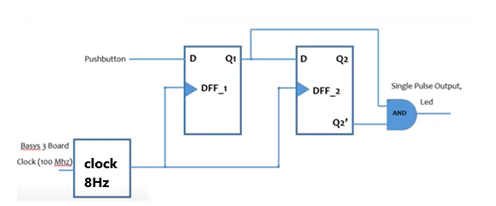
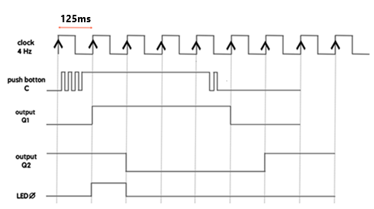
FPGA의 버튼을 누를 때 단일 펄스만 생성하도록 Verilog에
간단한 디바운싱 회로를 구현.
FPGA 의 버튼을 눌렀다 놓으면 푸시 버튼 신호에서 예기치 않은 위아래 바운스가
많이 발생. 디바운싱 회로는 예상대로 바운싱 없이 clock 기간을 가진
단일 pulse만 생성
FPGA의 버튼에 대한 디바운싱 회로
100Mhz 🡪 8Hz
100M
------ = 12,500,000 cycles
8
12,500,000
------------ = 6,250,000 (10us * 62500개)
2
디바운싱 회로의 예상 파형

Slide 3
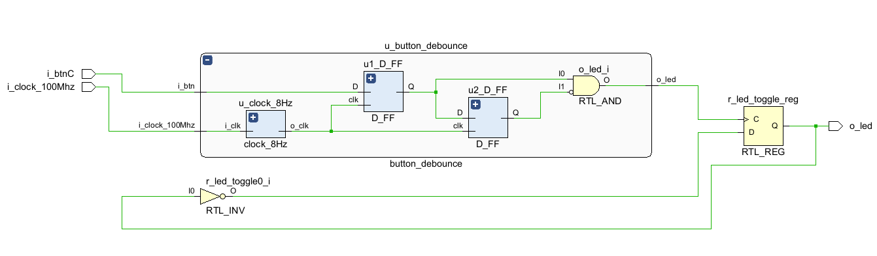
ELABORATED DESIGN Schematic
아래는 btnC를 1번 눌렀다 떼면 led가 on <--> off toggle

Slide 4
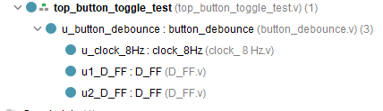
verilog code
`timescale 1ns / 1ps
module button_debounce(
input i_btn,
input i_clock_100Mhz,
output o_led
);
wire w_out_clk;
wire w_Q1, w_Q2, w_Q2_bar;
clock_8Hz u_clock_8Hz(
.i_clk(i_clock_100Mhz),
.o_clk(w_out_clk)
);
D_FF u1_D_FF(
.clk(w_out_clk),
.D(i_btn),
.Q(w_Q1)
);
D_FF u2_D_FF(
.clk(w_out_clk),
.D(w_Q1),
.Q(w_Q2)
);
assign w_Q2_bar = ~w_Q2;
assign o_led = w_Q1 & w_Q2_bar;
endmodule
`timescale 1ns / 1ps
module clock_8Hz(
input i_clk, // input clock of the basys3 output reg o_clk // 8Hz clock
);
reg [25:0] i_count=0;
always @(posedge i_clk)
begin
i_count <= i_count + 1;
if (i_count == 62_500) // 8Hz 125000/2 -> 62500
begin
i_count <= 0;
o_clk = ~o_clk;
end
end
endmodule
`timescale 1ns / 1ps
`timescale 1ns / 1ps
module top_button_toggle_test (
input i_btnC,
input i_clock_100Mhz,
output o_led
);
wire w_clock_8Hz;
wire w_btn_debounce;
reg r_led_toggle = 1'b0;
button_debounce u_button_debounce (
.i_btn(i_btnC),
.i_clock_100Mhz(i_clock_100Mhz),
.o_led(w_btn_debounce)
);
always @(posedge w_btn_debounce)
begin
r_led_toggle <= ~r_led_toggle;
end
assign o_led = (r_led_toggle == 1) ? 1'b1 : 1'b0;
endmodule
< clock_8Hz.v >
button_debounce.v
top_button_toggle_test.v

Slide 5
verilog code
`timescale 1ns / 1ps
module D_FF(
input clk,
input D,
output reg Q,
output reg Qbar
);
always @ (posedge clk)
begin
Q <= D;
Qbar <= !Q;
end
endmodule
D_FF.V

Slide 6
Basys3-Master_orginal.xdc
## This file is a general .xdc for the Basys3 rev B board
## To use it in a project:
## - uncomment the lines corresponding to used pins
## - rename the used ports (in each line, after get_ports) according to the top level signal names in the project
## Clock signal
set_property -dict { PACKAGE_PIN W5 IOSTANDARD LVCMOS33 } [get_ports i_clock_100Mhz]
create_clock -add -name sys_clk_pin -period 10.00 -waveform {0 5} [get_ports i_clock_100Mhz]
## LEDs
set_property -dict { PACKAGE_PIN U16 IOSTANDARD LVCMOS33 } [get_ports {o_led}]
##Buttons
set_property -dict { PACKAGE_PIN U18 IOSTANDARD LVCMOS33 } [get_ports i_btnC]
set_property BITSTREAM.CONFIG.CONFIGRATE 33 [current_design]
set_property CONFIG_MODE SPIx4 [current_design]

