Slide 1
Design and Experimental Evaluation of a Cloud-Based RAG Framework
Reducing Hallucination in Large Language Models
MSc Final Year Project | Vels University

Slide 2
Presenter Details
Student Name: Sundar A
College ID: 24207105
Department: MSc Computer Science
Institution: Vels University
Reference Name: Akila
Presentation Date: 2026-02-27

Slide 3
Agenda
Problem and motivation
Research objectives and questions
System architecture and implementation
Experiments and evaluation metrics
Results, limitations, and future work

Slide 4
Problem Statement
LLMs can generate fluent but factually incorrect responses
Hallucination is a major blocker for enterprise adoption
Pure prompt engineering is often insufficient
Need retrieval-grounded generation for reliability

Slide 5
Project Aim and Objectives
Design a cloud-based RAG framework
Compare baseline LLM vs RAG-enhanced LLM
Measure factuality, hallucination, retrieval quality, and latency
Deliver a reproducible API + Docker deployment

Slide 6
Research Questions
RQ1: Does RAG reduce hallucination vs baseline LLM?
RQ2: What latency tradeoff does retrieval introduce?
RQ3: Which context settings improve answer quality most?

Slide 7
Literature Foundation
Transformers: Attention Is All You Need (2017)
LLM scaling: GPT few-shot learning (2020)
RAG for knowledge-intensive tasks (2020)
Dense retrieval and vector search (DPR + FAISS)

Slide 8
Proposed Workflow
Document collection (PDF/TXT/MD)
Text extraction and chunking
Embedding generation (Sentence Transformers)
FAISS indexing and top-k retrieval
Context injection and LLM answer generation
Evaluation and comparison

Slide 9
System Architecture
User -> FastAPI API Layer
Query Encoder -> FAISS Vector Search
Top-k Context Retrieval
Prompt Builder -> LLM Generator
Evaluation Module -> Response + Metrics

Slide 10
Baseline vs RAG
Baseline LLM
Direct question to model
No external evidence grounding
Lower latency
Higher hallucination risk
RAG LLM
Retrieves relevant evidence
Context-grounded answer generation
Slight latency overhead
Better factual reliability

Slide 11
Technology Stack
Python, FastAPI
Sentence Transformers (embeddings)
FAISS (vector database)
Transformers (generator model)
Docker + AWS EC2 / Azure VM

Slide 12
Experimental Strategy
Experiment 1: Baseline LLM
Experiment 2: Basic RAG
Experiment 3: Optimized RAG
Compare quality and latency across all setups

Slide 13
Evaluation Metrics
Hallucination Rate (proxy)
Factual Accuracy (proxy)
Precision@K and Recall@K (retrieval quality)
Latency (ms) and computational cost

Slide 14
Six-Month Timeline
Month 1: Fundamentals + literature review
Month 2: Ingestion and indexing
Month 3: Baseline + RAG implementation
Month 4: Evaluation module and tuning
Month 5: Cloud deployment and full testing
Month 6: Final experiments + dissertation + viva

Slide 15
Risks and Mitigation
Data quality risk -> source validation
Model/runtime limits -> lighter model fallback
Cloud security risk -> least privilege and TLS
Schedule overrun -> weekly milestone tracking

Slide 16
Expected Outcomes
Measured reduction in hallucination with RAG
Improved factual grounding and answer trustworthiness
Reproducible academic and technical artifacts
Practical guidance for enterprise AI assistants

Slide 17
Conclusion
RAG is a practical method to improve factual reliability
This project combines engineering and experimental rigor
Framework is cloud-ready and reproducible
Future work: reranking, citation verification, human eval

Slide 18
Thank You
Questions and Discussion
Supervisor Feedback Welcome
Vels University

Slide 19
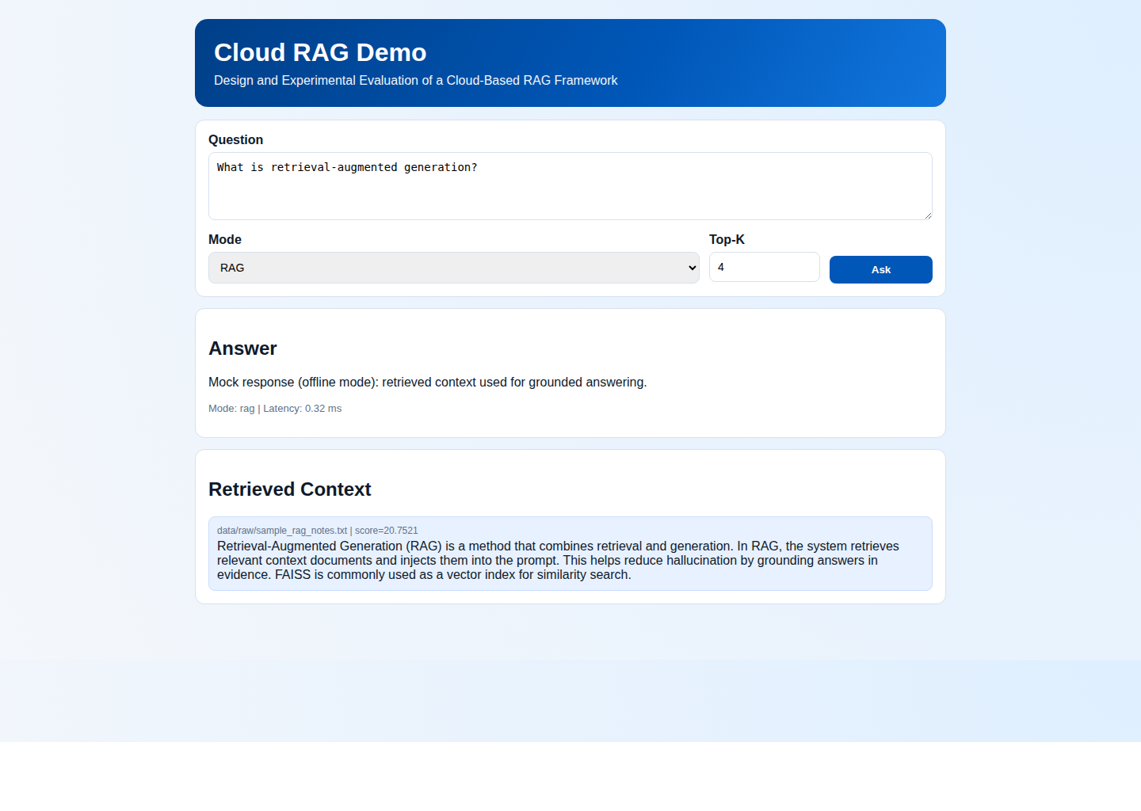
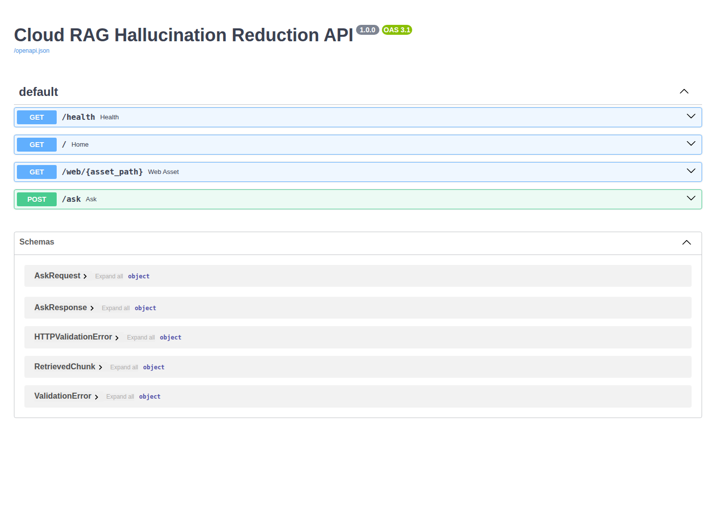
Application Screenshots (Frontend + Backend)
Left: Frontend UI demo | Right: Backend FastAPI Swagger docs

