Slide 1
Credit Default Analysis
IE 6318 – 001 Data Mining & Analytics
Instructor : Dr. Shouyi Wang (Asst. Professor, IMSE, UTA)
Submitted by:
Shanmuga Sundar Palanikumar : 1001440128
Abhishek Devar : 1001545089
Hemant Modiyil : 1001512733

Slide 2
INTRODUCTION
With the growing usage of technology and cloud based services, opening and maintaining a bank account has become a hassle free process as opposed to what it was in the previous decade or so. This also gave banks and impetus to offer customers with a variety of options of accounts with varying degree of benefits, suited to the overall profile of the customer. They could achieve this utilizing the information they had with all the data of their and other banks customers.
Credit accounts are a major business generating tool of banking service providers and extensive analysis goes into approving or denying a customer based on their financial track record. This project touches of one of the areas of the analyses – risk assessment which can be explained by the probability of a customer to default a payment against a statement balance. This is one of the basic but an essential criterion that the customer ought to meet to be eligible for a service.
We use a dataset comprising of attributes such as age, gender, income, and their previous six months billing amounts and the payments made against those amounts. We would analyse the dataset to try and predict whether the customer would default the payment in the sixth month of the billing cycle in our analysis. We would use various data mining and machine learning algorithms to come up models to reach our conclusion. Our impetus here in this project would be to explore the data and the models rather than building an absolute model for the application.

Slide 3
DATASET SOURCE-UCI Machine Repository
Attribute name | Description
X1 | Amount of the given credit in Taiwanese dollars (NT dollar) it includes both the individual consumer credit and his/her family (supplementary) credit.
X2 | Gender (1 = male; 2 = female).
X3 | Education (1 = graduate school; 2 = university; 3 = high school; 4 = others).
X4 | Marital status (1 = married; 2 = single; 3 = others).
X5 | Age (year).
X6 - X11 | History of past payment
X6 | history of payment in September, 2005
X7 | history of payment in August, 2005
X8 | history of payment in July, 2005
X9 | history of payment in June, 2005
X10 | history of payment in May, 2005
X11 | history of payment in April, 2005
PAY_0 | the repayment status in September, 2005
PAY_2 | the repayment status in August, 2005
PAY_3 | the repayment status in July, 2005
PAY_4 | the repayment status in June, 2005
PAY_5 | the repayment status in May, 2005
PAY_6 | the repayment status in April, 2005
X12 | billing amount in September, 2005
X13 | billing amount in August, 2005
X14 | billing amount in July, 2005
X15 | billing amount in June, 2005
X16 | billing amoiunt in May, 2005
X17 | billing amount in April, 2005
Df | Default status; 1 : Defaulter; 2: Non-defaulter

Slide 4
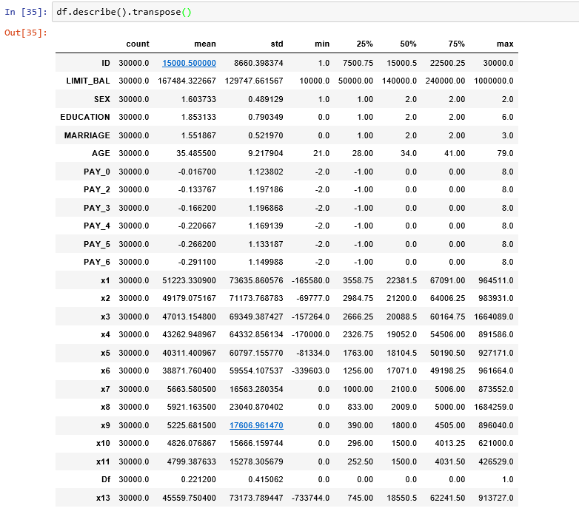
DATA EXPLORATION
Statistical Overview
Observation:
Lot of variance in the attributes x1-x11.

Slide 5
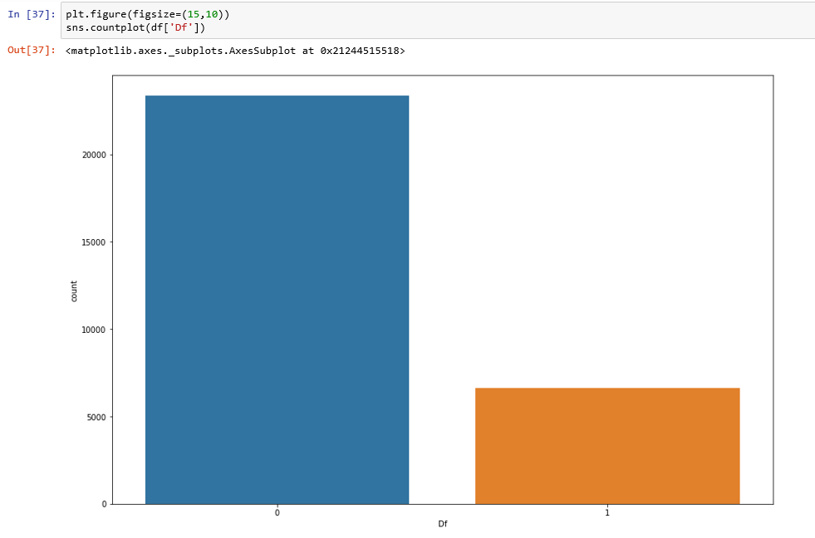
DATA EXPLORATION
A-B Test:
A-B test was performed for the Class –Binary Classification Default (0 or 1)
Observation:
The Data is Biased for the Class 0.

Slide 6
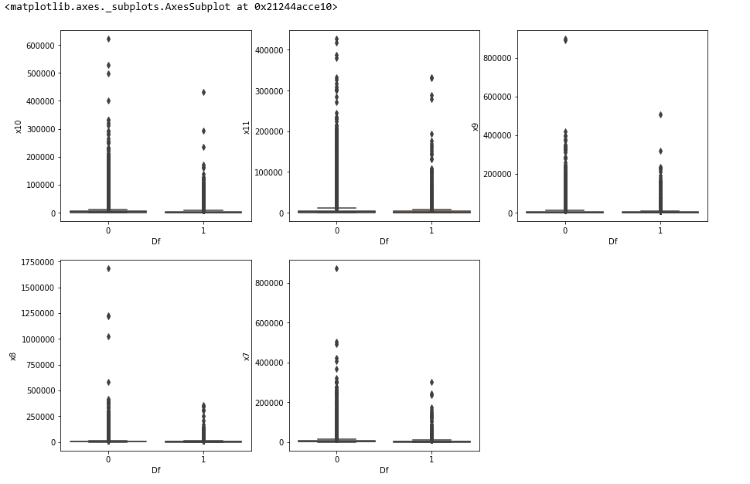
DATA EXPLORATION
Observation:
The Attributes Payments from x7-x11 for each month was not in Normal Distribution.
There are lot of outliers in the attributes x7-x11.

Slide 7
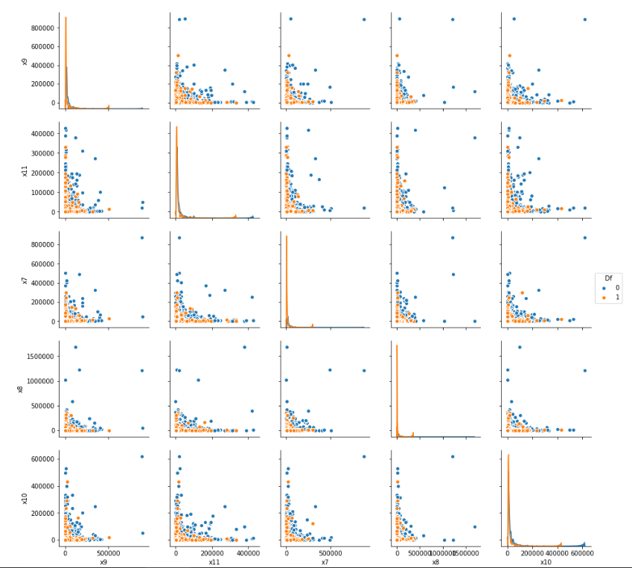
DATA EXPLORATION
Distribution of the attributes x7-x10 are right screwed.
Hence there is no normal distribution.

Slide 8
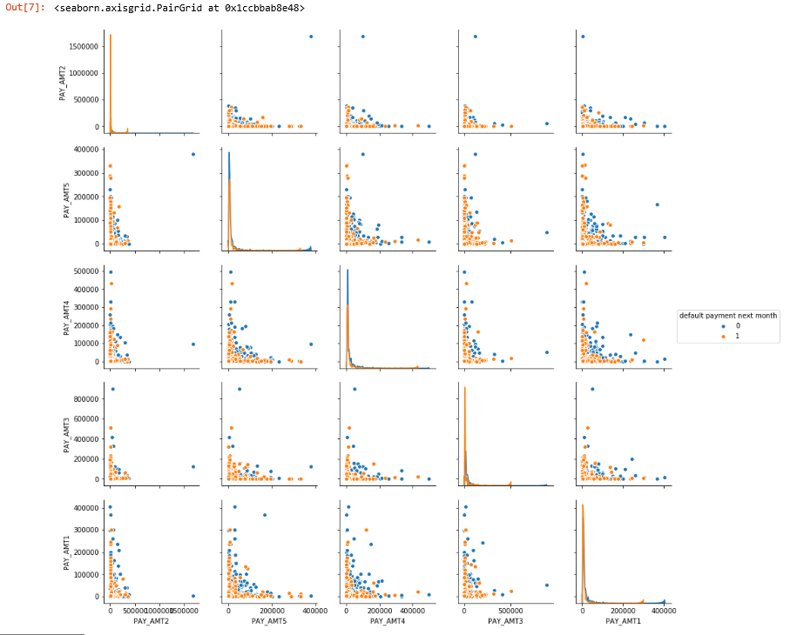
DATA CLEANING- Stratified Sampling
Since there where lot of biases for the data on the class and the distribution for the attributes was not normal.
Following Approach where used:
Stratified Random Sampling – For Equal number of Class samples.
The Distribution was not normal after the Stratified Random Sampling.

Slide 9
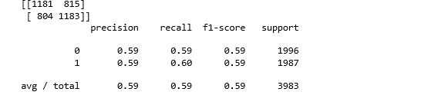
DATA EXPLORATION-KNN
The Stratified Random Sampling was applied on KNN ML algorithm to determine the accuracy.
Observation:
The Accuracy of classification was equally distributed. Indicates the Stratified Sampling will result in overfitting.

Slide 10
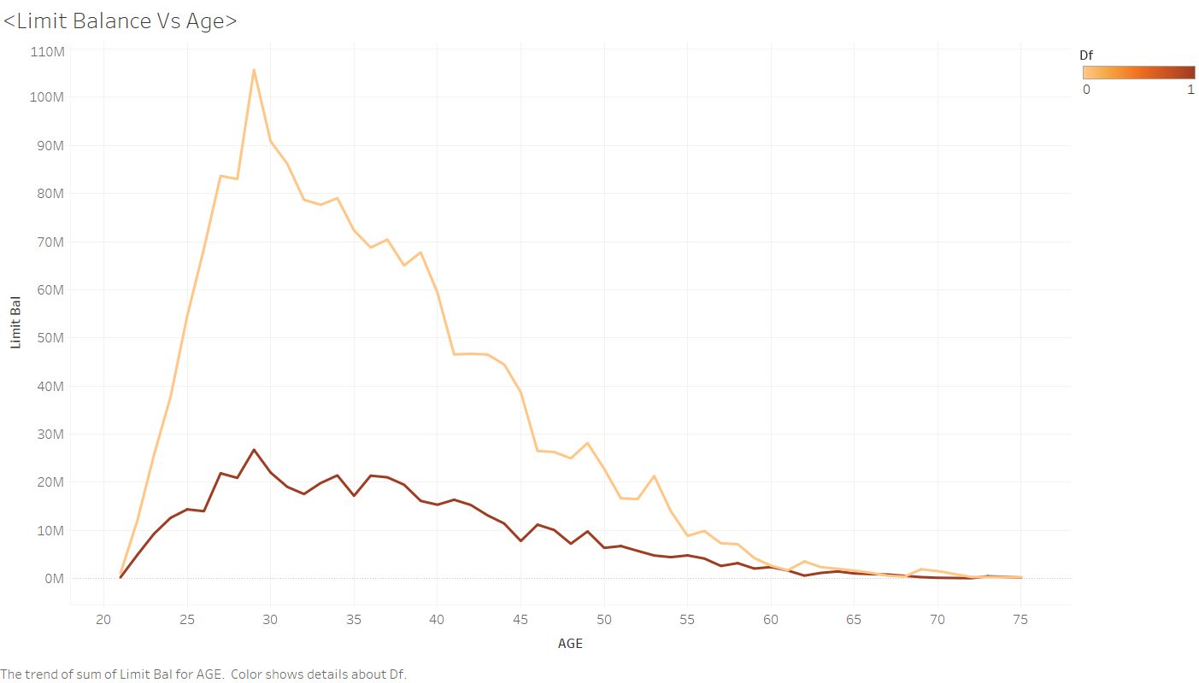
DATA EXPLORATION
Removed data for non – defaulters having LIMIT_BAL above 710000 Taiwan Dollar’s.

Slide 11
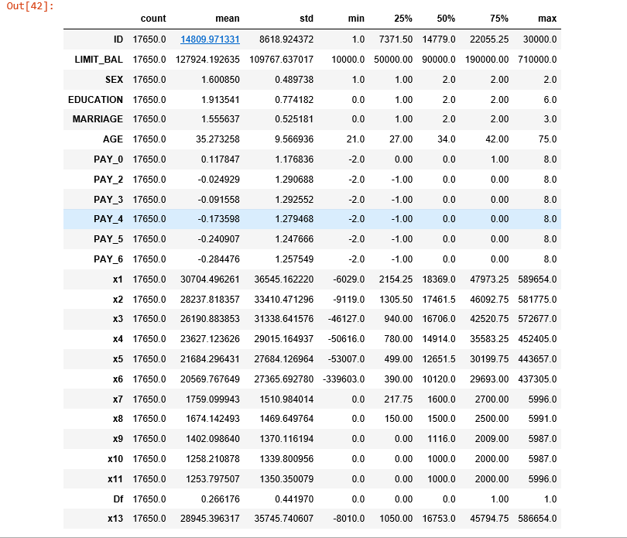
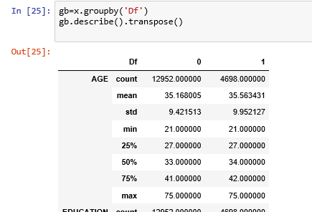
Cleaned Data

Slide 12
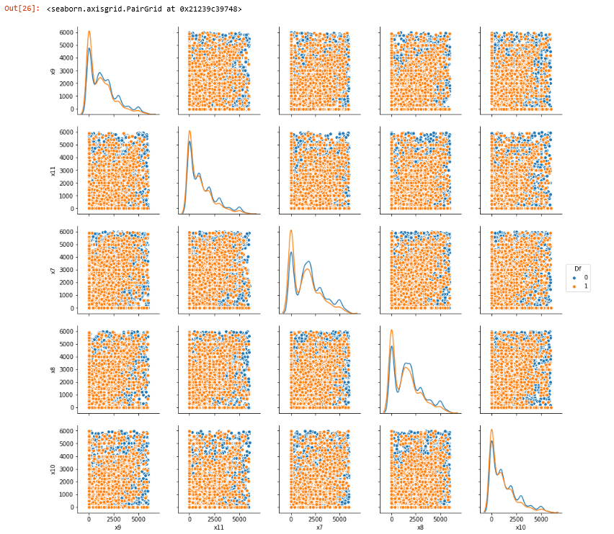
DATA EXPLORATION
After the Cleaning the Data, The attributes x7-x11 have Bimodal and Normal Distribution.

Slide 13
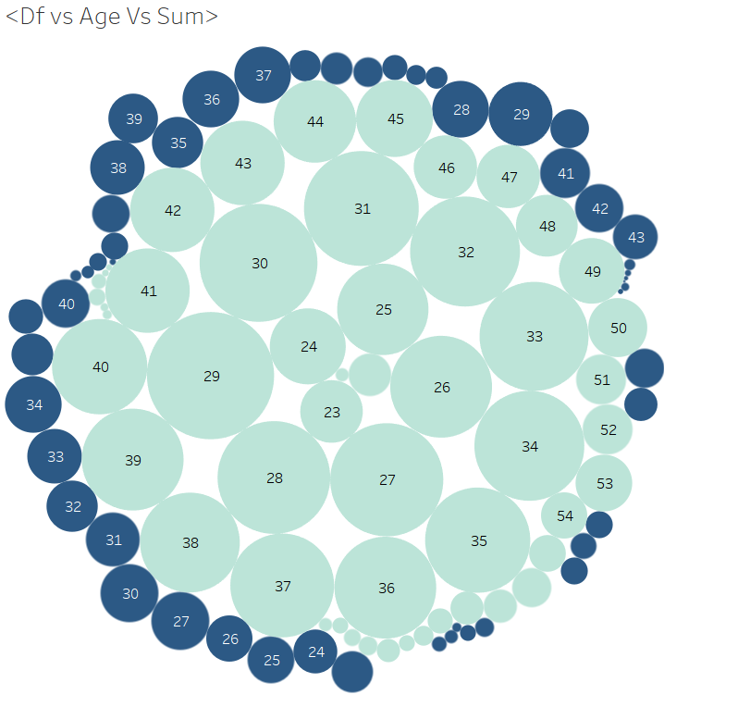
DATA EXPLORATION-Age- Df- Limit_Balance

Slide 14
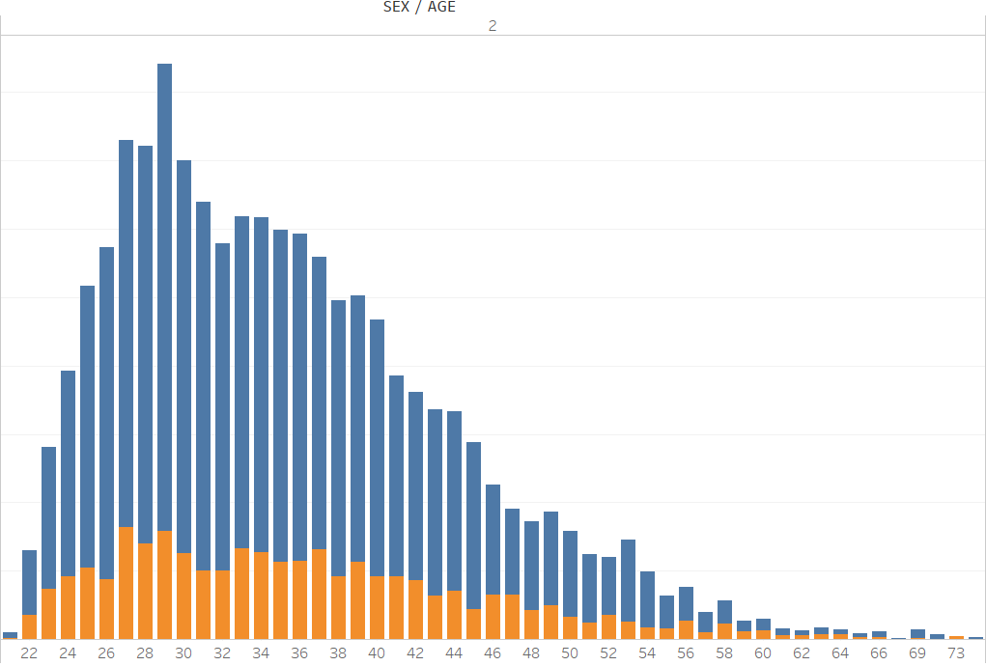
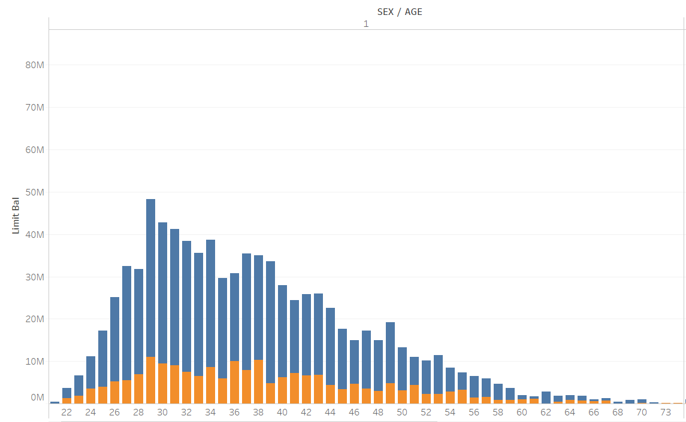

DE – AGE –LIMIT BALANCE- SEX

Slide 15
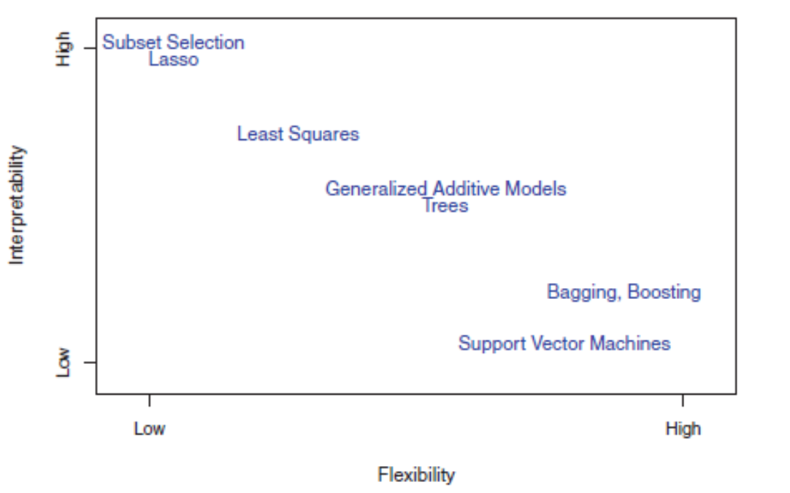
CLASSIFICATION MODELS

Slide 16
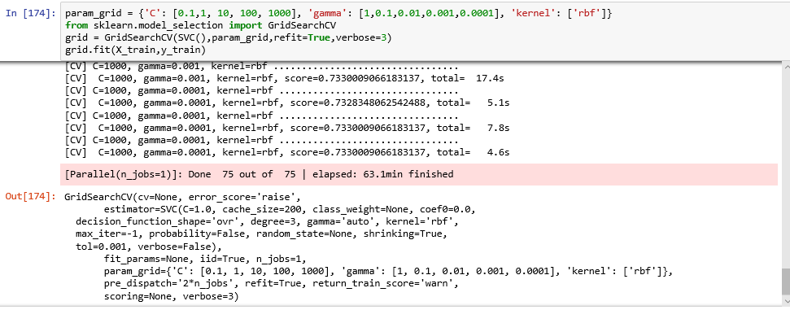
Model – SVC (Support Vector Machine)- RBF
Since the Classification is a Binary, the method gives the optimal accuracy.
Parameter Tuning- Grid Search was used.
Observation
Range:
Betta -0.1-1000
Gamma – 1- 0.001
Gamma- 1 & Beta -0.1
Grid Search – Parameter Tuning

Slide 17
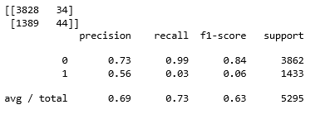
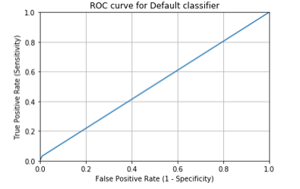
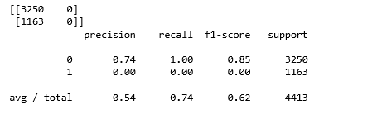
SVC – Results Overview
After Parameter Tuning
Before Parameter Tuning – Accuracy –0.54
After Parameter Tuning – Accuracy – 0.69
AUC = 0.5109505432176308
Before Parameter Tuning

Slide 18
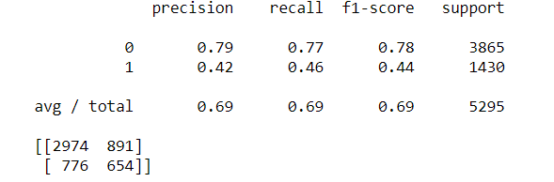
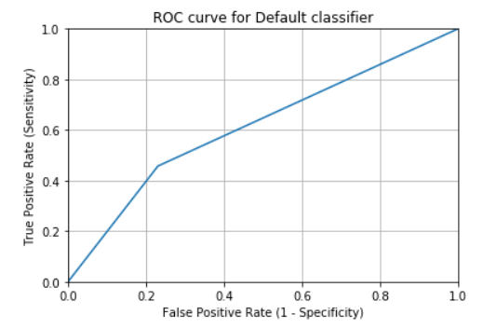
MODEL - DECISION TREE
Accuracy and Confusion Matrix
Commonly used method in Data Mining.
The final leaves have only one classification.
Observation:
Accuracy – 69%.
AUC – 61%
AUC = 0.6134061281538643

Slide 19
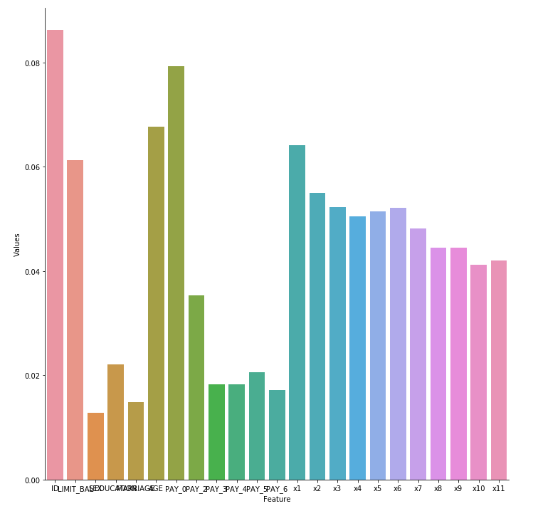
Feature Selection Using Random Forest
The Importance Scores are plotted against the Feature.
Best Features
Age
Limit Balance
Bill Statement – [x1-x6]
Repayment amount – [x7- x11]

Slide 20
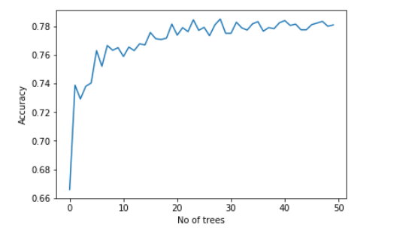
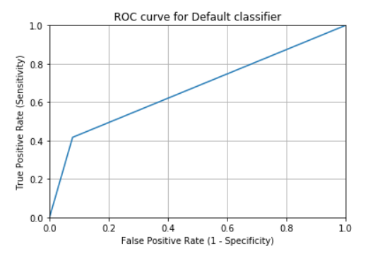
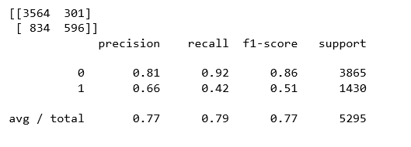
Model – Random Forest
Number of Tree Selection
Confusion and Accuracy matrix
ROC Curve
Parameter Tuning – Number of Trees.[Entropy Method]

Slide 21
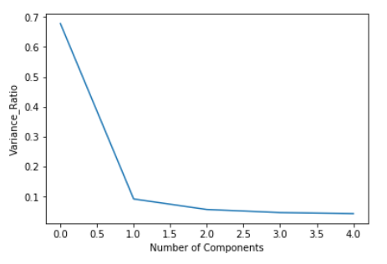
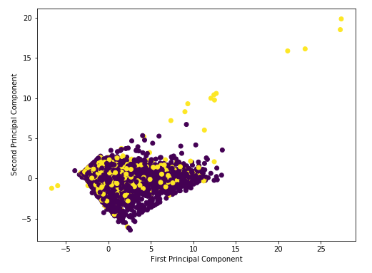
PCA – Principal Component Analysis
PCA are mainly used to reduce the Dimension , but still variance in the data remains the same.
11 attributes from x1-x10 are to optimal number of PCA.
5 PCA S was initial computed to find the variance ratio.
Elbow effect- the variance ratio is plotted against the Number of Components.

Slide 22
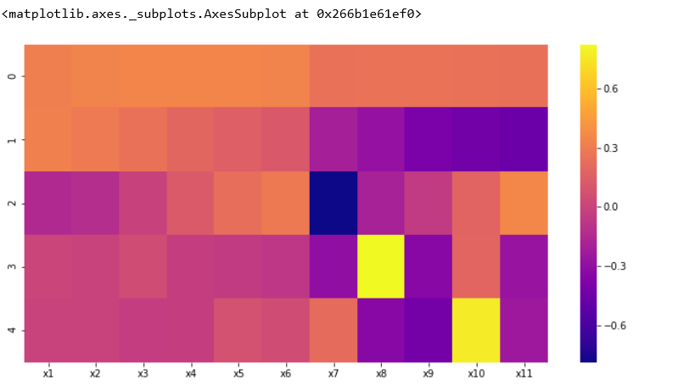
PCA - Heat Map – Correlation Between the Components and PCA (0-4)
Correlation between the PCA and Feature (x1-x11), and how the variance is distributed.

Slide 23
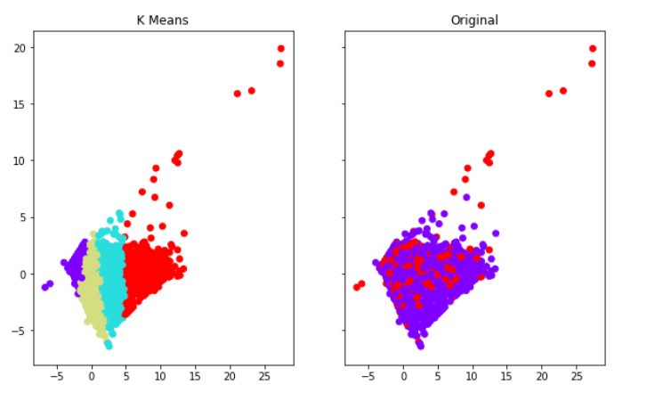
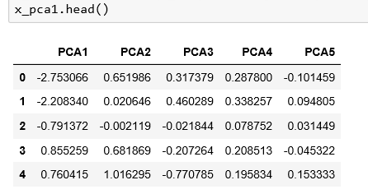
Unsupervised Learning- Clustering

Slide 24
K-Nearest Neighbors Classification parameter tuning:
There are 3 main parameter to tune:
K-value.
Distance Method – Minkowski distance.
r-value based on distance method. (r=2)

Slide 25
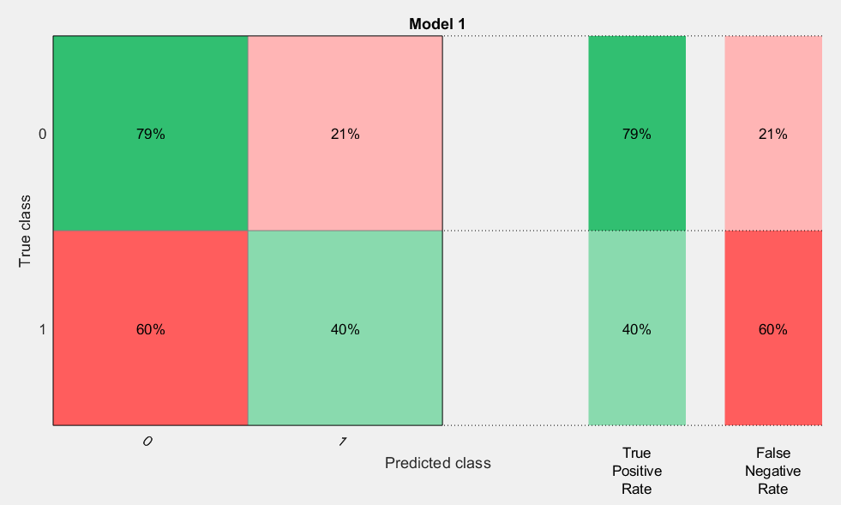
K-Nearest Neighbors Classification:
Cross Validation, number of folds used 5.
Nearest Neighbors k=1. (Accuracy obtained 68.6%)

Slide 26
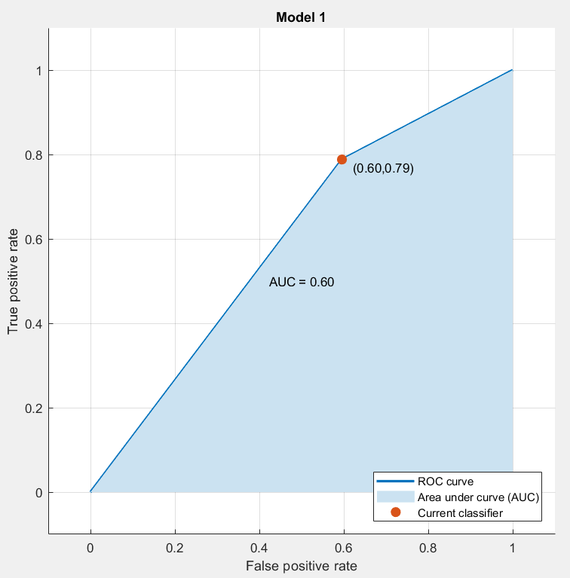
K-Nearest Neighbor: K=1
AUC=60%

Slide 27
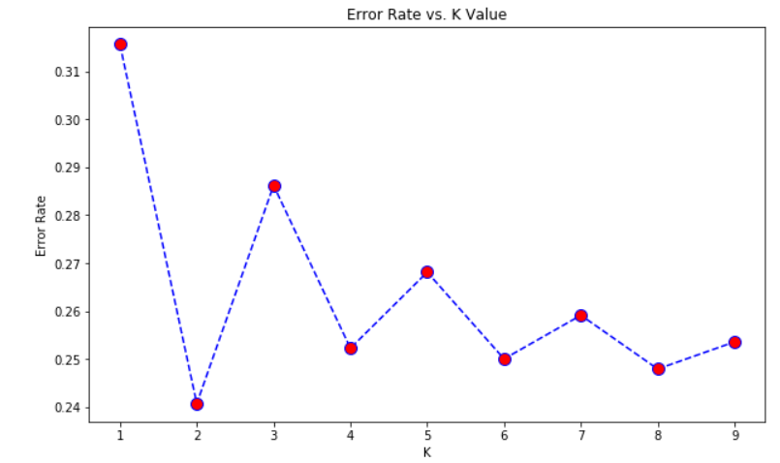
Finding optimum K-value:
The best choice of k depends upon the data; generally, larger values of k reduces effect of the noise on the classification.
The number of K were plotted against the error rate.

Slide 28
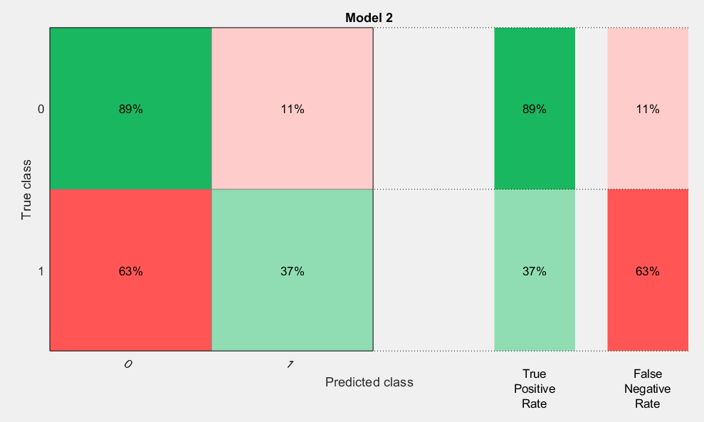
K-Nearest Neighbors Classification
Accuracy | Specificity | Sensitivity
74.9% | 54.28% | 79.5%
At Nearest Neighbors k=5.

Slide 29
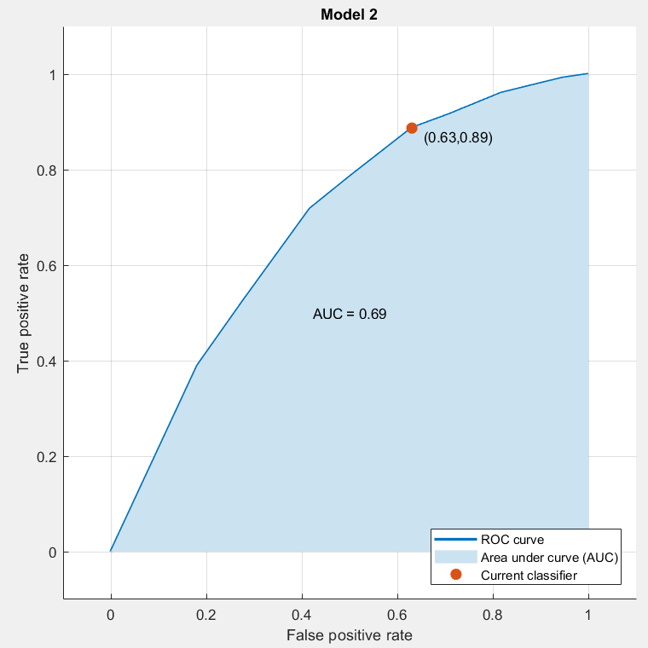
K-Nearest Neighbors Classification
K=5

Slide 30
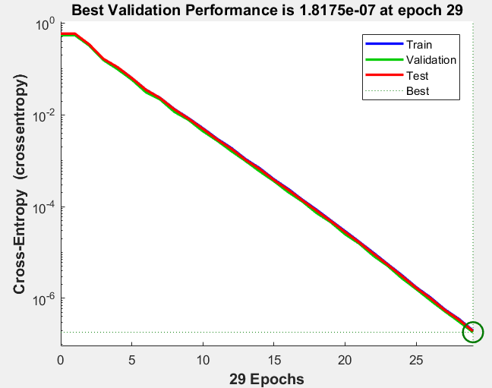
Neural Network:
We started from epoch 1 and incremented it continually till 1000 hidden layers and the epoch with minimum Cross Entropy was found in a model with 10 hidden layers and 29 epochs.

Slide 31
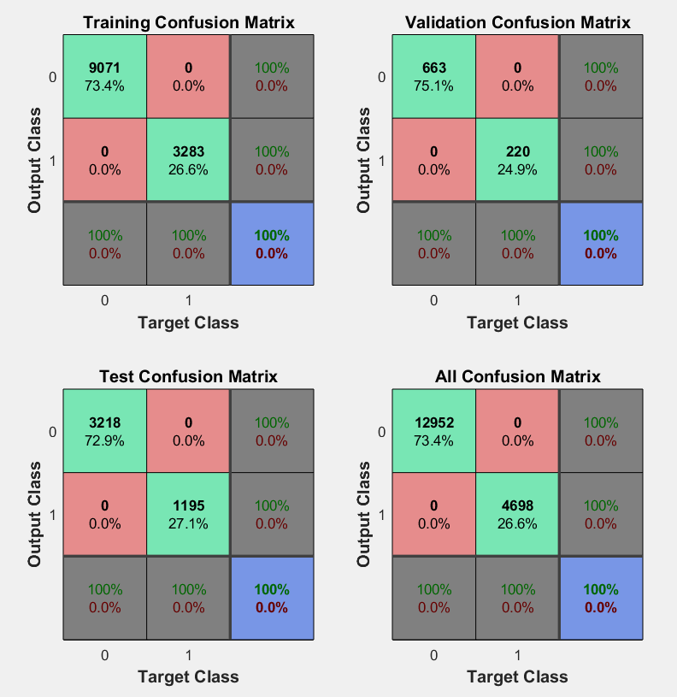
Neural Network Confusion Matrix:
70% data was used for training.
15% data was used for validation and improvement of training data.
15% data was used for testing the trained model.

Slide 32
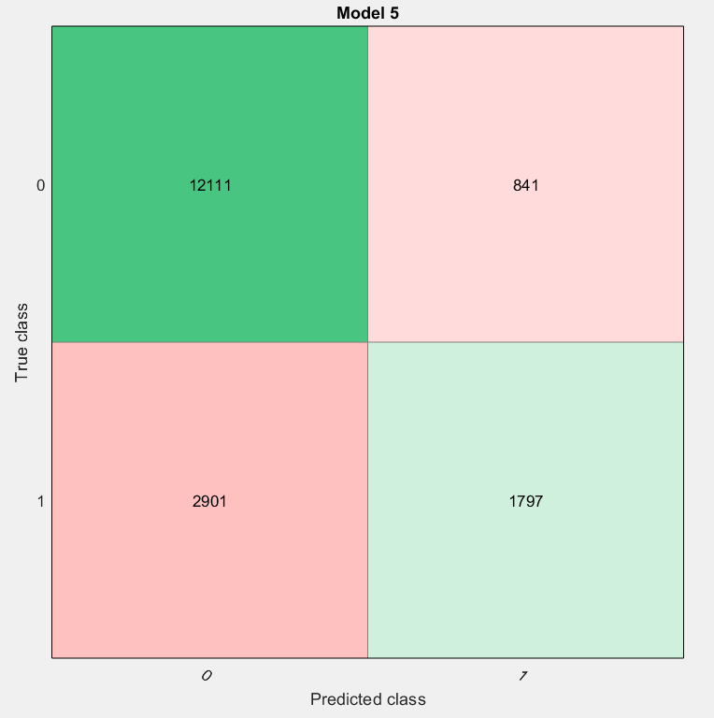
Ada Boosting:
Maximum number of branch points used are 20, to control depth of your tree learners.
Number of learners used 20.
Learning rate 0.1.
Accuracy obtained 78.8%.
Specificity – 68.12%.
Sensitivity – 80.68%.

Slide 33
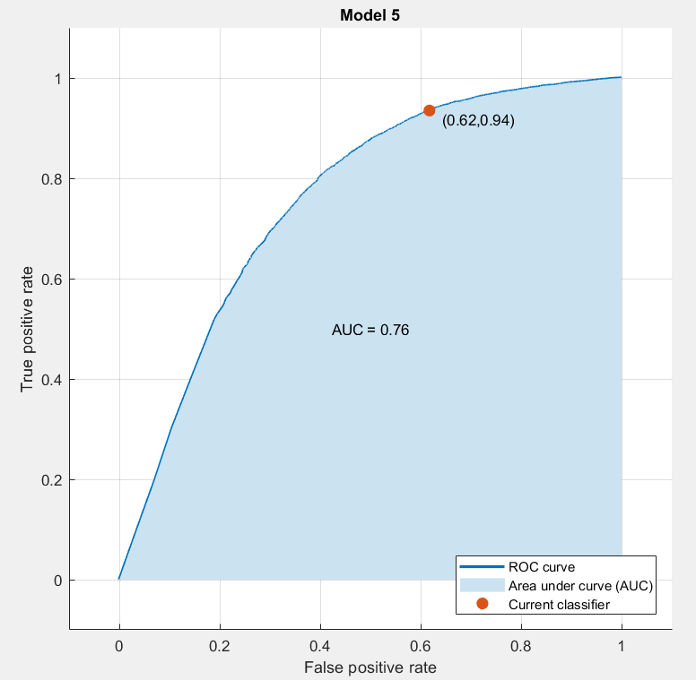
Ada Boosting:
ROC Curve
AUC – 76%

Slide 34
Comparisons of Models:
Classification Methods | Accuracy | Specificity | Sensitivity
K-NN | 74.9% | 54.28% | 79.5%
Decision Tree | 68.52% | 42.33% | 79.31%
Random Forest | 78.56% | 66.44% | 81.04%
SVM | 73.13% | 56.41% | 73.38%
Neural Network | 100% | 100% | 100%
Ada Boosting | 78.8% | 68.12% | 80.68%

Slide 35
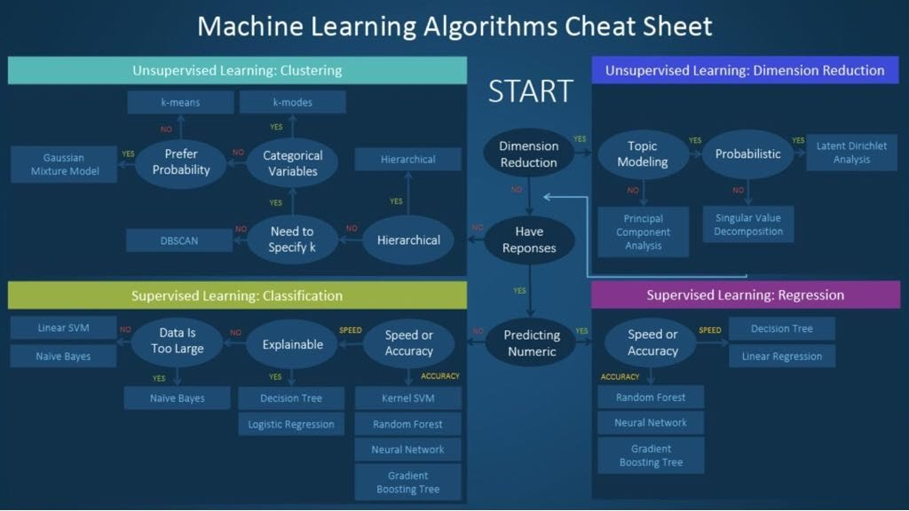

Slide 36
Conclusion
Customers are most likely default their payments when their LIMIT_BAL(credit limit) is less than 300000 NT dollars and they fall in the age group of 25 to 45 years.
Having said that, it is also evident from the analysis that this age group has the highest concentration of non-defaulters owing to the fact that this is the period in a persons life where they earn the maximum.
The image shown above is a good representation of how non-parametric models are a better option for inferential classification problems such as the one discussed in this project. We were able to predict results with high accuracy rates and as expected Neural Network with back propogation provides us with the highest accuracy of 100% and it is able to predict whether a customer is a defaulter or not in all instances.
The accuracy figure obtained with Neural Network is debatable as this could be a case of over-fitting when there is an inherent bias in the dataset. This can be mitigated in the scope for future research by combining the features LIMIT_BAL(credit limit), the age of the customer and payment patterns for creating a high influence feature which in a revised model.

Slide 37
Future Scope
Data Aspect: Testing the model with real world data with no label. Predicting how really the model is working in real data.(Artificial Neural Networks)
Methods: Implementing Bagging and aggregation methods for model. In which Each model with Stratified data, Random sampling and Balanced Data by which all models are combined to rectify the Misclassification errors.

Slide 38
References
UCI Machine Learning Repository: https://archive.ics.uci.edu/ml/datasets/default+of+credit+card+clients
An Introduction to Statistical Learning by Gareth James, Daniela Witten, Trevor Hastie and Robert Tibshirani
https://docs.python.org
https://www.linkedIn.com/machine-learning
https://www.wikipedia.org
Matlab Classifer Learning

