Slide 1
MLOPS Reference Architecture

Slide 2
MLOPS Life Cycle

Slide 3











Propose Architecture KubeFlow on AWS
Option-1
AWS Glue Data Catalog
Cloud Storage
Amazon S3
Cloud Storage
Amazon S3
Amazon RedShift
Feature Store
Extract Features
Load Raw Data
Transform Data
NLP API
Amazon Comprehend
ML Pipelines, Experimentation & Deployment
ETL Pipelines
Cloud Storage
Amazon S3
Amazon
RedShift
Amazon
RDS
Postgres
Amazon
RedShift
Github Actions
Vault
Access Key Management & Code Deployment
Data Warehouse
Note: This architecture is based on current analysis of Kubeflow services and may change upon further exploration of Kubeflow

Slide 4
Option 1
The Option -1 leverages the GCP Solution used for retailer with Kubeflow as an enabler supported by AWS Services for Data Engineering.
Use Airflow for ETL Pipeline ( Same as GCP approach)
AWS Services for Data Engineering
AWS Services Redshift & Amazon RDS for Datawarehouse
AWS RDS – Postgress SQL for Cloud Storage
AWS Glue Catalog for Data Catalog requirement
AWS S3 for Cloud Storage
AWS Comprehend for NLP functionality
Use KubeFlow on AWS for ML Pipeline, Experimentation and Deployment

Slide 5
Kubeflow for AWS - Overview
AWS recently launched Kubeflow v1.4 as part of its own Kubeflow distribution (called Kubeflow on AWS), which streamlines data science tasks and helps build highly reliable, secure, portable, and scalable ML systems with reduced operational overheads through integrations with AWS managed services.
Kubeflow distribution to build ML systems on top of Amazon Elastic Kubernetes Service (Amazon EKS) to build, train, tune, and deploy ML models for a wide variety of use cases, including computer vision, natural language processing, speech translation, and financial modeling.

Slide 6
Kube Flow - AWS Services
Application Load Balancer for secure external traffic management over HTTPS
Amazon CloudWatch for persistent log management
AWS Cognito for user authentication with Transport Layer Security (TLS)
AWS Deep Learning Containers for highly optimized Jupyter notebook server images
Amazon EKS for managed Kubernetes clusters
Amazon Relational Database Service (Amazon RDS) for highly scalable pipelines and a metadata store
AWS Secrets Manager to protect secrets needed to access your applications
Amazon Simple Storage Service (Amazon S3) for an easy-to-use pipeline artifacts store
Decouple critical parts of the Kubeflow control plane from Kubernetes, providing a secure, scalable, resilient, and cost-optimized design.
Amazon Elastic File System (Amazon EFS) or Amazon FSx for Lustre for a simple, scalable, and serverless file storage

Slide 7
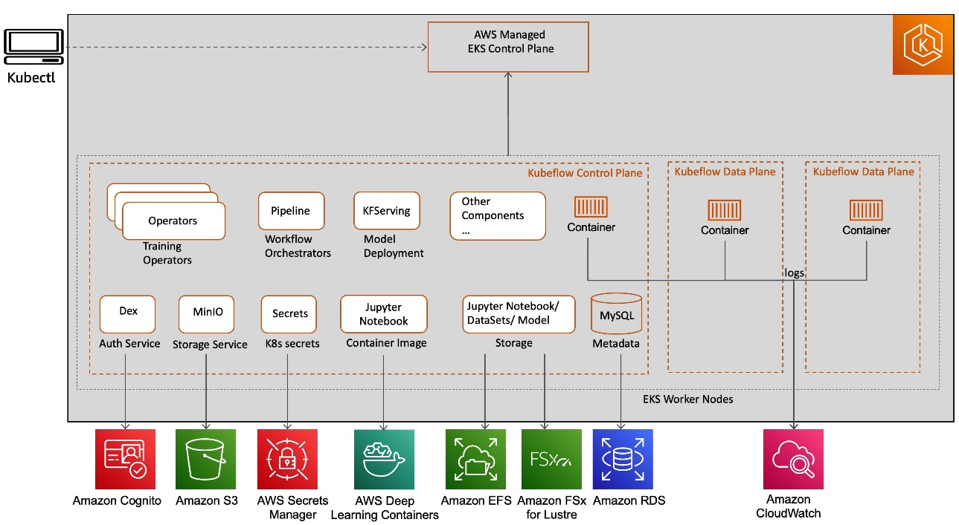
AWS Service integrations with Kubeflow Pipeline

Slide 8
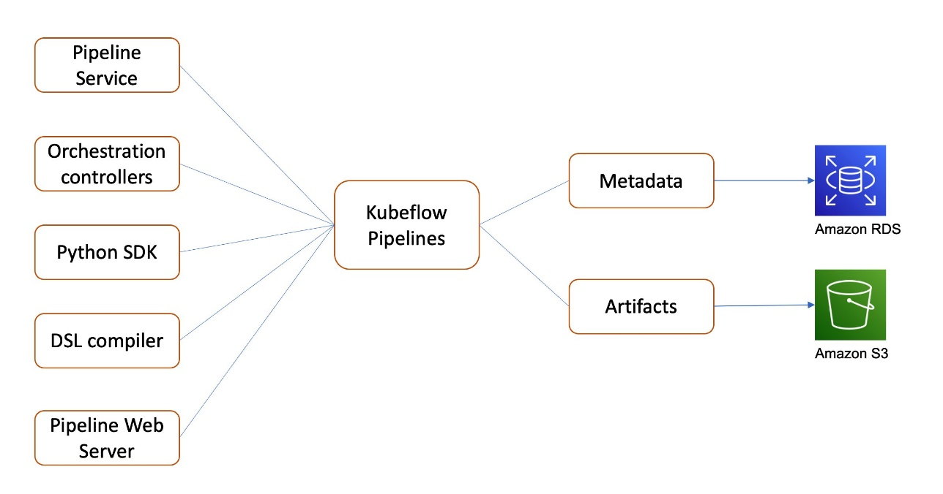
Kubeflow Pipeline

Slide 9
KubeFlow – AWS Services Value Chain

Slide 10
KubeFlow – Deployment Options

Slide 12



Option-2
Proposed Architecture –
Airflow & MLflow
AWS Glue Data Catalog
Cloud Storage
Amazon S3
Cloud Storage
Amazon S3
Amazon RedShift
Feature Store
Extract Features
Load Raw Data
Transform Data
NLP API
Amazon Comprehend
Airflow with Papermill Operator & Jupyter Notebooks
MLFlow server on Compute Engine
ETL Pipelines
ML Pipelines, Experimentation & Deployment
Cloud Storage
Amazon S3
Amazon
RedShift
Amazon
RDS
Postgres
Amazon
RedShift
Github Actions
Vault
Access Key Management & Code Deployment
Data Warehouse
Note: This architecture is based on current analysis of Kubeflow services and may change upon further exploration of Kubeflow

Slide 14
Propose Architecture MLOps with MLFlow and Amazon SageMaker Pipelines
Option - 3

Slide 15
Propose Architecture MLOps Workload Orchestrator
Option - 4

Slide 16
Appendix - A

Slide 17
Appendix - A

Slide 18
