Slide 1
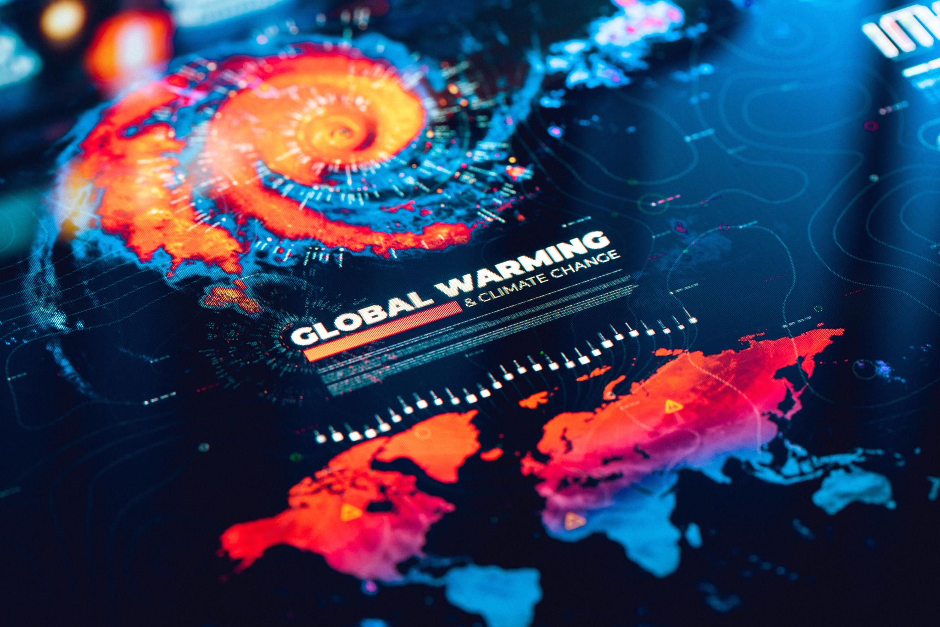
Global Warming: A Threat to Our Future
A speech by R. Akshitha
7th - Ramanujam

Slide 2
Agenda
Introduction
Definition
Cause
Effects
Solution

Slide 3

Introduction
Good morning, everyone.
Thank you for being here today.
I am Akshitha R.
I am here to talk to you about a very important issue that affects us all: global warming.

Slide 4
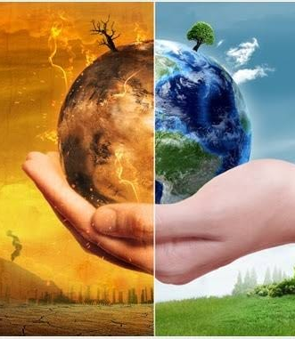
Global Warming A Man-Made Phenomenon

Slide 5
Global Warming - Definition
Global warming is the increase in the average temperature of the Earth's surface and atmosphere, caused by the accumulation of greenhouse gases in the air.
These gases trap heat and prevent it from escaping into space, creating a greenhouse effect.

Slide 6
Causes, Effects, and Solutions

Slide 7
Global Warming – How they Occur ?
Global warming is not a natural phenomenon.
It is the result of human activities, such as burning fossil fuels, deforestation, agriculture, and industrialization.
These activities release carbon dioxide, methane, nitrous oxide, and other gases that contribute to global warming.

Slide 8
Global Warming – Burning Problem
Global warming is not a distant problem. It is happening right now, and it is affecting our lives in many ways.
It is causing more extreme weather events, such as heat waves, droughts, floods, storms, and wildfires.
It is melting ice caps and glaciers, raising sea levels, and threatening coastal communities.
It is disrupting ecosystems, endangering wildlife, and spreading diseases. It is harming our health, our economy, and our security.

Slide 9
Global warming is not a hopeless situation.
We can still take action to reduce greenhouse gas emissions, adapt to the changing climate, and mitigate the impacts of global warming.
We can use renewable energy sources, such as solar, wind, and hydro power.
We can conserve energy, use public transportation, and drive less.
We can plant trees, protect forests, and restore wetlands.
We can recycle, reuse, and reduce waste.
We can educate ourselves and others, and support policies and initiatives that address

Slide 10
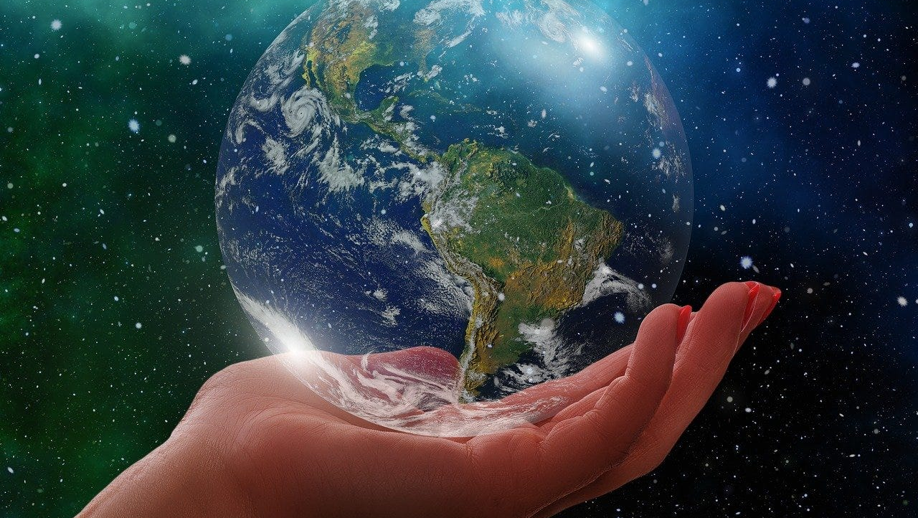
Pledge
Together we will save our “Mother Earth”.

Slide 11
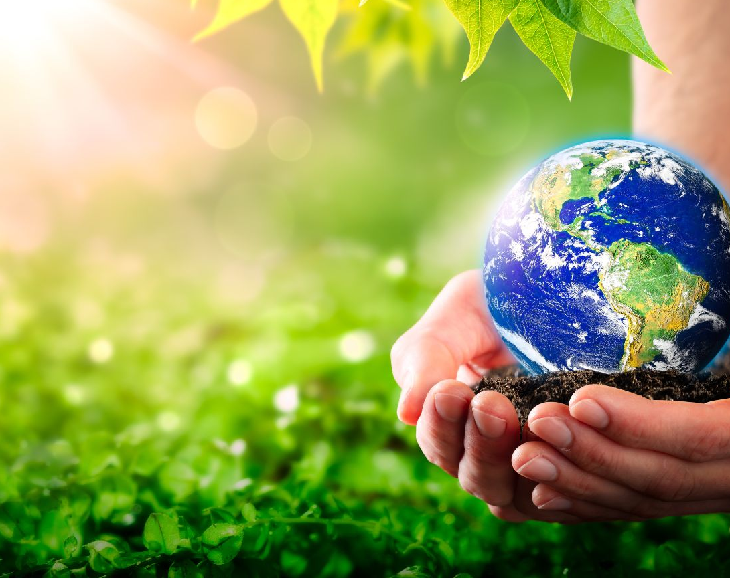
Thank you

