Slide 1
Stock Market Data Trend Analysis
Exploratory Data Analysis and Hypothesis testing, Regression Analysis

Slide 2
Presented By
Sundaralingam Srinivasan

Slide 3
Statistical Question
Is there a statistically significant difference between stock opening and closing prices from our data analysis?

Slide 4
Selected Variables
These are the selected 5 variable
1. Open
2. Close
3. High
4. Low
5. Volume

Slide 5
Descriptive Statistics
Statistic | Open | Close | High | Low | Volume
count | 1000.00 | 1000.00 | 1000.00 | 1000.00 | 1000.00
mean | 99.33 | 101.20 | 105.57 | 95.18 | 565811.30
std | 20.46 | 19.49 | 20.05 | 19.86 | 256129.68
min | 34.25 | 35.77 | 39.22 | 20.48 | 101643.00
25% | 85.99 | 87.89 | 92.52 | 82.14 | 349957.75
50% | 98.58 | 101.42 | 105.30 | 95.00 | 578270.50
75% | 112.62 | 114.99 | 119.29 | 108.16 | 787294.50
max | 171.85 | 170.74 | 185.10 | 157.43 | 998851.00

Slide 6
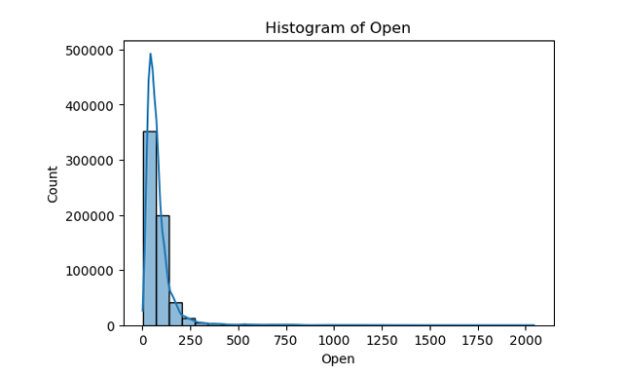
Histogram of Open

Slide 7
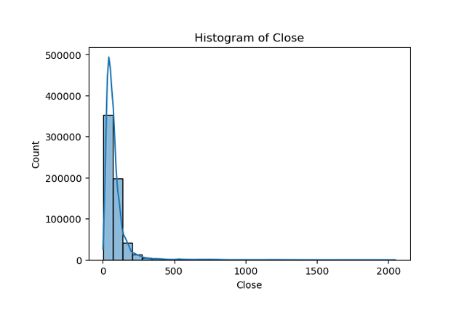
Histogram of Close

Slide 8
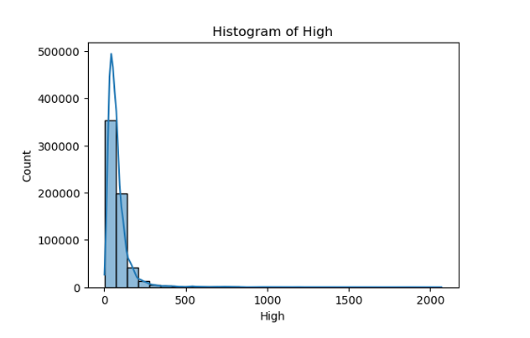
Histogram of High - Stock

Slide 9
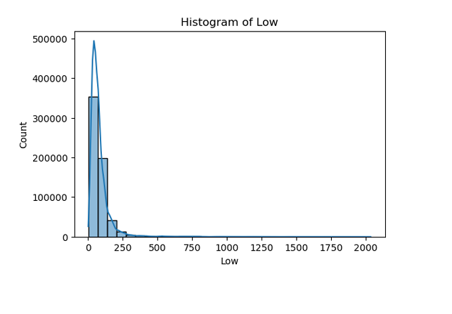
Histogram of Low

Slide 10
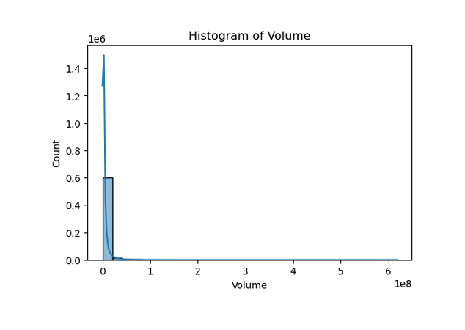
Histogram of Volume

Slide 11
Outliers
Outliers in Open: 38963
Outliers in Close: 38930
Outliers in High: 39020
Outliers in Low: 38891
Outliers in Volume: 59502

Slide 12
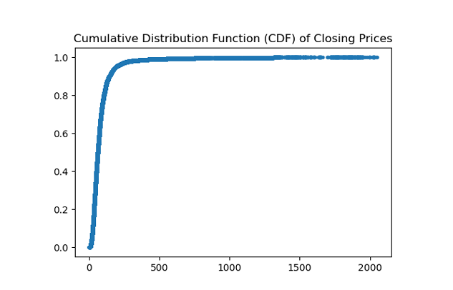
Cumulative Distribution Function (CDF)

Slide 13
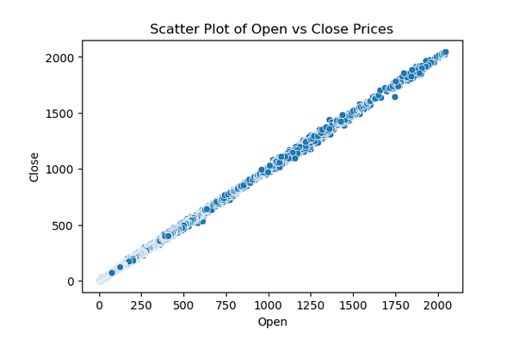
Scatter Plot: Open vs Close

Slide 14
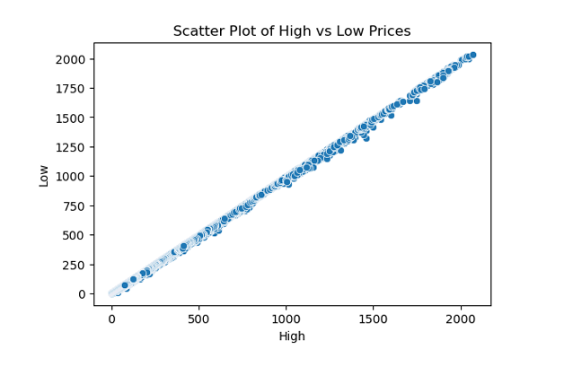
Scatter Plot: High vs Low

Slide 15
Hypothesis Testing
T-Statistic: -2.09
P-Value: 0.03647
Conclusion: Reject H0

Slide 16
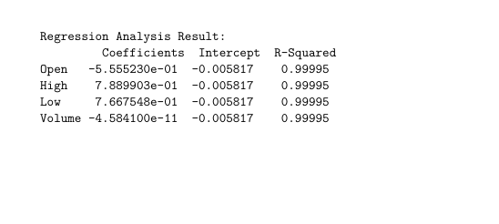
Regression Analysis

Slide 17
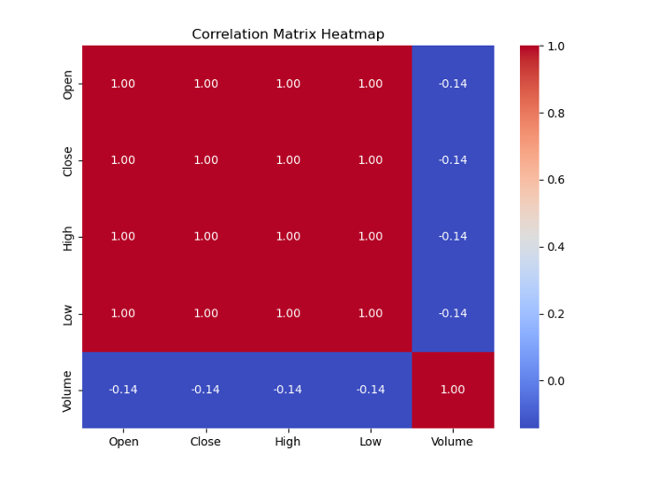
Correlation Matrix

