Slide 1
Streaming Service User Analysis
MS Excel Data Analysis Assignment
By: Sundaram Samaddar
Date: 17-09-2025

Slide 2
Project Overview
Objective: Transform raw streaming service data into interactive and user-friendly dashboards.
Tools Used: MS Excel.
Source Files:
    Streaming_service_data.xlsx (Raw Data)
    Streaming Service User Analysis.pdf (Instructions)
Final Dashboard File:
    SundaramSamaddar_CPDA_6.xlsx

Slide 3
STEP 1. Data Understanding
To check if any data is missing or not, COUNTBLANK() function was applied.
Key Fields were analysed like:
  User Demographics: Age Groups, Country, Language.
  Engagement Metrics: Watch Hours, Favourite Genre, Device (Active and First), Total Movies and Series, Primary Watch Time, Average Ratings, etc.
  Subscriptions Details: Monthly Price, Payment Method, Loyalty Points.

Slide 4
Step 2. Data Cleaning & Error Handling
Data formats were normalized for Numbers, Text, and Date.
Date formats were rearranged using TEXT TO COLUMN option in data tab to DMY format as some entries were following MDY format while rest DMY format.
Columns added for
  Join_Date_month: (TEXT(DATE,”MMM”)),
  Join_Date_Year: (TEXT(DATE,”YYY”)),
  Last_Login_Month: (TEXT(DATE,”MMM”)),
  Active_Days: (ABS(Last_Login_Date - Join_Date_Date))
  Average_Watch_Hours: (Watch_Hours/(Min(Join_date)- Max(Last_login))

Slide 5
Step 2. Data Cleaning & Error Handling (cont.)
Column Headings were marked Bold (Ctrl+B) and Column width was adjusted using Format option and Wrap Text option in Home tab.
Column Headings were freezed using Freeze Panes option in View tab.
Outliers were marked in Average_Watch_Hours for value greater than 12 hours per day using Conditional Formatting option in Home tab.
Converted the Range to Table using Table option in Insert tab.

Slide 6
Step 3. Data Summarization
Summarization of Matrices were prepared using PIVOT TABLE option in Insert tab.
Key Matrices were divided into 5 parts (each in sperate sheet in the same workbook) with each having multiple matrices:
  Subscription & Revenue Analysis:
    Total User Counts.
    Total Revenue generated per month.
    Distribution of users across different price tiers.
    Monthly revenue based on different price tiers.
  User Engagement Metrics:
    Total watch hours by users.
    Average watch hours per user across different age tiers.
    Average of total movies vs. average of series watched per user across different age tiers.
    Impact of recommended content on engagement by their watch hours across different age tiers.

Slide 7
Step 3. Data Summarization (Cont.)
  Demographic & Behavioural Insights:
    Count of users for preferred genres by age tiers.
    Device usage trends across different age tiers:
      By device preference
      By number(s) of device.
    Count of users by their peak watch time.
  Retention & Loyalty:
    Total loyalty points distributed to users.
    Count of users for downloaded content.
    Count of users with their membership status (Active vs. Inactive).
    Percentage of loyalty points distributed across different age tiers and price tiers.
    Count of users for frequency of logins (last login month) and content downloads.

Slide 8
Step 3. Data Summarization (Cont.)
  Payment Preferences & Regional Trends:
    Average rating by users.
    Count of users for their preferred payment method by region.
    Count of users subscribed per country.
    User Impact on language preferences and their correlation with total watch hour and average of average watch hour.

Slide 9
Step 4. Data Visualisation
After the summarisation then came the visualisation part.
Pivot charts were formed by selecting the pivot table I want to visualise then selecting the required chart in PIVOTCHART option in PivotTable Analyze tab.
Gridlines and Field buttons were removed from the charts for better visibility, Data labels were added, unwanted Axis and Legends were removed and Chart Titles were added for better understanding.

Slide 10
Step 4. Data Visualisation (Cont.)
Chart types used for visualisation of matrices:
  Column Charts:
    Distribution of users across different price tiers.
    Device usage trends across different age tiers:
      By device preference and
      By number(s) of device.
    Percentage of loyalty points distributed across different age tiers and price tiers.
    Count of users for their preferred payment method by region.
  Bar Charts:
    Average watch hours per user across different age tiers.
    Count of users for preferred genres by age tiers.
    Count of users by their peak watch time.
    Count of users for frequency of logins (last login month) and content downloads.
    Count of users subscribed per country.

Slide 11
Step 4. Data Visualisation (Cont.)
  Doughnut Chart:
    Distribution of users across different price tiers.
    Count of users with their membership status (Active vs. Inactive).
  Combo Chart(Data labels were not added for these type of charts):
    Average of total movies vs. average of series watched per user across different age tiers.
    Impact of recommended content on engagement by their watch hours across different age tiers.
    User Impact on language preferences and their correlation with total watch hour and average of average watch hour.

Slide 12
Step 5. Dashboarding
5 New sheets have been added in the same workbook
  Dashboard_1: Subscription & Revenue Analysis
  Dashboard_2: User Engagement Metrics
  Dashboard_3: Demographic & Behavioural Insights
  Dashboard_4: Retention & Loyalty
  Dashboard_5: Payment Preferences & Regional Trends
to prepare 5 dashboards each containing one categories of Key Matrices (mentioned in Slides 6 to 8)
I have prepared 5 dashboards instead of single dashboard for better visualisation and better interactive-ness.

Slide 13
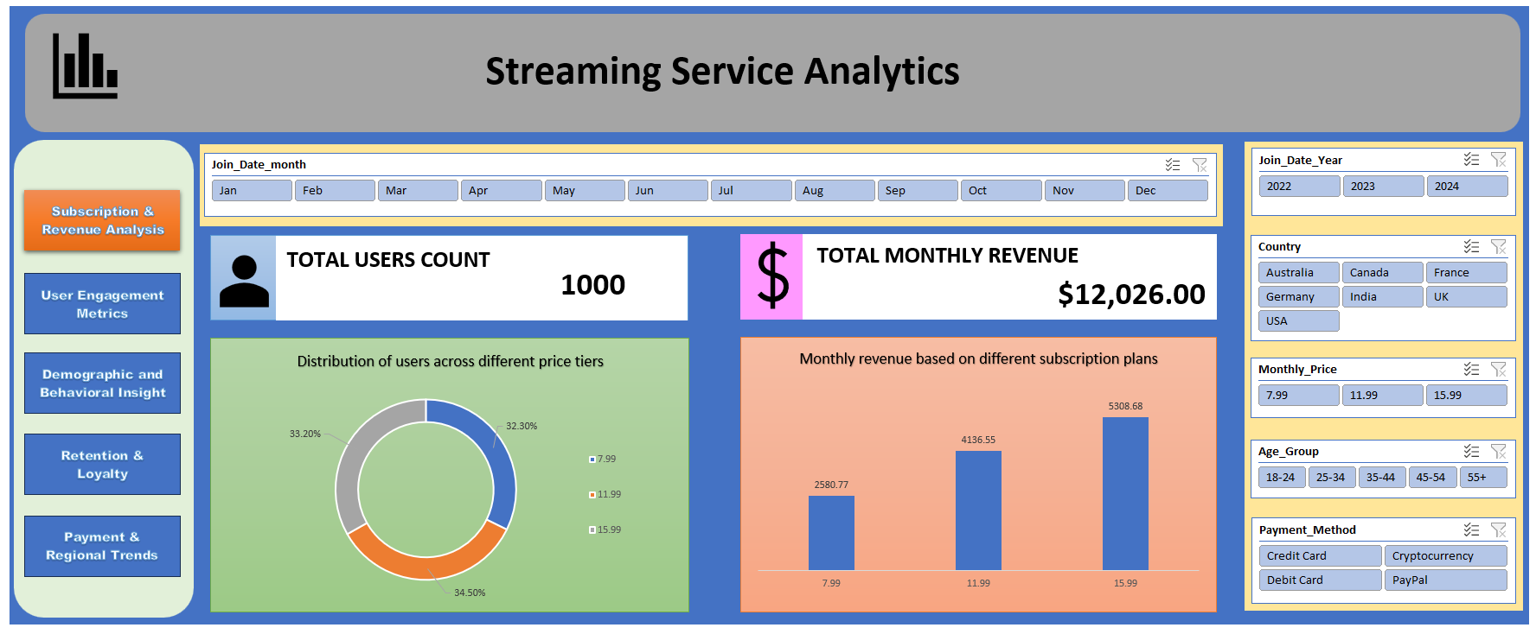
Step 5. Dashboarding (Cont.)
Slicers were added and reported connection to all the key metrices for better interactive-ness.
This area in Dashboard is assigned for switching between different dashboards in the workbook without the need for searching each and every sheet.
This area in Dashboard is assigned for data charts and key matrices.

Slide 14
Thank You

