Slide 1
Containerization

Slide 2
What is Containerization?
Containerization is a technology that packages applications and their dependencies into a single unit called a container. Containers are portable and self-contained, and can run on any operating system or cloud environment
Security: Containers run in isolated environments, limiting the impact of security vulnerabilities.
Resource utilization: Containers improve resource utilization.
Operational agility: Containers make it easier to deploy, scale, and manage applications

Slide 3
Virtualization Vs Containerization
Aspect | Virtualization | Containerization
Isolation | Each VM runs its own guest operating system | Containers share the host operating system kernel
Resource Usage | Each VM requires its own set of resources | Containers are lightweight and share host resources
Performance | May have higher overhead due to multiple OS instances | Lower overhead as containers share the host OS kernel
Portability | VMs are less portable due to varying guest OS | Containers are highly portable across different systems
Deployment Speed | Slower deployment times due to OS boot process | Faster deployment times as containers start quickly
Resource Utilization | Requires more resources as each VM has its own OS | More efficient resource utilization with containerization
Ecosystem | Mature ecosystem with various hypervisors and tools | Growing ecosystem with tools like Docker and Kubernetes
Use Cases | Ideal for running multiple applications on a single host | Ideal for microservices architectures and cloud-native applications

Slide 4
Advantages of containerization
Portability(write once, run anywhere)
Efficiency(Lightweight)
Agility(deploy to any environment)
Faster delivery
Improved security(isolated with other application)
Easier management
Flexibility

Slide 5
Docker image
A Docker image is a lightweight, standalone, and executable package that includes everything needed to run a piece of software, such as code, runtime, libraries, environment variables, and configurations.
Docker images serve as the blueprint for creating Docker containers, which are instances of these images running in an isolated environment.
Base Image:
The starting point of an image, such as ubuntu or alpine.
Can be a minimal operating system or an application image.
Layers:
Each instruction in a Dockerfile (e.g., RUN, COPY, ADD) creates a new layer.
Layers are cached, making builds faster.
Container Creation:
When a container is launched, Docker uses the image as a read-only template.

Slide 6
Dockerfile for war deployment
FROM tomcat:9.0-jdk17
# Expose port 8080 to allow external access to the application
EXPOSE 8080
# Set the working directory for the application
WORKDIR /usr/local/tomcat/webapps
# Copy the WAR file into the webapps directory of Tomcat
COPY PatientAppoinment-0.0.1-SNAPSHOT.war ./ROOT.war
# Start the Tomcat server
CMD ["catalina.sh", "run"]

Slide 7
Dockerfile for ubuntu OS deployment
FROM ubuntu:latest
RUN apt-get update -y
RUN apt-get install -y openssh-server sudo
RUN mkdir /var/run/sshd
RUN echo 'root:P@ssw0rd' | chpasswd
RUN sed -i 's/PermitRootLogin prohibit-password/PermitRootLogin yes/' /etc/ssh/sshd_config
EXPOSE 22
WORKDIR /root
COPY testfile.txt /root/testfile.txt
CMD ["/usr/sbin/sshd", "-D"]

Slide 8
Deploy the image
Create the docker image through below command
docker build -t(tagname) patientapp(image_name) .
Deploy the docker image to container
docker run -d –name patientapp(containername) -p 8080(hostport):8080(containerport) patientapp(imagename)

Slide 9
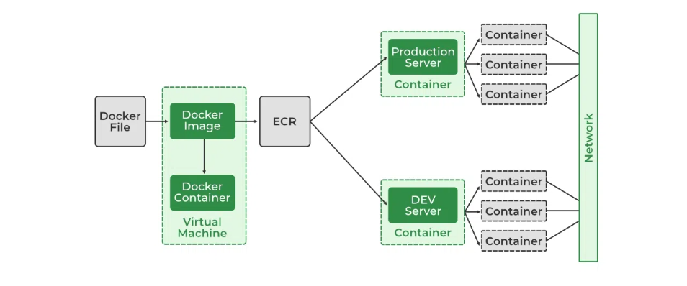
Docker network
Docker Networking allows you to create a Network of Docker Containers managed by a master node called the manager. Containers inside the Docker Network can talk to each other by sharing packets of information.

Slide 10
Docker Network Drivers
There are several default network drivers available in Docker and some can be installed with the help of plugins, Command to see the list of containers in Docker mentioned below.
#docker network ls
Types of Network Drivers
bridge: If you build a container without specifying the kind of driver, the container will only be created in the bridge network, which is the default network.
host: Containers will not have any IP address they will be directly created in the system network which will remove isolation between the docker host and containers.
none: IP addresses won’t be assigned to containers. These containments are not accessible to us from the outside or from any other container.
overlay: overlay network will enable the connection between multiple Docker demons and make different Docker swarm services communicate with each other.
ipvlan: Users have complete control over both IPv4 and IPv6 addressing by using the IPvlan driver.
macvlan: macvlan driver makes it possible to assign MAC addresses to a container.

Slide 11
Docker volumes
Docker containers enable apps to execute in an isolated environment. All modifications made inside the container are lost by default when it ends. Docker volumes and bind mounts can be useful for storing data in between runs. One way to store data outside of containers is with volumes. All volumes are kept in a specific directory on your host, typically /var/lib/docker/volumes for Linux systems, and are controlled by Docker
Docker volume types
Volumes: Docker manages volumes kept in a section of the host filesystem (/var/lib/docker/volumes on Linux). This portion of the filesystem shouldn't be altered by non-Docker processes. In Docker, volumes are the most effective way to store data. Using the docker volume create command, we may directly create a volume, or Docker can do it for us when it creates a container or service.
Bind Mounts: On the host system, bind mounts can be kept anywhere. These might be crucial system folders or files. They are always modifiable by non-Docker processes running on a Docker host or in a Docker container. Comparatively speaking, bind mounts are less useful than volumes.
Tmpfs Mounts: These mounts are never written to the host system's filesystem; instead, they are kept solely in the memory of the host system. Neither on the Docker host nor in a container is it stored on a disc. Sensitive or non-persistent state data can be stored on the tmpfs mount for the duration of the container.

Slide 12
Docker compose
Docker Compose is a tool for defining and running multi-container applications. It is the key to unlocking a streamlined and efficient development and deployment experience.
Compose simplifies the control of your entire application stack, making it easy to manage services, networks, and volumes in a single, comprehensible YAML configuration file. Then, with a single command, you create and start all the services from your configuration file.
Compose works in all environments; production, staging, development, testing, as well as CI workflows. It also has commands for managing the whole lifecycle of your application:
Start, stop, and rebuild services
View the status of running services
Stream the log output of running services
Run a one-off command on a service

Slide 13
Docker compose command
docker compose up –d (deploy the docker compose)
docker compose down (delete the docker compose)
docker compose logs postgres<service_name>
docker compose ps (list all services)

