Slide 1
MAJOR PROJECT REVIEW • COMBINED REVIEW (REVIEW 1 & 2)
SubSense
SaaS Subscription & Expense Analytics Dashboard
Project Summary & Highlights
• Objective: Eliminate subscription sprawl and optimize cloud/SaaS recurring expenditure through unified tracking and intelligent analytics.
• Full-Stack Architecture: React 18 frontend with Recharts visualization, Node.js + Express backend, MongoDB Atlas persistence, and JWT session security.
• Core Capabilities: Automated renewal countdowns, category budget guardrails, interactive spend trajectories, and smart license optimization.
• Current Milestone: Review 1 & 2 complete with core APIs, database models, frontend views, and automated test coverage.
Presentation Details
Domain: Full-Stack Web Engineering (MERN)
Core Stack: MongoDB • Express • React 18 • Node.js
Design System: Tailwind CSS • Glassmorphism
Security: JWT Bearer Tokens • BCrypt Salting
Target Environment: Vercel / Render / MongoDB Atlas
Review Milestone: Review 1 & 2 Combined Presentation
SubSense | Department of Computer Science & Engineering | Combined Review Presentation

Slide 2
AGENDA
Scope of This Review
SubSense Project Overview
SaaS Subscription & Expense Analytics Dashboard
• Problem: The average professional/team manages 8+ subscriptions, leading to billing surprises, untracked renewals, and redundant tool spending.
• Solution: SubSense centralizes all recurring subscriptions into an executive glassmorphic dashboard with live spend analytics and renewal alerts.
• Architecture: Built with the MERN stack (MongoDB, Express.js, React 18, Node.js) with JWT authentication and Recharts data visualization.
• Review Scope: Comprehensive review of system design, database architecture, end-to-end API integration, UI implementation, and test suites.
Requirements (Functional & Non-Functional)
Detailed 3-Tier System Architecture
Use Case & Database ER Modeling
Module Description & Feature Matrix
Technology Stack & Supporting Libraries
UI Wireframes & Component Design System
Frontend (React 18 + Vite) & Backend (Express) Build
Database (MongoDB + Mongoose) & REST APIs
Progress (95%), Screenshots & Live Demo Flow
Technical Challenges, Solutions & Next Steps
Agenda
SubSense | Review 1 & 2 (MERN Stack Project)

Slide 3
01
REQUIREMENTS
Functional & Non-Functional Requirements
Functional Requirements
Non-Functional Requirements
User registration, login & secure JWT token authentication
Centralized subscription tracking & lifecycle states (Active, Paused, Cancelled)
Multi-cycle billing calculation (Monthly, Weekly, Quarterly, Yearly)
Real-time spend analytics & interactive Recharts spend trend visualization
Category-based budget tracking with dynamic spending cap alerts
Proactive renewal reminders & automated payment due-date countdown
Smart insights: duplicate subscription alerts & unused license detection
Performance: sub-second API response (< 200ms) with MongoDB compound indexing
Scalability: stateless REST API architecture handling high concurrent traffic
Security: BCrypt password hashing (10 salt rounds), JWT Bearer tokens, CORS controls
Usability: responsive glassmorphic dark UI styled with Tailwind CSS utility tokens
Reliability: resilient MongoDB Atlas connection pooling & schema validation
Maintainability: modular MVC backend architecture & reusable React components
Requirements
SubSense | Review 1 & 2 (MERN Stack Project)

Slide 4
02
ARCHITECTURE
System Architecture (Detailed)
CLIENT TIER
APPLICATION TIER
DATA TIER
React.js 18 + Vite (SPA)
React Context API (Auth)
Tailwind CSS + Glassmorphism
Recharts (Area & Donut)
Axios HTTP (Bearer JWT)
⇄
Node.js + Express.js REST API
JWT Authentication Middleware
Payload Validation Layer
MVC Controllers & Services
Jest & Supertest Test Suites
⇄
MongoDB Atlas Cloud DB
Mongoose ODM Models
Users & Subscriptions Collections
Compound & Unique Indexes
Schema Enums & Sanitization
Stateless HTTP/HTTPS REST requests flow from the React 18 client through Express endpoints, verified by JWT auth and validation middleware, before querying MongoDB Atlas via Mongoose ODM.
Architecture Pipeline: Client Tier (React 18 + Vite) ⇄ Application Tier (Node/Express REST API + JWT) ⇄ Data Tier (MongoDB Atlas Cloud Cluster via Mongoose ODM).
Architecture
SubSense | Review 1 & 2 (MERN Stack Project)

Slide 5
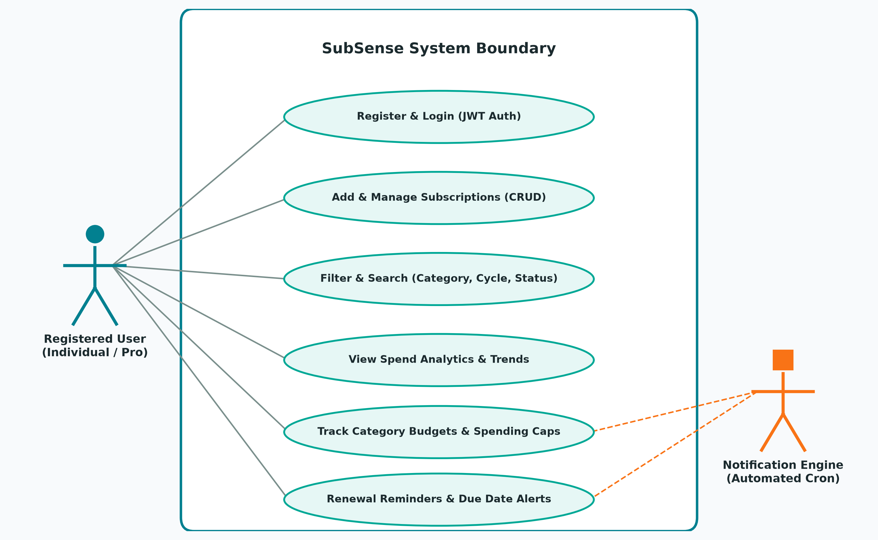
03
USE CASE
Use Case Diagram
System Actors & Use Cases
Primary Actor: Registered User
• Secure Register & Login (JWT Auth)
• Add, Edit, Delete Subscriptions (CRUD)
• Filter & Search (Category, Status, Cycle)
• View Live Spend Analytics & Trends
• Configure Category Budget Guardrails
• Track Upcoming Renewal Due Dates
Secondary Actor: Notification Engine
• Calculate Renewal Due Countdowns
• Trigger Proactive Renewal Alerts (3d/1d)
• Detect Duplicate Subscriptions
Relationships: User initiates interactive CRUD; Engine monitors cron-scheduled events.
Use Case
SubSense | Review 1 & 2 (MERN Stack Project)

Slide 6
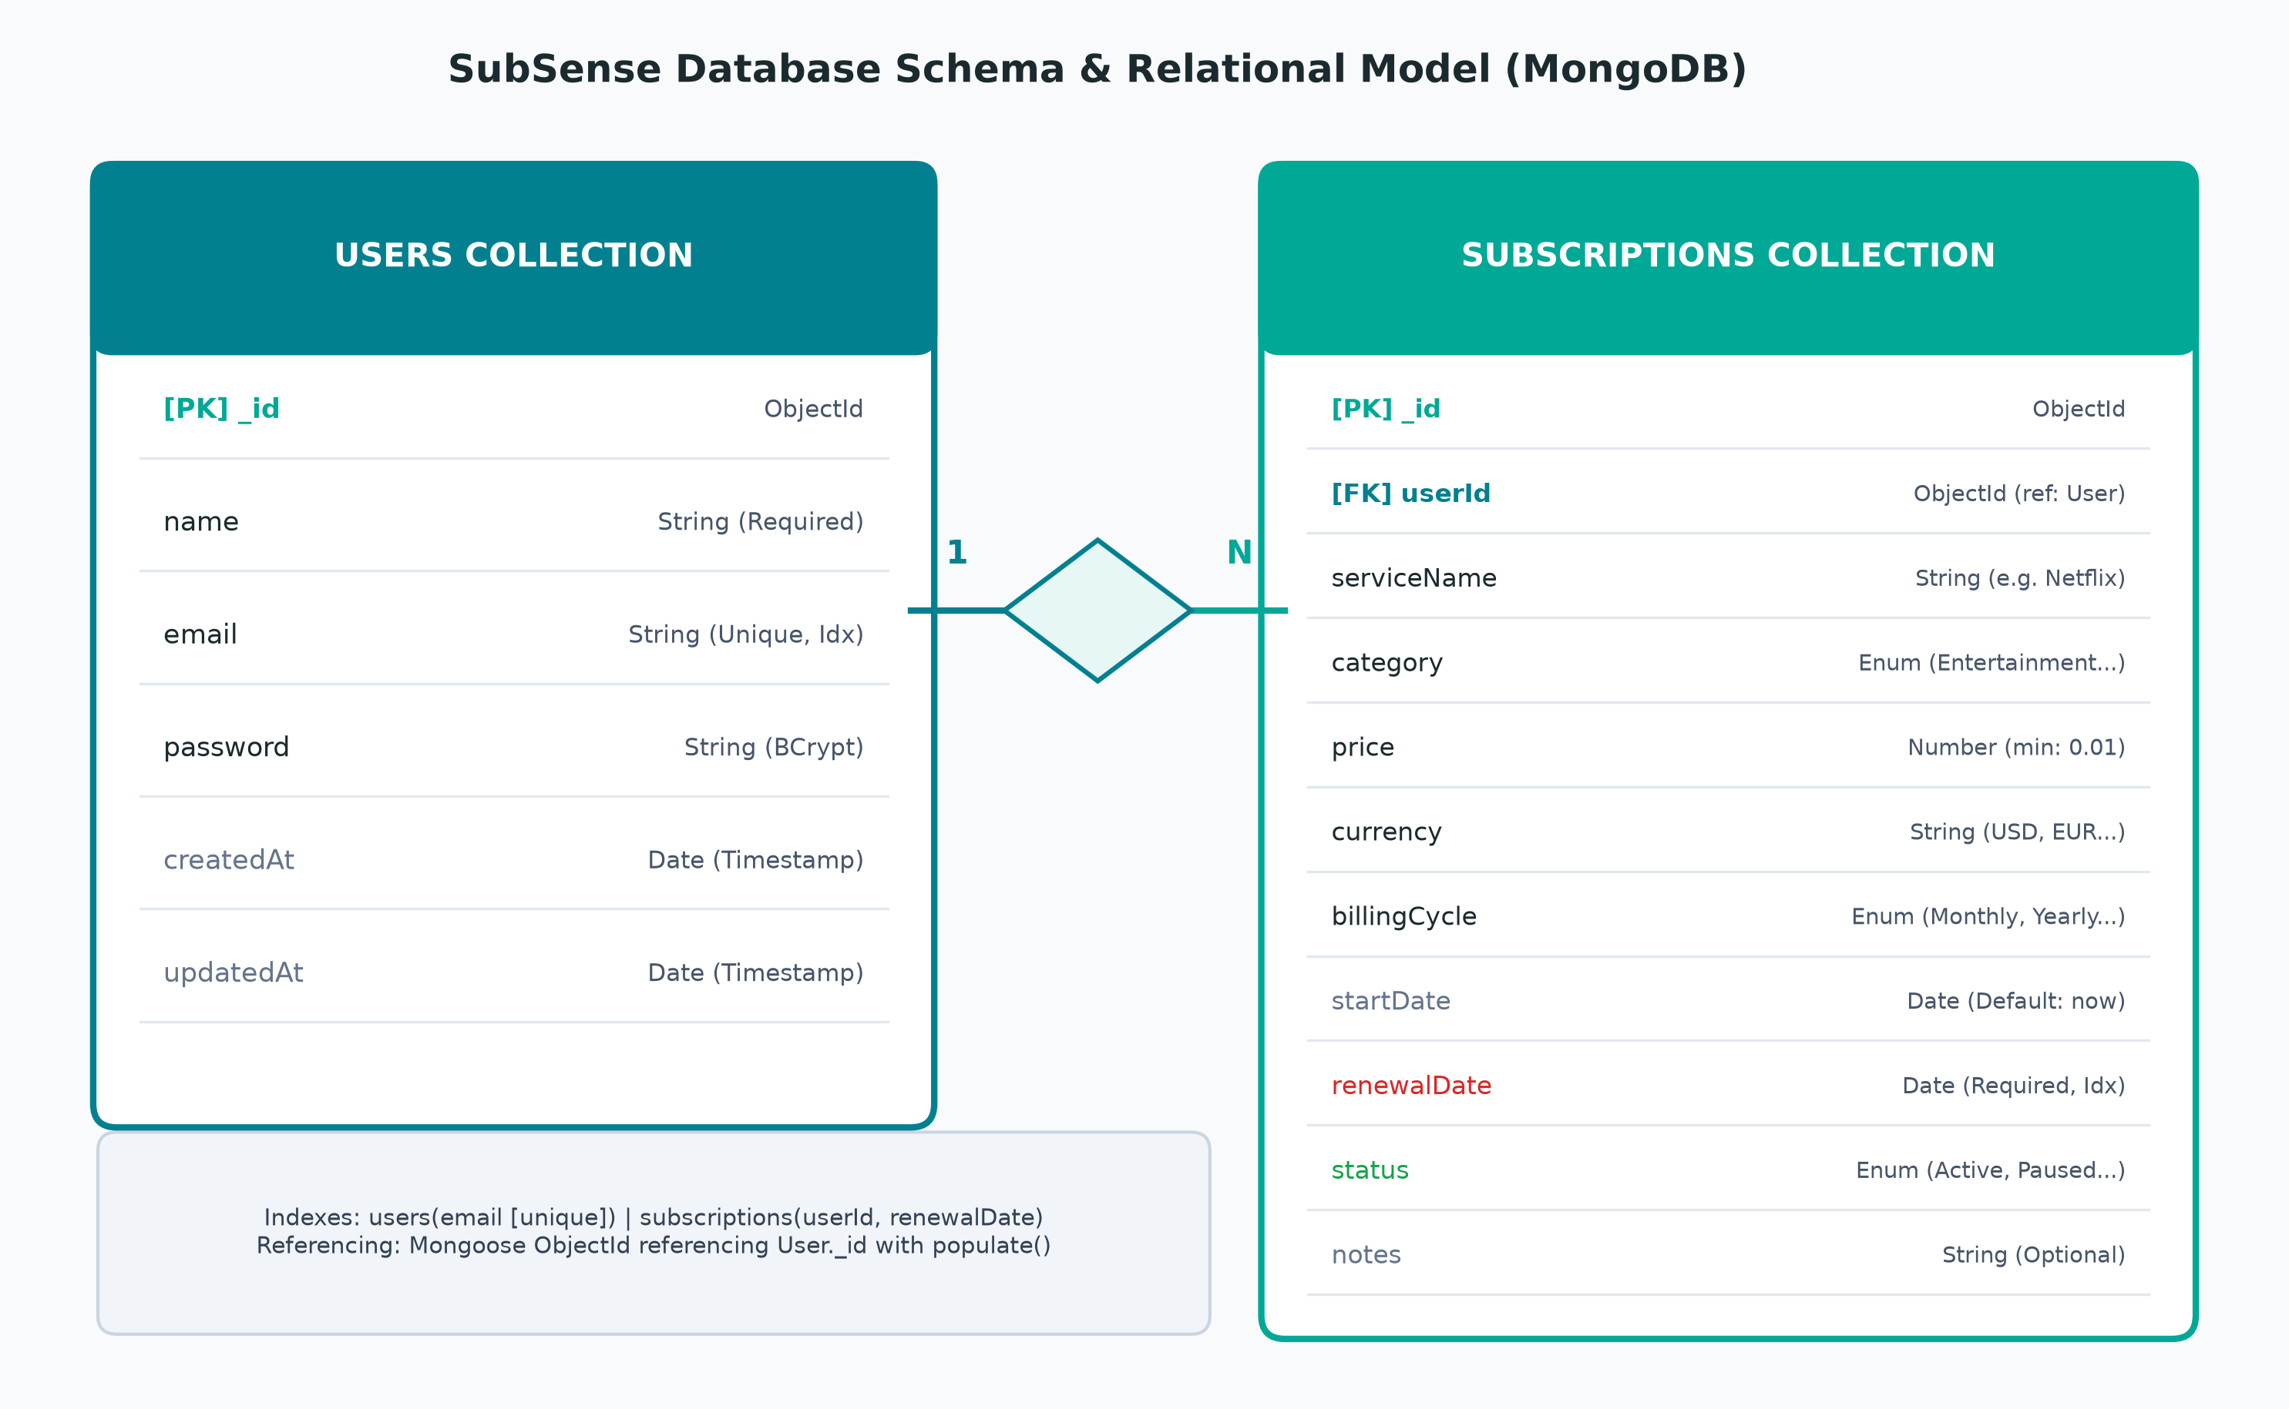
04
ER DIAGRAM
ER Diagram / Database Design
Database Schema Design
Users Collection ('users'):
• _id: ObjectId [Primary Key]
• name, email [Unique, Lowercase], password [BCrypt]
• createdAt, updatedAt [Timestamps]
Subscriptions Collection ('subscriptions'):
• _id: ObjectId [Primary Key]
• userId: ObjectId [Foreign Key -> users._id, Indexed]
• serviceName, price, currency (USD)
• category: Enum (Entertainment, Dev, Cloud, Design...)
• billingCycle: Enum (Weekly, Monthly, Quarterly, Yearly)
• renewalDate: Date [Indexed], status: Enum (Active/Paused)
Cardinality: 1:N (1 User has many Subscriptions)
Optimization: Compound index on { userId: 1, createdAt: -1 }.
ER Diagram
SubSense | Review 1 & 2 (MERN Stack Project)

Slide 7
05
MODULES
Module Description
Module | Description | Key Functions
User Authentication | Secure user onboarding, password hashing, and token issuance | Signup, Login, JWT verification, Protected routes
Subscription Core | Full lifecycle management of recurring software subscriptions | Create, Read, Update, Delete, Status Toggle, Billing cycles
Spend Analytics | Visual breakdown of recurring expenses and financial trends | Recharts AreaChart, Donut category split, Run-rate projection
Budget Guardrails | Category spending limits and threshold monitoring | Set Category Budgets, Progress tracking, Overspend alerts
Renewal & Alerts | Timeline tracking of upcoming renewal dates and smart heuristics | Renewal countdown, Days remaining, Duplicate detection
Modules
SubSense | Review 1 & 2 (MERN Stack Project)

Slide 8
06
TECH STACK
Technology Stack
MongoDB
Express.js
React.js
Node.js
NoSQL document database, Mongoose ODM schemas, compound indexes, cloud Atlas deployment.
Minimalist backend framework, RESTful API architecture, JWT auth middleware, custom validators.
React 18 SPA with Vite bundler, React Router v6, Context API, Recharts, Tailwind CSS.
Asynchronous event-driven V8 JavaScript runtime, non-blocking I/O, npm package ecosystem.
Supporting Tools
Mongoose ODM (Object Data Modeling & Schema validation)
Tailwind CSS (Utility-first modern dark glassmorphism UI)
Recharts (Interactive SVG spend charts & dynamic tooltips)
JWT & bcryptjs (Stateless tokens & cryptographic hashing)
Axios (Promise-based HTTP client with Bearer interceptors)
Jest & Supertest (Automated unit and integration testing)
Tech Stack
SubSense | Review 1 & 2 (MERN Stack Project)

Slide 9
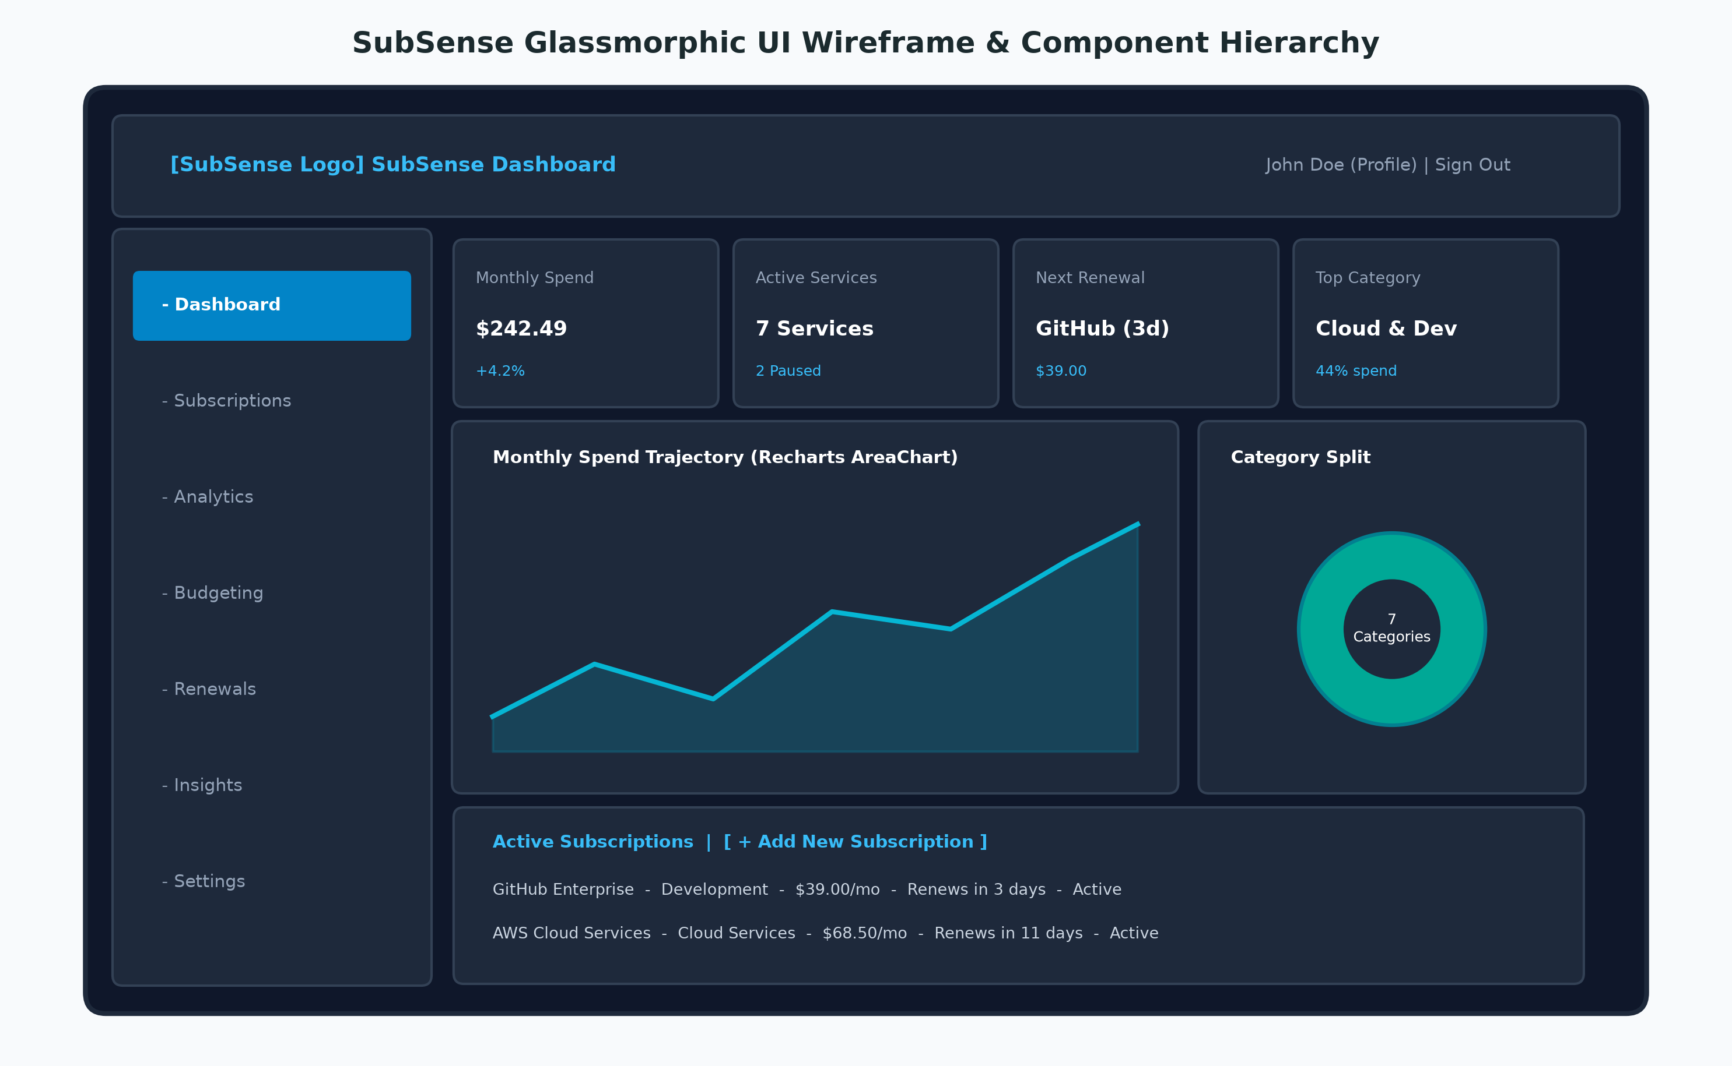
07
UI DESIGN
UI Design / Wireframes
Design Philosophy & Hierarchy
Glassmorphic Aesthetic:
• Deep slate backdrop (#0B0F19 / #0F172A)
• High-contrast cyan & emerald accents (#38BDF8, #10B981)
• Translucent glass cards with subtle borders & blur
Component Layout Hierarchy:
• DashboardLayout: Persistent responsive Sidebar & Navbar
• Metric Grid: 4 Top KPI StatCards with percentage shifts
• Visualization Grid: Spend Trajectory AreaChart & Donut
• Management Table: Filter pills, Search bar, CRUD modals
Responsive Design:
• Tailored breakpoints for Desktop (1280px+), Tablet, Mobile
• Built with modern Tailwind CSS utility tokens.
UI Design
SubSense | Review 1 & 2 (MERN Stack Project)

Slide 10
08
FRONTEND
Frontend Development
Built with React 18 & Vite providing instant HMR and optimized production bundling (< 1s build)
Component-driven modular architecture: DashboardLayout, Sidebar, Navbar, StatCards, Modals
Global authentication state managed via React Context API (AuthContext) with persistent localStorage
Client-side routing implemented with React Router DOM v6 with protected route authorization guards
Interactive financial data visualizations engineered with Recharts (AreaChart, PieChart & custom tooltips)
Modern glassmorphic dark design system styled with Tailwind CSS utility classes & custom CSS animations
Centralized Axios HTTP client with request interceptors for automatic Bearer JWT header injection
Completed Pages & Views: HomePage, LoginPage, RegisterPage, DashboardPage, SubscriptionsPage, AnalyticsPage, BudgetPage, RenewalsPage, InsightsPage, SettingsPage.
Frontend
SubSense | Review 1 & 2 (MERN Stack Project)

Slide 11
09
BACKEND
Backend Development
Node.js & Express.js RESTful API structured cleanly using the Model-View-Controller (MVC) pattern
Stateless authentication pipeline with JWT tokens and BCrypt password encryption (10 salt rounds)
Custom middleware architecture: protect for JWT route verification and validateSubscription for payload checks
Strict input validation enforcing category enums, billing cycle enums, positive prices, and ISO dates
Centralized error handling returning structured JSON status codes and developer-friendly messages
Multi-environment configuration powered by dotenv for development and production portability
Automated integration test suites built with Jest and Supertest (auth-flow.test.js, subscriptions.test.js)
Security & Middleware Stack: auth.protect (JWT token extraction & verification), validateSubscription.js (schema sanitization), and automated Jest API tests.
Backend
SubSense | Review 1 & 2 (MERN Stack Project)

Slide 12
10
DATABASE
Database Integration
MongoDB Atlas cloud cluster configured with Mongoose ODM connection pooling and auto-reconnect
Normalized document schemas: User and Subscription models with strict type definitions
Relational modeling using Mongoose ObjectId referencing (userId: Schema.Types.ObjectId -> User)
Compound indexing on { userId: 1, createdAt: -1 } ensuring sub-millisecond user query performance
Unique index on users.email preventing duplicate account creation at the database engine level
Built-in Mongoose schema validators for categories, billing cycles, and subscription statuses
Clean separation of database connection logic in config/db.js with structured connection logging
Active Collections: 'users' (identity, hashed credentials, timestamps) and 'subscriptions' (service metadata, price, billing cycle, renewal date, status, notes).
Database
SubSense | Review 1 & 2 (MERN Stack Project)

Slide 13
11
API
API Development
Method | Endpoint | Description
POST | /api/auth/register | Register a new user account with hashed password
POST | /api/auth/login | Authenticate user credentials & issue 7-day JWT token
GET | /api/auth/me | Retrieve current authenticated user profile via JWT
GET | /api/subscriptions | Fetch all subscriptions belonging to authenticated user
POST | /api/subscriptions | Create a new subscription record with schema validation
PUT / DEL | /api/subscriptions/:id | Update subscription details / delete subscription by ID
API
SubSense | Review 1 & 2 (MERN Stack Project)

Slide 14
12
STATUS
Module-wise Implementation Status
User Authentication & JWT Pipeline
100%
Frontend UI (Core Dashboard & Views)
95%
Backend REST APIs & Controllers
95%
Database Integration & Mongoose Schemas
95%
Spend Analytics & Recharts Data Visualization
90%
Renewal Reminders & Budget Thresholds
80%
Status
SubSense | Review 1 & 2 (MERN Stack Project)

Slide 15
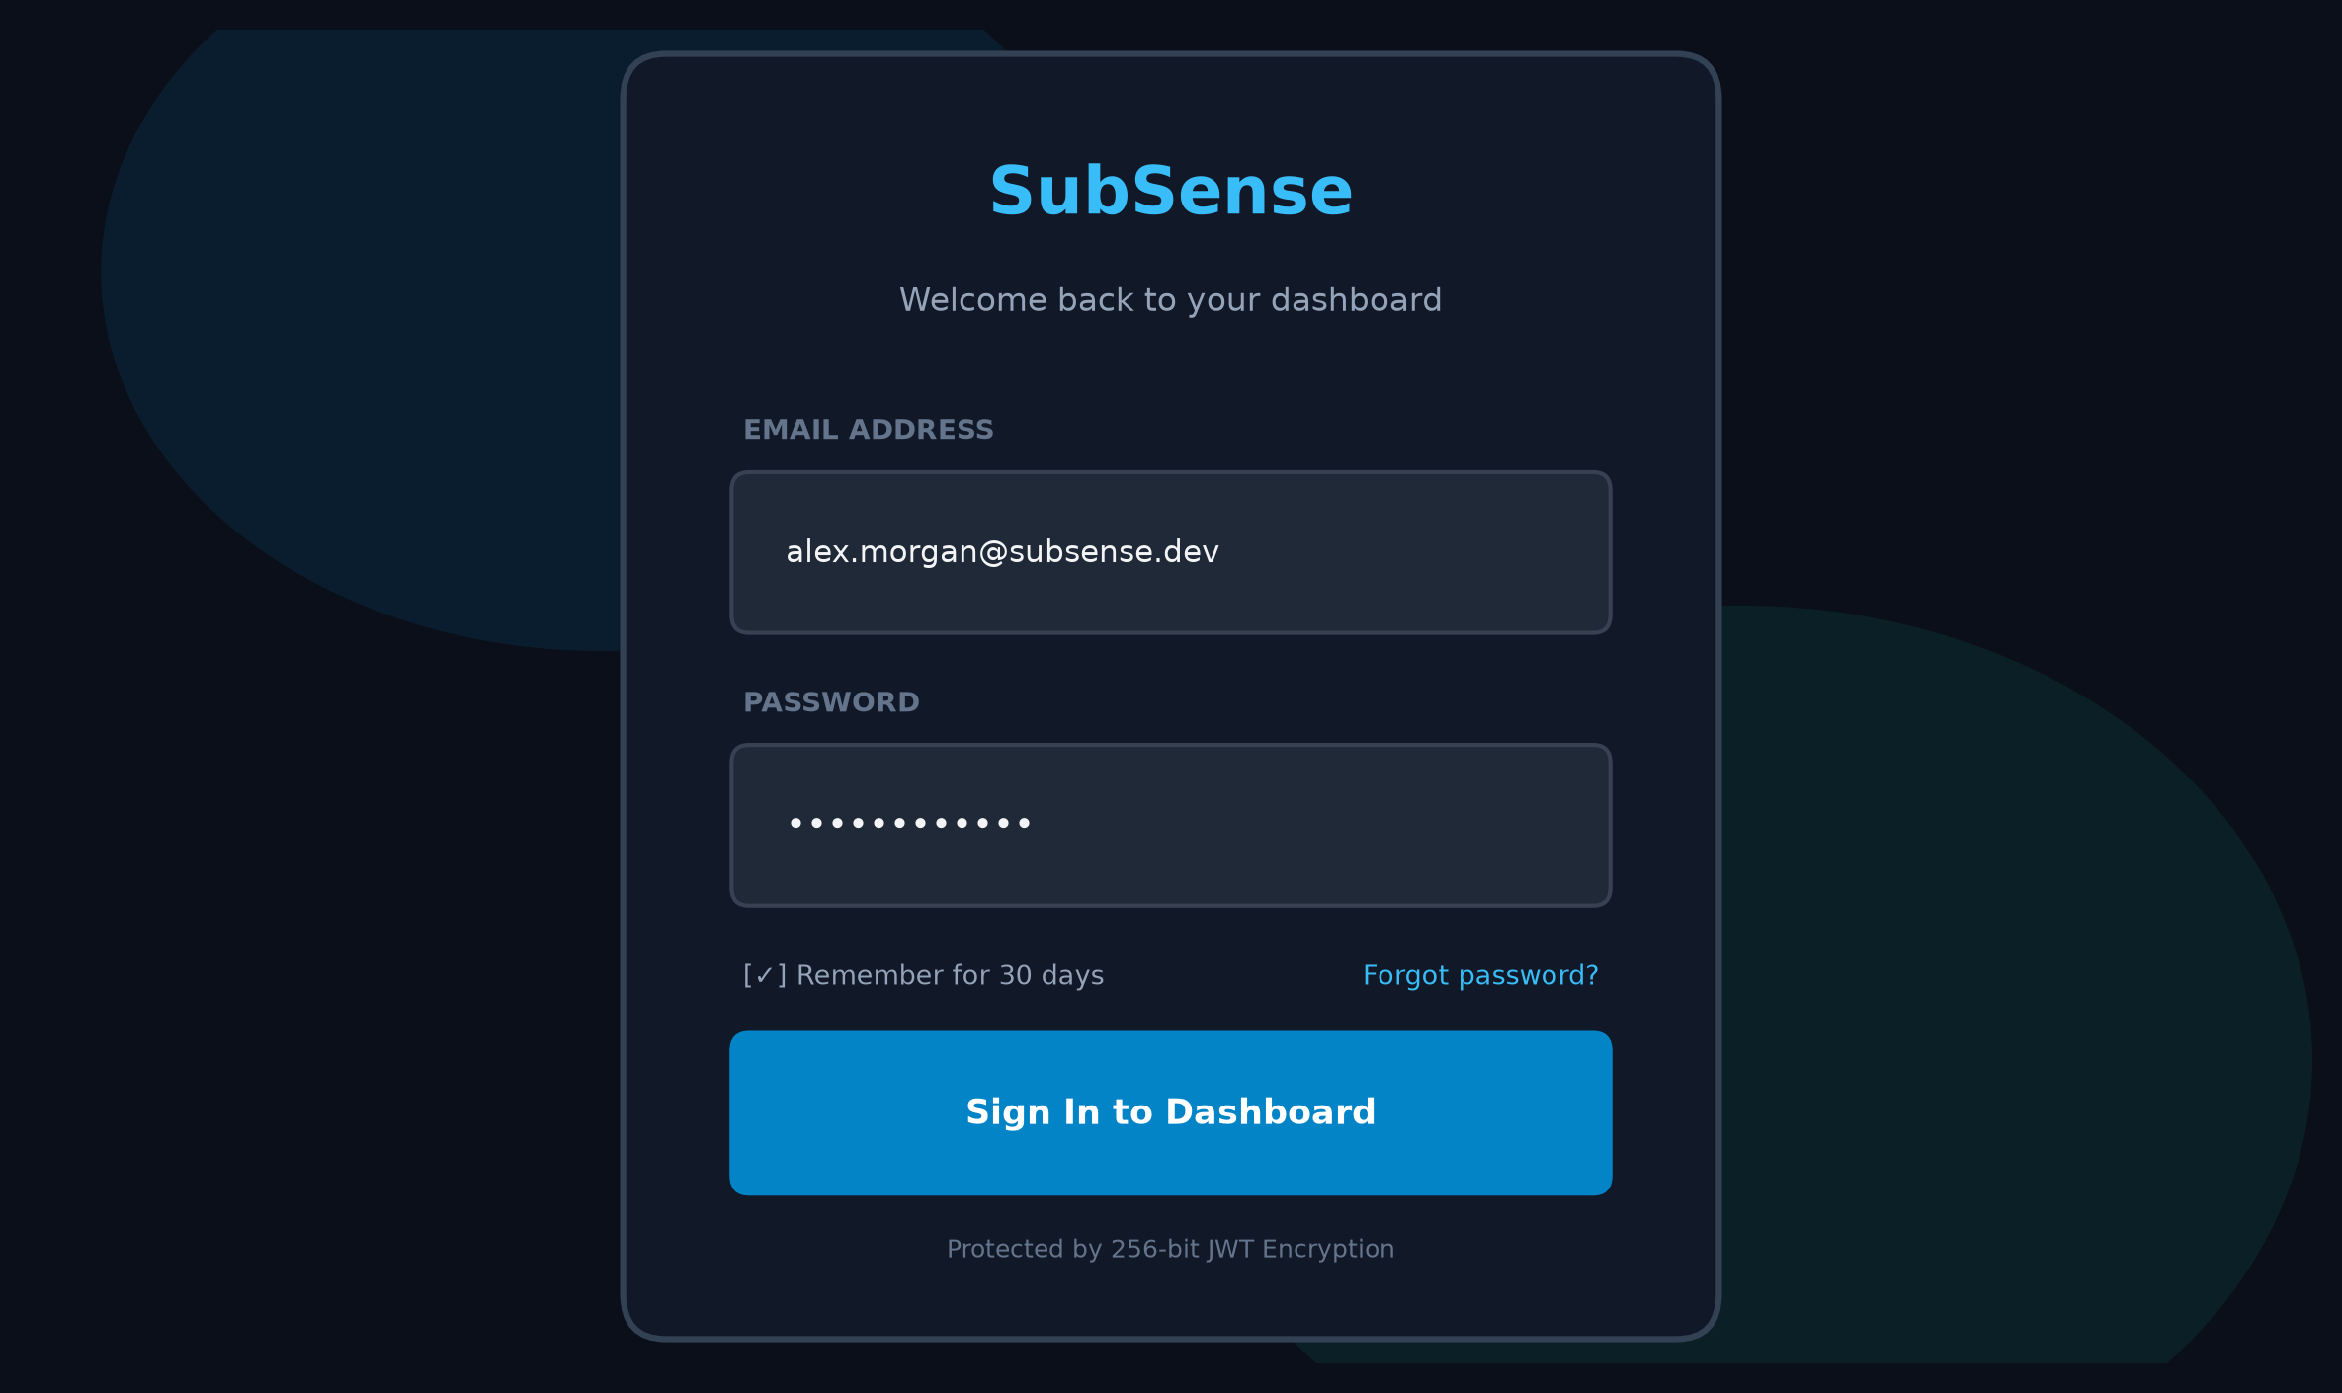
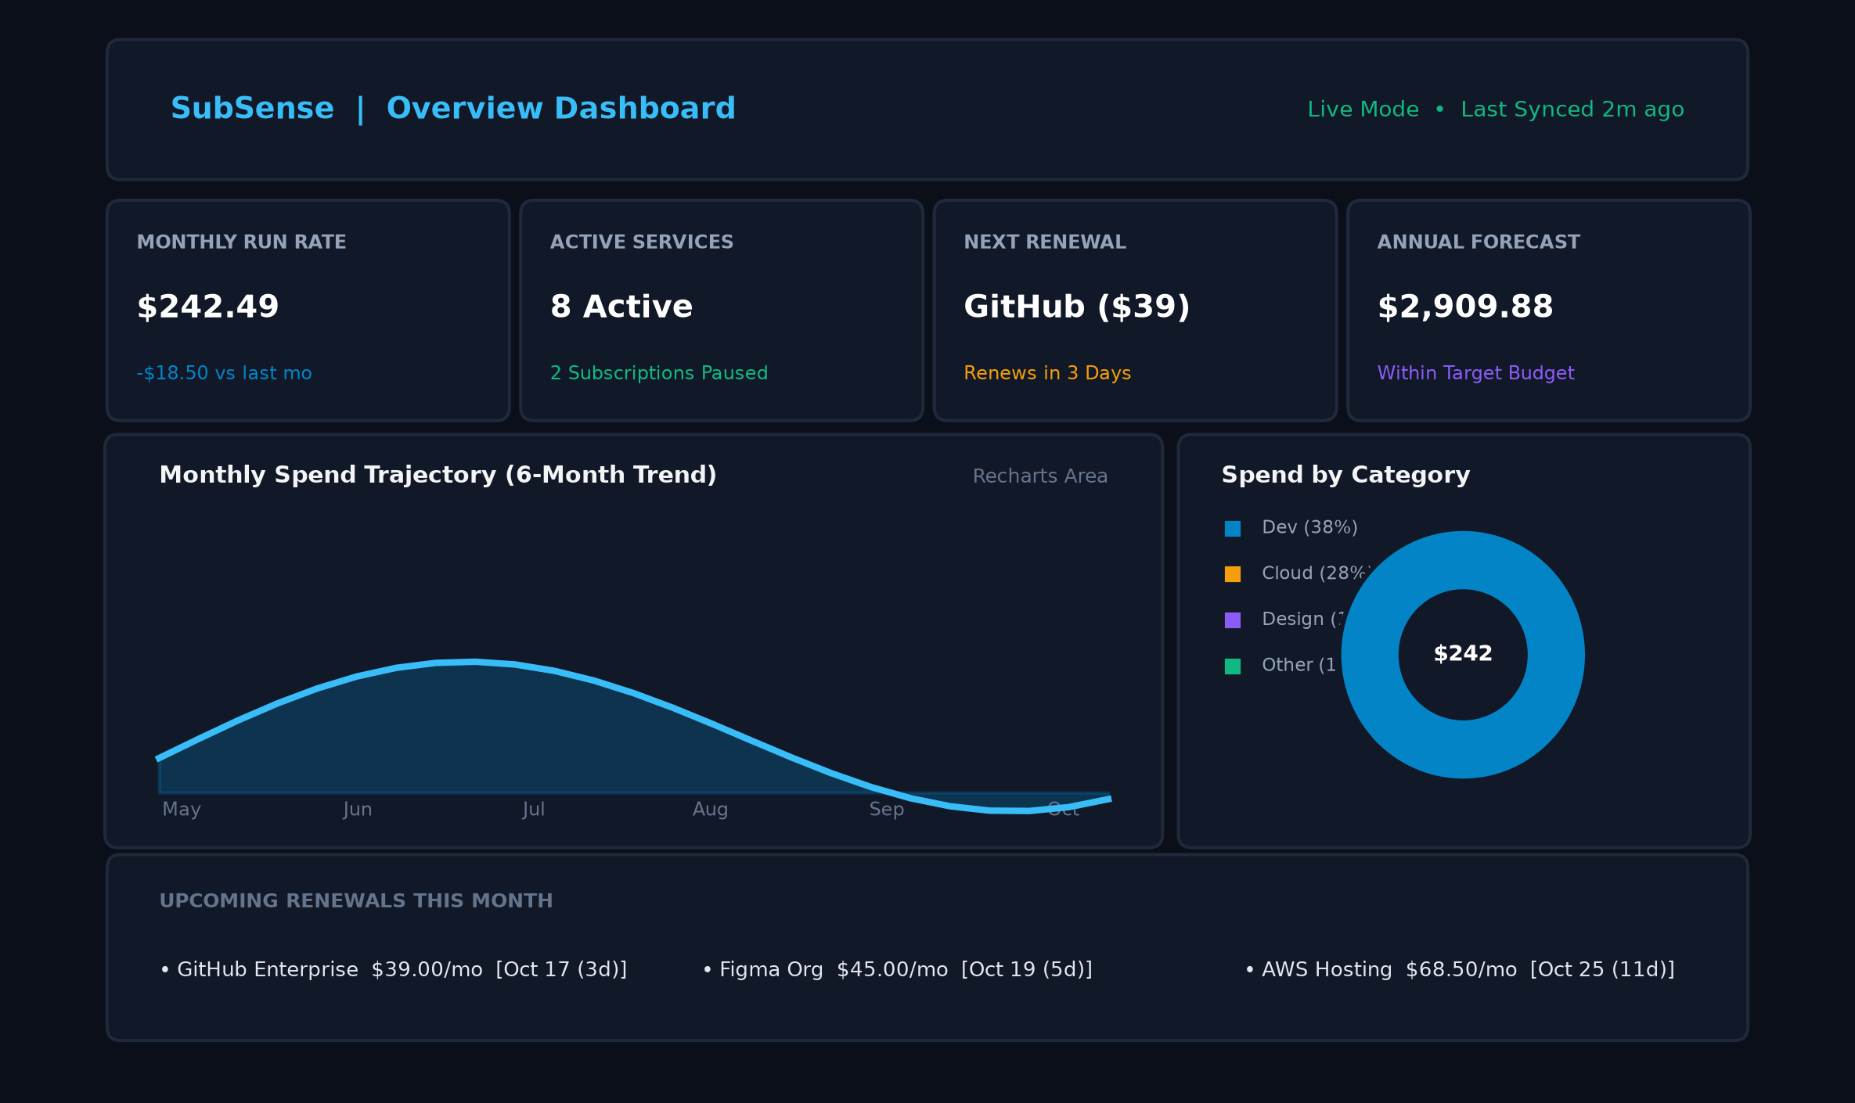
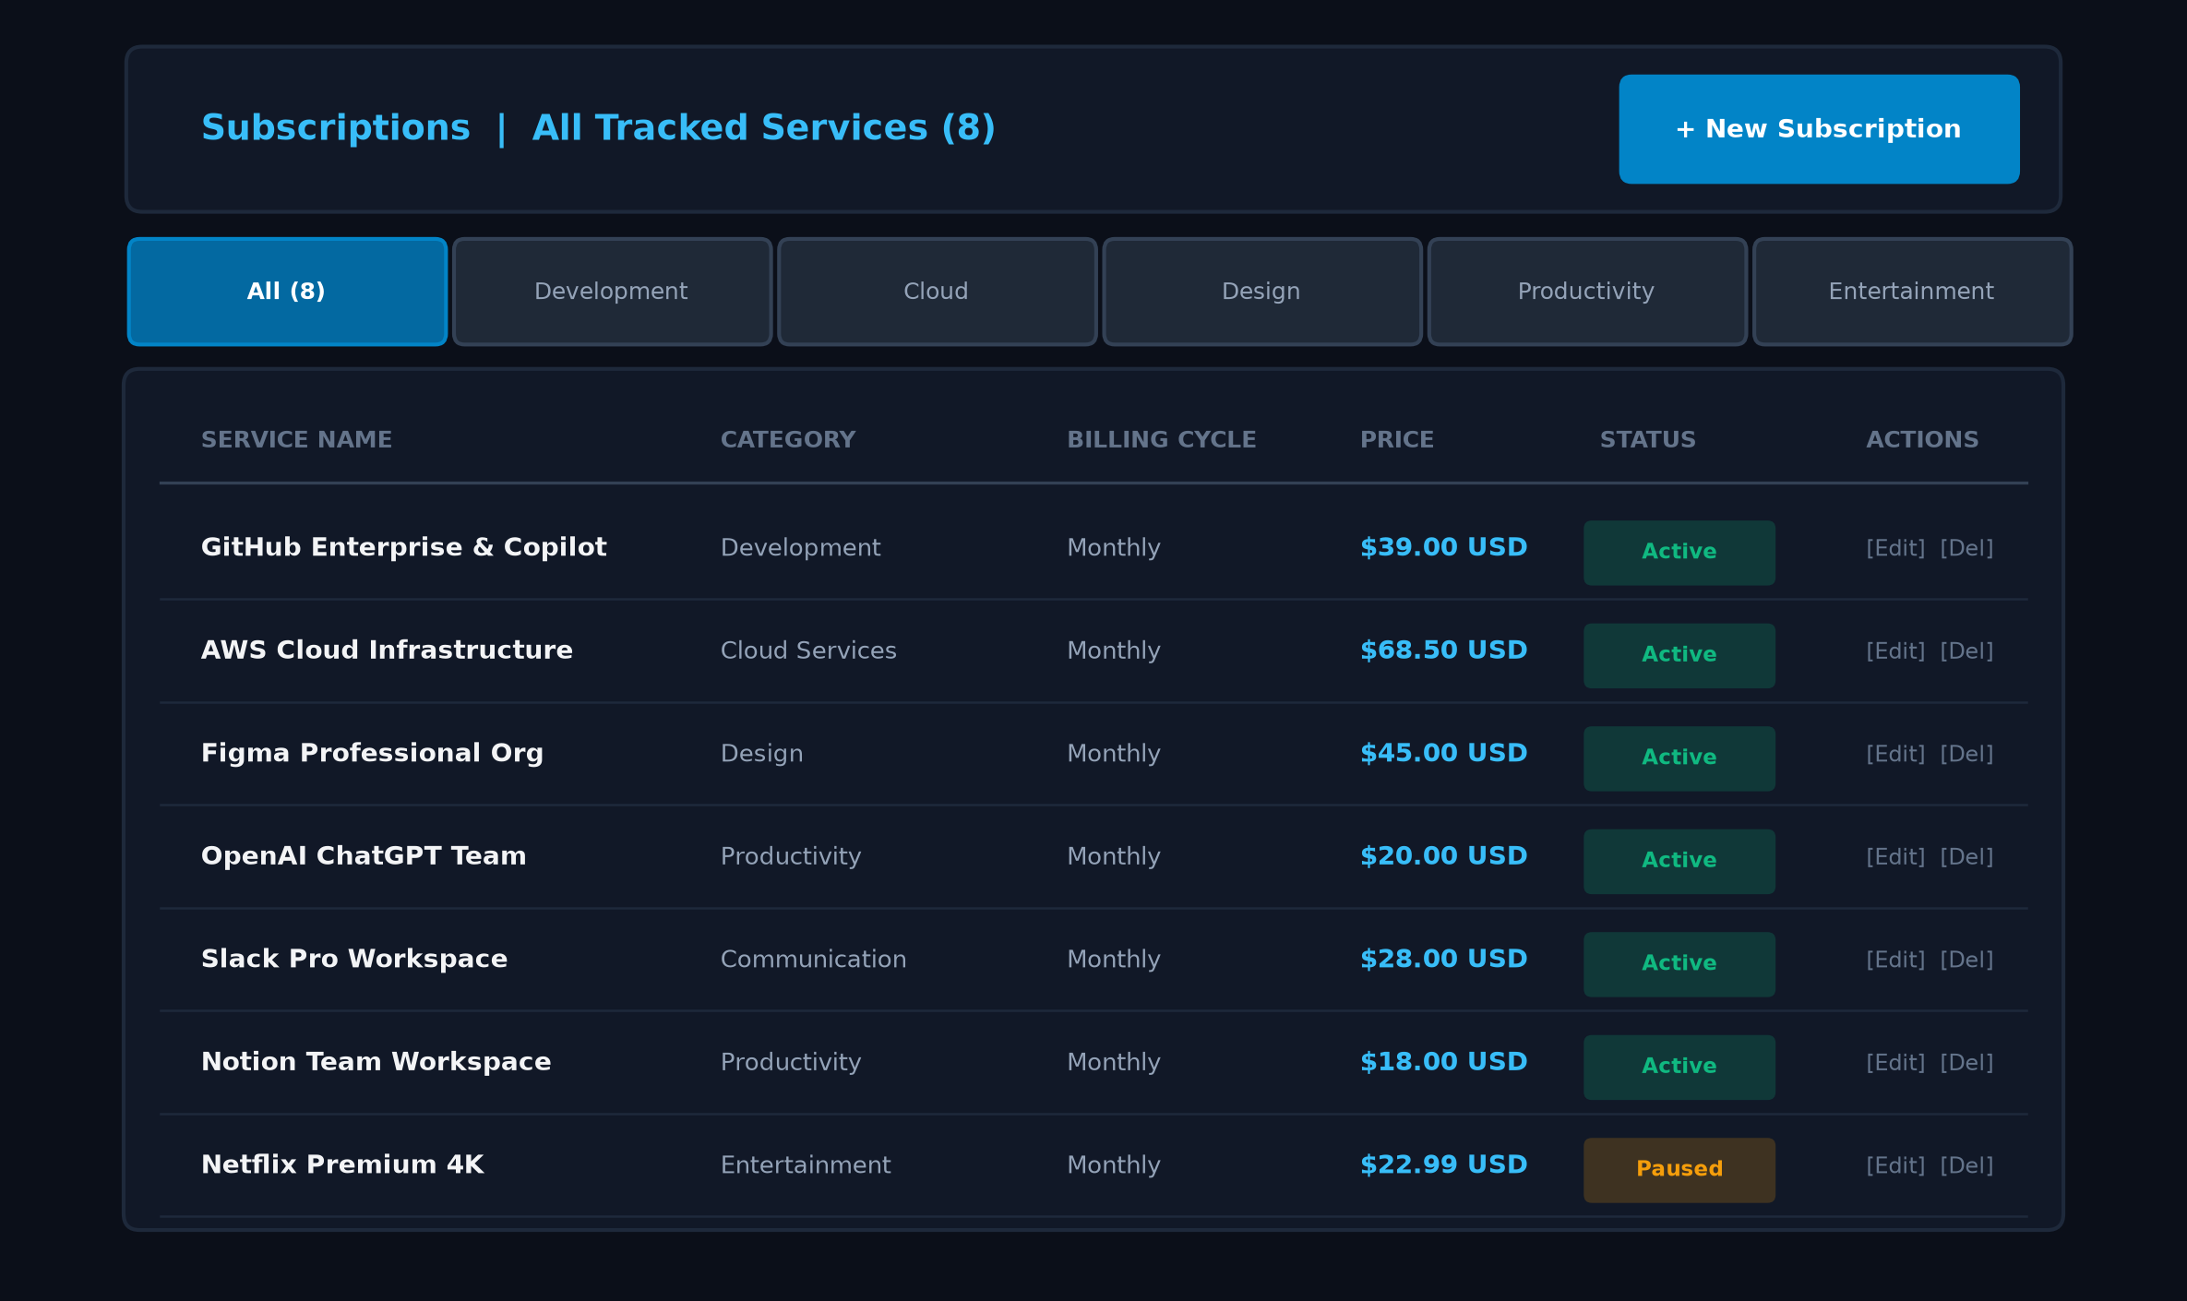
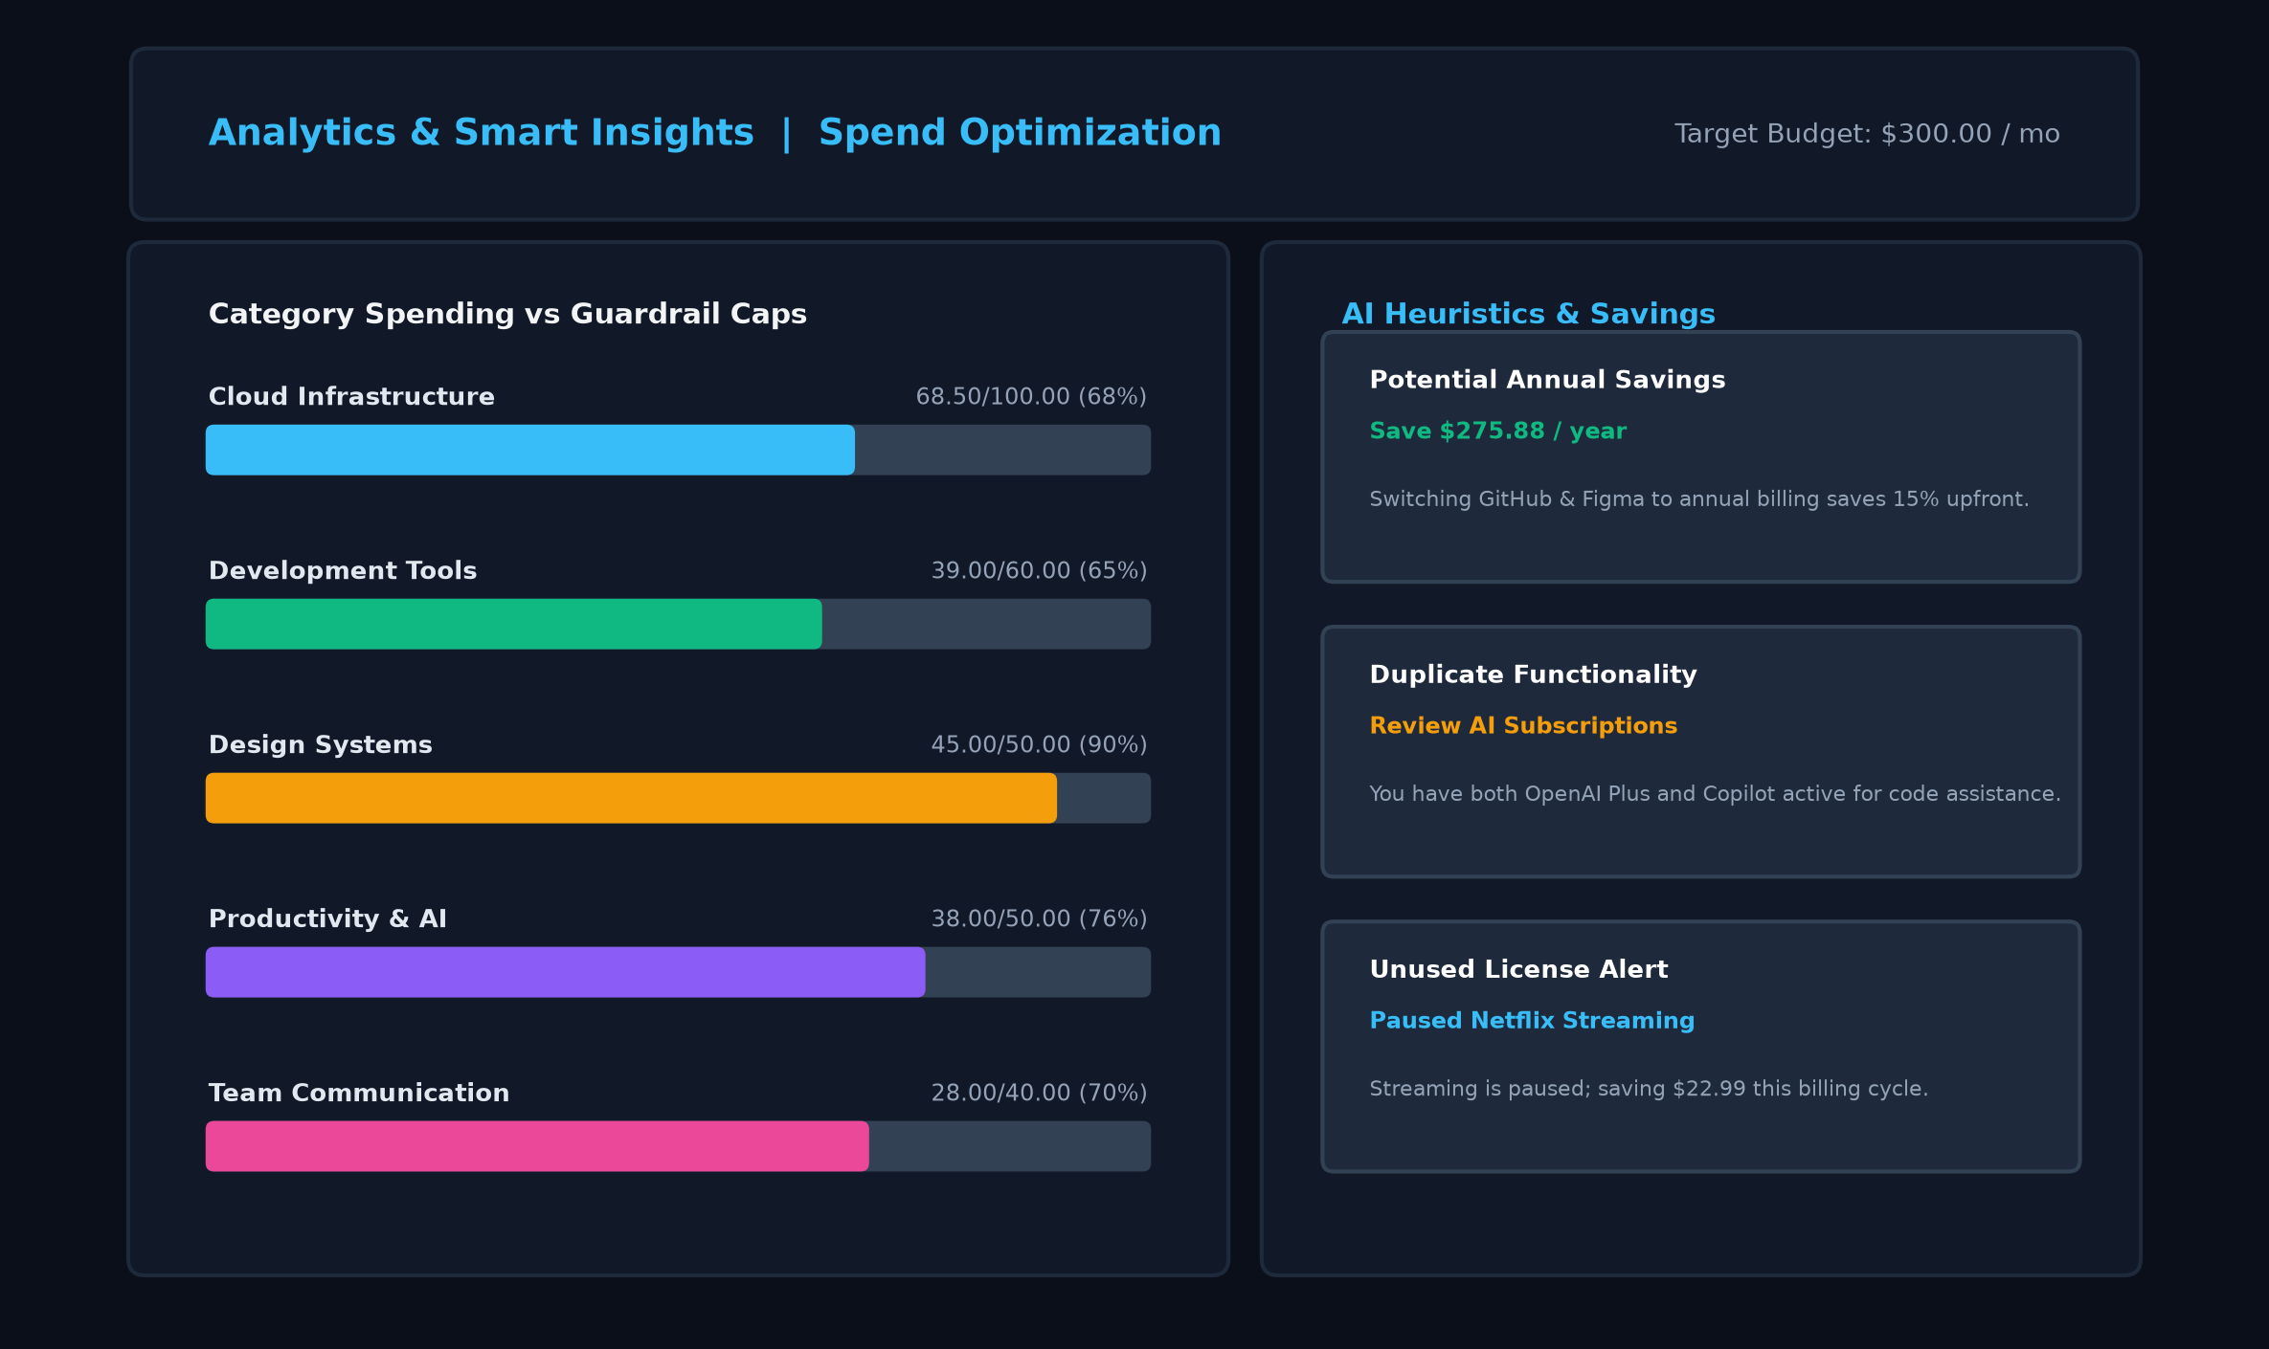
13
SCREENSHOTS
Screenshots
1. Authentication & JWT Login
2. Executive Overview Dashboard
3. Subscriptions Lifecycle & CRUD
4. Spend Analytics & Smart Insights
Screenshots
SubSense | Review 1 & 2 (MERN Stack Project)

Slide 16
14
CHALLENGES
Challenges Faced & Solutions
Challenge | Solution Adopted
Heterogeneous Billing Cycle Normalization | Engineered conversion algorithms normalizing Weekly, Monthly, Quarterly, and Yearly rates to monthly equivalents for unified analytics.
Stateless Session & Route Protection | Implemented JWT Bearer token authentication with Express middleware and React Context API to retain auth state across page reloads.
Real-time Recharts Synchronization | Centralized API queries and state updates so subscription mutations (Add/Edit/Delete) instantly re-render AreaChart and PieChart without refresh.
Strict Multi-field Input Validation | Created dual-layer validation via Express middleware and Mongoose schema enums to reject invalid dates, negative prices, and bad enums.
Challenges
SubSense | Review 1 & 2 (MERN Stack Project)

Slide 17
15
NEXT STEPS
Remaining Work & Plan
Automated Email & Webhook Renewal Alerts: Integration with Nodemailer / SendGrid and node-cron scheduler for proactive 3-day and 1-day reminders
Multi-Currency Conversion & Live FX Rates: Integration with Open Exchange Rates API for dynamic multi-currency display and global conversion
Bank Statement & CSV Import: Automated transaction parsing engine to detect recurring SaaS subscriptions automatically from statements
Predictive ML Spend Anomaly Detection: Heuristic statistical model to predict unexpected price increases and budget overruns before they occur
Production Cloud Deployment: Deployment of frontend SPA to Vercel, containerized Node.js backend on Render, and MongoDB Atlas cluster
Comprehensive End-to-End Testing & Accessibility: Lighthouse 95+ performance optimization and Jest / Cypress automated test coverage expansion
Next Steps
SubSense | Review 1 & 2 (MERN Stack Project)

Slide 18
16
REFERENCES
References
# | Reference
1 | MongoDB & Mongoose ODM Documentation — https://www.mongodb.com/docs, https://mongoosejs.com
2 | Express.js & Node.js Application Framework Guides — https://expressjs.com, https://nodejs.org
3 | React 18 & Vite Official Documentation — https://react.dev, https://vite.dev
4 | RFC 7519: JSON Web Token (JWT) Standard & Recharts Framework — https://recharts.org
Next Steps
SubSense | Review 1 & 2 (MERN Stack Project)

