Slide 1
Robotic Indoor Localization using IMUs
Group No: 50 Date: 14/08/2015
Team Members
Project Advisor (Guide) : Dr. Vidhya Balasubramanian
S.No | Reg.No | Name | Section
1 | CB.EN.U4CSE12123 | Kiran Kassyap S | CSE-B
2 | CB.EN.U4CSE12133 | Ragul B | CSE-B
3 | CB.EN.U4CSE12147 | Sundarrajan G | CSE-B
4 | CB.EN.U4CSE12148 | Suriya D Murthy | CSE-B

Slide 2
ROBOTIC INDOOR LOCALIZATION
USING IMUs

Slide 3
MAJOR AREA
There are many techniques for localizing a mobile robot such as dead reckoning, using wifi etc. But these methods have lots of error.
Our goal is to devise an optimal error reducing algorithm for indoor localization using the sensors in-built in the Bstem board.
The Bstem board consists of sensors like gyroscope, accelerometer and motor encoders.
The map of the building is given to the board and the other details such as distance, angle are obtained from the gyroscope and the motor encoders respectively. With these information we are trying to write an algorithm so the robot is a able to localize itself in the building.

Slide 4
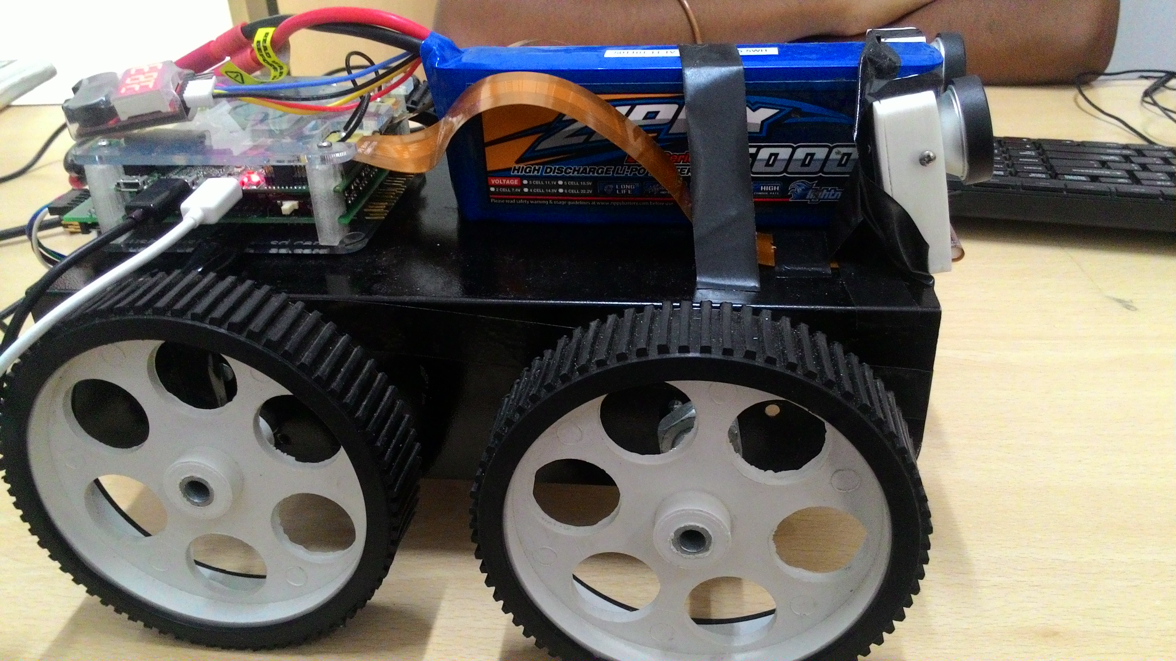

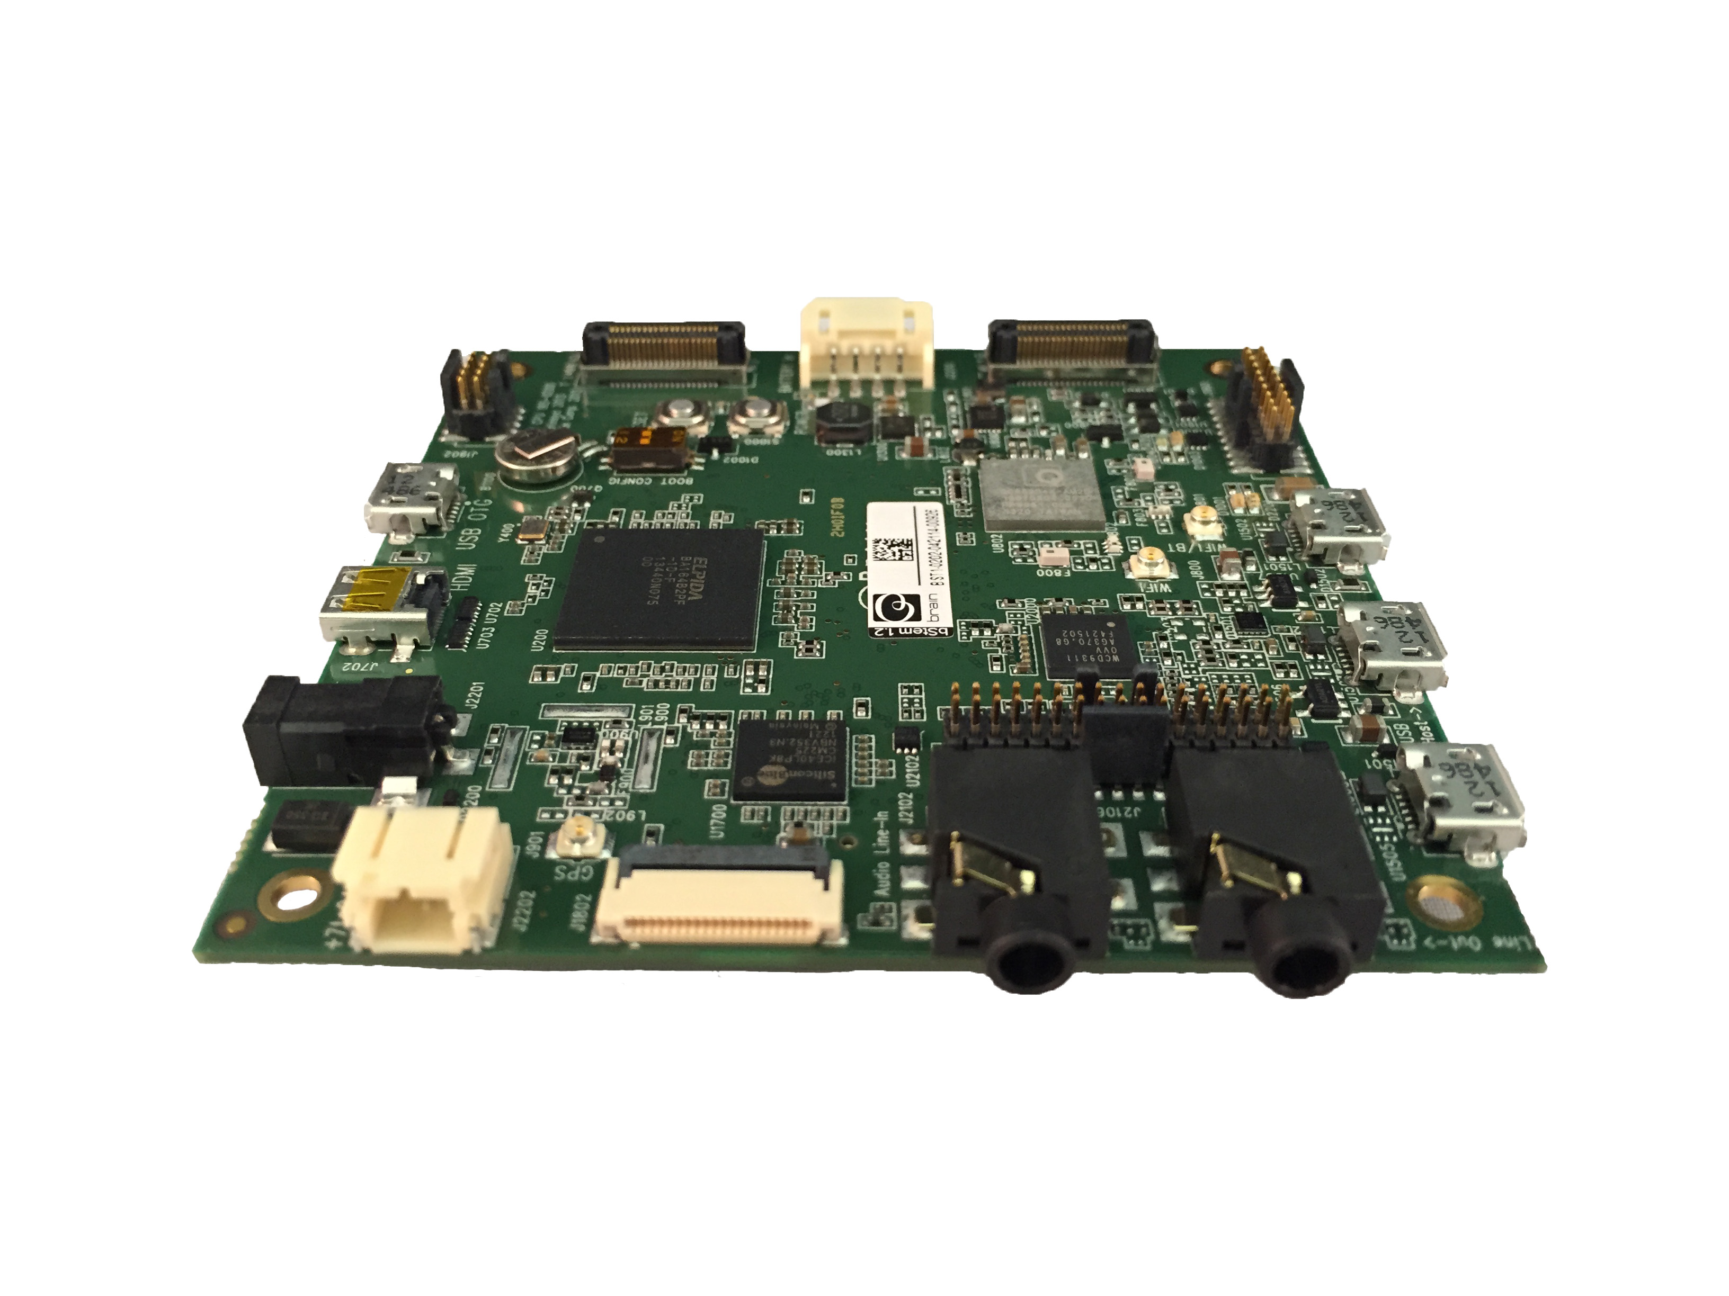

Slide 5
Motivation
Localization gives the answer to the question “Where am I ?”
Indoor localization is essential for proper navigation in building, obstacle avoidance, mapping of a building, also used in times of disaster and other emergency situations.
Current localization techniques are highly prone to error and its not completely reliable due to their lack of accuracy.
Thus writing an error reducing indoor localization algorithm helps to solve many real life problems.

Slide 6
Problem Statement
To develop an error reducing algorithm for Indoor localization of mobile robots.

Slide 7
GOALS
The problem has to be solved without the use of external agents like wifi as in emergency situations like disaster, it is not good to rely on external agents for localization.
The use of cost effective sensors to solve this problem.
Localization should be accurate.

Slide 8
METHOD PLANNED
The use of dead reckoning approach to solve this problem with the help of the inertial measurement unit (IMU) present in the bstem board.
The IMU consist of accelerometer and gyroscope. The orientation of the robot is obtained from these IMUs.
Using Kalman filter technique, the accuracy of the value is increased.
We also make use of the motor encoders to calculate the distance travelled by the robot.
The map of the building is already fed into the program. With all these information obtained, we are trying to write a error reducing algorithm.

Slide 9
WORK PLANNED
Study of existing algorithms.
Make the robot autonomous.
To integrate sensors and encoder values to find the distance travelled and angle of orientation of the robot and to plot the values in the provided map.
To devise an algorithm that corrects errors with help of the provided map and to obtain an accurate position of the robot in the given map.

Slide 10
REFERENCE PAPERS

Slide 11
Self-Contained Indoor Positioning on Off-The-Shelf Mobile Devices:
Indoor positioning is done using pedestrian dead-reckoning method, GNSS and activity based map matching algorithms to reduce errors.
Inertial Measurement Unit is integrated with GPS and magnetometer to derive the exact location of the mobile device.
User’s movement patterns are identified with help of an accelerometer and are uniquely classified.

Slide 12
Self-Contained Indoor Positioning on Off-The-Shelf Mobile Devices (Contd.):
The PDR algorithm happens to give values with errors even after application of filters. Hence an activity based map matching approach is carried to reduce errors.
Whenever there occurs a specific event in the accelerometer the values plotted in the map are corrected with help of the event database and hence path of the user is corrected.

Slide 13
Light Weight Map Matching Technique For Localization Using Conditional Random Field
Indoor localization is done using a dead reckoning approach, which makes use of Veterbi algorithm to determine the position of the person using the mobile device.
MapCraft is a new approach which makes use of Conditional Random Field(CRF), is used to map the position of the mobile device in real time.

Slide 14
Light Weight Map Matching Technique For Localization Using Conditional Random Field (Contd):
Conditional Random Field(CRF) gives the probability of the next possible states for the mobile device. CRF makes use of the training set to compute the probabilities.
Veterbi algorithm makes use of the probabilities and gives out a maximum likelihood position of the mobile device.

Slide 15
Conference paper I :
Dominik Gusenbauer, Carsten Isert and Jens Krösche, “Self-Contained Indoor Positioning on Off-The-Shelf Mobile Devices”, International Conference on Indoor Positioning and Indoor Navigation (IPIN), 15-17 September 2010.
Conference paper II :
Haitao Bao and Wai-Choong Wong, “An Indoor Dead-Reckoning Algorithm with Map Matching ”, Wireless Communications and Mobile Computing Conference (IWCMC), 9th July 2013.
Link for Paper I:
Dominik Gusenbauer, Carsten Isert and Jens Krösche, “Self-Contained Indoor Positioning on Off-The-Shelf Mobile Devices”, International Conference on Indoor Positioning and Indoor Navigation (IPIN), http://ieeexplore.ieee.org/xpls/abs_all.jsp?arnumber=5646681, September 2010.
Link for Paper II:
Zhuoling Xiao, Hongkai Wen, Andrew Markham, Niki Trigoni, “Lightweight Map Matching for Indoor Localisation using Conditional Random Fields”, Information Processing in Sensor Networks, IPSN-14 Proceedings of the 13th International Symposium, http://www.cs.ox.ac.uk/files/6677/MapCraftPublishedIPSN14.pdf , 15-17 April 2014

