Slide 1
ROBOTIC INDOOR LOCALIZATION
USING INERTIAL MEASUREMENT UNITS

Slide 2
2
Robotic Indoor Localization using Inertial Measurement units
Group No: 50 Date: 24/11/2015
Team Members
Project Advisor (Guide) : Dr. Vidhya Balasubramanian
S.No | Reg.No | Name | Section
1 | CB.EN.U4CSE12123 | Kiran Kassyap S | CSE-B
2 | CB.EN.U4CSE12133 | Ragul B | CSE-B
3 | CB.EN.U4CSE12147 | Sundarrajan G | CSE-B
4 | CB.EN.U4CSE12148 | Suriya D Murthy | CSE-B
Notes:
2

Slide 3
Problem Statement
To develop an error reducing algorithm for Indoor localization of mobile robots using
the inertial measurement units(IMUs).

Slide 4
4
Architecture Diagram
Wi-Fi
IMUs
Gyroscope
Magnetometer
Accelerometer
Map Of The
Building
BSTEM
AdCord
Board
Ultra-Sonic Sensors
Motors and Motor Encoders

Slide 5
Accelerometer
Gyroscope
Motor Encoders
Xa,Ya
Wg
Xe,Ye
arctan
((Xl - Xr)/W)
((Yl - Yr)/W)
ʃ
ʃ
Ɵa
Ɵg
Ɵg
Ɵe
Kalman Filter
Kalman Filter
Ɵag
Ɵge

Slide 6
Work Completed
Studied the existing algorithms.
Calibrated the gyroscope sensor values.
Read that Conditional Random Field(CRF) and found that was not relevant to our work.
Integrated sensors and encoder values to find the distance travelled and angle of orientation of the robot and plotted the values .

Slide 7
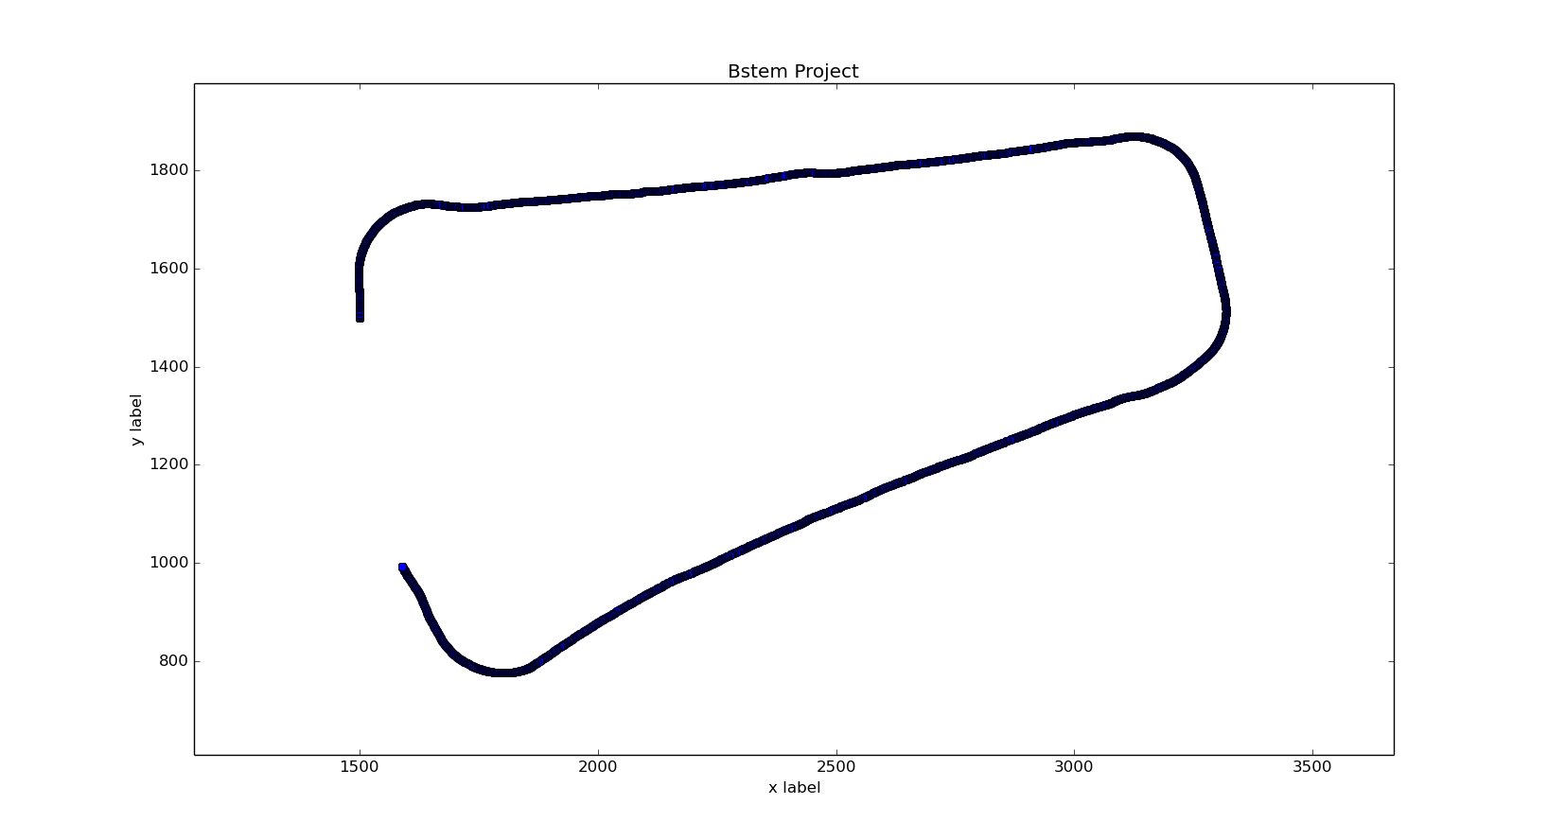
Implementation
Simple Square(20ft*10ft)

Slide 8
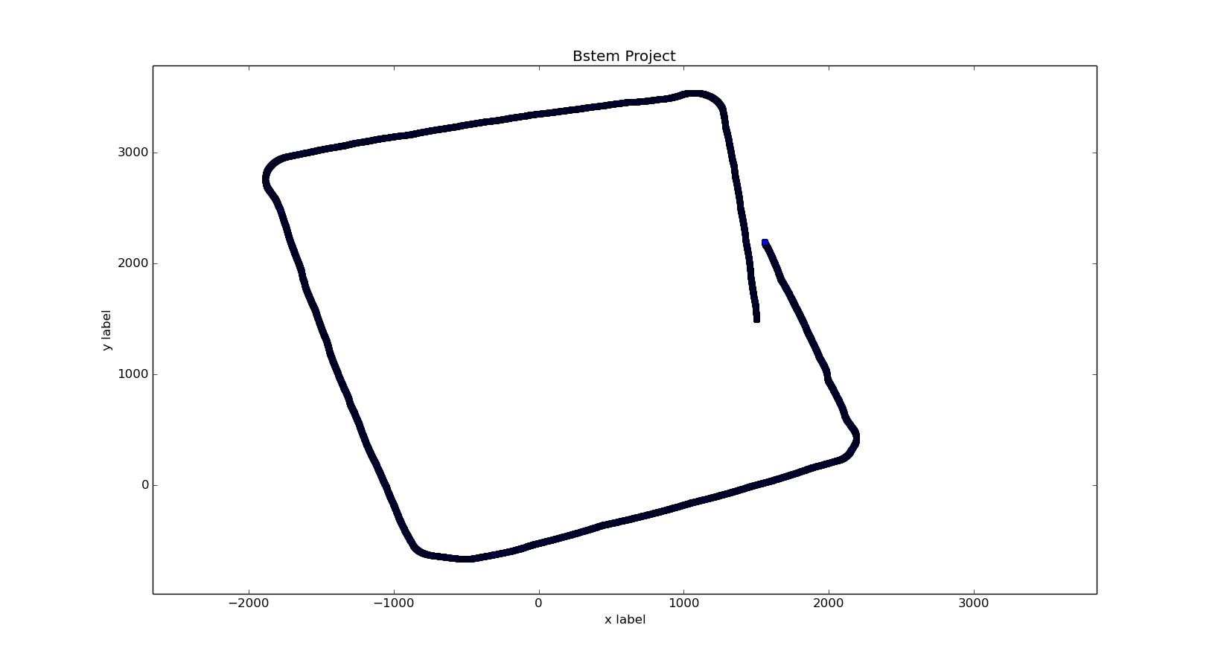
Implementation
Square Grid(Ground Floor, around staff room)

Slide 9
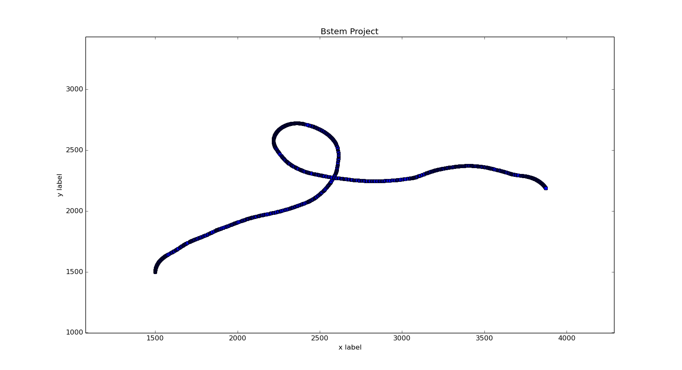
Implementation
8 – Shape (accumulated drift errors)

Slide 10
Future Work Planned
Getting more parameter values to apply in the available error reducing algorithms.
Working on finding angle using the encoders.
Working on reducing the gyroscope drift errors using filtering techniques.
Implement the existing error reducing algorithms and compare the results.
Device another error reducing algorithm which produces better result than the existing algorithms.

