Slide 1
ROBOTIC INDOOR LOCALIZATION
USING INERTIAL MEASUREMENT UNITS

Slide 2
2
Robotic Indoor Localization using Inertial Measurement units
Group No: 50 Date: 09/02/2016
Team Members
Project Advisor (Guide) : Dr. Vidhya Balasubramanian
S.No | Reg.No | Name | Section
1 | CB.EN.U4CSE12123 | Kiran Kassyap S | CSE-B
2 | CB.EN.U4CSE12144 | Srivenkata Krishnan | CSE-B
3 | CB.EN.U4CSE12147 | Sundarrajan G | CSE-B
Notes:
2

Slide 3
Problem Statement
To develop an error reducing algorithm for Indoor localization of mobile robots using
the inertial measurement units(IMUs) and
Range finder sensors.

Slide 4
Design of the Robot
Dimensions of the robot is 105*55*57mm and consists of 4 wheels each of 110mm diameter.
bStem acts as the main processing board and adCord board acts as an interface between motors and bStem.
Powered by Lithium Polymer battery(12V,5000mah,30C).
Consists of two ultrasonic and two infrared range finder sensors.
Arduino microcontroller is used for sensor integration.

Slide 5
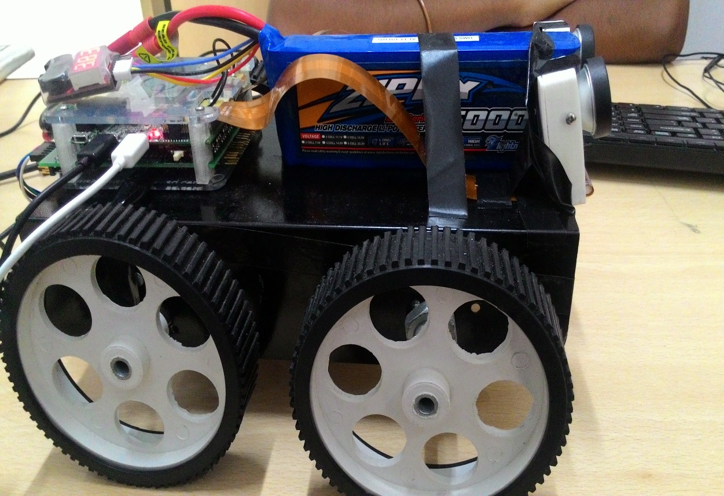

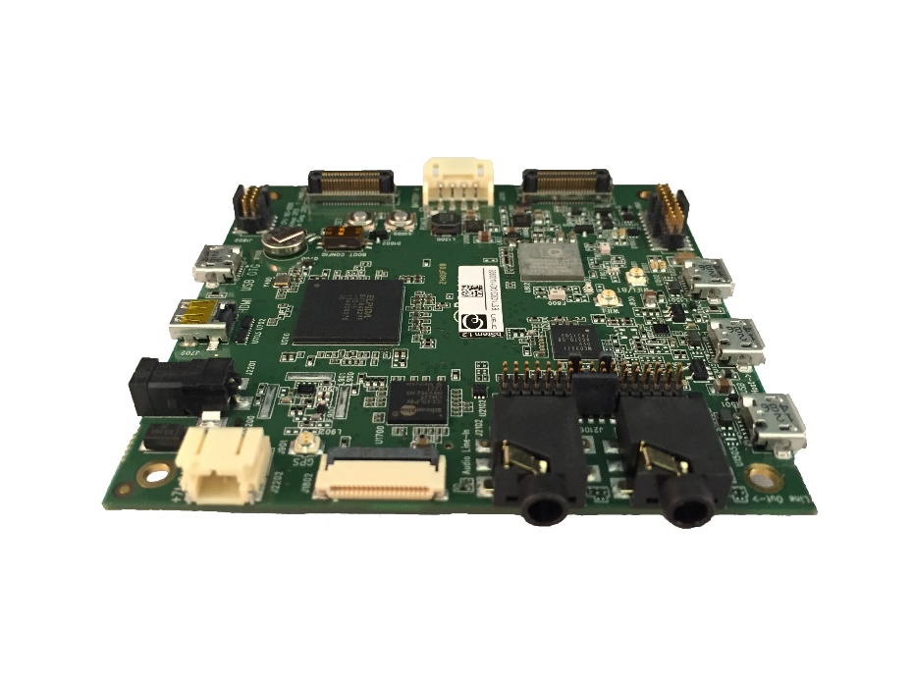
Design of the Robot (contd.)

Slide 6
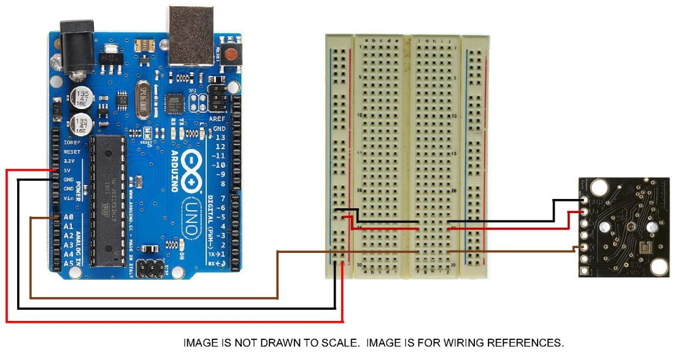
Circuit diagram
Ultrasonic Sensor : (For detection greater than 30cms)

Slide 7
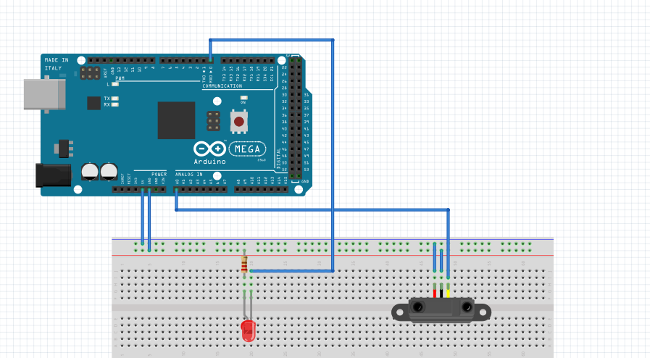
Circuit diagram (contd)
Infrared Sensor : (For detection less than 30cms)

Slide 8
8
Architecture Diagram (design)
Wi-Fi
Gyroscope
Map Of The
Building
BSTEM
AdCord
Board
Motors and Motor Encoders
Range Finder Sensors
Arduino

Slide 9
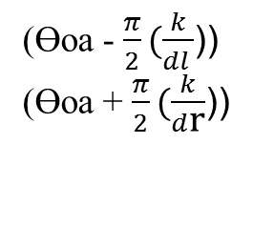
Architecture Diagram
Range Finder Sensors
Gyroscope
Motor Encoders
Wg
Xe,Ye
dl,dr
((Xl - Xr)/W)
((Yl - Yr)/W)
(Ɵoa - $\frac{π}{2}(\frac{k}{dl }$))
(Ɵoa + $\frac{π}{2}(\frac{k}{d\text{r} }$))
ʃ
ʃ
Ɵoa
Ɵg
Ɵg
Ɵe
Complimentary Filter
Complimentary Filter
Ɵoag
Ɵge

Slide 10
Work Completed
Studied the existing algorithms.
Calibrated the gyroscope sensor values.
Integrated encoder values to find the distance travelled and angle of orientation of the robot and plotted the values.
Integrated obstacle avoidance sensors with bStem with help of an Arduino microprocessor and added the required API’s.

Slide 11
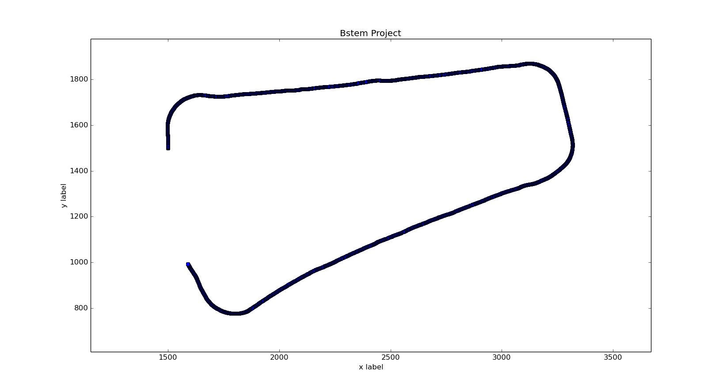
Previous Implementation
Gyroscope plot a.
Simple rectangle(20ft*10ft)

Slide 12
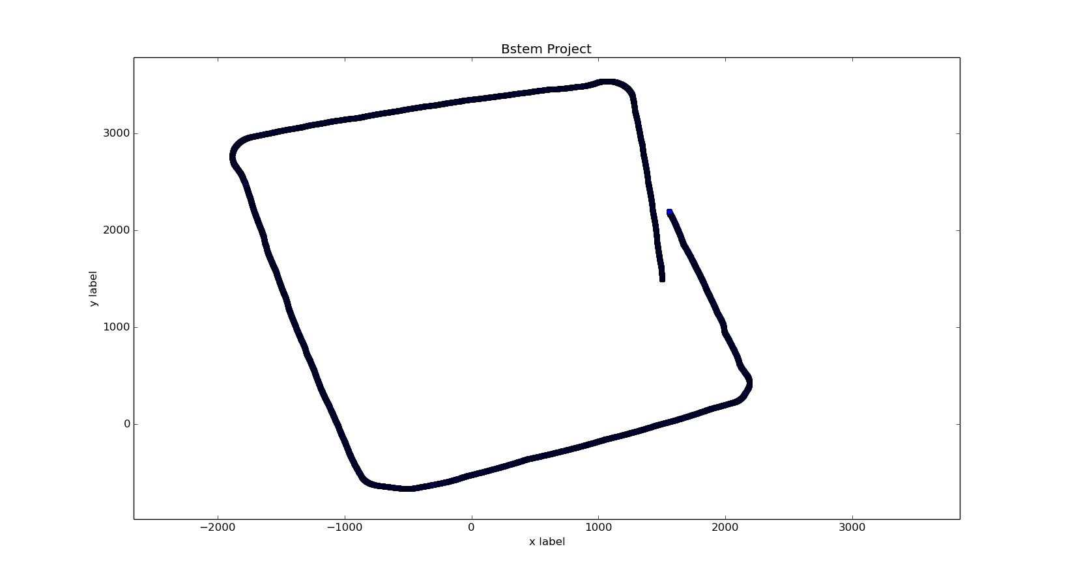
Previous Implementation
Gyroscope plot b.
Simple square 20ft*20ft

Slide 13
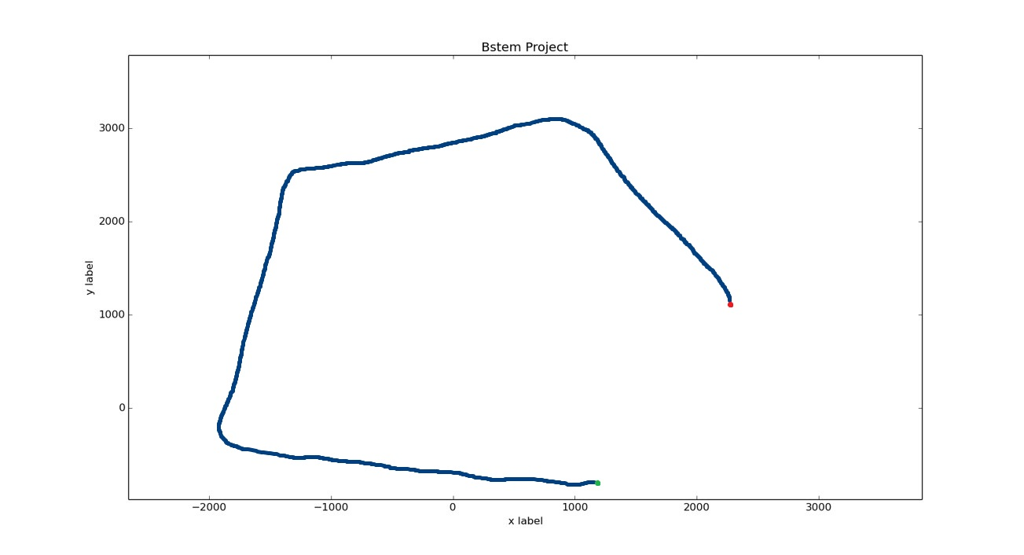
Current Implementation
Encoders plot:
Simple square 20ft*20ft

Slide 14
Gyroscope Encoder Fusion
From previous graphs we detected that encoders give proper value when travelling in a straight path.
Same way Gyroscope gives accurate values during the turns.
Hence we obtain encoder values when bot is travelling straight and similarly gyroscope values when the bot is taking turns.
This helps reducing gyro drift errors and encoder slip errors during turns.

Slide 15
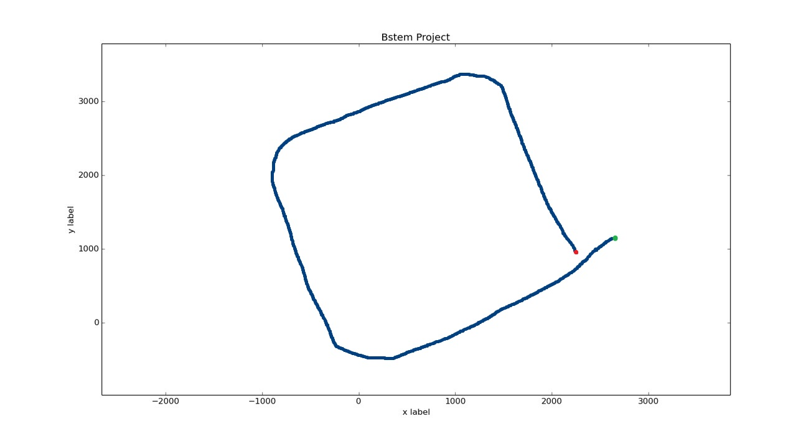
Current Implementation
Encoders + Gyroscope plot:
Simple square 20ft*20ft

Slide 16
Future Work Planned
Getting more parameter values to apply in the available error reducing algorithms.
To make the robot completely autonomous with help of obstacle avoiding sensors.
Working on reducing the gyroscope drift errors using filtering techniques.
To device another error reducing algorithm which produces better result than the existing algorithms.

