Slide 1
ROBOTIC INDOOR LOCALIZATION
USING INERTIAL MEASUREMENT UNITS

Slide 2
2
Robotic Indoor Localization using Inertial Measurement units
Group No: 50 Date: 31/03/2016
Team Members
Project Advisor (Guide) : Dr. Vidhya Balasubramanian
S.No | Reg.No | Name | Section
1 | CB.EN.U4CSE12123 | Kiran Kassyap S | CSE-B
2 | CB.EN.U4CSE12144 | Srivenkata Krishnan | CSE-B
3 | CB.EN.U4CSE12147 | Sundarrajan G | CSE-B
Notes:
2

Slide 3
Problem Statement
To develop an error reducing algorithm for Indoor localization of mobile robots using
the inertial measurement units(IMUs) and
Range finder sensors.

Slide 4
Previous Implementation
Studied the existing algorithms.
Calibrated the gyroscope sensor values.
Integrated encoder values to find the distance travelled and angle of orientation of the robot and plotted the values.
Integrated obstacle avoidance sensors with bStem with help of an Arduino microprocessor and added the required API’s.

Slide 5
Filters
Filters are primarily used for merging one or more values or to filter erroneous values from raw data
The most predominantly used filters are Kalman filters and complimentary filters
Kalman filters provide great accuracies and are computationally complex
On other hand Complimentary filters provide good accuracies with less computation

Slide 6
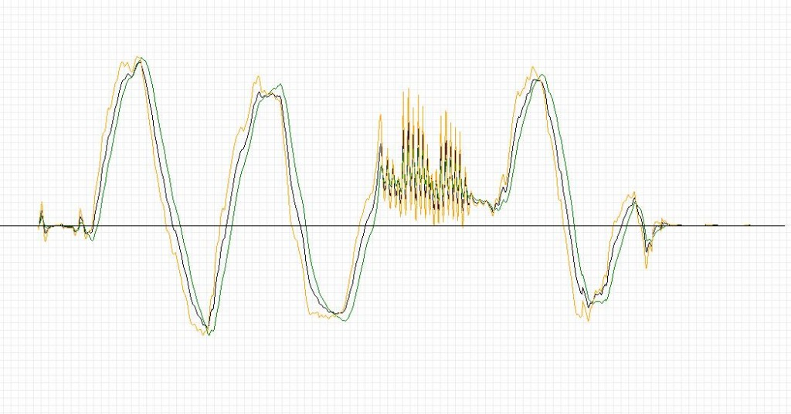
Kalman vs Complementary filters
Green - Kalman
Yellow - Complimentary
Blue - Raw values

Slide 7
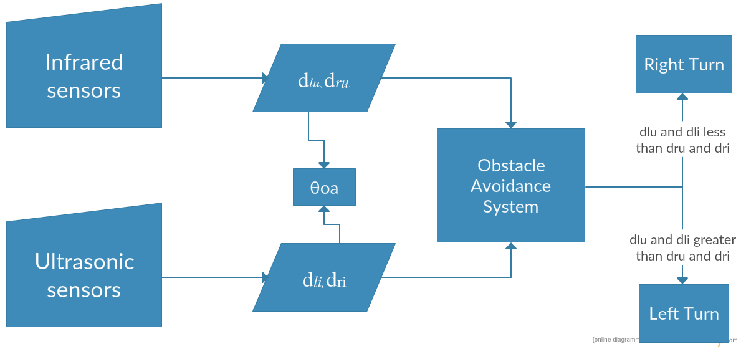
Obstacle Avoidance Design

Slide 8
Obstacle Avoidance
Obstacle avoidance is done with help of distance from both ultrasonic and infrared sensors
If the distance is less than Dsafe then the bot is programmed to avoid obstacles
Ultrasonic sensors are used for determining obstacles above 30cm and Infrared sensors are used for detecting obstacles less than 30cm

Slide 9
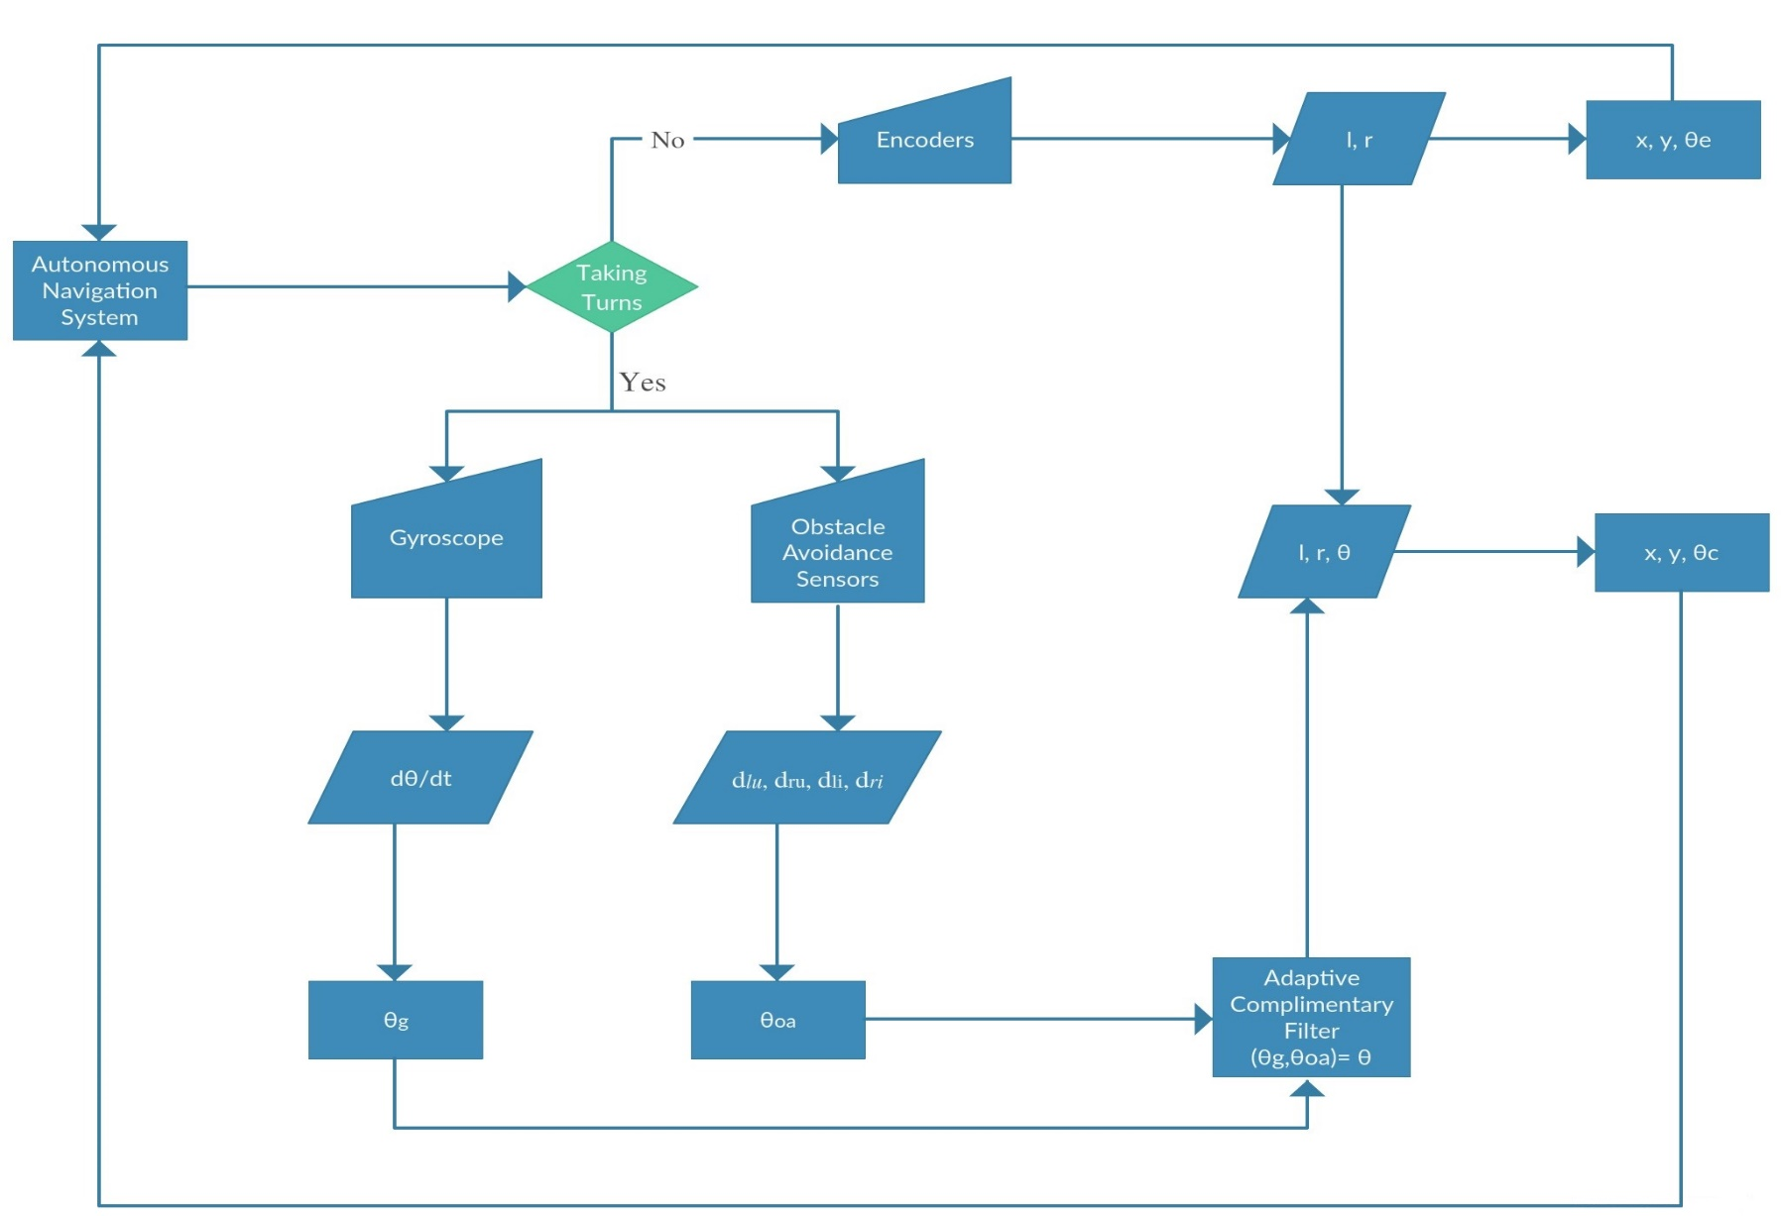
Architecture Diagram

Slide 10
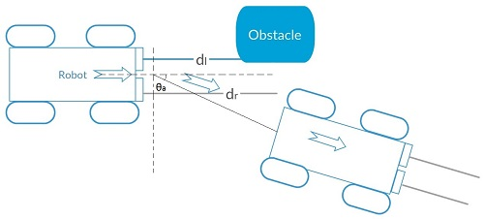
Obstacle Avoidance

Slide 11
Obstacle Avoidance angle calculation
Right turn:
θoa(t) = θoa(t −1)− n×(π/2)(kθ/dr)
Left turn:
θoa(t) = θoa(t −1)+ n×(π/2)(kθ/dl)

Slide 12
Work Completed
Implemented the obstacle avoidance system with help of range finder sensors and have made the robot autonomous
Determination of new orientation estimate using obstacle avoidance data
Compared different filters for merging orientation estimate

Slide 13
Future Work Planned
To integrate the orientation estimates obtained above in an efficient way and check for the accuracy of the proposed method

