Slide 1
Robotic Indoor Localization using IMUs
Group No: 50 Date: 05/05/2016
Team Members
Project Advisor (Guide) : Dr. Vidhya Balasubramanian
S.No | Reg.No | Name | Section
1 | CB.EN.U4CSE12123 | Kiran Kassyap S | CSE-B
2 | CB.EN.U4CSE12144 | Srivenkata Krishnan | CSE-B
3 | CB.EN.U4CSE12147 | Sundarrajan G | CSE-B

Slide 2
ROBOTIC INDOOR LOCALIZATION
USING INERTIAL MEASUREMENT UNIT

Slide 3
PROBLEM STATEMENT
To develop an error reducing algorithm for Indoor localization of mobile robots using
the inertial measurement units(IMUs) and
Range finder sensors.

Slide 4
PREVIOUS IMPLEMENTATION
Implemented the obstacle avoidance system and have made the robot autonomous
Obtained orientation from range finder sensors and position was estimated

Slide 5
WORK IMPLEMENTED
Integrated three position values with help of a complementary filter to obtain accurate position of the robot
The three positions are as follows:
Position estimated from motor encoders[1]
Position obtained from gyroscope
Position calculated from range finder sensors[2]

Slide 6
COMPLEMENTARY FILTER
angle = (1-alpha)*(gyro_angle) + (alpha)*(obstacle)
Alpha value is calculated with help of number of obstacles present in the environment
The more the obstacles the more the alpha value.
Alpha value is always less than 1.

Slide 7
EXPERIMENTS UNDERTAKEN
SQUARE TRAJECTORY
EIGHT TRAJECTORY
RANDOM TRAJECTORY

Slide 8
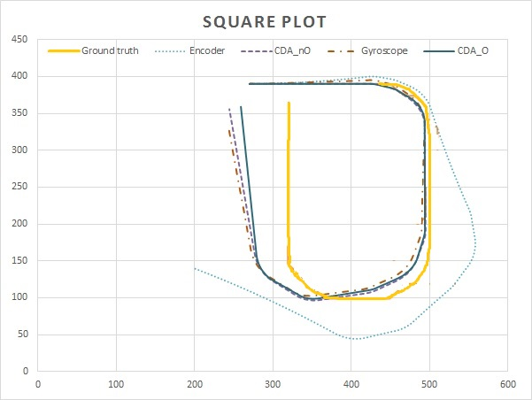
SQUARE TRAJECTORY

Slide 9
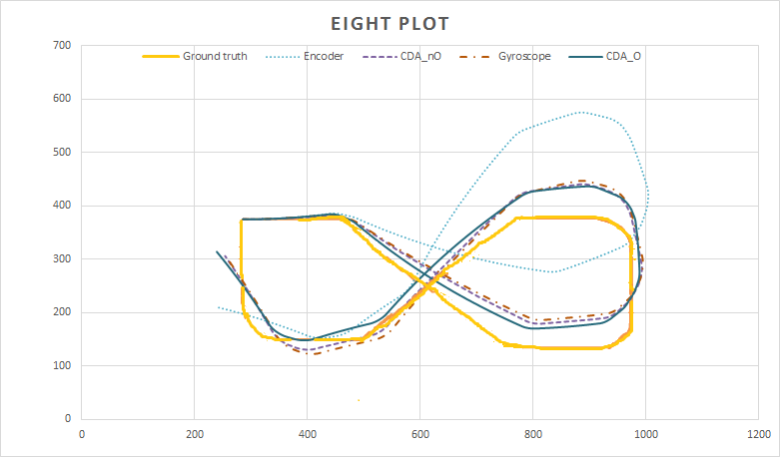
EIGHT TRAJECTORY

Slide 10
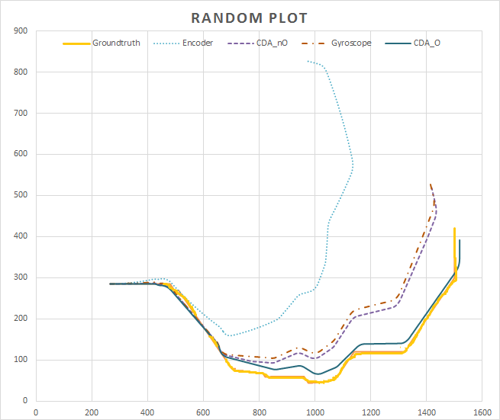
RANDOM TRAJECTORY

Slide 11
AVERAGE EUCLEDEAN ERROR
Methods implemented | Trajectory 1 (Square) (cm) | Trajectory 2 (Eight) (cm) | Trajectory 3 (Random) (cm)
Encoders | 121.96 | 89.27 | 333.65
Gyroscope | 40.50 | 44.22 | 75.33
CDA_nO | 28.64 | 39.50 | 65.38
CDA_O | 20.25 | 34.68 | 20.49

Slide 12
APPLICATIONS
Can be used as assistive robots in emergency situations which can be hazardous to humans

Slide 13
REFERENCE
[1] Dominik Gusenbauer, Carsten Isert and Jens Krösche, “Self-Contained Indoor Positioning on Off-The-Shelf Mobile Devices”, International Conference on Indoor Positioning and Indoor Navigation (IPIN), 15-17 September 2010.
[2] Robot pose correction using photogrammetric tracking", Proc. SPIE 4189, Machine Vision and Three-Dimensional Imaging Systems for Inspection and Metrology, 170 (February 12, 2001)

