Slide 1


Analysis on Democrat and Republican Tweets
Presented By,
Bala Tripura Sundari Kaza Venkata

Slide 2



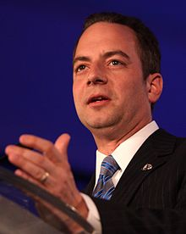


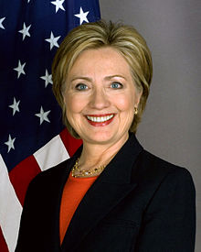

Who are democrats and Republicans?
Democratic Party | Republican Party
One of the two major contemporary political parties in the United States. | Commonly referred to as the GOP (abbreviation for Grand Old Party).
Founded in 1828 by Andrew Jackson. | Founded by anti-slavery activists, modernists, ex-Whigs, and ex-Free Soilers in 1854
Chair Person – Donna Brazile . | Chair Person - Reince Priebus.
Last Elected President- Barack Obama (2009 - 2016) | Last Elected President – George W Bush (2001 - 2009)
Electoral Candidate for Election-2016: Hillary Clinton. | Electoral Candidate for Election-2016: Donald Trump (Winner).

Slide 3
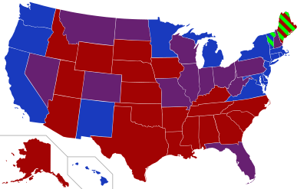
Senators for U.S. States
Affiliation | Members
Republican Party | 54
Democratic Party | 44
Independent Party | 2
Total | 100
2 Democrats
2 Republicans
1 Democrat and 1 Republican
Independent Party

Slide 4
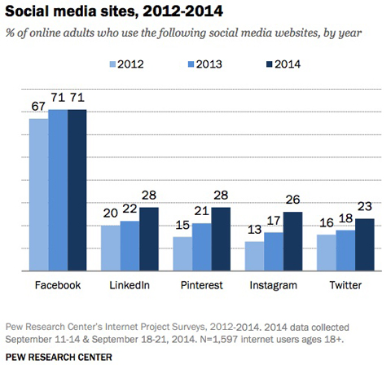


Social Media and Its Usage Trends
The most prominent social networking sites being used for multiple campaigns, voluntary activities, polls are Twitter, Facebook.
Adapted from [3]

Slide 5

About Twitter
Twitter is an online news and social networking service where users post and read short 140-character messages called "tweets".
Registered users can post and read tweets, but those who are unregistered can only read them.
To repost a message from another Twitter user and share it with one's own followers, a user can click the retweet button within the Tweet.
Some of the tweet formats include group posts with hashtags(#) , the "@" sign followed by a username is used for mentioning or replying to other users.
Adapted from [1]
ITC 691
5

Slide 6
Tools Used For Collecting Twitter Data
Twitter API - A Python wrapper for performing API requests such as searching for users and downloading tweets.
Free Users get an option of Gardenhose API for collecting 1% twitter data.
Paid Users get and option of Firehose API for collecting 10% twitter data.
Only the big companies such as Google, Yahoo are able to access 100% of the twitter data.
Other options can be MongoDB, PyMongo, CronJobs.

Slide 7
Queries Analyzed
Which party retweets more? Democrats or Republicans ?
Top 1000 tweets of Democrats and Republicans based on retweet count.
What are republicans and Democrats talking about? Is it same or different?
Top topic categories for each party and associated topics for each category.

Slide 8
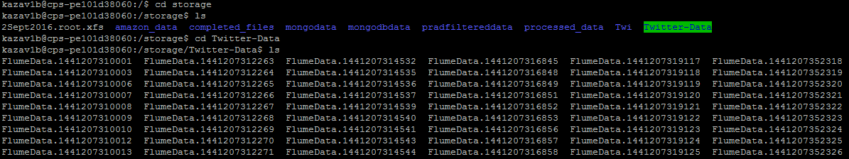
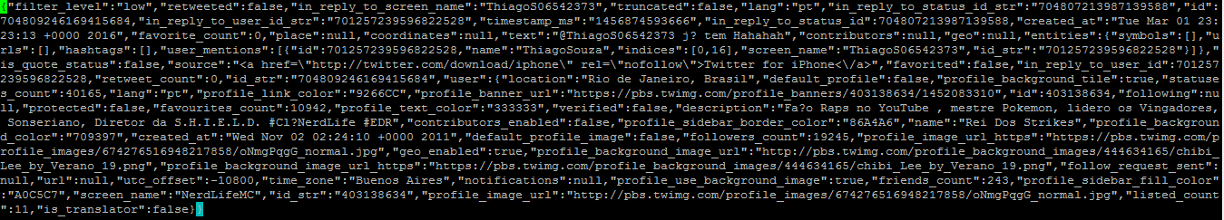
Data Collection
Initial data for analysis is taken from Dr. Jesse Eickholt’s 1% data collected over an year span. This data is around 750GB.

Slide 9
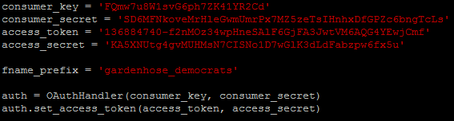
Data Collection
In addition to this, there is around 1GB of data collected by streaming the twitter API for senators and electoral candidates for each party.

Slide 10
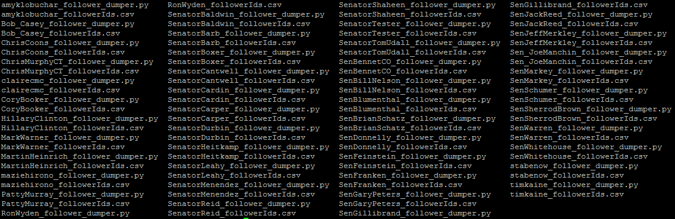
Data Collection
For Each of the 100 senators all the follower ids have been collected by streaming Twitter API(followers until September,2016).
Democrats:

Slide 11
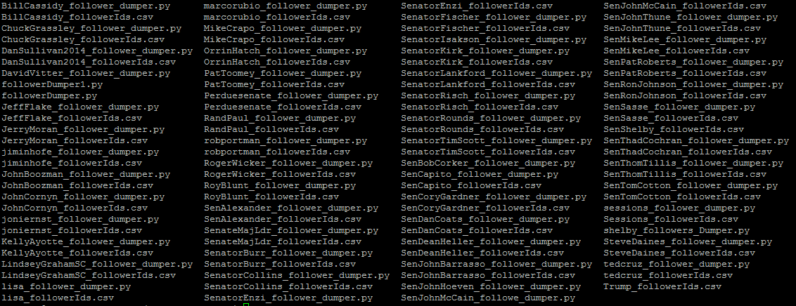
Data Collection
Republicans:

Slide 12
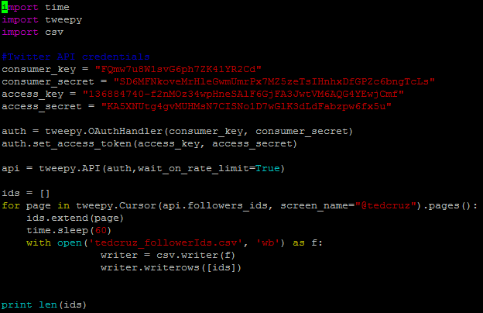
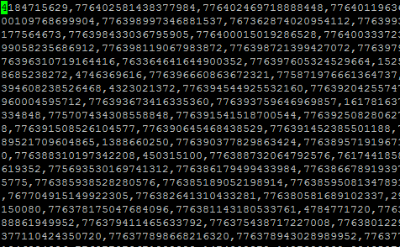
Data Collection
Sample Script and output:

Slide 13
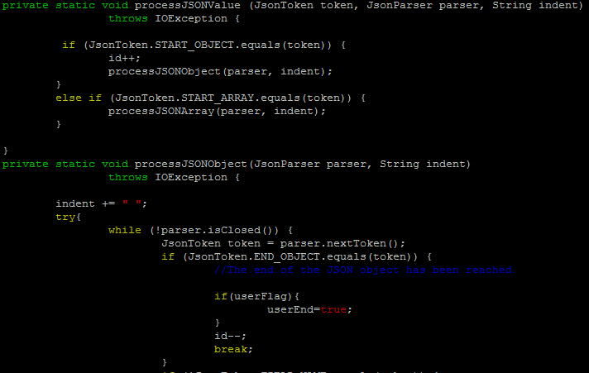
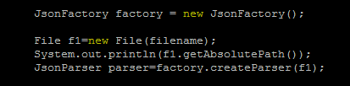
Data Filtration
Jackson API for parsing JSON Files.
Further Filtrations Done by SED and AWK commands.

Slide 14
Tweets Obtained After Data Filtration

Slide 15
Query 1
Question Posed: Which party retweets more?
This question is answered by finding the total of retweet count values for each party. Then retweet ratio is calculated where, Retweet ratio= Retweet Count of each party / Total tweets of each party.
Also what kind of tweets have been retweeted more is also found out based on the retweet count value.
Stage | Tool Used
Data Collection | Python Scripts
Data Filtration | Jackson API and SED, AWK Commands
Query Processing | Hive
Visualization | Excel

Slide 16
Query 1
CREATE EXTERNAL TABLE democrats(
id STRING,
name STRING,
retweet STRING,
retweet_count INT
tweet_msg STRING)
ROW FORMAT DELIMITED FIELDS TERMINATED BY ','
STORED AS TEXTFILE
location '/user/kazav1b/project_data/democrats';
CREATE EXTERNAL TABLE republicans(
id STRING,
name STRING,
retweet STRING,
retweet_count INT
tweet_msg STRING)
ROW FORMAT DELIMITED FIELDS TERMINATED BY ','
STORED AS TEXTFILE
location '/user/kazav1b/project_data/republicans';

Slide 17
Query 1 Results

Slide 18
Query 1 Results

Slide 19
Query 1 Results

Slide 20
Query 1 Results : Top 2 Tweets of Democrats
@NoelRock: @Dublinyfg @NormaSammon @FG_DNW @FGcllrs @DubCllrs @women4election @DcuYfg @FineGael She's going to be fantastic.
@MarkHalperin: Join me @jheil for 1 hr of @MSNBC election coverage @ 6p ET. @ThomasARoberts @gabegutierrez @kasie @kwelkernbc @jpodhor

Slide 21
Query 1 Results : Top 2 Tweets of Republicans
@MPBNews @tedcruz @GOP @RNC have likely already cost us this election Americans have one vote & no one can buy or steal it @realDonaldTrump
@SundayFutures: .@StephenMoore on @realDonaldTrump beating @HillaryClinton in general election: "I think he can" @FoxNews @MariaBartiromo

Slide 22
Query 2
Question Posed: What are republicans and Democrats talking about?
This question is answered by finding the top topics for each party.
Also what is the correct number of topics which suits the dataset is analyzed.
Stage | Tool Used
Data Collection | Python Scripts
Data Filtration | Jackson API and SED, AWK Commands
Query Processing | Hive, Mallet
Visualization | Excel

Slide 23

About
MALLET is a Java-based package for statistical natural language processing, document classification, clustering, topic modeling, information extraction, and other machine learning applications to text [4].
MALLET was written by Andrew McCallum, with contributions from several graduate students and staff.
Mallet includes tools for document classification, sequence tagging, topic modelling, numerical optimization.

Slide 24
Query 2 : Topic Modelling
To get the .mallet file:
To get the topics and related diagnostics files:

Slide 25
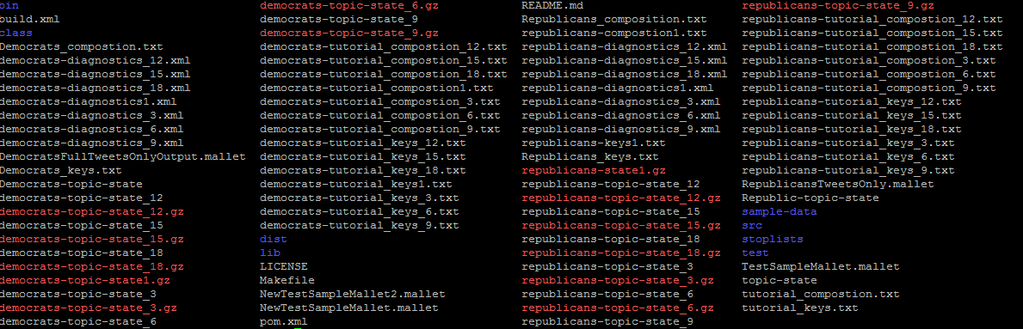
Query 2 : Mallet Files Generated
Files generated for different runs of topics in mallet.

Slide 26

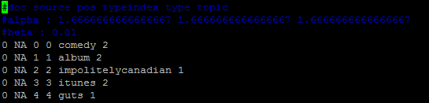
Query 2 : Mallet Files Generated
democrats-tutorial_compostion_3.txt
Outputs a text file indicating the breakdown, by percentage, of each topic within each original text file imported.
democrats-topic-state_3
Outputs every word in your corpus of materials and the topic it belongs to into a compressed file.

Slide 27
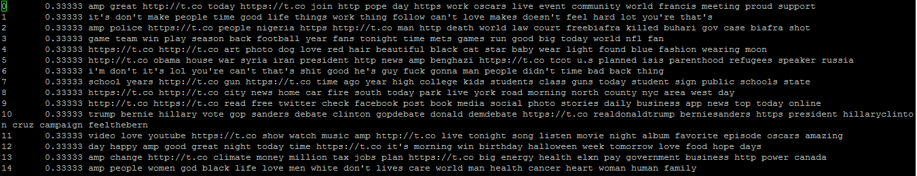
Query 2 : Mallet Files Generated
democrats-tutorial_compostion_3.txt
outputs a text document showing what the top key words are for each topic

Slide 28
Query 2: Mallet Files Generated
democrats-diagnostics_3.xml
Generated Detailed Report on each topic in the top topic categories.

Slide 29
Query 2 Results : Diagnostic Runs

Slide 30
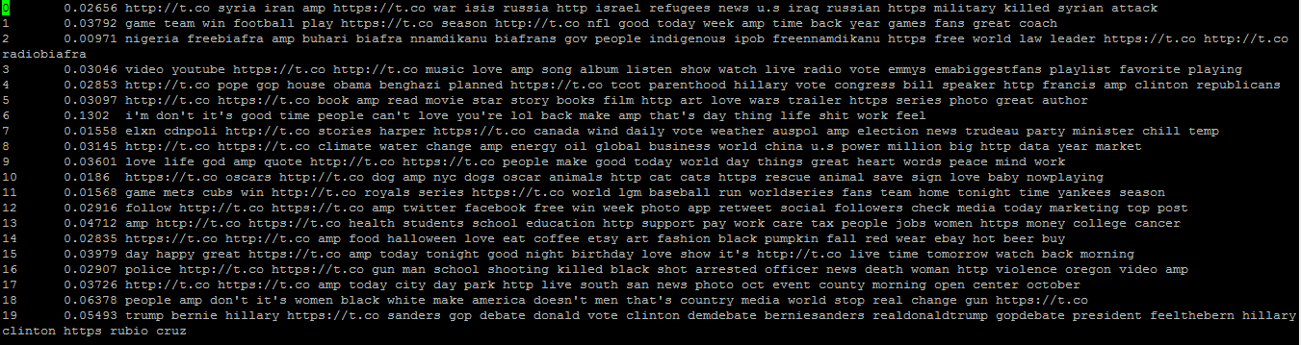
Query 2 Results : Democrats Top 20 Topic Categories

Slide 31
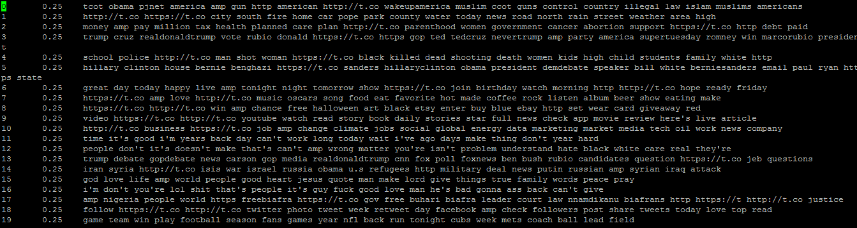
Query 2 Results : Republicans Top 20 Topic Categories

Slide 32
Query 2 Results : Republicans
Border enforcement
Job Market
illegal
jobs
work
control
tech
Wakeup America
Health care
health
Global market
abortion
Planned care

Slide 33
Query 2 Results : Democrats
Syrian Issue
Students Employment
Syrian attack
students
Israel refugees
support
Work visa
Military killed
Global Relations and resources
care
Energy
China relations
World business

Slide 34
Challenges Faced
Data Collection and analysis of data.
Rate Limit Exception for Twitter API.
Mallet not supporting extended ASCII Characters.

Slide 35
Conclusion
According to my study topics were mostly related to the keywords each party has used for the election campaigns.
The top topics tweeted by democrats were related to students work visas, Syrian attack, global relations and about building the GDP.
The top topics tweeted by republicans were related to illegal immigration, healthcare, global market.
According to my study, Democrats retweeted more.

Slide 36
References
https://en.wikipedia.org/wiki/
https://en.wikipedia.org/wiki/List_of_current_United_States_Senators
http://www.socialmediaexaminer.com/twitter-experiencing-massive-growth-new-research/
McCallum, Andrew Kachites. "MALLET: A Machine Learning for Language Toolkit." http://mallet.cs.umass.edu. 2002.
http://programminghistorian.org/lessons/topic-modeling-and-mallet

Slide 37

Queries?

Slide 38


