Slide 1
Figures
Mekhos Health – CLS

Slide 2
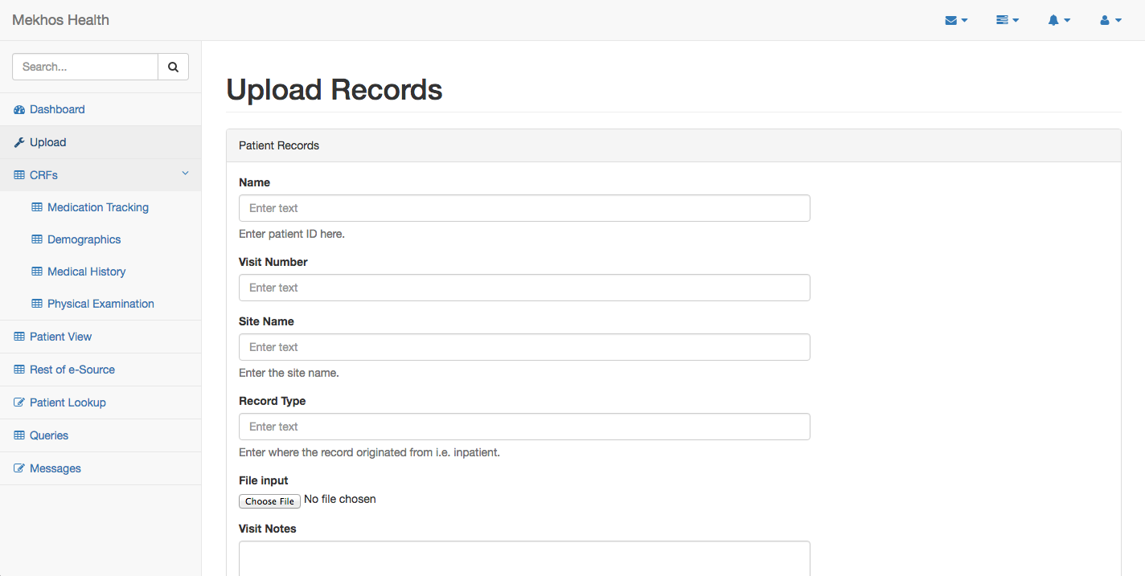
Figure 1

Slide 3
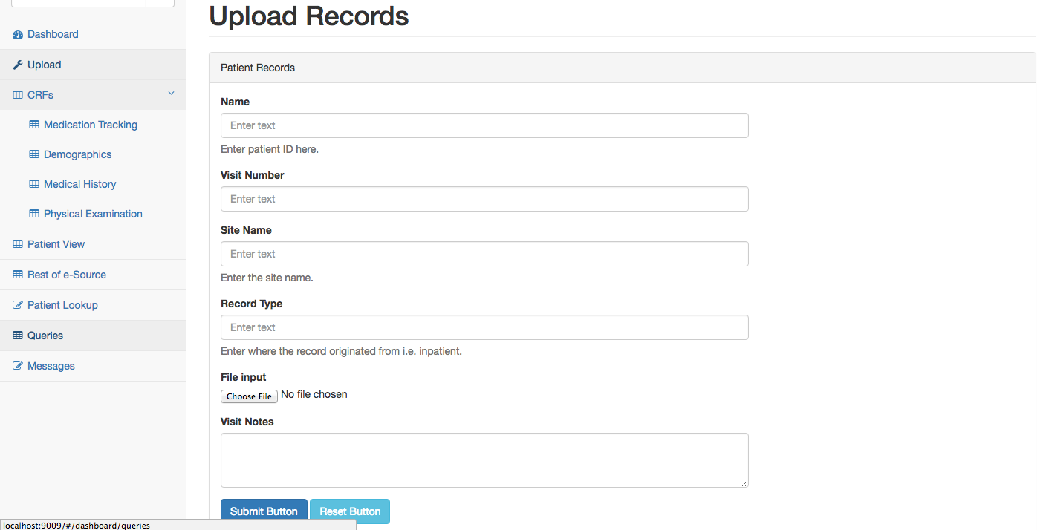
Figure 1

Slide 4
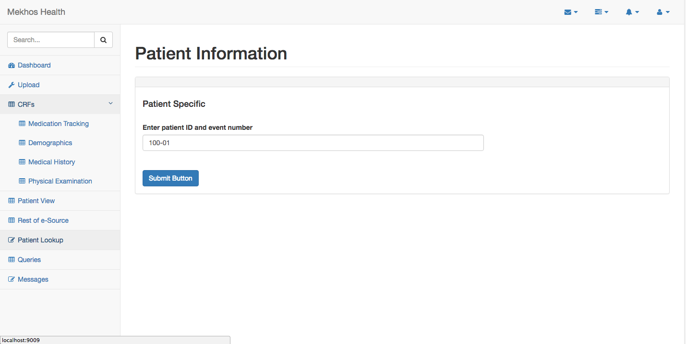
Figure 2

Slide 5
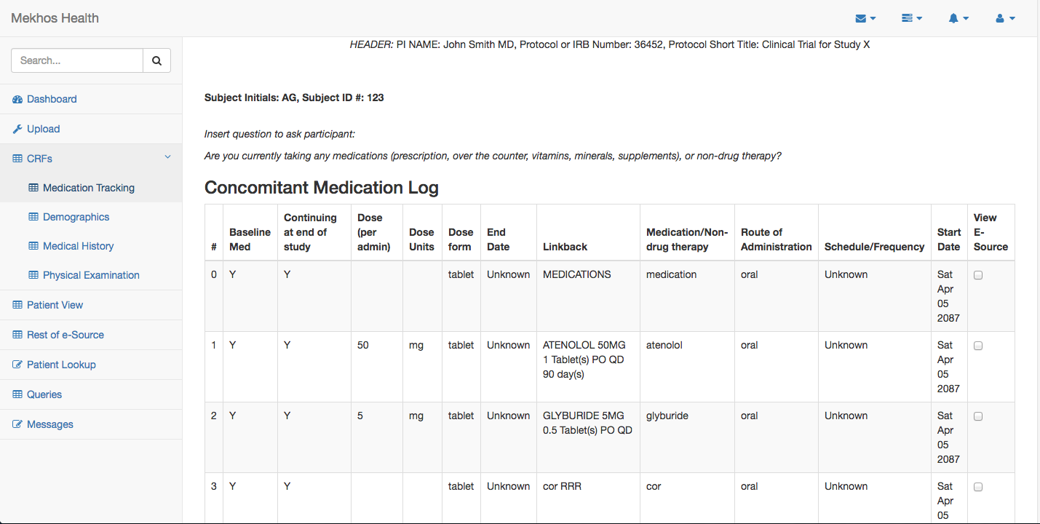
Figure 3

Slide 6
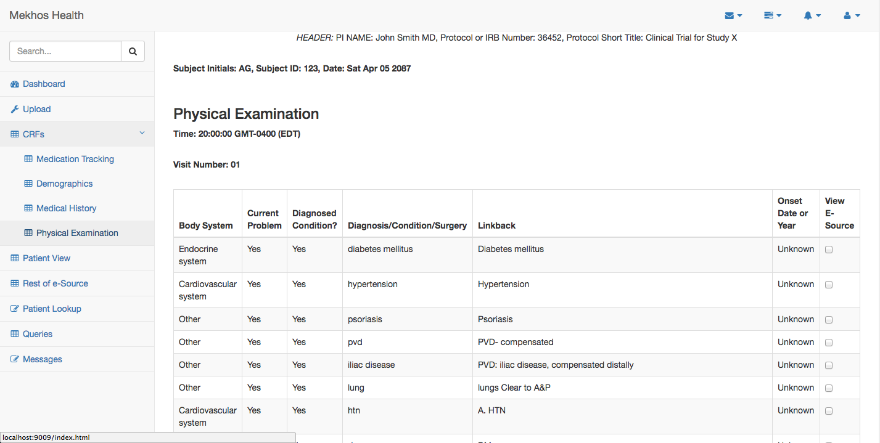
Figure 3

Slide 7
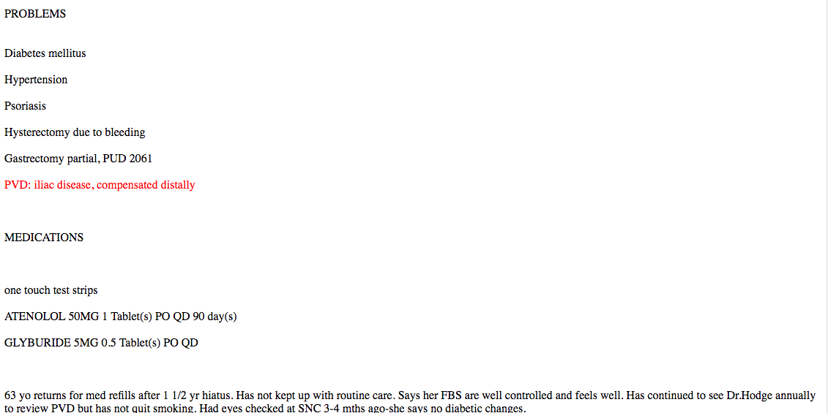
Figure 3: View E-Source (iliac disease)

Slide 8
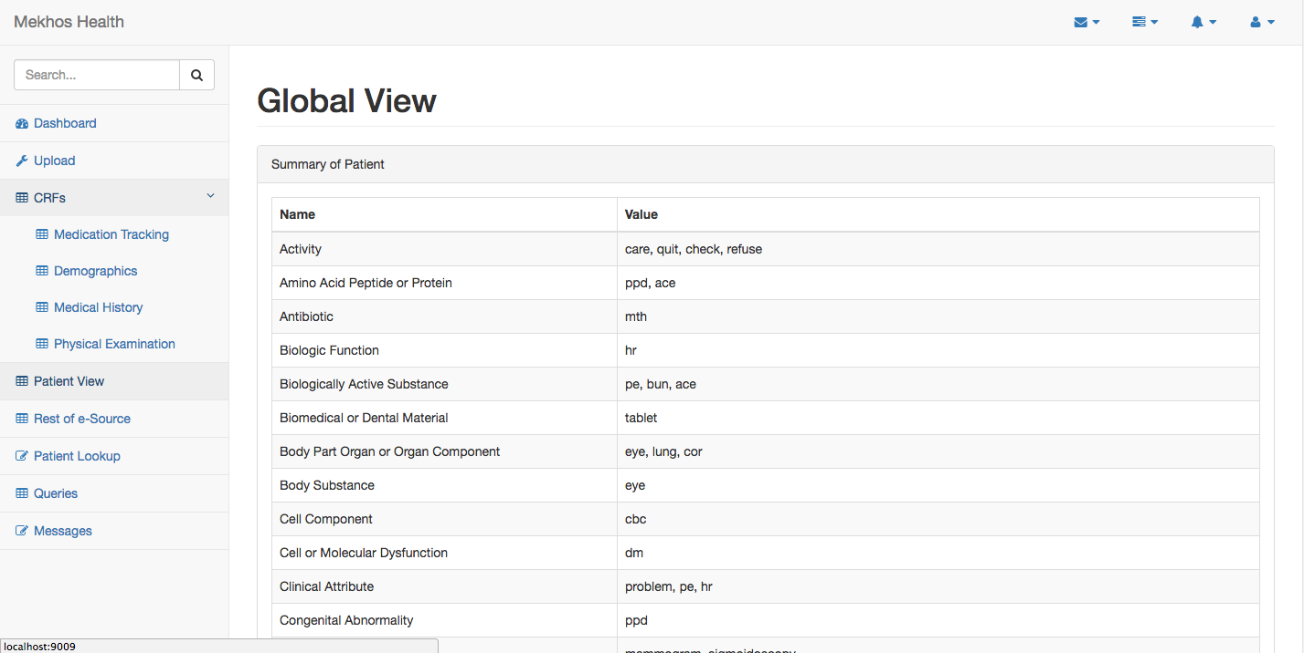
Figure 4

Slide 9
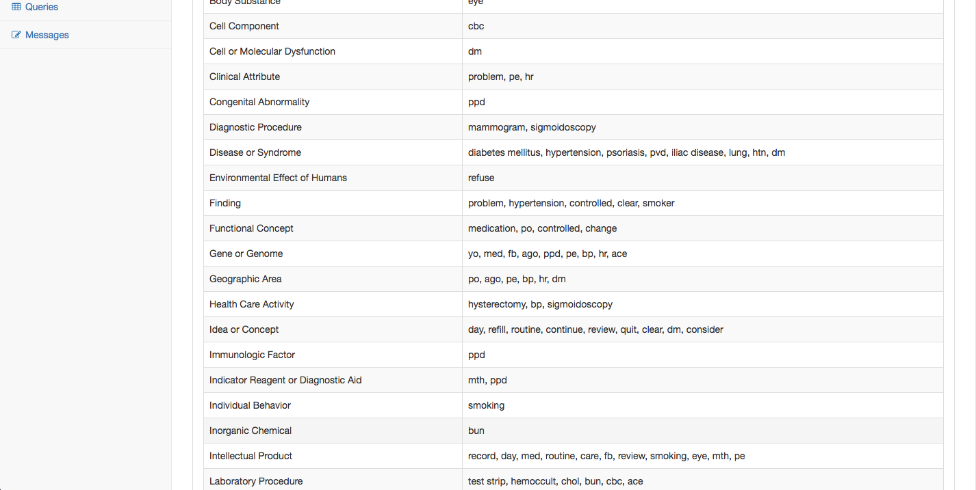
Figure 4

Slide 10
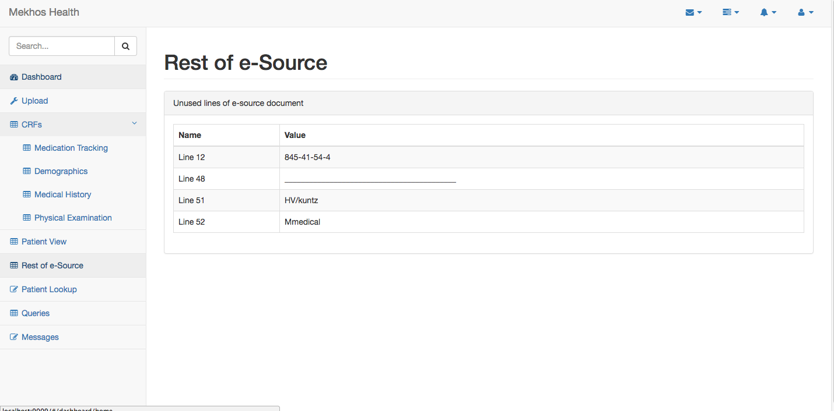
Figure 5

