Slide 1
Bike E-Catalogue Mobile App
PIP104 University Project-II
Final Review
Batch Number: G15 - 7ISE2
Roll Number | Student Name
20201ISE0059 | Bindu K
20201ISE0090 | Chandana J
20201ISE0060 | Deeparani B A
Under the Supervision of,
Ms. Kimmi Kumari
Assistant Professor
School of Computer Science & Engineering
Presidency University

Slide 2
Introduction
The Bike E-Catalogue project aims to develop a mobile app that provides customers with an engaging and simple platform to browse and purchase bikes using QR codes.
The primary goal of this project is to enhance the customer experience in the bike retail industry while also meeting the growing demand for online purchases.
The project intends to provide a comprehensive overview of its objectives, scope, methodology, and outcomes.
As online shopping becomes increasingly popular, customers are demanding more convenient and interactive ways to browse and purchase products.

Slide 3
Literature Review
Paper Title : An Analytical Study Evaluating the Applicability of a Developed Innovative E-Sourcing System for Automobile Based Firm.
Method : Designed MVC e-sourcing system architecture
Advantages : Data reveals that the respondents accept the developed innovative e-sourcing system for automobile-based firms than existing manual sourcing approaches.
Limitations : Empirically the developed innovative e-sourcing system was evaluated with data from only 50 respondents. Secondly, data was collected from respondents familiar with e-sourcing operations in Malaysia only. Thirdly, the developed innovative sourcing system is only concerned with the sale of new automobile products. Therefore, car accessories are not sold in the developed system.

Slide 4
Literature Review - Contd.
Paper Title : Future of E-commerce in India
Method : Extensive literature search Content analysis
Advantages : Increased access to markets. Cost-effective operations. Enhanced consumer convenience. Job creation and economic growth. Increased digital inclusion.
Limitations : Infrastructure challenges Regulatory and policy issues Trust and security concerns Low digital literacy Competition and pricing pressures.

Slide 5
Literature Review - Contd.
Paper Title : E-commerce platform for online shopping consumers
Method : Conceptual Model of Online Shopping Information Platform’s Security Customer Satisfaction.
Advantages : Convenience and accessibility. Wide product selection Customer reviews and ratings. Personalization and recommendations.
Limitations : Lack of physical experience. Security concerns. Trust and credibility concerns.

Slide 6
Literature Review - Contd.
Paper Title : Automobile AR E-Catalogue
Method : Augmented Reality.
Advantages: It can be updated in real-time, unlike the brochures that are provided at the showrooms, as they need to wait for the next release but using this application they can change any data anytime, like updating the car models or related information, etc. Users can search for vehicles and can get information in the mobile view.
Limitations : Expensive Data can be manipulated to influence. Lack of truly precise AR objects.

Slide 7
Challenges in Existing Systems
Existing System: In the existing system, since the Yamaha vehicle details are in the text format anyone can access & misuse the data. It may lead to hacking the software & database.
Drawbacks: Storing information is huge Need to maintain quantity records No accuracy in work Need extra security to prevent the data.
Proposed System: The proposed system has been developed to overcome the difficulties in manual maintenance and billing maintenance on the Google Firebase. In the proposed system since the Yamaha product information is stored in QR Code format only the authorized user can access the data by scanning the QR Code.

Slide 8
Advantages of Proposed systems:
Provides the searching facilities based on various factors, such as important features like mileage, and engine types.
It tracks all information about managers, staff, product data Manages the information of reports.
Adding and updating of records in proper management of Manager, Staff, Products.

Slide 9
Proposed Methodology
Research Design
Development of Augmented Reality-based Bike E-Catalogue
Data Collection
Participants
Data Analysis
Quantitative Analysis
Qualitative Analysis

Slide 10
Proposed Methodology
Color Customization and Multimedia Integration Analysis
Ethical Considerations
Privacy and Anonymity
Limitations
Future Research

Slide 11
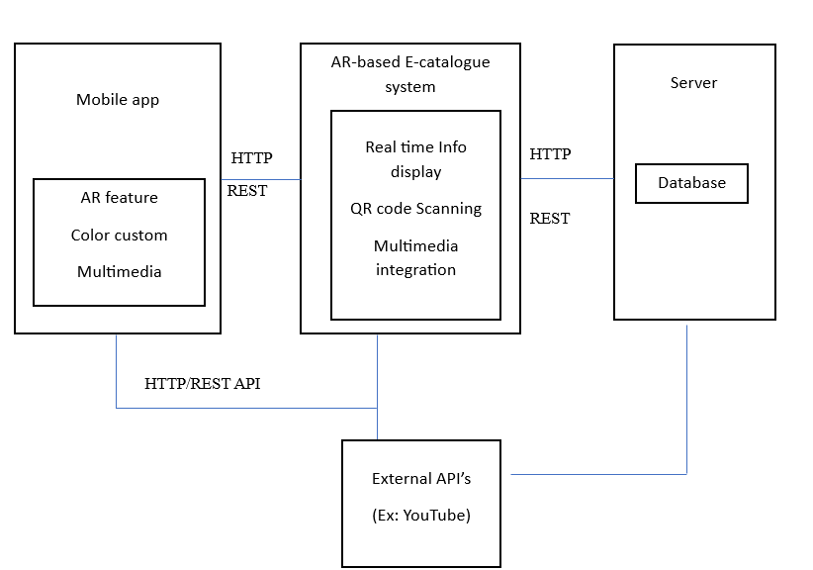
Architecture Design

Slide 12
Objectives
Showcasing Product Range
Facilitating Product Discovery
Enhancing User Experience
Enabling Virtual Product Exploration
Facilitating Easy Purchases
Promoting Brand Awareness
Encouraging User Engagement
Providing Accurate Product Information
Supporting Offline Accessibility
Integrating Augmented Reality

Slide 13
Timeline of Project
TASK | DURATION (WEEKS) | START DATE | END DATE | DEPENDENCIES
Project Initiation | 1 | 15/08/2023 | 08/10/2023 | -
Requirement Analysis | 1 | 17/08/2023 | 24/10/2023 | Project Initiation
System Design (Database, User Interface (UI) & Integration) | 2 | 25/10/2023 | 07/11/2023 | Project Initiation
Development (Frontend & Backend) | 4 | 08/11/2023 | 29/11/2023 | System Design (All)
Database Implementation | 1 | 30/11/2023 | 07/12/2023 | Development (Backend)
Testing (Unit & Integration) + User Acceptance Testing | 2 | 08/12/2023 | 22/12/2023 | Testing (All)
Project Documentation & Closure | 1 | 23/12/2023 | 30/12/2023 | Monitoring and Maintenance Planning

Slide 14
Expected Outcomes
Improved Accessibility : Prospective buyers can browse the bike e-catalogue whenever and wherever they want via the QR code smartphone app.
Rich Multimedia Experience : Bicycle merchants and manufacturers can offer a rich multimedia experience by inserting QR codes into the e-catalogue.
Real-Time changes : The bike e-catalogue's digital nature allows for real-time changes, unlike traditional printed catalogues.

Slide 15
Conclusion
In conclusion, the usage of a mobile QR code app to access bike e-catalogue has the potential to completely change how people discover, understand, and interact with bikes.
The bike e-catalogue app has the potential to become a go-to platform for bike lovers, businesses, and people interested in the world of cycling by focusing on user-centric design, ongoing improvement, and staying up-to-date with technical improvements.

Slide 16
References
Choi, D., Kim, J., & Kim, S. (2019). Augmented reality applications in e-commerce: A study of online apparel shopping. *Journal of Fashion Marketing and Management, 23*(3), 386-403.
Gao, P., Wu, Y., & Shang, J. (2021). Augmented reality maintenance assistance for electric vehicles: A human-centered design approach. *International Journal of Human-Computer Interaction, 37*(5), 453-464.
Javornik, A. (2016). Augmented reality: Research agenda for studying the impact of its media characteristics on consumer behavior. *Journal of Retailing and Consumer Services, 30*, 252-261.
Kim, J., & Forsythe, S. (2008). Adoption of virtual try-on technology for online apparel shopping. *Journal of Interactive Marketing, 22*(2), 45-59.
Lee, S., & Lee, J. (2020). The role of augmented reality (AR) in enhancing customer experiences in the retailing environment. *Computers in Human Behavior, 108*, 106312.
Lee, Y., Park, Y. J., & Lee, Y. (2018). Exploring factors affecting the adoption of augmented reality mobile shopping applications: A moderating role of gender differences. *Telematics and Informatics, 35*(6), 1657-1667.
Li, X., Wang, D., Chen, Y., & Liang, T. P. (2020). The effect of augmented reality on perceived enjoyment: An investigation of visitors to a science museum. *International Journal of Human-Computer Interaction, 36*(13), 1218-1232

Slide 17
Thank You

