Slide 1
Sundar Krishnakumar
Final Project Demo – Synchronome Time Lapse
Board used: Jetson nano
Other hardware: UVC complaint USB Camera Logitech C270
Scheduling Policy: Rate Monotonic Scheduling Policy
ECEN 5623 - Real-Time Embedded Systems (Dr. Sam Siewert)
Summer -2020

Slide 2
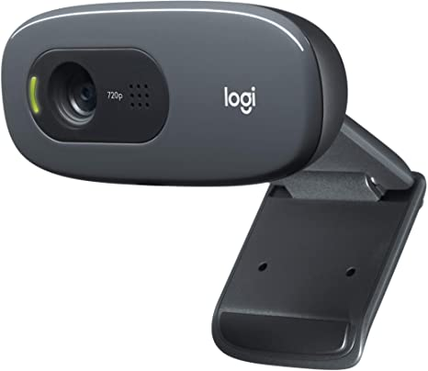

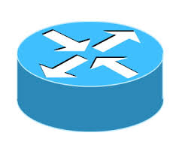

High Level Description:
SELECT GOOD FRAME
CLOCK
ANALOG/DIGITAL
CAPTURE IMAGE
LOGITECH C270 USB CAMERA
SAVE + TRANSFER
ROUTER
TARGET MACHINE
DISK DRIVE

Slide 3
Proposal :
Sequencer(RT) – 100Hz
Select frame– BE
Message queue 2
Image Processing or
Frame transfer– BE
Frame Capture(RT)– 20Hz
Send Frame(RT) – 20Hz
Core 3
Core 2
Message queue 1
RT Threads follow Rate Monotonic Scheduling Policy
BE – Best effort services

Slide 4
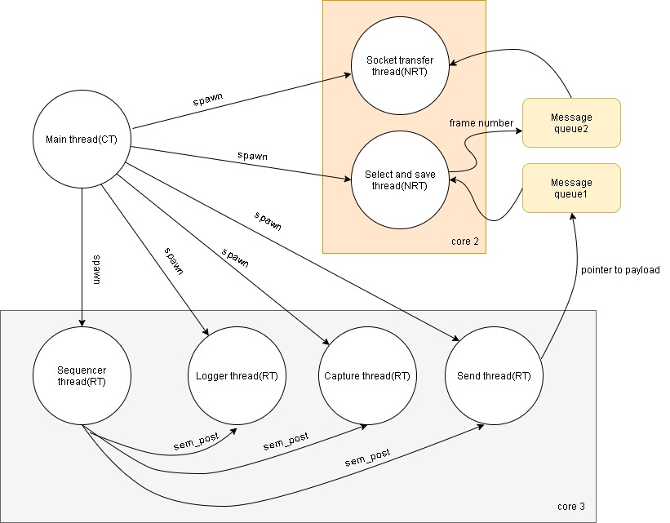
System architecture:
Resembles a High frequency cyclic executive model
Main thread – Container thread.
RT Threads follow RMS Policy.
NRT Threads are Best effort services.
MQs :Message queue 1,2 for IPC
Semaphores: 3 used for task release.
Core 3 for RT tasks.
Core 2 for NRT tasks.

Slide 5
Scheduler and RT Task frequencies
1Hz
5Hz
10Hz
Scheduler : 100Hz
Capture Task : 25Hz
Send Task: 25Hz
Scheduler : 100Hz
Capture Task : 25Hz
Send Task: 25Hz
Scheduler : 120Hz
Capture Task : 30Hz
Send Task: 30Hz
Associated MACRO settings
Associated MACRO settings
Associated MACRO settings
SEQ_FREQ 100
CAP_FREQ_MOD 4
FPS 1
SEQ_FREQ 100
CAP_FREQ_MOD 4
FPS 5
SEQ_FREQ 120
CAP_FREQ_MOD 4
FPS 10
Based on the frequencies and WCET analysis the real time requirements(S_{i}, C_{i}, T_{i} and D_{i}) are decided. (Report Pg14,17)

Slide 6
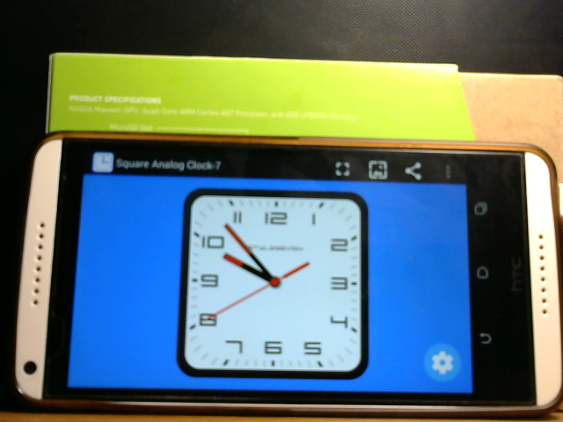





Error Analysis for frame glitches at 25fps capture rate:
rgb_189.ppm
rgb_190.ppm
rgb_191.ppm
rgb_248.ppm
rgb_249.ppm
rgb_250.ppm

Slide 7
Error Analysis Cont'd
Uneven times at which capture occurs. This should be due to the use of multiple V4L2 buffers .But high rate frame capture is possible because of this technique.
Movement of the second hand is not periodic in the analog clock application.
Image selector model can be re-implemented using adaptive thresholding or other binary conversion model for better selection.
(See skip_repeat_ea.txt under “error analysis 1Hz “ folder for syslog data.)
1Hz capture Jitter analysis
10Hz deadline miss after 600 frames at 30fps capture rate:
There is a need for more frames for a good selection. In 30fps frame capture rate(maximum possible).So (30/10 =3) only 3 frames available per 100milliseconds for selection algorithm to do a good selection.
Also, Initially camera delivers 30fps but during course the rate degrades(See capture jitter plot for 10Hz).
These two reasons make 10Hz target capture unsuccessful in this oversampling and selection model.
(Also discussed in Report page 20, 25).
10Hz capture Jitter analysis

Slide 8
Issues/problems occurred:
Clock drift in nanosleep() and clock_nanosleep() calls.
The second hand in the app does not have a monotonic movement. Must have used a physical clock.
Camorama makes image adjustments. The image selection parameters(refer Report Page 11) need to be altered due to this.
The Logitech C270 is not always 30fps.More capacity needed for a 10Hz target frequency in the current software model to get enough samples for selection

