Slide 1
Engineering Workshop
SUNDAR RAJAN MUTHURAJ, SDE II
23ND JUL 2018

Slide 2
Agenda
SCM – git practices
Build practices – Jenkins, Build, CI, CD, CR
Automation Tools
Unit Testing
Refactoring
Clean Code
Test Driven Development

Slide 3
SCM
Comfortable / User-level knowledge on Git
Pull & Push often (avoid merge hell)
Hands on
Repo/Branches
Commits, Rebase & Squash (Learn it online)
Commit comments (7 rules of great git commit message)

Slide 4
Build practices
Ant, Maven, Gradle, npm, webpack, browserify
Jenkins
CI / CD / CR
Suggestion
Know how to manage dependency.
Learn existing systems.
Watch notifications.
Respond to failures.

Slide 5
Automation
D-R-Y
Develop tools & utilities
Debugging
Repeaters (compile-package-deploy), daily installation
Regression tests – 20/80 rule.
Suggestion:
Automate everything
Watch out for tools (selenium, Cumumber, AutoIT etc).

Slide 6
Unit Testing
In memory
Notion of Second Class Citizen – a myth
Readability, Maintainability, Trustworthiness (reliability)
Test Doubles
Dummies, Stubs, Spies, Mocks & Fakes.
Bad Tests, Happy Tests, Canary Tests…
Design by Tests
Books:
Effective Unit Testing: A guide for java developers.
JUnit Recipes: Practical Methods for Programmer Testing.
Pragmatic Unit Testing in Java with JUnit.

Slide 7
Refactoring & Clean code
Genuine interest to improve.
Extract
Variable, Field, Parameter, Method, Class
SOLID
Quotes from Notes
Inline
Books:
Clean code: A handbook of agile software craftsmanship.
Refactoring: Improving the design of existing code.

Slide 8
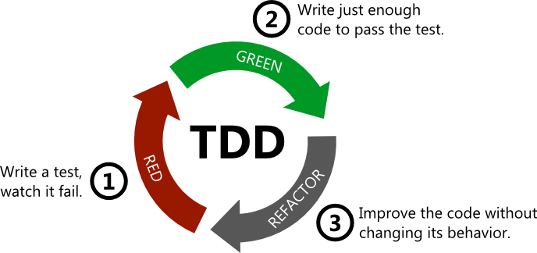
Test Driven Development
Simple/Testable design
Clean code
Less bugs / high confidence
Quick feedback loop
Avoiding debuggers

Slide 9
Practitioners – to know…
Clean Code - Uncle Bob (https://en.wikipedia.org/wiki/Robert_C._Martin)
TDD - Kent (https://en.wikipedia.org/wiki/Kent_Beck)
Pragmatic Andy (https://en.wikipedia.org/wiki/Andy_Hunt_(author))
Refactoring – Martin (https://martinfowler.com/)
Legacy Code – Micheal Feathers (Working Effectively with Legacy Code)
Agile Developer – Venkat (https://agiledeveloper.com/)
Junit – J.B. Rainsberger https://www.jbrains.ca/

Slide 10
Thank You
Sundar.Muthuraj@tesco.com

