Slide 1
AGENTIC AI
Merchandising AI
A Multi-Agent System for Non-Purchaser Feedback Analytics
Architecture · Topology · Agents · Tools · Evaluation · Observability
PRESENTED BY
Sundar Ram Subramanian
DATE
May 16, 2026

Slide 2
OVERVIEW
Project at a Glance
THE BUSINESS PROBLEM
THE ARTIFACT
Six-store jewelry chain (X1–X6). Salesmen capture free-text reasons when a customer leaves without buying. ~1,200 records.
Merchandising team needs to know:
“What should we stock more at X2?” · “Compare size issues across X1 and X4.” · “What’s the top reason at X3 yesterday?”
Production-grade multi-agent chat assistant. Natural-language questions in. Grounded, source-cited, SQL-backed answers out.
9 specialised LLM agents · 11 deterministic tools · 1 rule-based Python orchestrator · 1 audit log.
9
11
2
0.0
≈$0.02
LLM agents
(5 reasoning + 4 reflection)
deterministic
tools
model tiers
(Sonnet 4.6 + Haiku 4.5)
Temperature.
Highly deterministic agents
happy-case cost
per SQL turn
Two surfaces.
Chat - free-form Q&A driven by the agent pipeline.
Recommendations - one-click deterministic report computed in pandas, identical every time.
Merchandising AI · Multi-Agent System
2 / 27

Slide 3
DESIGN RATIONALE
Why a Multi-Agent System is the Right Tool?
“What should we stock more at X1?” looks like one question. It is actually six obligations a single LLM call cannot satisfy simultaneously:
1
Translate
2
Execute safely
3
Verify semantics
Map colloquial business phrasing into a precise multi-dimensional SQL aggregation.
Run that SQL against production data with SELECT-only / banned-keyword guards.
Check that the rows returned actually answer the question that was asked.
4
Compose prose
5
Visualise (if it helps)
6
Surface reasoning
Write a markdown answer that cites only numbers verifiable against the data.
Render an optional chart whose code and image both pass review.
Expose every step so a sceptical stakeholder can audit the answer end-to-end.
Takeaway. Task decomposition and splitting of works across specialised agents whose outputs are independently reviewed is the smallest design that satisfies all six obligations. A single prompt or a plain RAG retrieval cannot.
Merchandising AI · Multi-Agent System
3 / 27

Slide 4
CROSS-CUTTING PRINCIPLES
Five Foundational Design Choices
These five choices touch every layer of the system. They are the doctrines the rest of the architecture flows from.
1
Determinism over creativity
All 9 agents run at temperature 0.0. Writer was dropped from 0.2 → 0.0 after the same SQL value of 41 yielded “approximately 40,” “exactly 41,” and fabricated subset sums on different retries.
2
Rule-based Orchestrator, not an autonomous loop
Control plane is pure Python. Agents emit structured text in XML tags or JSON; the Orchestrator parses and routes. No LLM ever decides what runs next.
3
Closed enums everywhere
Reviewer verdicts, Planner path, Supervisor action, Topic Classifier output - all enum-checked in both prompt and Python. Out-of-enum output counts against the retry budget.
4
Hard-block over soft-block on numeric grounding
If the Writer cannot ground every number in two attempts, the system ships an explicit refusal, not unverified prose with the wrong subtotal.
5
Schema vocabulary discipline
Renamed attribute_type → non_purchase_type because the word “attributes” collided with another column and caused the LLM to disambiguate incorrectly. Schema-level naming clarity beats prompt-level scaffolding.
Merchandising AI · Multi-Agent System
4 / 27

Slide 5
HIGH-LEVEL ARCHITECTURE
The Eight-Layer Stack
Each layer has a single concern. Each layer talks only to its neighbours. The Orchestrator is the only component permitted to call agents or tools.
8
Observability & Interface
Streamlit UI · StepEvent · chat_trace surfacing
7
Tooling & Validation
sql_parser · sql_safety_guard · sql_executor · viz tools · groundedness · log_turn
6
Orchestration & Recovery
Rule-based control plane · retry budgets · Supervisor escape hatch
5
Reflection
Code Reviewer · Output Reviewer · Viz Code Reviewer · Viz Reviewer (multimodal)
4
Reasoning
Planner · Coder · Writer · Viz Coder · Supervisor
3
Memory
Streamlit session state · 8-message look-back · resolved_question mechanism
2
Knowledge
Offline topic-enrichment pipeline · SCHEMA_TEXT constant
1
Data
MySQL · non_purchasers_feedback (~1,200 rows) · chat_trace audit table
Merchandising AI · Multi-Agent System
5 / 27

Slide 6
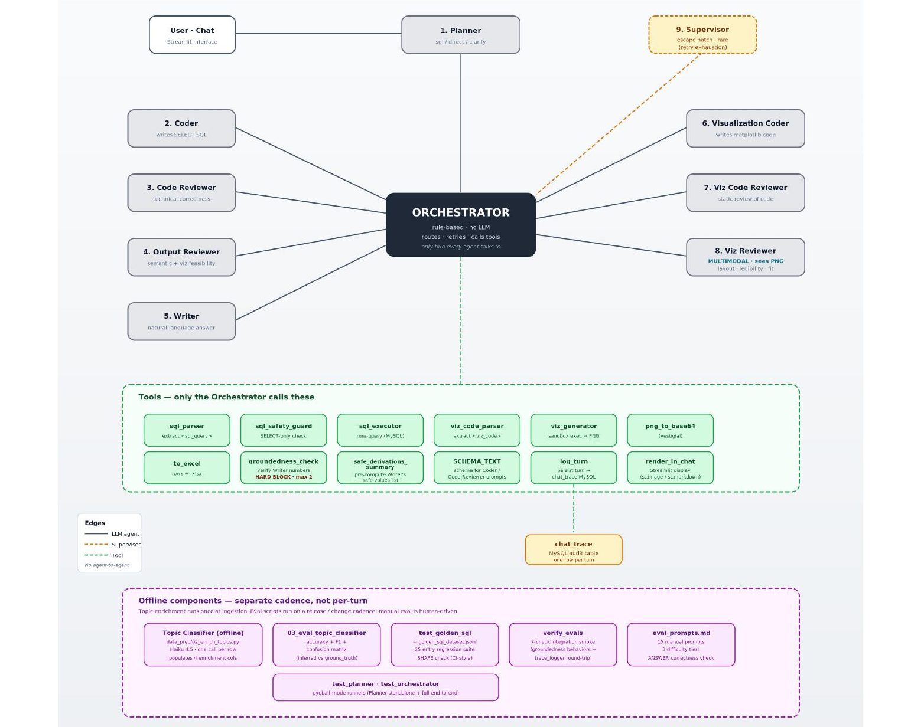
COMPONENT CALL GRAPH
A Single Hub Topology
WHY THIS SHAPE
FIVE CONCRETE BENEFITS
Every agent is connected only to the Orchestrator.
Every tool is connected only to the Orchestrator.
No agent ever calls another agent. No agent ever calls a tool.
The hub-and-spoke shape is the design statement.
single place to set retry budgets
log every step
apply safety guards
audit every tool call
read control flow top-to-bottom in one Python file
Merchandising AI · Multi-Agent System
6 / 27

Slide 7
THE MOST CONSEQUENTIAL CHOICE
Single-Hub Orchestrator vs MCP / Tool-Use Loop
AUTONOMOUS AGENT LOOP-REJECTED
RULE-BASED PYTHON ORCHESTRATOR-CHOSEN
MCP servers · LangGraph · AutoGen · Anthropic tool_use
agents/orchestrator.py · ~679 lines · zero LLM in routing logic
Single LLM decides at each step which tool to invoke next.
LLMs emit structured text. Python parses and dispatches.
Flexible - agent navigates problems it was not programmed for
Worst-case cost is bounded by retry budgets
Worst-case cost is unbounded
Retry budgets enforced by Python, not by the LLM
Retry budgets are hard to enforce
Every tool call goes through one auditable control-flow point
Tracing requires decoding the LLM's tool-use rationale
No tool-use round trips inflate cost
Cost ceilings drift as the model decides its own loop length
Debugging is reading Python, not decoding LLM rationale
Trade-off accepted: less flexibility on never-seen problems. Trade-off rejected: unbounded cost, opaque control flow, and unreliable retry enforcement. For a focused merchandising chat where the same control flow applies to every turn, autonomy is the wrong trade.
Merchandising AI · Multi-Agent System
7 / 27

Slide 8
WHAT THIS SYSTEM DOES NOT USE
Two Deliberate Non-Choices
NO VECTOR DATABASE · NO RAG
NO LANGCHAIN · NO LANGGRAPH
No embedding model. No similarity index. No retrieval-augmented generation.
Neither LangChain nor LangGraph is a dependency. orchestrator.py is ~679 lines of plain Python.
Why?
Trade-off accepted:
• Data is small: ~1,200 rows of structured feedback
• Schema is fixed: known columns, known types
• Questions are quantitative aggregations, not semantic search
Right primitive: SQL with a strongly-typed schema.
When to reconsider: scope widening to free-text Q&A over policy documents or product PDFs.
Adding a new agent requires editing the orchestrator file rather than declaring a node in a graph.
Benefits gained:
• Total visibility into control flow: every retry, every escape hatch, every step event visible inline
• Zero exposure to framework breakage when an upstream library tweaks its public interface
• Lower cognitive load for the next engineer to read the codebase
Both non-choices are reversible: the system would absorb a vector store or a framework if the problem shape changed. This problem shape does not require them.
Merchandising AI · Multi-Agent System
8 / 27

Slide 9
ANTHROPIC CLAUDE · SONNET 4.6 + HAIKU 4.5
Model Strategy — A Deliberate Two-Tier Allocation
Sonnet 4.6 is used only where it is structurally required. Haiku 4.5 is roughly 3–5× cheaper and used everywhere else, where it delivers Sonnet-acceptable quality.
Agent
Model
Temp
Why this model
Coder
Sonnet 4.6
0.0
Hardest task. Haiku failed on MySQL window-functions and on the non_purchase_type vs attribute_value disambiguation.
Code Reviewer
Sonnet 4.6
0.0
Must match the Coder's tier or it rubber-stamps subtle errors. Tier-matching is what makes reasoning-vs-SQL verification work.
Planner
Haiku 4.5
0.0
Routes the turn into sql / direct / clarify. A simple classification task.
Output Reviewer
Haiku 4.5
0.0
Binary verdict on whether rows answer the question. Haiku is sufficient.
Writer
Haiku 4.5
0.0
Composes prose from a pre-computed safe-values list. Arithmetic is taken off the LLM.
Viz Coder
Haiku 4.5
0.0
Writes short, pattern-based matplotlib snippets. Well-bounded task.
Viz Code Reviewer
Haiku 4.5
0.0
Static safety check for banned identifiers and missing labels.
Viz Reviewer
Haiku 4.5 vision
0.0
Must SEE the rendered PNG. Requires multimodal input natively.
Supervisor
Haiku 4.5
0.0
Picks one of four recovery actions from the step trace. A small decision.
All agents run at temp 0 to maximise determinism. Sonnet = SQL-quality bottleneck only. Haiku vision = the one agent that must inspect an image. Everything else = standard Haiku.
Merchandising AI · Multi-Agent System
9 / 27

Slide 10
THE TWO SPECIFIC FAILURE MODES SONNET FIXED
Why Sonnet 4.6 for the Coder + Code Reviewer
Earlier iterations ran the Coder on Haiku 4.5 to save cost. Two specific failure modes drove the upgrade.
FAILURE MODE 1 — WINDOW FUNCTIONS
FAILURE MODE 2 — DOMAIN VOCABULARY
MySQL window-function syntax required for top-N within each group.
Disambiguating non_purchase_type vs attribute_value — central to the merchandising domain.
ROW_NUMBER() OVER (PARTITION BY ... ORDER BY ...)
non_purchase_type ∈ {design, size, color, weight, price, customization, ...}
attribute_value ∈ {'rose gold', 'size 8', 'star design', ...}
Haiku 4.5: consistently mis-syntaxed the PARTITION BY clause, omitted the ORDER BY, or fell back to nested sub-queries that returned the wrong row count.
Sonnet 4.6: handles it reliably under the same prompt.
Haiku 4.5: filtered on the wrong column on compound questions like “top design attributes at X1”
Sonnet 4.6: picks the right column under the same prompt.
THE REVIEWER MUST MATCH THE CODER
A Haiku-tier reviewer cannot catch a Sonnet-tier Coder's subtle mistakes. Tier-matching is what makes the reasoning-vs-SQL verification work in practice
Merchandising AI · Multi-Agent System
10 / 27

Slide 11
KNOWLEDGE LAYER
Data Layer & Closed-Enum Discipline
One MySQL table. Nine captured columns + four LLM-enriched columns. Enrichment runs once offline and not per chat turn.
THE SCHEMA
CLOSED ENUMS — DUAL ENFORCEMENT
Captured at the storefront (9 cols)
Validated in the prompt AND in Python. Out-of-enum output counts against the retry budget.
feedback_id · visit_date · store_code · customer_name · customer_email · user_category · product_looking_for · reason_for_non_purchase · ground_truth_topic
inferred_topic
→ non_purchase_type
Design Unavailable
design
Size Unavailable
size
Stock Unavailable
stock
Enriched offline by LLM Topic Classifier (4 cols)
Price Too High
price
inferred_topic · topic_confidence · non_purchase_type · attribute_value
Quality Concerns
none
Weight Concerns
weight
Color/Finish Mismatch
color
Why offline? Pattern-matching free-text reasons inside every chat turn would be fragile and slow. Persisting clean structured columns lets the Coder write aggregations against enums.
Customization Not Offered
customization
Sales Service
service
Others
none
Vocabulary discipline goes back to the schema. Column was originally attribute_type — the word “attributes” collided with another column. Renaming it to non_purchase_type prevented an entire class of disambiguation errors.
Merchandising AI · Multi-Agent System
11 / 27

Slide 12
TWO HORIZONS, ONE RESOLUTION POINT
Memory & Context Management
SHORT-TERM · PER-SESSION
LONG-TERM · CROSS-SESSION
8-message look-back at the Planner only
chat_trace MySQL audit table
The Planner sees history[-8:] and emits a resolved_question which is a self-contained string with context baked in.
Every chat turn → one row. Derived columns (path, retry_count, supervisor_invoked, groundedness_warned) + full StepEvent trace as JSON.
Every downstream agent (Coder, Output Reviewer, Writer, Viz Coder) reads the resolved question but never the raw user message.
Why denormalised?
• Common queries are “give me all turns where X happened”. The derived columns answer them without JSON-path parsing
• Full JSON trace preserves complete detail for the rarer “give me every step in turn Y” case
Why 8?
• Empirically, follow-ups point back 1–2 turns; depth > 4 rarely catches new references
• Keeps Planner prompt small (~1–2K tokens total)
• Caps total token cost to O(n) instead of O(n²) on long sessions
Logging is wrapped in two layers of try/except:
MySQL outage cannot affect the chat response that has already been returned.
Merchandising AI · Multi-Agent System
12 / 27

Slide 13
5 REASONING + 4 REFLECTION
The Nine-Agent Roster
Each reasoning agent has a paired reflection agent. Cross-review, not self-critique. All temp 0, all closed-enum verdicts.
REASONING AGENTS (5)
REFLECTION AGENTS (4)
1
Planner
Haiku
3
Code Reviewer
Sonnet
Routes turn into sql / direct / clarify · resolves history
Verifies SQL technical correctness + reasoning-vs-SQL consistency
2
Coder
Sonnet
4
Output Reviewer
Haiku
Writes <reasoning> + <sql_query> — the SQL bottleneck
Decides if rows answer the question · flags viz_applies
5
Writer
Haiku
7
Viz Code Reviewer
Haiku
Composes markdown answer from safe-values list
Static safety check - banned identifiers, missing labels
6
Viz Coder
Haiku
8
Viz Reviewer
Haiku vis
Writes short matplotlib snippet for the sandbox
MULTIMODAL - judges the rendered PNG: layout · legibility · fit
9
Supervisor
Haiku
Picks recovery action when a retry budget exhausts
+ 1 offline agent: Topic Classifier (Haiku 4.5, one-time, ~1,200 rows, 10-topic closed enum) - runs at ingestion, not per turn
Merchandising AI · Multi-Agent System
13 / 27

Slide 14
TOOL LAYER | PURE PYTHON, SINGLE-CONCERN, ORCHESTRATOR-ONLY
Eleven Deterministic Tools
Every tool is pure Python. Every tool receives pre-parsed, pre-validated data but never raw model text. Every tool is called exclusively by the Orchestrator.
SQL
SQL
SQL
sql_parser
sql_safety_guard
sql_executor
Extract <sql_query> + <reasoning> blocks from Coder output
SELECT-only + banned-keyword + multi-statement check
Run SQL against MySQL · cap 500 rows
VIZ
VIZ
VIZ
viz_code_parser
viz_generator
png_to_base64
Extract Python from <viz_code> tags
Sandboxed exec of matplotlib code · whitelist __builtins
Encode rendered PNG bytes for multimodal call
I/O
VERIFY
VERIFY
to_excel
groundedness_check
safe_derivations_summary
openpyxl-backed .xlsx bytes for download affordance
Regex-based numeric verification · HARD BLOCK
Pre-compute the Writer's safe-values list
OBS
META
log_turn / ensure_table
SCHEMA_TEXT / get_schema_for_prompt
Persist one row to chat_trace · idempotent schema
Canonical schema as a string constant
Why deterministic, not agent-driven tool-use? Tools receive Python values, not raw model text. Each tool is trivially unit-testable and free of any model-specific assumption. This is what makes worst-case cost bounded.
Merchandising AI · Multi-Agent System
14 / 27

Slide 15
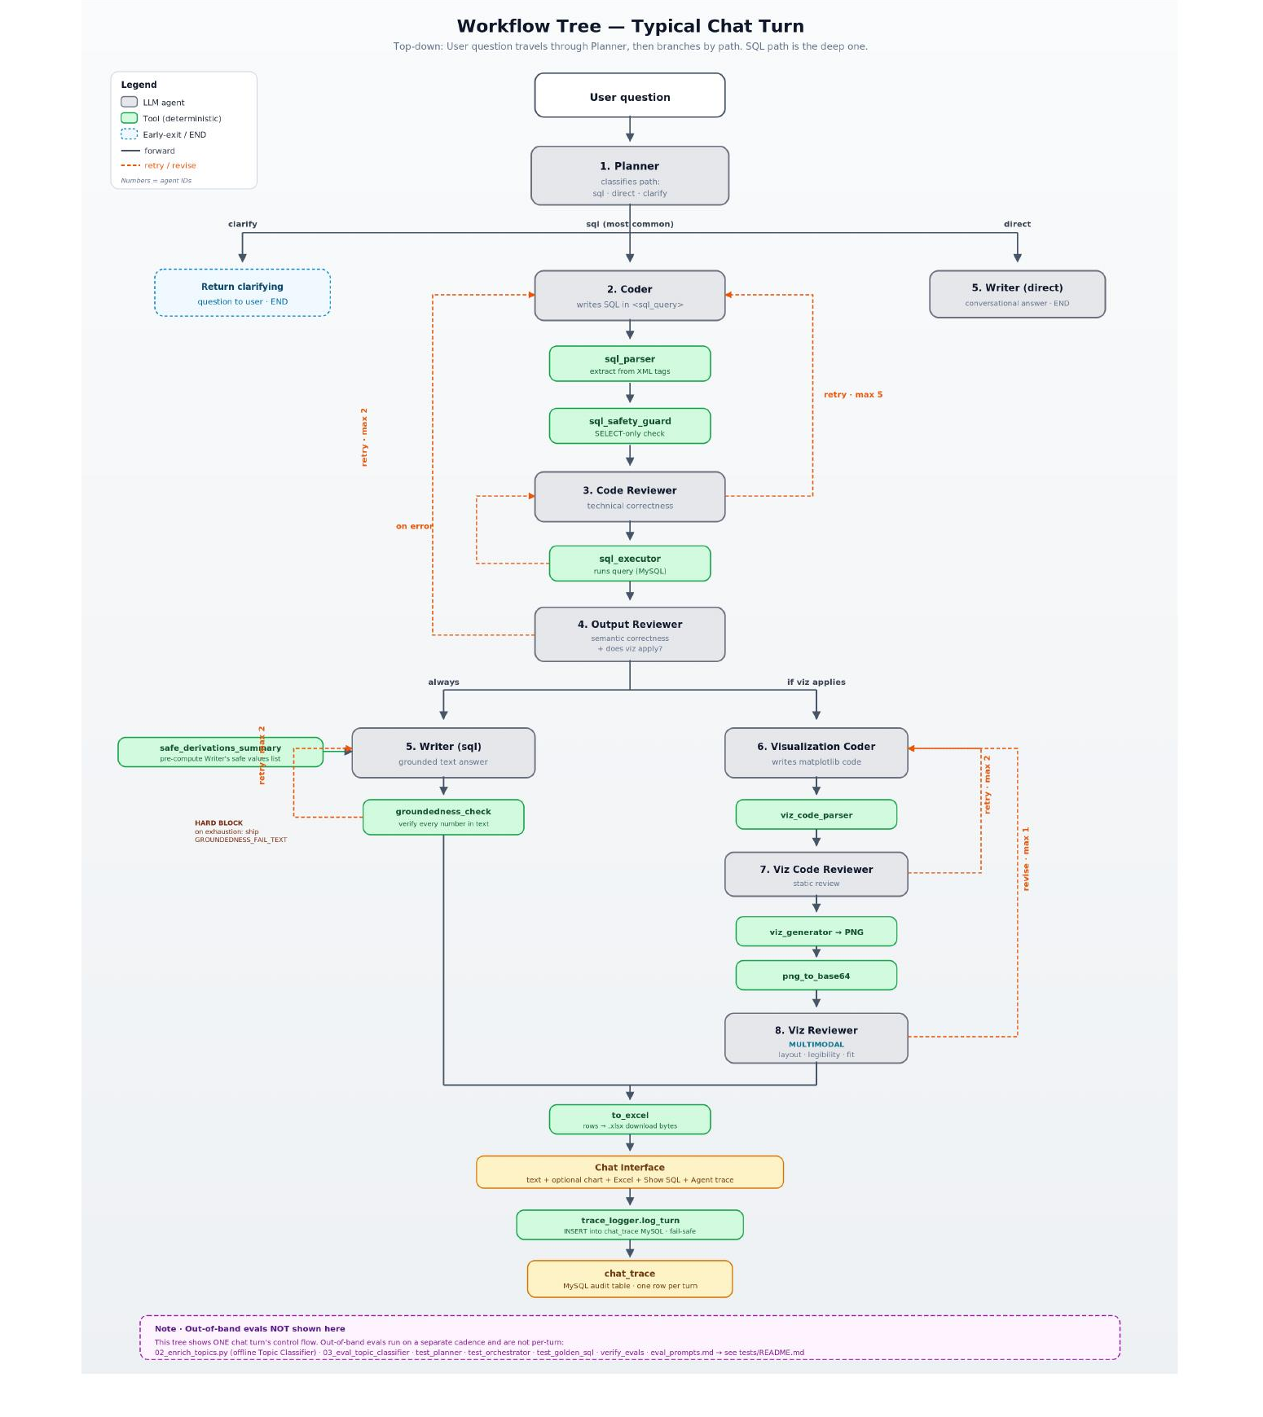
TEMPORAL AGENTIC WORKFLOW
End-to-End Workflow — One SQL-Path Chat Turn
THE FIVE NESTED LOOPS
5
Inner SQL loop
Coder ↔ Code Reviewer ↔ sql_executor
2
Output review loop
Output Reviewer ↔ Coder
2
Writer grounding loop
Writer ↔ groundedness_check
2
Viz code loop
Viz Coder ↔ Viz Code Reviewer
1
Viz revise loop
Viz Reviewer (multimodal)
Three loops escalate to the Supervisor on exhaustion (SQL strategy can plausibly change). Two do not (Writer grounding → hard-block refusal; Viz pipeline → drop chart, ship text).
Merchandising AI · Multi-Agent System
15 / 27

Slide 16
WORST-CASE COST IS BOUNDED BY DESIGN
Retry Budgets & Supervisor Recovery
Every retry budget lives as a module-level constant at the top of orchestrator.py. No magic numbers buried in functions.
Loop
Max
Exhaustion behaviour
Coder ↔ Code Reviewer ↔ sql_executor
5
Escalate to Supervisor
Output Reviewer ↔ Coder
2
Escalate to Supervisor
Writer ↔ groundedness_check
2
Ship GROUNDEDNESS_FAIL_TEXT (hard-block)
Viz Coder ↔ Viz Code Reviewer
2
Drop chart · ship text-only
Viz Reviewer revise round
1
Ship last PNG or drop
WHEN A SQL LOOP EXHAUSTS: SUPERVISOR'S FOUR ACTIONS
abort_gracefully
retry_with_strategy
ship_partial
ask_user
Question is genuinely unanswerable. Ship a polite explanation.
Propose a fundamentally different SQL approach. One-shot only.
Useful result exists. Ship it with a caveat about limits.
Question is ambiguous. Return a focused clarifying question.
Hard-block vs soft-block is deliberate. Writer grounding → hard-block: a strategy change does not help; refuse with a fixed message. SQL loops → soft-block to Supervisor: different SQL might actually answer.
Merchandising AI · Multi-Agent System
16 / 27

Slide 17
PROMPT ENGINEERING: HOW THE PIPELINE STAYS GROUNDED
Three Coordinated CoT Scaffolds
Chain-of-thought is not a single prompt trick in this system. It is a triplet of mechanisms that guard a distinct failure surface each. Removing any one of them produces measurable regression on the manual eval suite.
1
Coder's <reasoning> block
2
Pre-computed safe-values list
3
Reasoning-vs-SQL verification
GUARDS AGAINST
GUARDS AGAINST
GUARDS AGAINST
Coder writes SQL that ignores its own intent
Writer fabricates a subtotal that misses the candidate set
Plausible-looking SQL that quietly contradicts the reasoning
MECHANISM
MECHANISM
MECHANISM
Before any SQL is emitted, the Coder is required to produce four named lines: Dimensions / Filters / Aggregation / Completeness. Once the structure is committed in text, the model's own consistency bias makes it linguistically jarring to contradict it in the SQL that follows.
After SQL runs, safe_derivations_summary computes in plain Python and every legitimate numeric derivation: grand totals, top-N partial sums, per-group subtotals, per-group row counts. The Writer is instructed to pick numbers from this list rather than compute its own.
The Code Reviewer reads both the <reasoning> block and the SQL, and verifies one against the other. Reasoning says “three dimensions” but SQL groups by two → retry. Reasoning says “no LIMIT” but SQL has LIMIT 30 → retry.
LIVES IN
LIVES IN
LIVES IN
Coder agent
Orchestrator (Python) → Writer agent
Code Reviewer agent
Scaffold 1 prevents missed dimensions. Scaffold 2 prevents fabricated subtotals. Scaffold 3 catches Scaffold 1 being ignored. Defence in depth, by design.
Merchandising AI · Multi-Agent System
17 / 27

Slide 18
WHY REVIEWER ≠ GENERATOR
Reflection: Cross-Review, Not Self-Critique
Each reviewer's verdict is a closed enum and each reviewer's feedback is a concise, concrete suggestion. The reasoning-vs-reflection split was chosen for two specific reasons.
REASON 1 — DILUTED ATTENTION
REASON 2 — CLEAN BUDGET BOUNDARY
Prompting one agent to both produce and critique its own output dilutes the system prompt and produces measurably worse criticism. The generator's prior toward its own output overwhelms the critic's job.
The reviewer's verdict is what determines whether the loop continues or terminates. That decision belongs in its own agent with its own narrow prompt and its own line in the retry-budget table.
FOUR DEDICATED REVIEWERS — EACH WITH ITS OWN GUARD
Code Reviewer
Output Reviewer
Viz Code Reviewer
Viz Reviewer (mm)
Guards against
Guards against
Guards against
Guards against
SQL correctness + reasoning consistency
Do the rows answer the question?
Static safety check on viz code
Multimodal: judges the rendered PNG
Verdict enum
Verdict enum
Verdict enum
Verdict enum
{ ok · retry }
{ ok · retry } + viz_applies
{ ok · retry }
{ ok · revise · drop }
Why not a single critic at the end? By the time a final critic fires, the system has already paid for Coder, sql_executor, Writer, and the viz pipeline. Critique at each stage means rejection happens at the cheapest point in the pipeline at which the error is detectable.
Merchandising AI · Multi-Agent System
18 / 27

Slide 19
IN-BAND · EVERY TURN
Evaluation: Three Concentric Runtime Rings
Each ring catches a different class of failure. Outer rings handle what inner rings cannot see.
Ring 1
Deterministic guards
R3 · retry loops + Supervisor
sql_parser · sql_safety_guard · viz_code_parser · viz_generator sandbox · groundedness_check · closed-enum validators on every structured output.
Cannot lie — pure Python, unit-testable.
R2 · cross-reviewing agents
Ring 2
Cross-reviewing LLM agents
R1
Code Reviewer · Output Reviewer · Viz Code Reviewer · Viz Reviewer. These are LLMs and can occasionally be wrong.
deterministic
Catch subtle errors the deterministic guards cannot see.
Ring 3
Retry loops + Supervisor escape hatch
Every reviewer veto bounces back to the reasoning agent with feedback as a hint. Bounded retries protect against infinite loops.
Supervisor recovers when SQL loops exhaust.
Merchandising AI · Multi-Agent System
19 / 27

Slide 20
RUN ON A CADENCE · NOT PER TURN
Four Out-of-Band Evaluation Suites
Each suite plays a distinct role in the trust-but-verify story. Running all four after any prompt or model change is the only reliable way to confirm no regression.
01
Integration smoke test
CATCHES
CADENCE
verify_evals.py
Wiring breaks · regressions in the safety-rail seam between agents and tools
After any code or prompt change
7 checks confirming groundedness behaviours + trace_logger round-trip
02
Q-to-SQL regression suite
CATCHES
CADENCE
test_golden_sql.py + dataset.jsonl
Planner path drift · forbidden columns · missing GROUP BY · removed LIMIT
CI-style on every release
26 entries · automated SHAPE check (path · SQL tokens · row-count bounds)
03
Manual answer-correctness suite
CATCHES
CADENCE
eval_prompts.md
Subtle aggregation errors that pass the shape check but produce wrong numbers
Human-driven · before any major release
15 prompts at 3 difficulty tiers · numbers compared against Excel pivots
04
Topic classifier accuracy
CATCHES
CADENCE
03_eval_topic_classifier.py
Drift in the offline enrichment that quietly biases all downstream aggregation
After any enrichment-prompt change
Precision · Recall · F1 per topic + full confusion matrix + low-confidence triage
Why both a shape check and an answer-correctness check? A row-count drift can pass the shape check; only the manual numeric comparison catches it. Conversely, a refactor that breaks path-routing is caught instantly by the shape check. Both layers are needed.
Merchandising AI · Multi-Agent System
20 / 27

Slide 21
GOLDEN SQL COVERAGE + TOPIC CLASSIFIER METRICS
Eval Suite Deep Dive
GOLDEN SQL DATASET — 25 ENTRIES
TOPIC CLASSIFIER METRICS
Single-store top-reason
3
Compared against synthetic ground_truth_topic. Per-topic + overall metrics + confusion matrix.
Cross-store aggregation
2
Two-store comparison
3
Precision(t)
=
TP(t) / ( TP(t) + FP(t) )
Attribute-value drill-down
3
Recall(t)
=
TP(t) / ( TP(t) + FN(t) )
Compound multi-dimension
2
Direct path (greet/define)
3
F1(t)
=
2 · Precision(t) · Recall(t) / ( Precision(t) + Recall(t) )
Clarify path (vague Qs)
2
Chart-request preservation
1
Accuracy
=
Σ_t TP(t) / N_total
Colloquial-vs-literal vocab
2
Topic-filtered ranking
2
Script also prints lowest-confidence mistakes — a regression often manifests as a small number of high-confidence wrong predictions, more informative than the overall accuracy number.
Loose product filters
2
Each entry asserts: (a) Planner picks the expected path · (b) SQL contains required tokens, avoids forbidden ones · (c) row count is within bounds. Shape check and not answer-correctness.
Topic Classifier is the most consequential bias surface in the system — a topic systematically under-classified at one store would silently misdirect merchandising decisions. Per-topic F1 is monitored individually, not blended into a single accuracy figure.
Merchandising AI · Multi-Agent System
21 / 27

Slide 22
THE HIGHEST-LEVERAGE QUALITY INTERVENTION
The Groundedness Check : Why Regex Beats LLM-as-Judge
For a quantitative business-analytics use case, numeric hallucination is the most damaging failure the system can produce. A fabricated count becomes a wrong purchase order.
HOW IT WORKS
Every numeric token in the Writer's prose is extracted by regex and verified against a broad candidate set derived from the SQL result rows.
individual cells
numbers in string labels
per-col grand totals
per-row column %
per-group subtotals
per-group row counts
top-N partial sums (N=2,3,4,5)
REGEX CHECK — CHOSEN
LLM-AS-JUDGE — REJECTED
Deterministic: same input, same verdict every time
Stochastic: same input may produce different verdicts
Zero additional cost: no extra API call per turn
Adds another API call per turn
Trivially explainable to a stakeholder
Requires its own eval harness to confirm the judge is correct
Structurally incapable of being talked into letting a bug through
Harder to explain: “the model said so” isn't an audit trail
Trade-off accepted: the regex cannot verify semantic attribution, but it can confirm “41 appears in the rows” but not “41 was attributed to the right group”. The Output Reviewer catches misattribution. The layering is intentional.
Merchandising AI · Multi-Agent System
22 / 27

Slide 23
EVERY STEP. EVERY TURN. PERSISTED TO MYSQL.
Observability & the chat_trace Audit Log
CHAT_TRACE SCHEMA · ONE ROW PER TURN
STEPEVENT · THE ATOM OF TRACING
Column
Type
Purpose
Idx
agent
Which agent or tool acted
trace_id
BIGINT PK
Auto-incrementing turn id
created_at
DATETIME
Insertion timestamp
◆
status
start · ok · retry · fail
path
VARCHAR(16)
sql / direct / clarify
◆
resolved_question
TEXT
Planner's context-resolved Q
summary
One-line human-readable
final_sql
TEXT
SQL that ran (NULL on non-sql)
detail
Agent-specific structured dict
has_chart
BOOL
Was a chart rendered?
has_excel
BOOL
Excel download attached?
IN-UI TRACE SURFACING
supervisor_invoked
BOOL
Was the Supervisor reached?
◆
groundedness_warned
BOOL
Hard-block fired?
◆
Every chat response carries four expandable panels:
step_count
INT
Number of StepEvents this turn
▸ Answer markdown - inline
retry_count
INT
Steps with status=retry
▸ Show SQL - executed query
answer_text
MEDIUMTEXT
Final user-facing markdown
▸ Show chart code - matplotlib snippet
steps_json
MEDIUMTEXT
Full step trace as JSON
▸ How I got this answer - full StepEvent trace
◆ indexed for common queries
Sceptical user audits the system without ever leaving the chat surface.
Denormalised intentionally, common queries are “give me all turns where X happened”, not “every step in turn Y”.
Merchandising AI · Multi-Agent System
23 / 27

Slide 24
HONEST SELF-ASSESSMENT, NOT A WIKI-PAGE POLICY
Ethics · PII - Incidental vs Designed Protection
The system has two PII columns: customer_name and customer_email. PII protection is incidental: a behavioural default, not a structural guarantee.
CURRENT — INCIDENTAL PROTECTION
FUTURE — DESIGNED PROTECTION
Four behavioural defaults keep PII out of typical answers:
Two ~100-line changes, both unit-testable:
• Coder corpus is aggregation-shaped - no example mentions PII columns
• PII-scrub wrapper around sql_executor - strips customer_name and customer_email from every result row before it reaches any agent
• Planner resolves into aggregation phrasing, never row-listing
• Writer template composes grouped summaries, not row lists
• Writer-prompt rule forbidding citation of individual customers - defence-in-depth even if scrub is changed
• Anthropic RLHF provides a thin backstop against gratuitous PII
Brittle. A directly phrased query - “list the names of customers who complained about size at X1” – might exposes the gap.
Robust. Agents never receive PII columns - the SQL itself cannot exfiltrate them, regardless of phrasing.
WHEN THE UPGRADE BECOMES MANDATORY
Any of: external user access · internal access beyond the merch team · regulatory audit · use-case expansion to individual-customer questions (loyalty programmes, single-customer journeys).
Merchandising AI · Multi-Agent System
24 / 27

Slide 25
PER-TURN LATENCY + PER-TURN TOKEN SPEND
Performance & Cost : Bounded by Design
15–20s
30–60s
2–5s
1–2s
SQL happy case
(1 Coder · 1 OR · 1 Writer)
SQL with retries
(1–2 retry attempts)
Direct path
(conversational only)
Clarify path
(planner returns clarifying Q)
PER-TURN COST DECOMPOSITION · ANTHROPIC PRICING
Worst-case cost is bounded. Sub-dollar even in the worst case because retry budgets are bounded. This is a direct consequence of the rule-based Orchestrator choice. An autonomous-loop design could not make this guarantee.
Merchandising AI · Multi-Agent System
25 / 27

Slide 26
WHAT'S NOT YET BUILT — AND WHY
Known Limitations & Future Directions
KNOWN LIMITATIONS
FUTURE DIRECTIONS
Groundedness verifies values, not attribution - wrong-group attribution can pass
CI integration: wire golden_sql + verify_evals into GitHub Actions on every PR
Planner is a single point of failure for history resolution
Prompt-version tracking : store prompt-file hashes in chat_trace.steps_json
Output Reviewer at Haiku can occasionally rubber-stamp subtle mismatches
PII redaction: sql_executor wrapper that scrubs customer_name and customer_email
PII is not guarded - incidental protection only (see Slide 24)
Viz sandbox is dev-grade, in-process exec, not subprocess-isolated
Subprocess-isolated viz sandbox: for production multi-tenancy
Tests are CI-ready but no CI workflow committed yet
Vector store (only) if scope widens to free-text Q&A over policy/PDF documents
Golden SQL set is starter-size (25 entries), should grow with new failure modes
Per-turn cost ceiling: hard token-budget check that aborts a runaway turn
No prompt-version hash stored in chat_trace, git-only traceability
Promote Output Reviewer to Sonnet 4.6 once cost permits.
Sonnet at temp 0 is not strictly bit-deterministic, identical-replay is imperfect
Cost rose ~3–5× with the Sonnet upgrade, worth re-checking quarterly
Merchandising AI · Multi-Agent System
26 / 27

Slide 27
THE ARCHITECTURAL THESIS
Match commitments to the problem.
A focused multi-agent system, built with deliberate rule-based orchestration and aggressive layered evaluation, can reliably translate natural-language business questions into grounded SQL answers at a bounded cost-per-turn.
Every architectural commitment in this system: single-hub orchestration, two-tier model selection, CoT scaffolding triplet, hard-block groundedness, end-to-end observability were made because the specific business problem rewards predictability over flexibility.
Every answer can be audited
Every retry can be bounded
Every regression can be detected
Thank you · Questions welcome

