Slide 1
Troop Messenger
Email Us: sales@troopmessenger.com
Website: https://www.troopmessenger.com
Phone no. (+1)-732 200 1688 / (+91) 91216 42626

Slide 2
Military-Grade Messaging App
We are in an information technology world where information has been exchanging between systems quicker and smarter than ever before, however, Data security and protection is the biggest challenge for the 21st century, as we are witnessing the data becomes vulnerable and may fall into the hands of unknown parties, data loss and lack of protection shall be a threat for the owners of data.
When the information is exchanged or stored in the system it needs to be secured by the in-built system, Security is the cardinal of military-grade messaging software applications.

Slide 3

Troop Messenger
How Troop Messenger protects your data and helps in communication!
Troop Messenger is a highly secured internal security app, it can be installed in various systems either by using On-Premise or SaaS. The company provides applications based on customer needs and feasibility.
Troop Messenger never lets unauthorized access on user’s conversations that means the user’s data is protected by the secured network where Troop Messenger resides, Troop messenger has come with the facility of LDAP/SSO integration into the user’s Active Directory (AD).

Slide 4

Can we call Troop Messenger a Military Grade application?
Yes!
Troop messenger qualifies for the requirements of “Military-grade” applications.
Military Grade is the term that has to be satisfied by certain principles in its manufacture and services. All software cant be regarded as Military-grade, only a few can be.

Slide 5
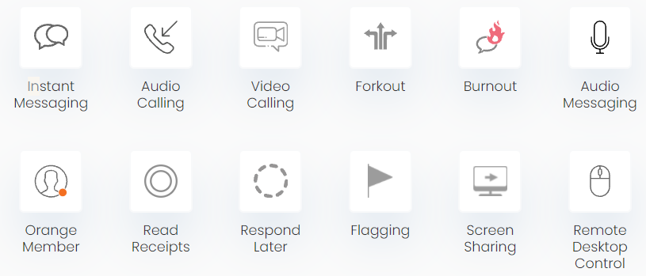
Features
All features on Troop Messenger As Military Grade application.
One-on-One Messaging
Unlimited Groups
Voice Calling
Audio Messaging
Video Calling
Advanced Search Filters
Screen Sharing
Live Location Tracking
Fork out (Send a single message to multiple users/multiple groups at once)
Burnout (private chat conversation window)
Live chat support
Delete unwanted and unnecessary data by choice
Clears all chats and information by the organization by its own
Recovery of data when needed
Optimization of applications
And more with Troop Messenger.

Slide 6
Troop Messenger for Military, Defence, and Armed Force
National security and protection National resources are the main duty of any state in the world, in fact, no country runs the system without security. Such import Domain its Data and conversation is a challenge for every nation. Troop messenger assists the armed forces to protect their data as Secure Messaging for Defence. The application can be used as a Messaging app for Defence.

Slide 7
Communication in Troop Messenger
Communication by Troop Messenger is end-to-end encrypted, the application following the world-class protocols that follow double ratchet algorithms, pre-keys, and triple elliptic-curve Diffie-Hellman(3DH), handshake, and used curve 25519, AES-256 as primaries. The application works as a C3 system ( Command - Control - communication). Troop Messenger includes any existing native application in case it is necessary for the organization.

Slide 8
Thank you

