Slide 1
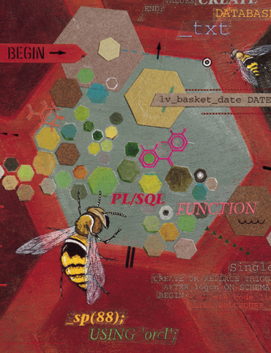
Oracle10g Developer:
PL/SQL Programming
Chapter 5
Procedures

Slide 2
Chapter Objectives
After completing this lesson, you should be able to understand:
  Named program units
  How to identify parameters
  The CREATE PROCEDURE statement
  Creating a procedure in SQL*Plus
  Using the IN OUT parameter
  Calling procedures from other blocks
  Using the DESCRIBE command with procedures
Oracle10g Developer: PL/SQL Programming

Slide 3
Chapter Objectives (continued)
After completing this lesson, you should be able to understand (continued):
  Debugging procedures using DBMS_OUTPUT
  Identifying useful software utilities for PL/SQL
  Using subprograms
  The scope of exception handling and transactions
  Using RAISE_APPLICATION_ERROR for error handling
  Removing procedures
Oracle10g Developer: PL/SQL Programming

Slide 4
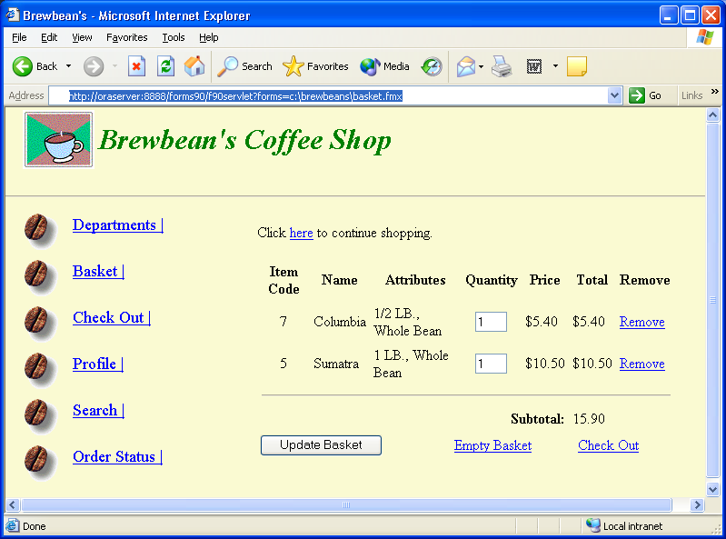
Brewbean’s Challenge
Develop programming modules for specific tasks such as calculating
taxes or updating inventory
Oracle10g Developer: PL/SQL Programming

Slide 5
Named Program Units
PL/SQL blocks executed thus far have been anonymous blocks
Now we will assign a name to the block and save it in the database as a stored program unit
This makes program units reusable
Oracle10g Developer: PL/SQL Programming

Slide 6
Types of Program Units
Program Unit Type
Description
Stored Procedures and Functions
Performs a task such as calculation of shipping cost. Can receive input values and return values to the calling program. Called explicitly from a program. Stored in the Oracle9i database.
Application Procedures and Functions*
Same as Stored Procedures and Functions except these are saved in an Oracle9i application or library on the client-side.
Package
A module used to group together related procedures and functions. Called explicitly from a program. Stored on the server side.
Database Trigger
Performs a task automatically when a DML action occurs on the table with which it is associated. Stored in the Oracle9i database.
Application Trigger*
Performs a task automatically when a particular application event occurs such as the user clicking a button on the screen. Stored in an Oracle9i application.
Oracle10g Developer: PL/SQL Programming

Slide 7
Parameters – Make Program Units Reusable
Mechanisms used to send values in and out of program units
MODE
DESCRIPTION
IN
Default if no mode is indicated. Passes a value from the application environment into the procedure. This value is considered a constant, as it cannot be changed within the procedure.
OUT
Passes a value out of the procedure to the application environment. If values are calculated or retrieved from the database within the procedure, OUT parameters are used to return these values to the calling environment.
IN OUT
Allows a value to be passed in and out using the same parameter. The values sent out can be different than the value sent in.
Oracle10g Developer: PL/SQL Programming

Slide 8
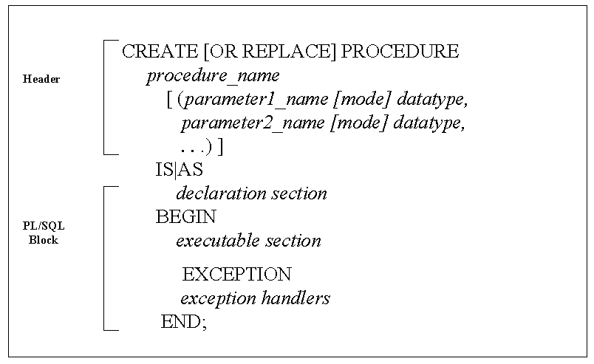
Create Procedure Statement Syntax
Oracle10g Developer: PL/SQL Programming

Slide 9
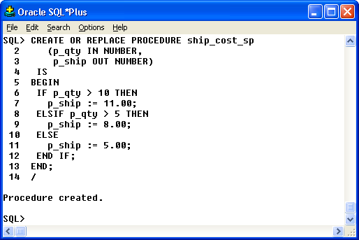
Create Procedure Execution
Procedure to determine shipping cost
Forward slash on last
line to execute
Note: Slash not needed for the Internet SQL*Plus interface
Oracle10g Developer: PL/SQL Programming

Slide 10
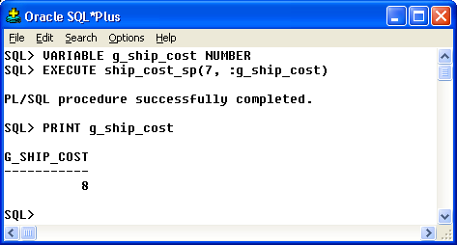
Execute the Procedure
Declare a host
variable
Use the SQL*Plus
EXECUTE command
Use the SQL*Plus
PRINT command
to view the host
variable value
Note: Parameter arguments are passed positionally
Oracle10g Developer: PL/SQL Programming

Slide 11
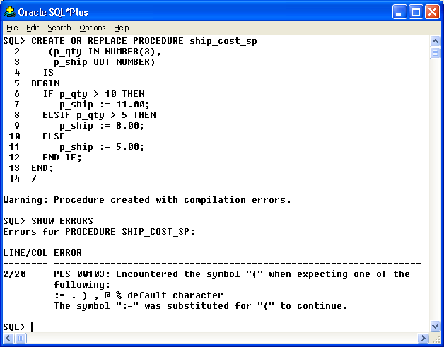
SHOW ERRORS Command
Error indicating parameter size
Compilation Error
Displays error message
Oracle10g Developer: PL/SQL Programming

Slide 12
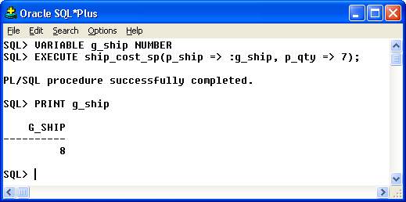
Named Association Method
Provide parameter values by position (default) or name
Pass arguments by parameter
name in execution
Oracle10g Developer: PL/SQL Programming

Slide 13
IN OUT mode
Send value in and out via the same parameter
CREATE OR REPLACE PROCEDURE phone_fmt_sp
(p_phone IN OUT VARCHAR2)
IS
BEGIN
p_phone := '(' || SUBSTR(p_phone,1,3) || ')' ||
SUBSTR(p_phone,4,3) || '-' ||
SUBSTR(p_phone,7,4);
END;
/
Oracle10g Developer: PL/SQL Programming

Slide 14
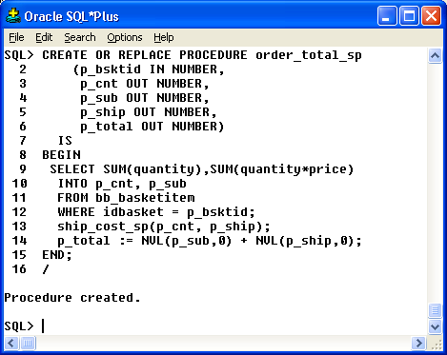
Calling a Procedure from a Block
Call to the ship_cost_sp
procedure
Oracle10g Developer: PL/SQL Programming

Slide 15
Variable Scope
When nesting blocks, are variables shared?
Inner blocks can use variables from outer blocks
Oracle10g Developer: PL/SQL Programming

Slide 16
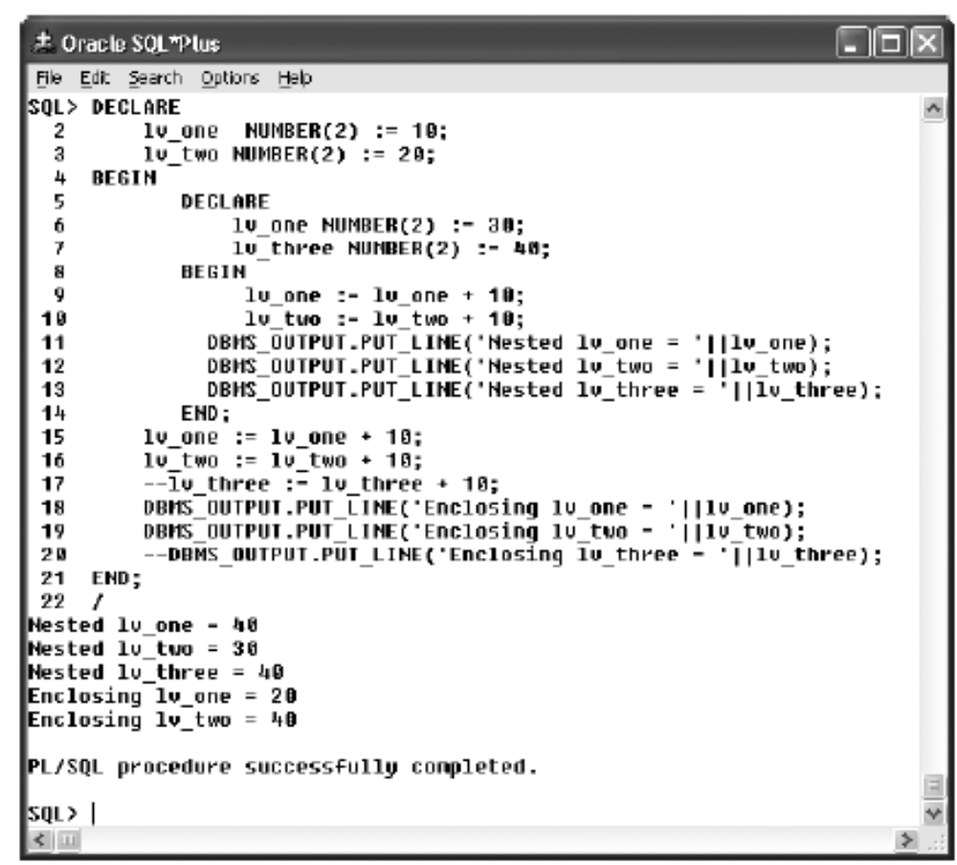
Variable Scope (continued)
Oracle10g Developer: PL/SQL Programming

Slide 17
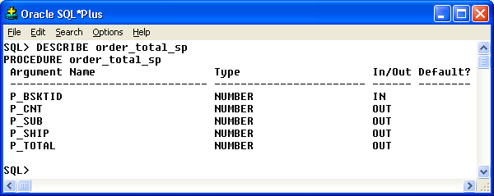
DESCRIBE Command
Lists the parameters of a program unit
Oracle10g Developer: PL/SQL Programming

Slide 18
Debugging in SQL*Plus
Use DBMS_OUTPUT.PUT_LINE statements to display messages from execution
Must set SERVEROUTPUT ON
Place display messages throughout the block to determine processing flow and variable values
Oracle10g Developer: PL/SQL Programming

Slide 19
Other Software Utilities
Other utilities provide additional functionality to assist in PL/SQL development such as color-coded syntax and step debugging
List of some popular third-party tools in Chapter 1
Oracle10g Developer: PL/SQL Programming

Slide 20
Subprograms
A program unit defined within another program unit
Must be declared in the DECLARE section of the containing program unit
Can only be referenced by the containing program unit
Oracle10g Developer: PL/SQL Programming

Slide 21
Transaction Scope
The scope refers to the group of DML statements that are affected by a particular transaction control statement
By default, a session has a single DML queue and a transaction control statement would affect all DML in the queue regardless of which program unit initiated the statement
DML statements of a program unit can be treated separately or as an autonomous transaction
Oracle10g Developer: PL/SQL Programming

Slide 22
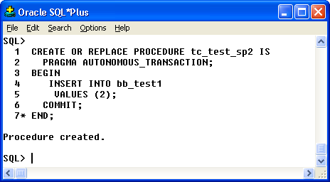
Autonomous Transaction
Indicates contained
DML statements are
autonomous
COMMIT will only affect the
INSERT in this program unit
Oracle10g Developer: PL/SQL Programming

Slide 23
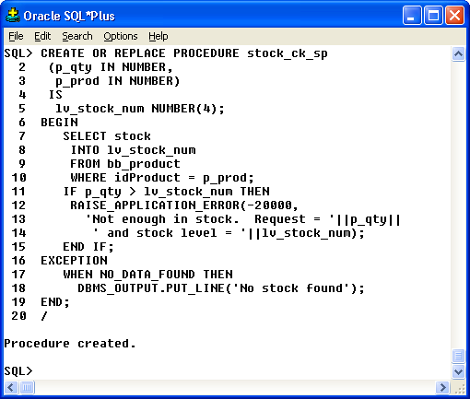
RAISE_APPLICATION_ERROR
Oracle10g Developer: PL/SQL Programming

Slide 24
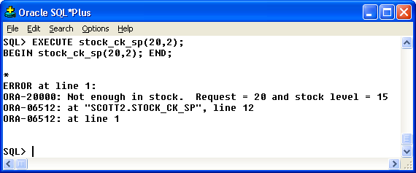
RAISE_APPLICATION_ERROR (continued)
Oracle10g Developer: PL/SQL Programming

Slide 25
Remove a Procedure
DROP PROCEDURE procedure_name;
Oracle10g Developer: PL/SQL Programming

Slide 26
Summary
Named program unit assigns a name to a program unit so it can be reused
Parameters are used to pass values in and out of program units
Stored program units are saved in the database
Parameter modes include: IN, OUT, and IN OUT
Use DBMS_OUTPUT.PUT_LINE statement to debug
Autonomous transactions must be explicitly created
Oracle10g Developer: PL/SQL Programming

