Slide 1
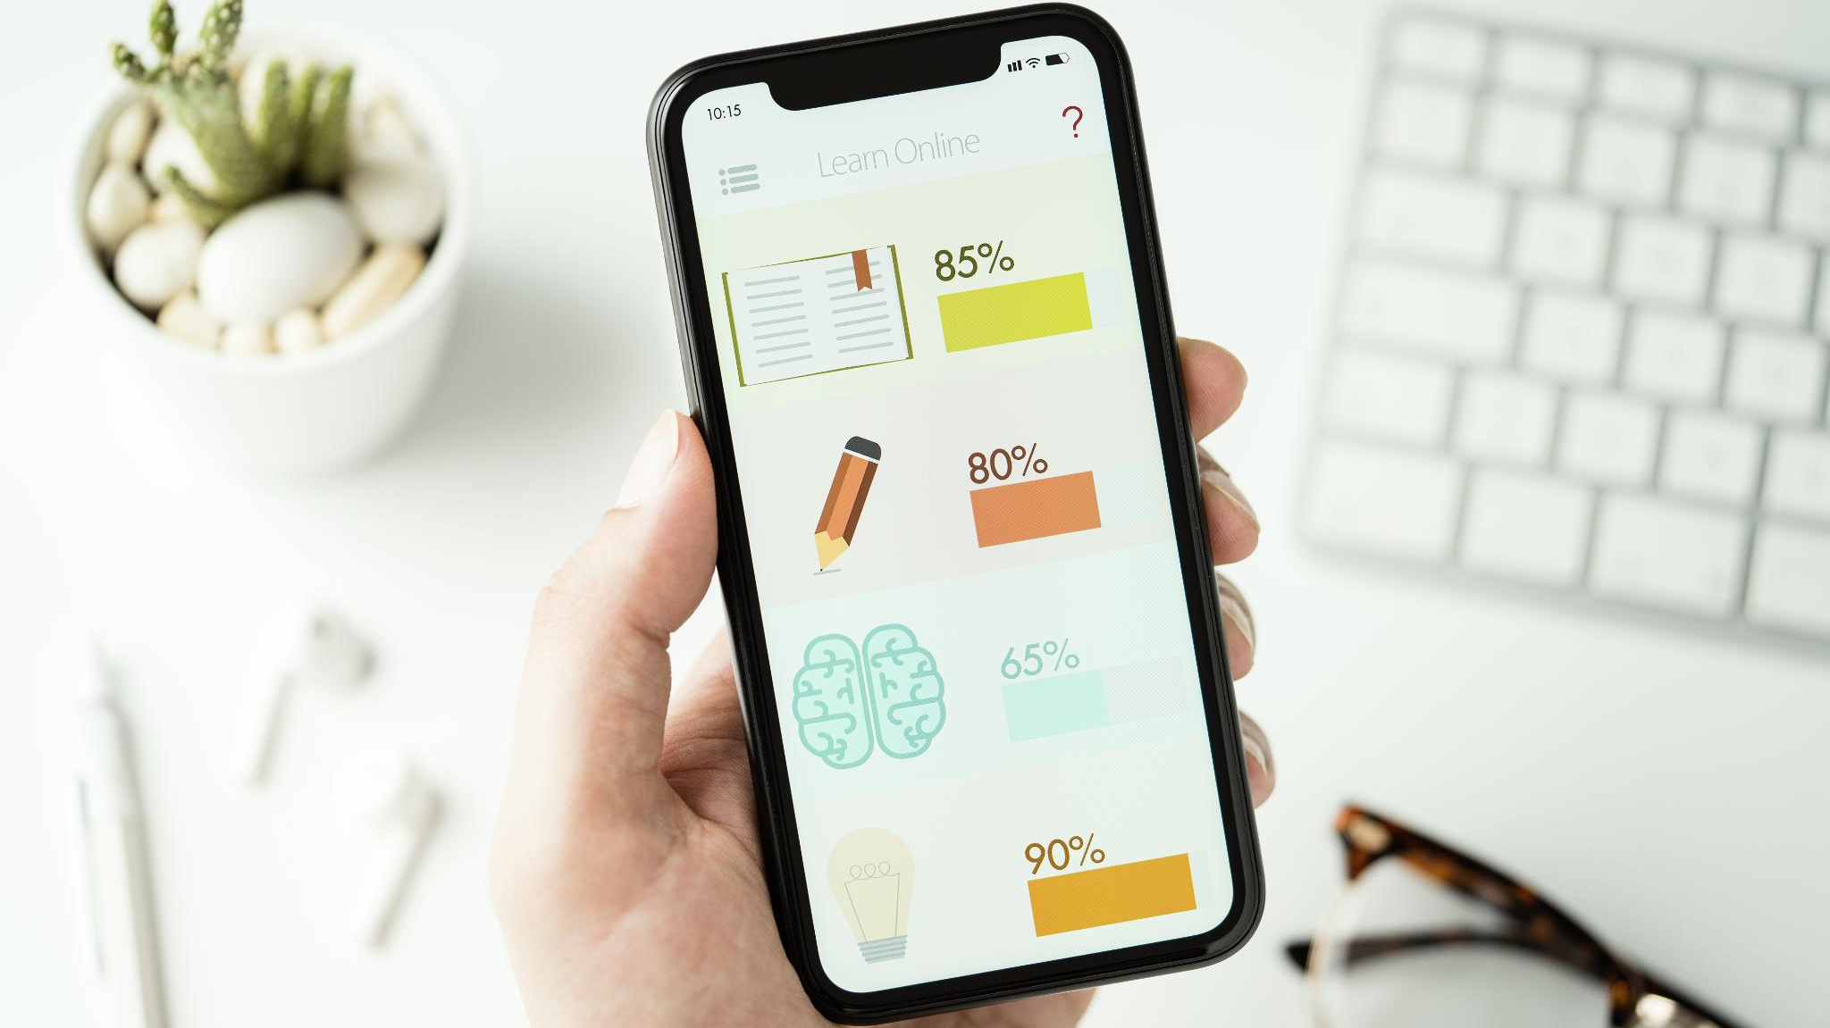
The
Calorie
COACH
Innovative mobile technology that analyzing diet instantly and accurately in Real Time
Notes:
---

Slide 2
Introduction
Notes:
Introducing a Mobile AI Agent for Real-Time Nutritional Analysis

Slide 3
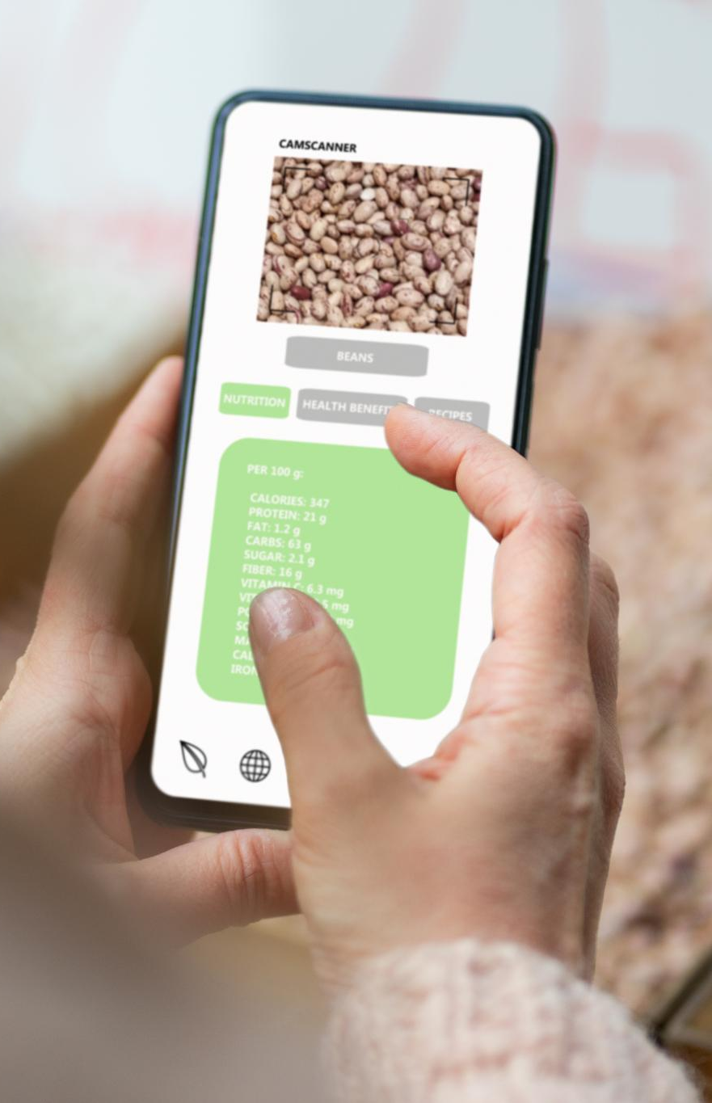
Introducing a Mobile AI Agent for Real-Time Nutritional Analysis
Automated Food Recognition
  The AI agent uses advanced image recognition to identify food items accurately from meal photos in real-time.
Real-Time Nutritional Estimation
  It estimates nutritional content instantly, enabling users to track dietary intake effortlessly and accurately.
Personalized Dietary Feedback
  The system provides customized recommendations to promote healthier eating habits based on individual nutritional data.
Enhanced User Convenience
  This AI-powered tool simplifies food logging, saving time while improving accuracy and user experience.
Notes:
This presentation introduces a groundbreaking concept: a mobile AI agent that leverages image recognition and GPT-4o Mini to perform real-time nutritional analysis of meals. The goal is to revolutionize how individuals track and understand their dietary intake by automating the process of food logging and nutritional estimation. Traditional methods of manually entering food data into apps are often inaccurate, time-consuming, and lack personalization. By integrating advanced computer vision and language models, this AI agent can identify food items from a photo, estimate their nutritional content, and provide personalized feedback instantly. This innovation not only enhances user convenience but also promotes healthier eating habits through real-time insights and recommendations. The mobile AI agent is designed to be intuitive, efficient, and highly responsive, making it a valuable tool for health-conscious individuals, fitness enthusiasts, and anyone looking to improve their dietary habits.

Slide 4
Problem Statement
Notes:
Challenges in Manual Food Logging

Slide 5
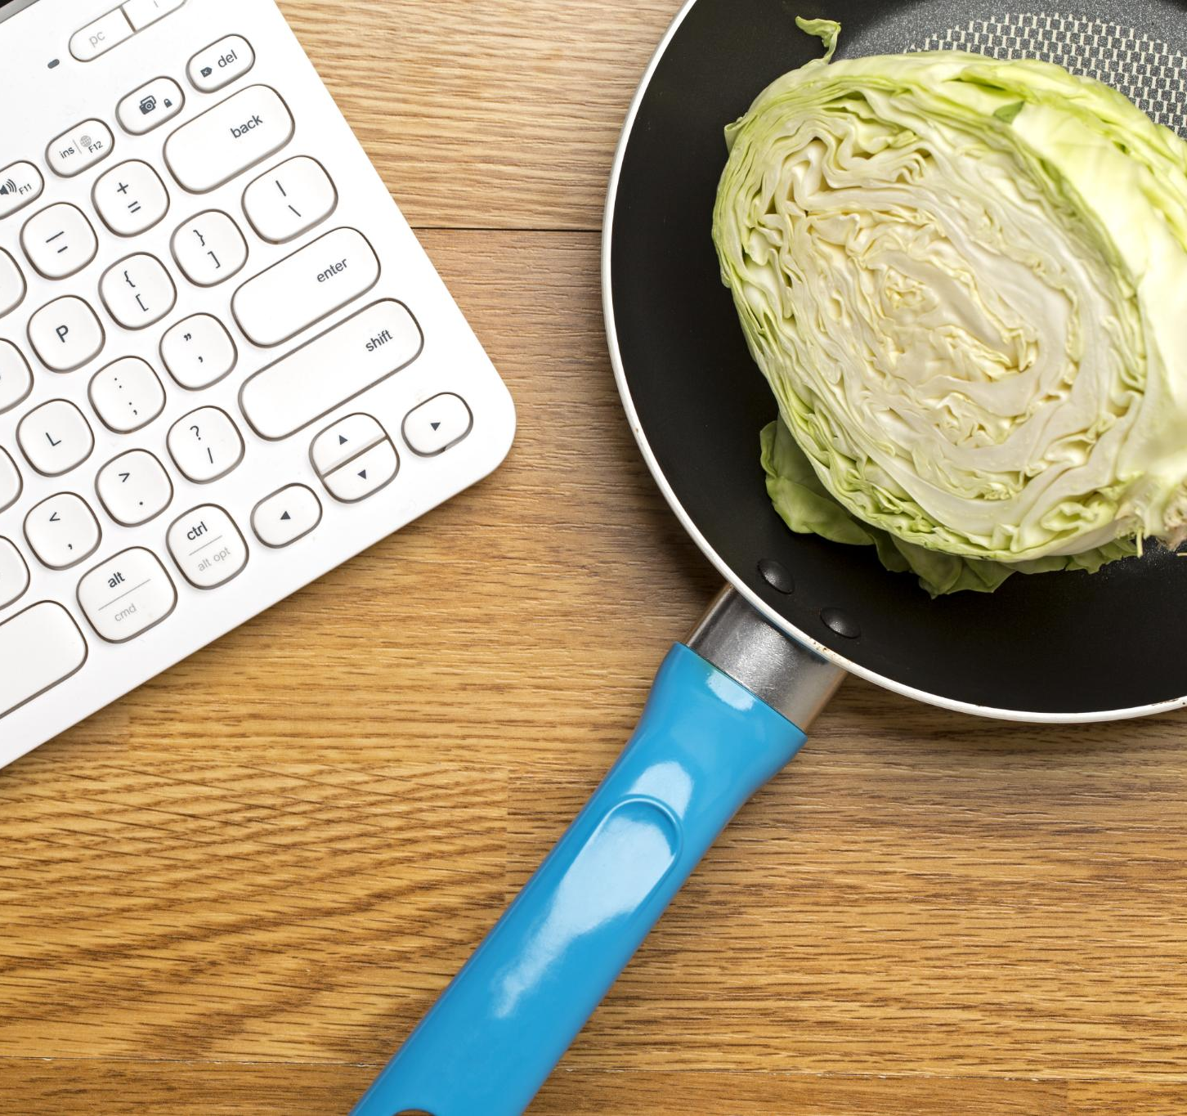
Challenges in Manual Food Logging
Time-Consuming Input
  Manual logging requires searching, estimating, and inputting food data, making the process slow and tedious.
Inaccuracy in Nutritional Estimation
  Users often misjudge calories and nutrients, especially with complex or unfamiliar meals, reducing tracking accuracy.
Lack of Real-Time Feedback
  Most tools do not provide personalized, instant dietary advice, limiting guidance toward healthier decisions.
Notes:
Manual food logging presents several challenges that hinder effective dietary tracking. Firstly, it is a time-consuming process that requires users to search for food items, estimate portion sizes, and input data manually. This often leads to inaccuracies and inconsistencies in the logged information. Secondly, users struggle to estimate calories and nutritional values accurately, especially when dealing with complex meals or unfamiliar foods. This lack of precision can undermine the effectiveness of dietary monitoring and goal setting. Lastly, most existing solutions do not offer personalized dietary feedback in real-time, limiting their usefulness in guiding users toward healthier choices. These limitations highlight the need for an automated, intelligent system that can streamline the process, improve accuracy, and provide meaningful insights. By addressing these pain points, the proposed mobile AI agent aims to transform the user experience and enhance the effectiveness of nutritional tracking.

Slide 6
Solution Overview
Notes:
Capabilities of the Mobile AI Agent

Slide 7
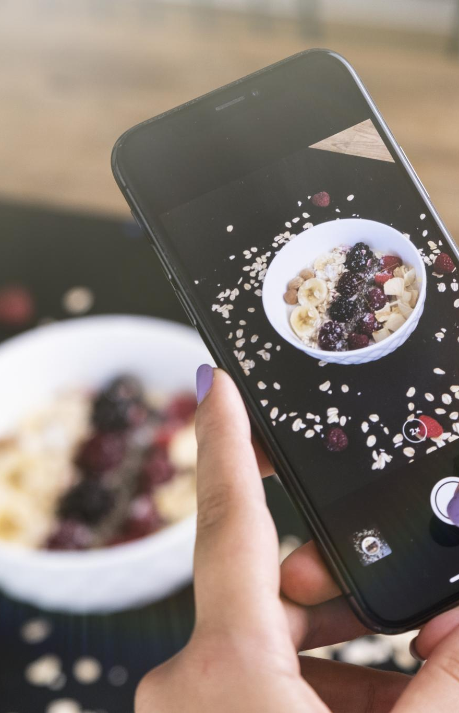
Capabilities of the Mobile AI Agent
Food Recognition Technology
  The AI agent uses advanced image recognition models like Efficient Net B0, ResNet50, YOLO11, MobileNet,VGG16 to identify food items from photos accurately.
Nutritional Analysis
  Calorie content and nutrition values are estimated using trusted databases such as USDA Food Data Central and Open Food Facts.
Conversational AI Integration
  GPT-4o Mini enables natural language interaction, providing personalized dietary advice and answering user queries.
Automated Meal Logging
  The agent automates meal tracking and monitors user goals to support seamless and intelligent dietary management.
Notes:
The proposed solution is a mobile AI agent that combines computer vision and GPT-4o Mini to deliver real-time nutritional analysis. This agent is capable of identifying food items from a photo using advanced image recognition models such as YOLOv8 or MobileNet. Once the food items are recognized, the agent estimates their calorie content and nutritional values by referencing comprehensive databases like USDA FoodData Central or Open Food Facts. The integration of GPT-4o Mini enables the agent to interpret user queries, provide personalized dietary feedback, and engage in natural language conversations. Additionally, the agent automates meal logging and tracks user goals, offering a seamless and intelligent dietary management experience. This solution represents a significant improvement over traditional methods by enhancing accuracy, reducing user effort, and delivering actionable insights in real-time. It empowers users to make informed dietary decisions and maintain healthier lifestyles with minimal friction.

Slide 8
Architecture
Notes:
System Components and Integration

Slide 9
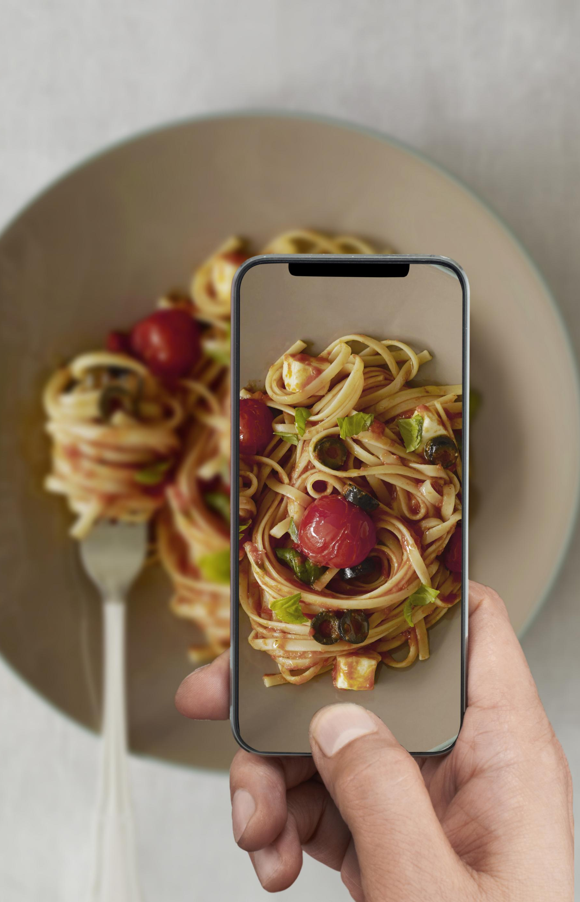
System Components and Integration
Mobile App Interface
  The front-end mobile app enables users to capture meal images and receive instant nutritional feedback.
Image Recognition Model
  Food items in meal images are identified using advanced image recognition models like Efficient Net B0, ResNet50,YOLO11, MobileNet,VGG16.
Nutritional Database Mapping
  Identified food items are mapped to nutritional databases to retrieve calorie and nutrient information accurately.
AI Interpretation and Workflow
  AI models interpret context, estimate portions, generate feedback, and autonomous frameworks manage workflow integration.
Notes:
The architecture of the mobile AI agent consists of several integrated components that work together to deliver real-time nutritional analysis. At the front end is the mobile app interface, developed using frameworks like Flutter or React Native, which allows users to capture meal images and receive feedback. The captured image is processed by an image recognition model, such as YOLOv8 or MobileNet, which identifies the food items present. These identified items are then mapped to a nutritional database, such as USDA FoodData Central or Open Food Facts, to retrieve calorie and nutrient information. GPT-4o Mini is employed to interpret the context, estimate portion sizes, and generate personalized feedback. An autonomous agent framework, like LangChain or AutoGen, orchestrates the workflow, handles user interactions, and manages goal tracking. This modular architecture ensures scalability, flexibility, and efficient performance, enabling the system to deliver accurate and timely nutritional insights to users.

Slide 10
Tech Stack
Notes:
Technologies and Tools Used

Slide 11
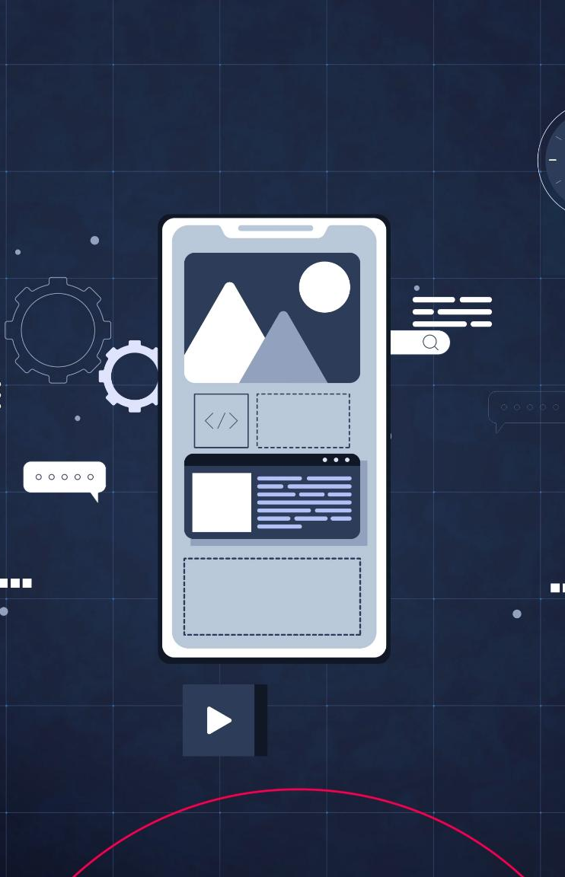
Technologies and Tools Used
Image Recognition Models
  Efficient Net B0, ResNet50,YOLO11, MobileNet,VGG16 provide efficient and accurate image detection for mobile AI applications.
Nutritional Data Sources
  Nutritional data is sourced from reliable databases like USDA API and Open Food Facts for accuracy.
Language Model and Feedback
  GPT-4o Mini enables natural language understanding and personalized feedback in the AI agent.
Development Frameworks
  Cross-platform frameworks like Flutter and React Native ensure smooth mobile app experiences.
Notes:
The mobile AI agent leverages a robust and modern tech stack to ensure high performance and reliability. For image recognition, models like YOLOv8 and MobileNet are used due to their efficiency and accuracy in object detection tasks. Nutritional data is sourced from trusted databases such as the USDA API and Open Food Facts, providing comprehensive and up-to-date information. GPT-4o Mini serves as the language model, enabling natural language understanding and personalized feedback generation. The autonomous agent logic is implemented using frameworks like LangChain or AutoGen, which facilitate task management and user interaction. The mobile application is developed using cross-platform frameworks such as Flutter or React Native, ensuring a smooth user experience across devices. Backend services, if needed, can be built using FastAPI or Firebase to handle data storage, authentication, and API integration. This tech stack is chosen for its compatibility, scalability, and ability to support real-time processing and interaction.

Slide 12
Workflow
Notes:
Step-by-Step User Interaction

Slide 13
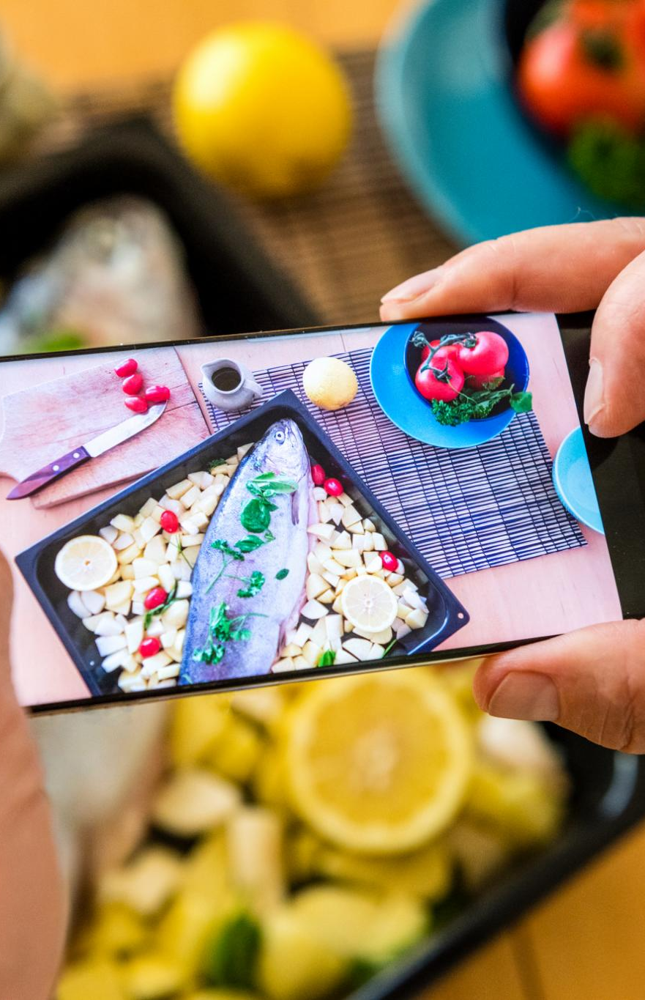
Step-by-Step User Interaction
Image Capture and Analysis
  Users start by taking a photo of their meal, which is analyzed by AI vision models to identify food items accurately.
Portion Estimation and Data Retrieval
  The system estimates portion sizes and accesses nutritional databases like USDA to gather relevant food data.
Context Interpretation and Feedback
  GPT-4o Mini interprets context and provides personalized dietary feedback based on user goals and preferences.
Meal Logging and Suggestions
  The autonomous agent logs meals, updates daily intake, and offers suggestions or reminders to support user goals.
Notes:
The workflow of the mobile AI agent is designed to be intuitive and efficient, providing users with instant nutritional insights. The process begins when a user takes a photo of their meal using the mobile app. The image is then analyzed by a vision model, such as YOLOv8 or MobileNet, which identifies the food items present. Once identified, the system estimates portion sizes and retrieves nutritional data from databases like USDA or Open Food Facts. GPT-4o Mini interprets the context, refines the estimates, and generates personalized feedback based on the user's dietary goals and preferences. The autonomous agent then logs the meal, updates the user's daily intake, and may provide suggestions or reminders. This seamless workflow ensures that users receive accurate, real-time information with minimal effort, enhancing their ability to make informed dietary choices and maintain consistent tracking of their nutritional intake.

Slide 14
MVP Features
Notes:
Key Functionalities of the Minimum Viable Product

Slide 15
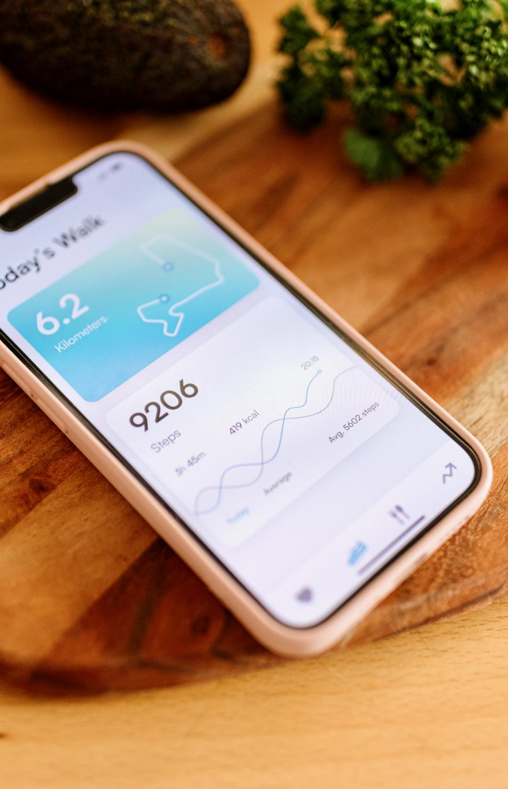
Key Functionalities of the Minimum Viable Product
Instant Meal Analysis
  Users snap a photo of their meal and instantly receive calorie and nutritional information without manual entry.
Automatic Meal Logging
  The system automatically logs meals to keep a daily record of nutritional intake without user effort.
Daily Nutritional Summary
  Users receive a daily overview of their nutritional consumption to help maintain dietary goals.
Personalized Dietary Suggestions
  AI provides personalized dietary suggestions based on user habits and preferences for better relevance.
Notes:
The Minimum Viable Product (MVP) of the mobile AI agent includes several essential features designed to demonstrate the core functionality and value of the system. Users can snap a photo of their meal and instantly receive calorie and nutritional information, eliminating the need for manual entry. The system automatically logs meals, maintaining a record of daily intake without user intervention. A daily summary provides users with an overview of their nutritional consumption, helping them stay on track with their dietary goals. Additionally, GPT-4o Mini offers personalized suggestions based on the user's eating habits and preferences, enhancing the relevance and usefulness of the feedback. These features collectively provide a compelling user experience, showcasing the potential of the AI agent to transform dietary tracking and promote healthier eating behaviors. The MVP serves as a foundation for future enhancements and user-driven improvements.

Slide 16
Next Steps
Notes:
Development and Deployment Plan

Slide 17
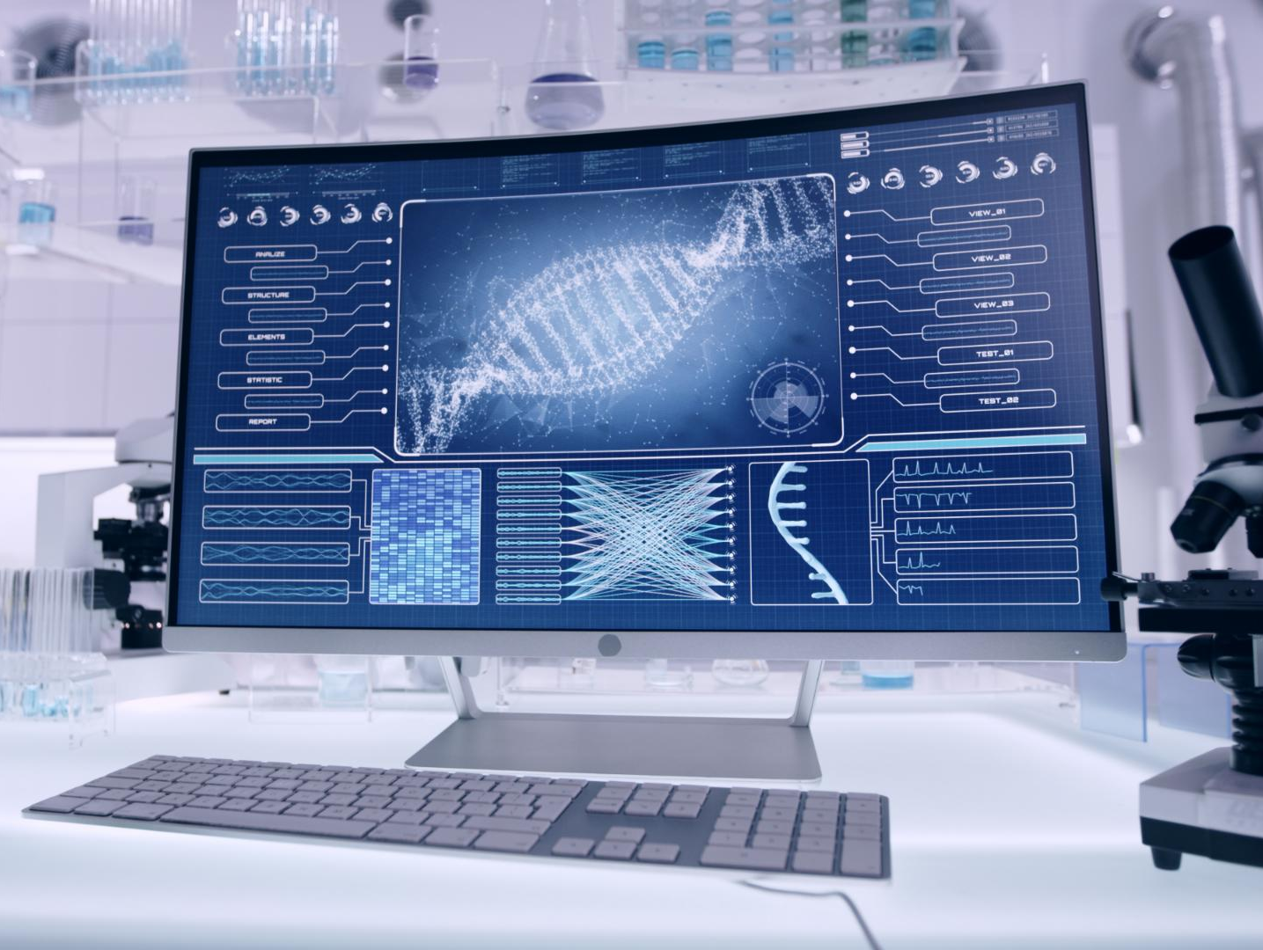
Development and Deployment Plan
Vision Model Training
  Build and train the vision model using food image datasets for accurate food recognition.
Natural Language Processing Integration
  Integrate GPT-4o Mini to handle natural language and generate personalized user feedback.
Mobile App Development
  Develop mobile app interface using Flutter or React Native focusing on real-time user interaction.
Testing and Feedback
  Launch MVP to select users for testing, gather feedback, and iteratively improve the product.
Notes:
The next steps in the development of the mobile AI agent involve a structured and phased approach. The first step is to build and train the vision model using relevant food image datasets to ensure accurate recognition. Concurrently, GPT-4o Mini will be integrated to handle natural language processing and personalized feedback generation. The mobile app interface will be developed using Flutter or React Native, focusing on user experience and real-time interaction. Integration with nutritional databases like USDA and Open Food Facts will be established to provide reliable data. Finally, the MVP will be launched to a select group of users for testing and feedback. This feedback will guide iterative improvements and feature enhancements. The goal is to refine the system based on real-world usage and prepare for a broader rollout. This development plan ensures a robust, user-centric product that meets the needs of its target audience.

Slide 18
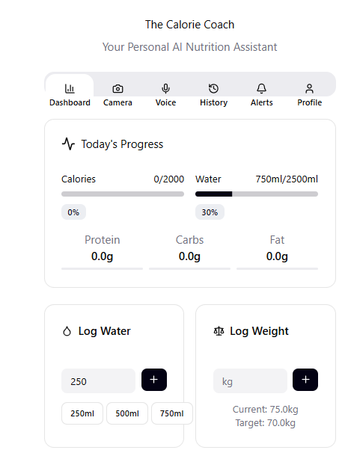

INTRO to
Calorie coach
Calorie Coach is a smart, user-friendly application designed to help users monitor and manage their daily nutritional intake.
The app features a clean dashboard with tabs for:
  Dashboard – Overview of daily progress
  Camera & Voice – Log meals using AI-powered input
  History – Review past nutrition data
  Alerts – Get reminders and health tips
  Profile – Customize user settings and goals
  Visual Cue:
  Include the uploaded image showing the main dashboard interface.

Slide 19
INTRO to
Calorie coach
Slide 2: Tracking Your Health Goals
Title: Stay on Track with Real-Time Insights
Today's Progress section displays:
  Calories: 0/2000 kcal
  Water Intake: 750ml/2500ml (30% complete)
  Macronutrients: Protein, Carbs, Fat – all at 0.0g
Quick Logging Tools:
  Water intake buttons: 250ml, 500ml, 750ml
  Weight tracking: Current – 75.0kg | Target – 70.0kg
Helps users stay accountable and make informed dietary choices.
Visual Cue:
Use the same image to highlight the progress bars and logging features.

Slide 20
FEATURES
Feature | Description
Dashboard | Overview of daily progress including calories, water, and macronutrients
Camera | Log meals using image recognition
Voice | Log meals and water intake using voice commands
History | Review past nutrition and weight data
Alerts | Receive reminders and health tips
Profile | Customize user settings and health goals

Slide 21
Tracking progress
Metric | Current Value | Target
Calories | 0 | 2000
Water Intake | 750ml | 2500ml
Protein | 0.0g | --
Carbs | 0.0g | --
Fat | 0.0g | --
Weight | 75.0kg | 70.0kg
Total Weight Loss | 1.2kg | 5.0kg
Weekly Goal | 0.2kg | --

Slide 22
Q & A
Notes:
Development and Deployment Plan

Slide 23
Thank you
Notes:
Development and Deployment Plan

