Slide 1
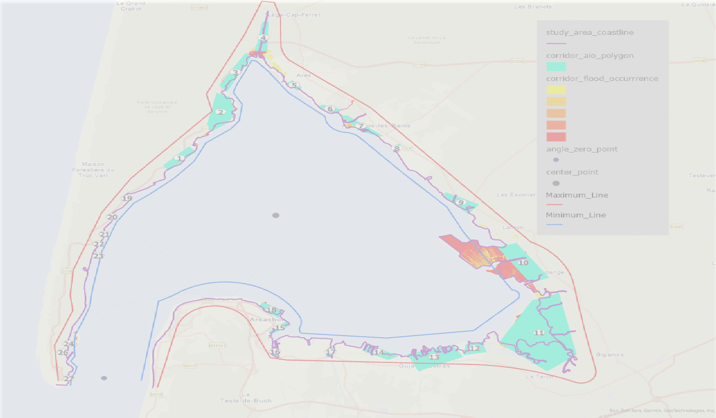



Visualization of Ensemble Coastal Flood Data in Arcachon Basin
Intern: Babafemi Sunday Olatunji
Supervised by: Jacques Gautier, Lâmân Lelegard, Julius Bangate

Slide 2
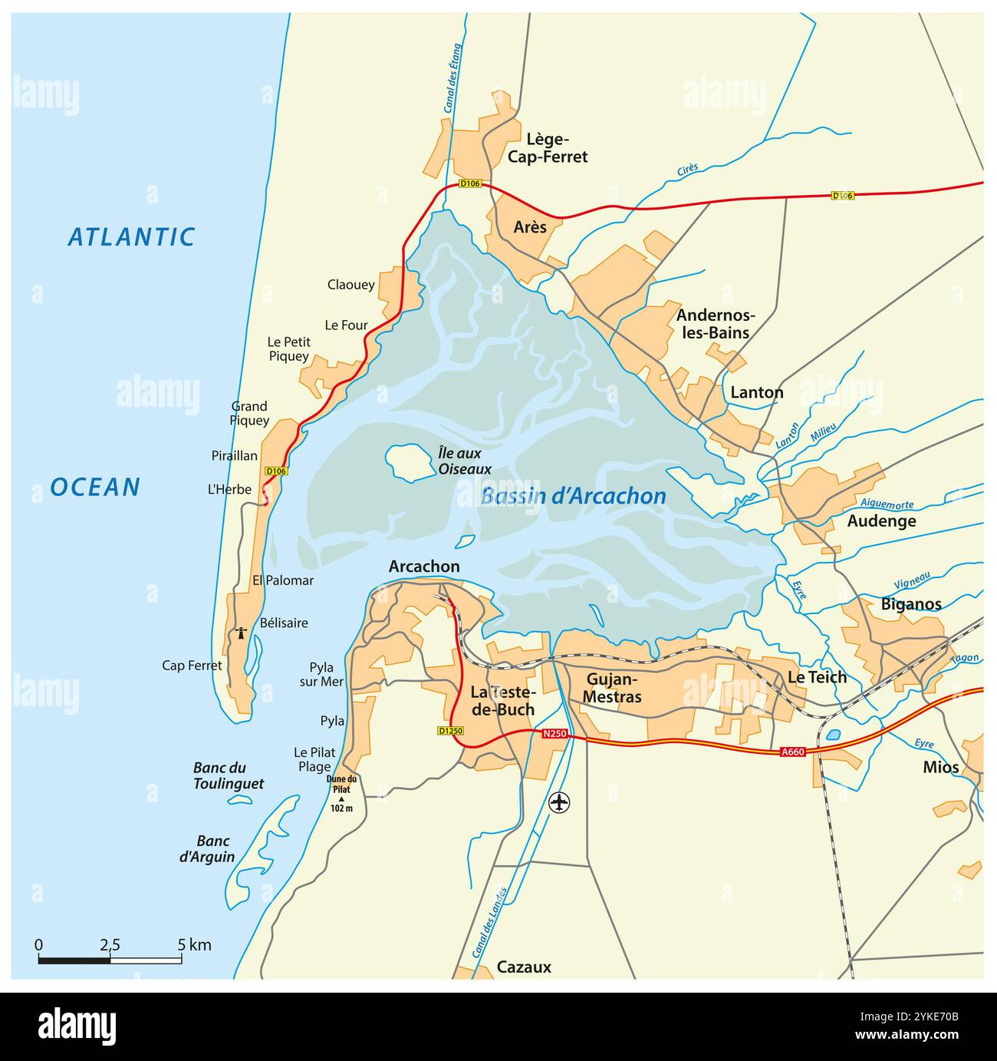
Internship Context
Project
Study area
The ANR ORACLES project investigates how ensemble forecasts of marine submersion can better support decisions under uncertainty
Role
Propose an alternative cartographic representation that helps experts compare flood occurrence, exposed assets and population along an irregular coastline.
https://www.alamy.com/stock-photo/arcachon-vector-outline-map.html?sortBy=relevant

Slide 3
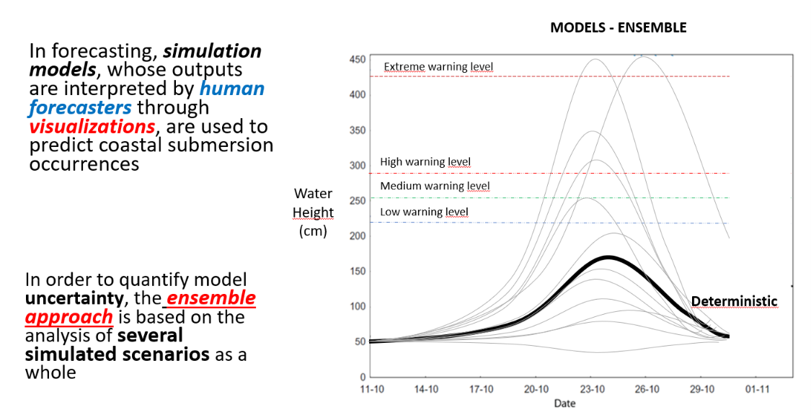
Ensemble forecasts

Slide 4
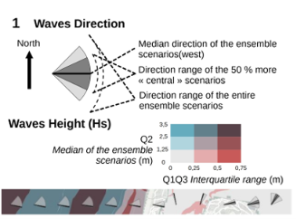
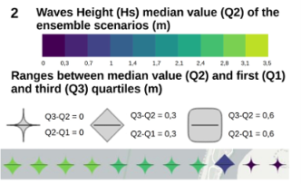
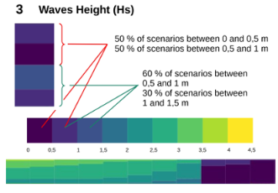
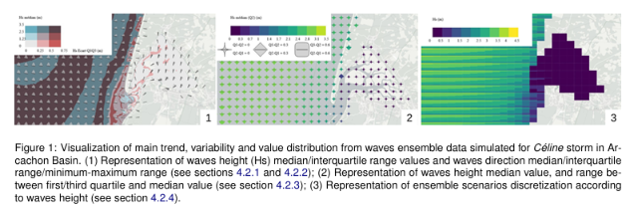
Previous work
Bañgate et al., 2025

Slide 5
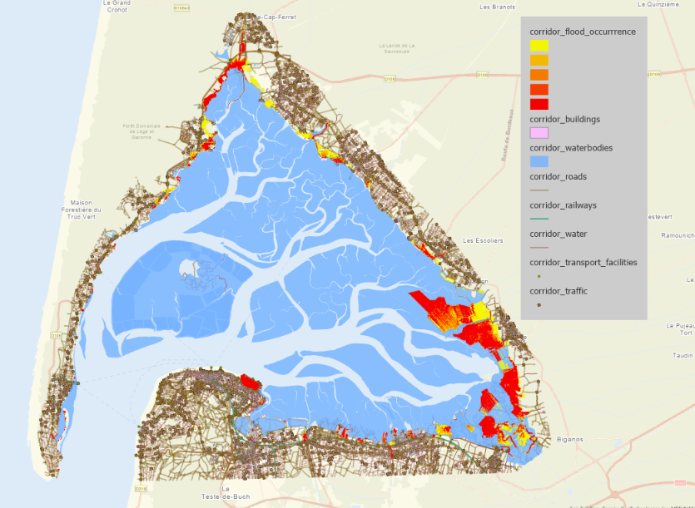

Why not conventional 2D map?
Crowdy
Coastal section
Center water area

Slide 6
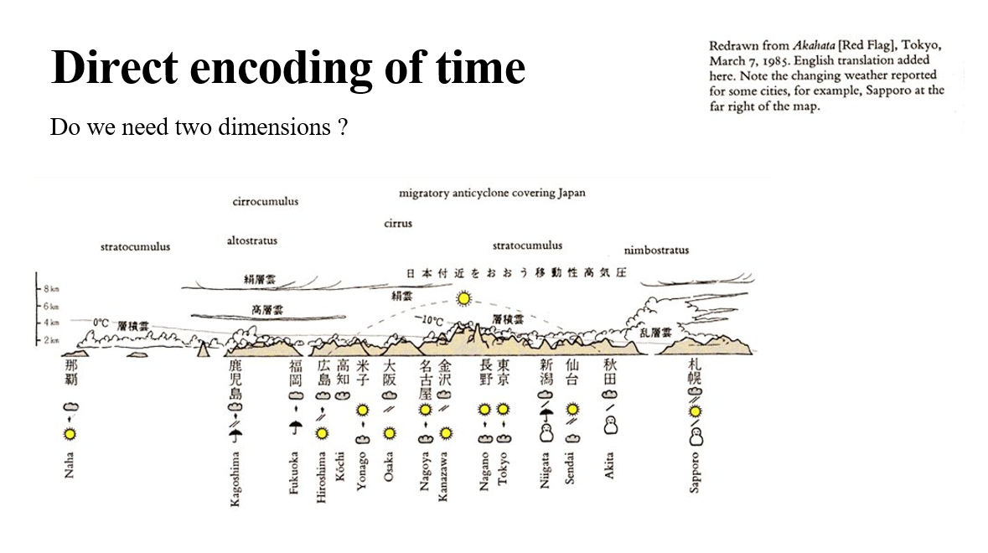
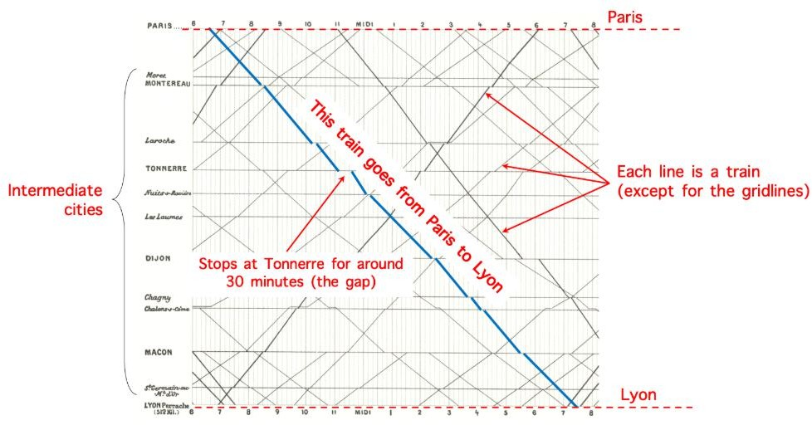
Need for a synthetic shoreline-based representation
Marey’s graphical train schedule
Marey’s train schedule diagram (adapted from Marey, 1885), showing the use of a flattened spatial axis to track secondary data over time

Slide 7
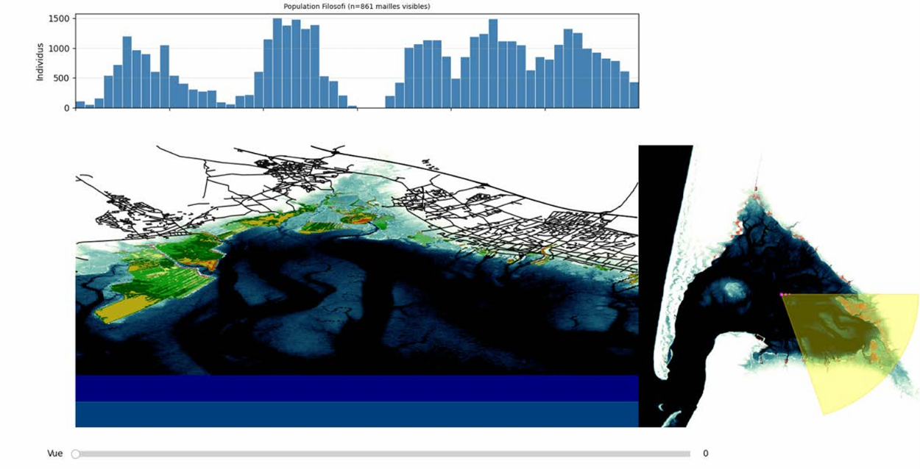
Previous Intern’s Approach
Diego Posado Bañuls 2026

Slide 8
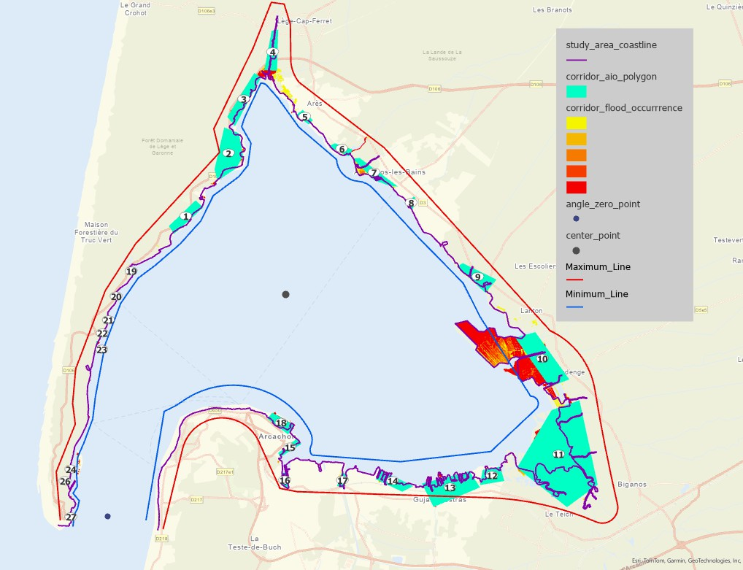
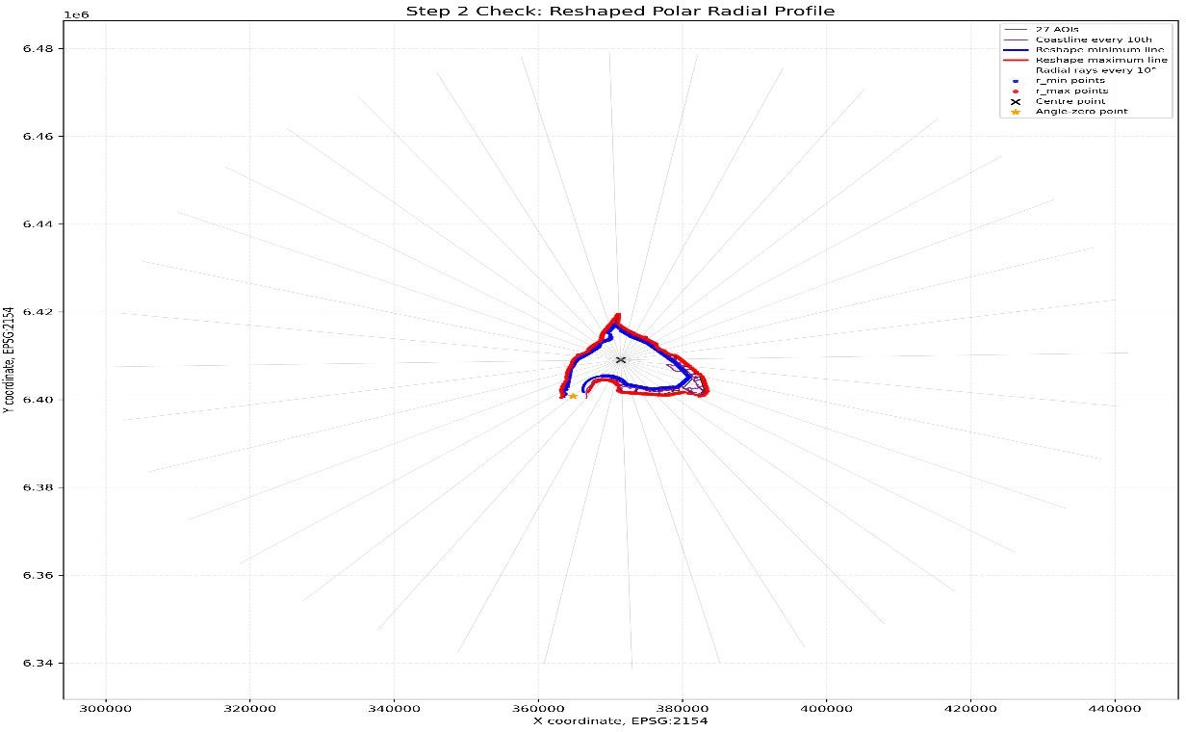
Polar-Radial Deformation
Geographic Coordinate (X, Y) (Ɵ, r) Polar-Radial Deformation
Flood Corridor Radial Profile

Slide 9

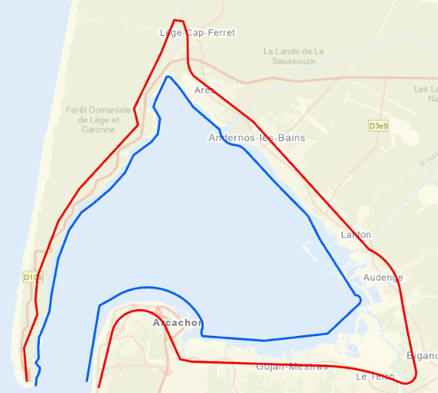
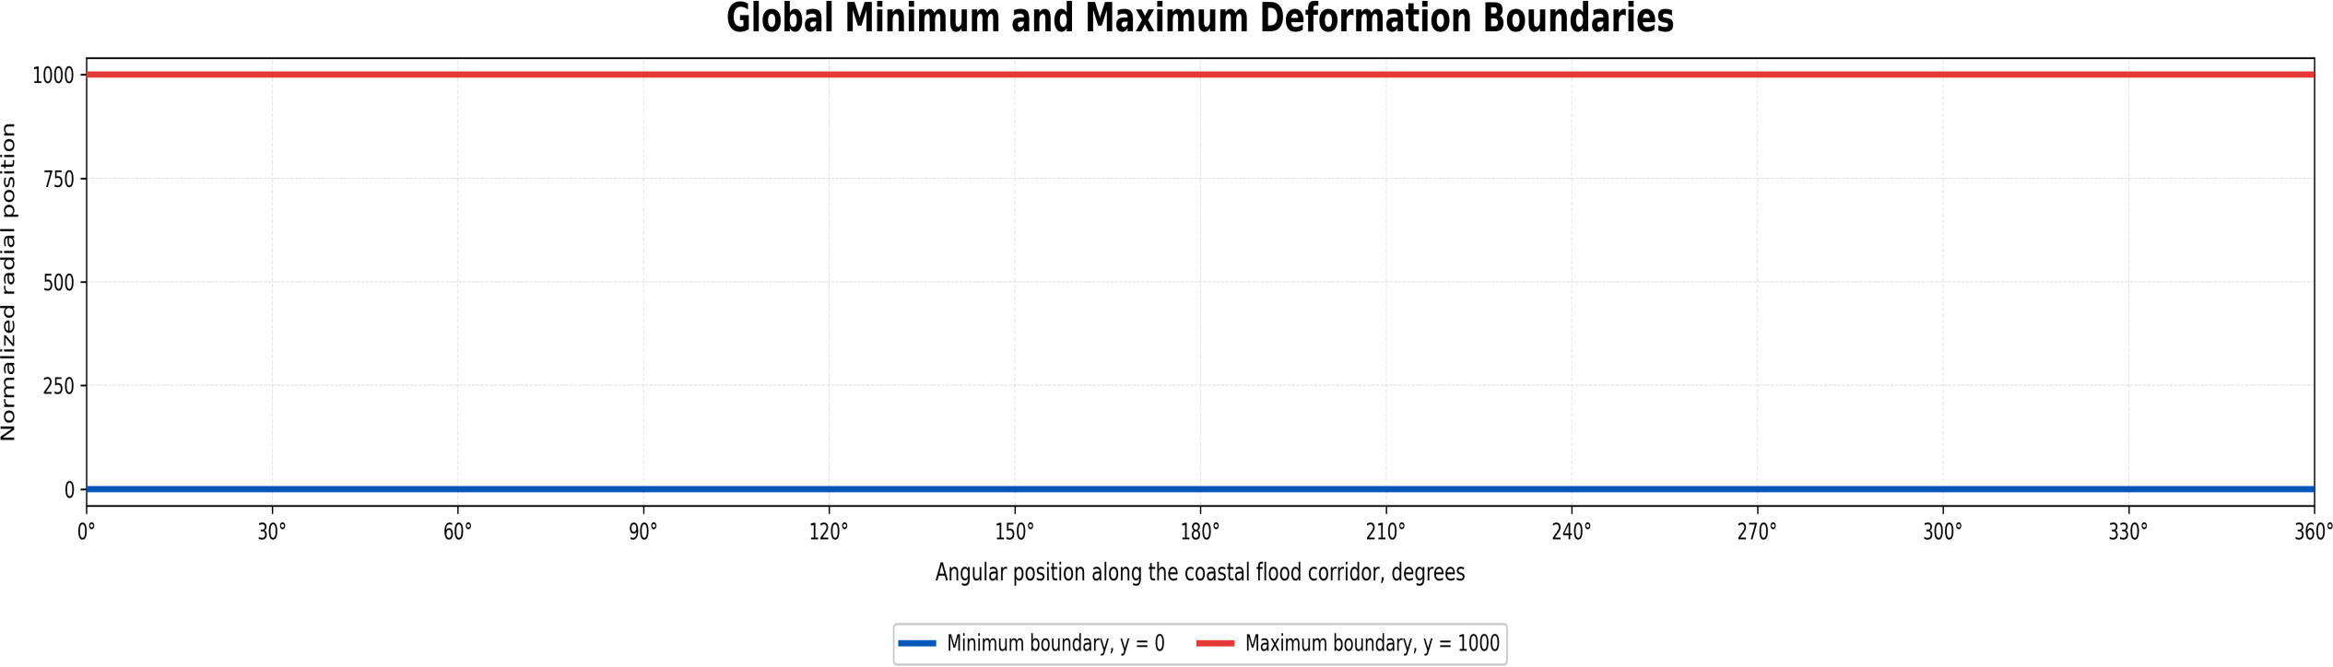
Transforming coordinate into deformation space
r_min(Ɵ): The distance from the center to the inner (minimum) boundary.
r_max(Ɵ): The distance from the center to the outer (maximum) boundary
x = Ɵ
y = V x 1000
This means that:
y = 0 represents the minimum boundary
Width(Ɵ) = r_max(Ɵ) - r_min(Ɵ)
y = 1000 represents the maximum boundary

Slide 10
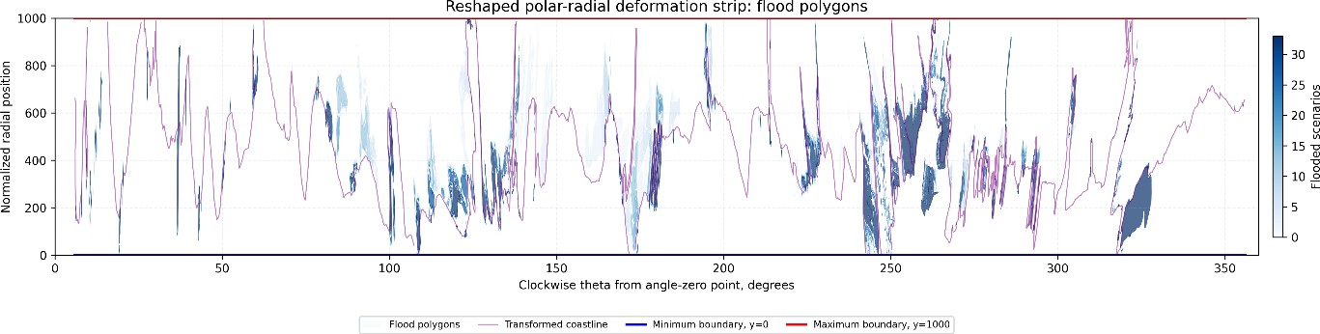
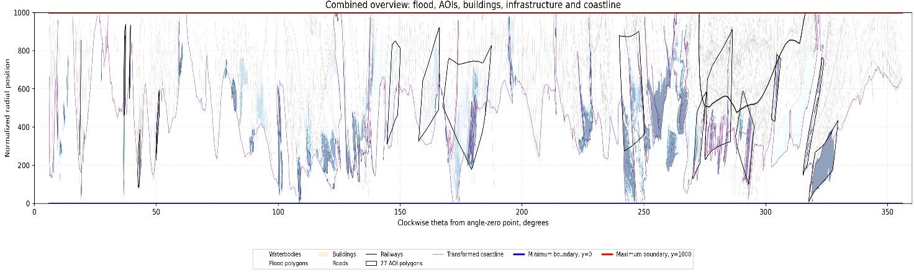
Transforming spatial layers by vertices

Slide 11
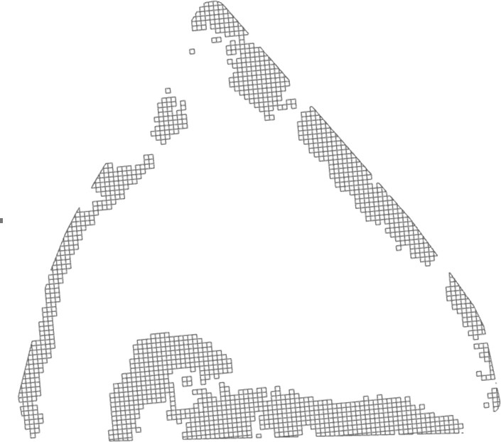
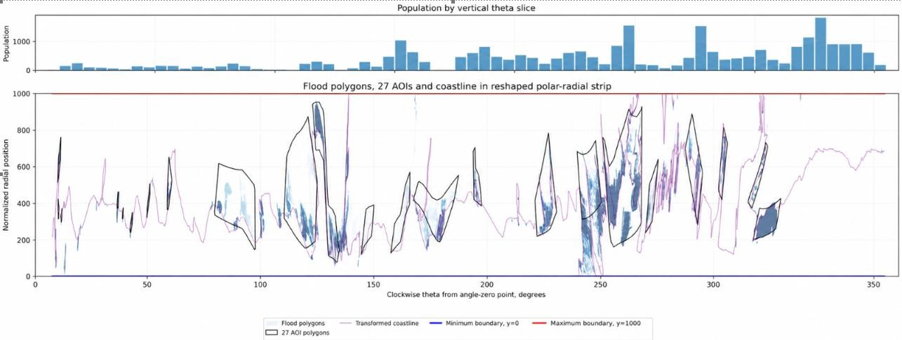
Population Representation by Vertical Slices

Slide 12
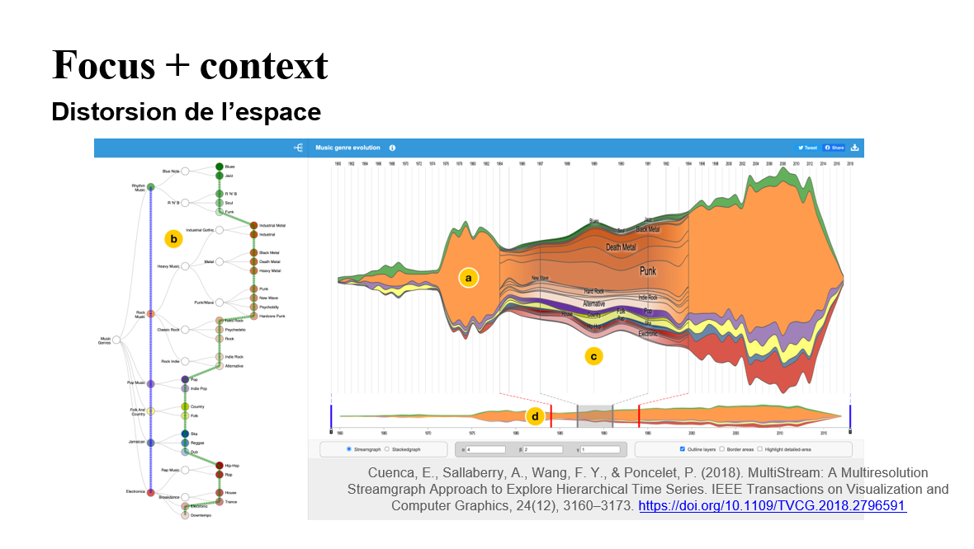

Slide 13
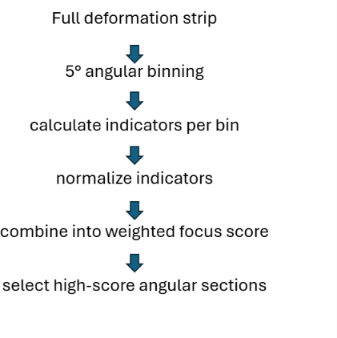
Focus area selection
focus_score =
0.40 x flood_score
+ 0.20 x population_score
+ 0.15 x building_score
+ 0.10 x infrastructure_score (roads
+ railways)
Normalized_value = value /
maximum_value

Slide 14
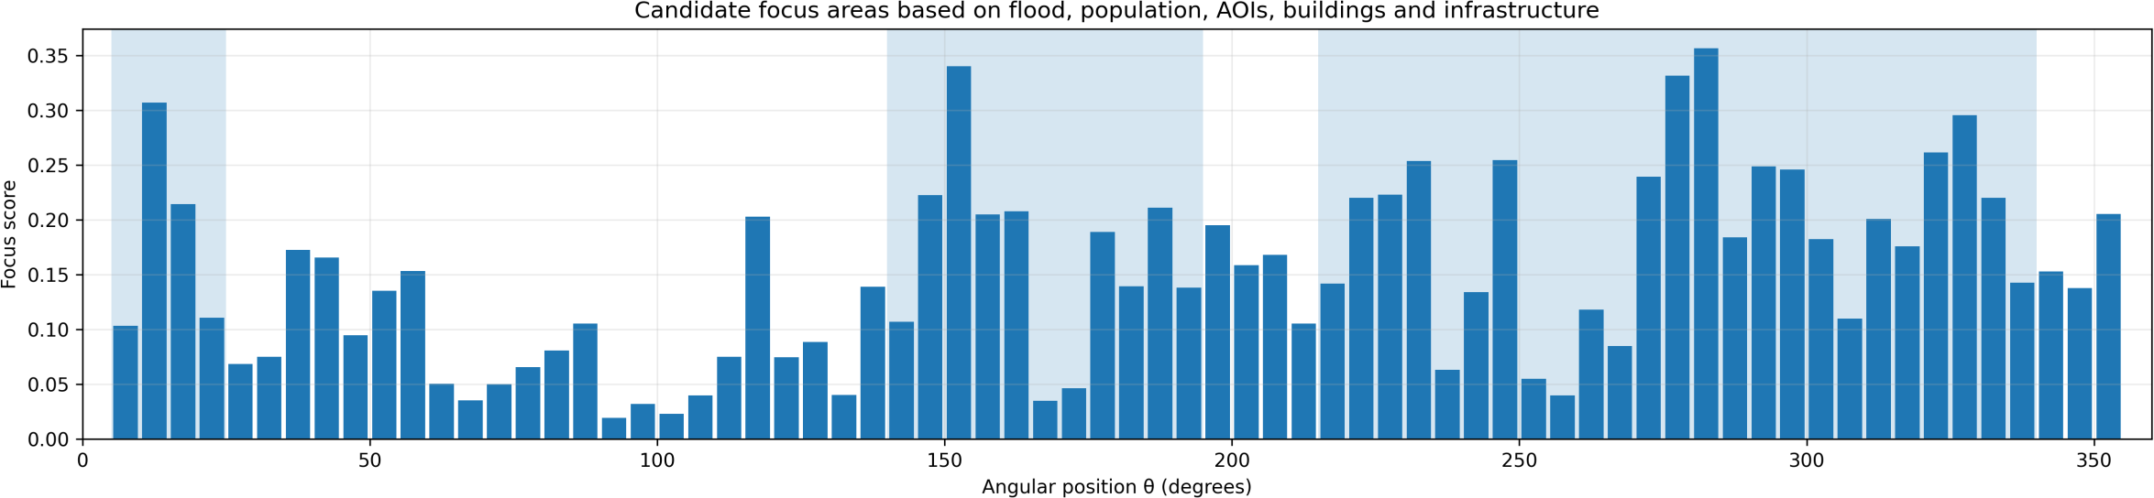
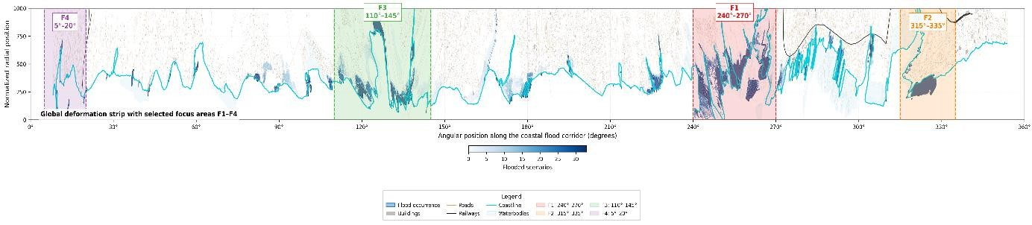
Global Index Strip

Slide 15
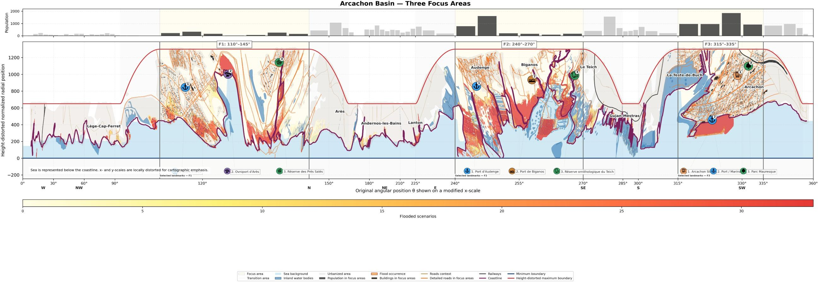
Mixed Scale Transformation & Cartographic styling

Slide 16
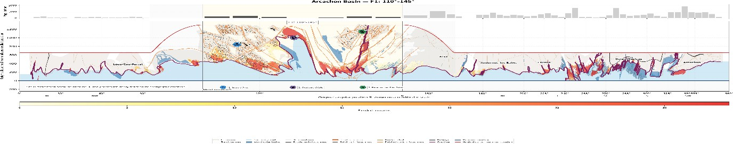
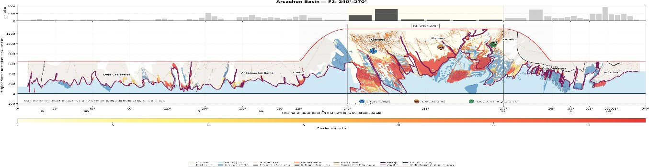
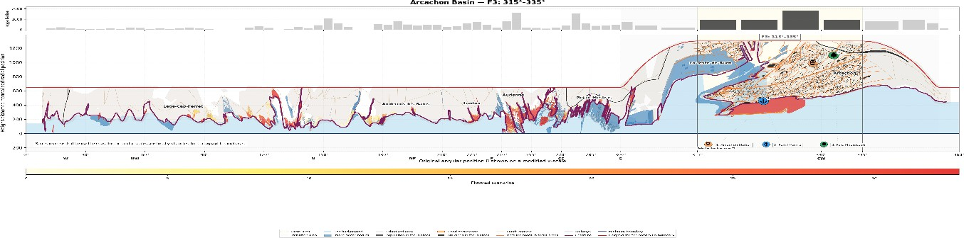

Slide 17

Contributions, Improvements & Limitations
🧱
Maintained the continuity of the full coastline
Enlarged important flood exposure areas
Connected population patterns to flood occurrence
Improved the visibility of buildings and transport networks
Supported comparison between coastal sections
Produced reusable transformed geographic
layers
Preparing and checking the spatial data
Defining and refining of area of interest
Minimum & Maximum lines
Building a polar radial workflow
Transforming the layers
Producing map plots
Integration of population data
Cartographic styling
Deformation alters geographic shape and scale
Some highly dense areas remain visually
complex
The visualization has not yet undergone user testing

Slide 18
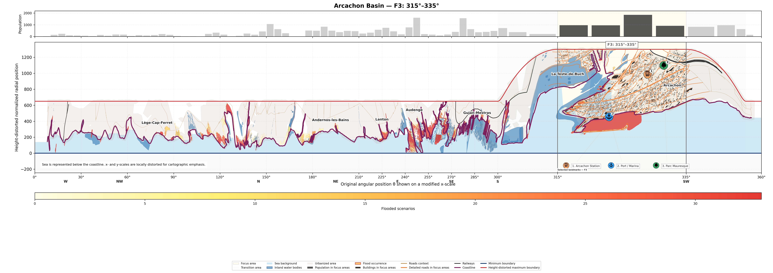
Thank You

