Slide 1

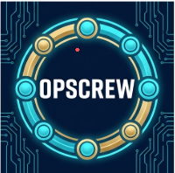

Team OpsCrew
Expense exception plans with human confirmation
Captain: Sunday Lee
Theme: Future of Work & Enterprise Productivity
Competition proposal / 17 October 2026
Notes:
Public captain name, when provided, comes from the owner. Eligibility and registration declarations remain the authorized team's responsibility.
https://aibuildercup.com/themes.html
Fresh Google AI Studio Build creation on 7 October. Logo supplied by owner as Gemini-generated. The owner reports that the teammate used Google Antigravity to assist Cloud deployment; this is tool attribution, not automated deployment-source attestation.

Slide 2
Brief about the idea
OpsCrew helps operations staff turn a synthetic expense exception into a supported handling plan.
Gemini extracts facts, proposes steps, then reviews the proposal in a separate call. Fixed policy checks constrain each stage.
A person reviews the current plan and explicitly confirms a case. The app reads the saved record independently before showing success.
The prototype covers one synthetic USD policy. It creates handling records and performs no reimbursement or payment.
OpsCrew / Competition proposal / 2
Notes:
https://aibuildercup.com/themes.html
SCOPE.md
docs/POLICY_AND_CONTRACTS.md

Slide 3
Opportunities and proposed value
Problem: staff must reconcile intake text, missing receipts and policy thresholds before deciding what to request next.
Proposed difference: OpsCrew binds the plan to supported facts and exact policy clauses, then stores the person's confirmation with that version.
Design value: input edits invalidate old plans. Contradictions and unsupported citations block case creation.
Expected impact: clearer exception triage and fewer unsupported actions. Actual staff time savings and customer adoption remain unmeasured.
OpsCrew / Competition proposal / 3
Notes:
SCOPE.md
docs/POLICY_AND_CONTRACTS.md
docs/EVALUATION_PROTOCOL.md

Slide 4
Features offered by the solution
Synthetic presets and original text citations make intake decisions inspectable.
Facts, Planner and Reviewer outputs expose disagreements and exact policy evidence.
Firebase visitor identity, owned history and version-bound confirmation protect each person's handling records.
Atomic writes, idempotent recovery and independent readback prevent duplicate or unverified success. Shared quotas bound model traffic.
OpsCrew / Competition proposal / 4
Notes:
docs/acceptance/S03-confirmation-and-cases.md
docs/PRECLOUD_BACKEND.md

Slide 5
Process flow and confirmation
Synthetic intake
Gemini facts
Planner + Reviewer
Saved record readback
Human confirmation
Fixed policy checks
Missing evidence produces a request plan. Contradictions block progression.
Editing intake requires a new analysis and a new confirmation.
OpsCrew / Competition proposal / 5
Notes:
src/domain/workflow.ts
docs/S3_CONFIRMATION_CASES.md
docs/PRECLOUD_BACKEND.md

Slide 6
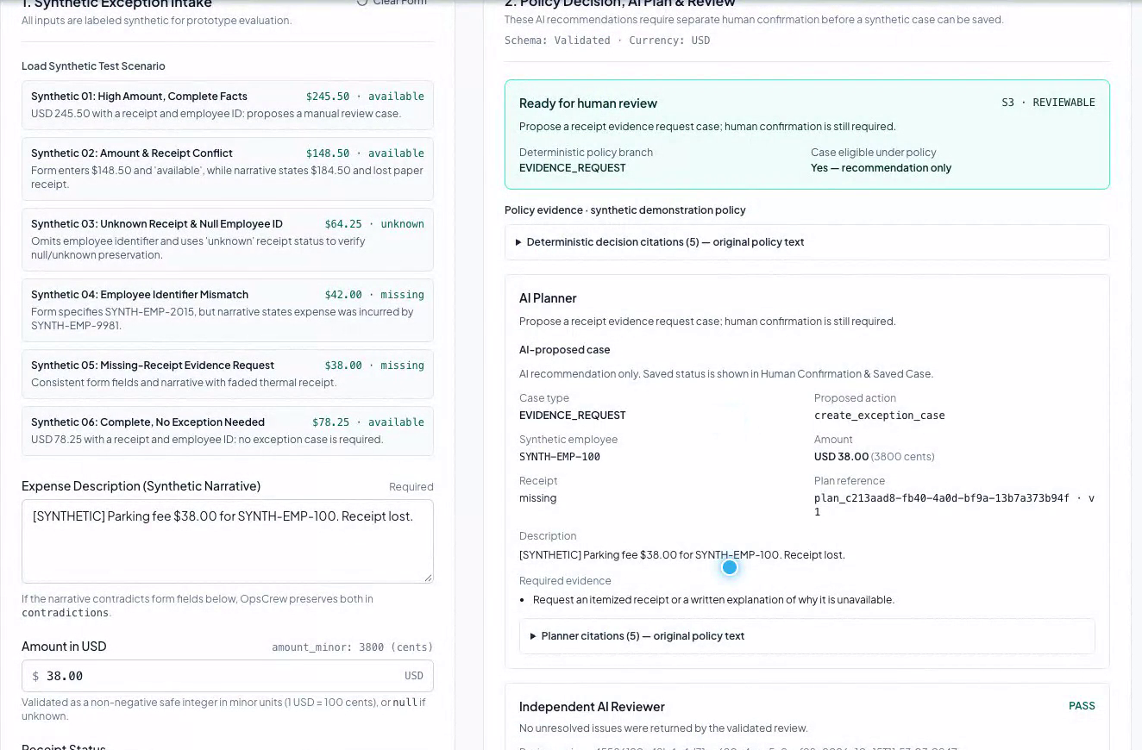
Interface in the recorded cloud demonstration
A person reviews the current result before confirming an eligible handling record.
Recorded UI, 15 October 2026, at 75 s. Synthetic example supplied by the team.
OpsCrew / Competition proposal / 6
Notes:
docs/acceptance/S03-confirmation-and-cases.md
docs/acceptance/FINAL-video-ui-plan-2026-10-16.png

Slide 7
Cloud architecture and trust boundaries
Browser
English React interface
Cloud Run
Node API + validators
Vertex AI / Gemini
Developer API option
Firebase Auth
Visitor identity
Firestore
Plans / cases / quotas
ADC service identity
API key optional
The server selects Vertex AI with ADC or the optional Developer API route. Model credentials stay on the server. Visitor identity controls access to plans and saved cases.
OpsCrew / Competition proposal / 7
Notes:
docs/acceptance/FINAL-integrated-validation-2026-10-16.json
docs/acceptance/FINAL-cloud-readonly-2026-10-16.json
aistudio-export-2026-10-07/server/runtime-config.ts
aistudio-export-2026-10-07/server/planning-service.ts

Slide 8
Technologies used in the solution
Component | Role
Google AI Studio Build | Fresh application origin on 7 October
Gemini server modes | Vertex AI with ADC; optional Developer API
Current service config | Gemini 2.5 Flash, self-reported on 16 October
Node 24 / React / TypeScript | Explicit confirmation and fixed API policy checks
Cloud Run + Firebase | Hosting, visitor identity and saved handling records
From zero in AI Studio Build. Antigravity assisted deployment (team-reported).
OpsCrew / Competition proposal / 8
Notes:
PROVENANCE.md
docs/acceptance/FINAL-integrated-validation-2026-10-16.json
docs/acceptance/FINAL-cloud-readonly-2026-10-16.json
aistudio-export-2026-10-07/server/runtime-config.ts

Slide 9
Implementation cost and traffic controls
Team management target: USD 40. Billing alerts and application quotas cannot guarantee a monetary spending cap.
Default model limits: 2 concurrent runs globally, 1 per visitor. Each visitor has 2 runs per minute and 12 per UTC day.
Global limits: 6 runs per minute and 60 per UTC day. Each workflow reserves up to 6 provider attempts. Unknown usage receives no refund.
Historical 13 October Developer API observations: 10 attempts and 11,680 known tokens. One FACTS call returned 503. Its usage and actual billed cost are unknown.
OpsCrew / Competition proposal / 9
Notes:
docs/DELIVERY_WORKBOARD.md
docs/PRECLOUD_BACKEND.md
docs/EVALUATION_PROTOCOL.md

Slide 10
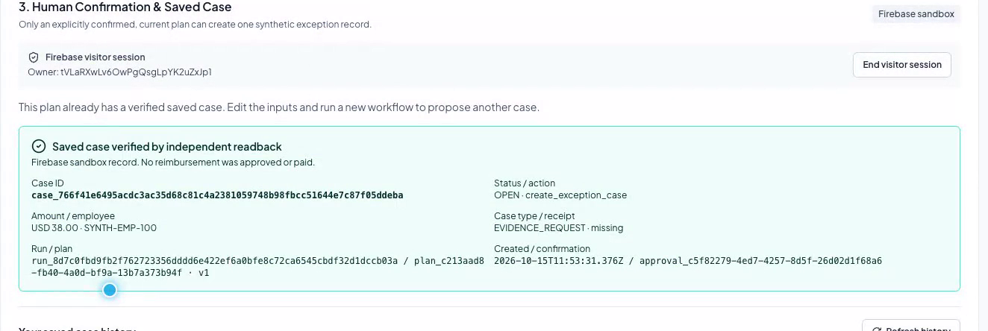
Prototype: confirmed case and independent readback
Recorded UI, 15 October 2026, at 96 s. The confirmed USD 38 synthetic request is OPEN. No reimbursement approval or payment occurs.
OpsCrew / Competition proposal / 10
Notes:
docs/acceptance/DELIVERY-cloud-G3-2026-10-13.json
docs/acceptance/DELIVERY-cloud-safety-and-fixtures-2026-10-13.json
docs/acceptance/FINAL-video-ui-savedcase-2026-10-16.png

Slide 11
Performance report and evidence boundaries
Evidence | Result | Method
Historical cloud core | 11 / 11 | 3.1 Flash-Lite Developer API, 13 Oct
Historical cloud safety | 14 / 14 | 13 Oct, includes overlapping core checks
Historical real workflows | 3 public cases | 3.1 Flash-Lite, 13 Oct
Offline engineering | 246 / 246 | 2026-10-16 local regressions
Native artifact checks | 12 groups | 9 HTTP checks included, 2026-10-16
13 October workflow observations: 8.381-12.042 s, including recovery from one 503. These results do not certify the current Vertex backend, an SLA or independent held-out acceptance.
OpsCrew / Competition proposal / 11
Notes:
docs/acceptance/FINAL-integrated-validation-2026-10-16.json
docs/acceptance/DELIVERY-cloud-G3-2026-10-13.json
docs/acceptance/DELIVERY-cloud-safety-and-fixtures-2026-10-13.json
docs/PRECLOUD_EVALUATION.md

Slide 12
Additional details and future development
Extend deployment operations checks and provider regression coverage. The retained real-model API evidence is dated 13 October; current provider switching has separate offline tests.
Current evidence uses public synthetic examples. Independent held-out evaluation and staff timing studies remain future validation work.
The 3 min 30.66 s demonstration combines recorded interface operation with explanatory title cards and English narration. Synthetic examples show the person's review before case creation.
After evaluation, consider broader policies and staff timing studies. Production reimbursement integrations require a separate design and authorization.
OpsCrew / Competition proposal / 12
Notes:
docs/CLOUD_TEAMMATE_HANDOFF.md
docs/EVALUATION_PROTOCOL.md
SUBMISSION_CHECKLIST.md

Slide 13
Repository, demo and final product links
Public GitHub repository
github.com/sundaylee3100-ljl/AI-Builder-Cup-2026-OpsCrew
Cloud product URL
https://opscrew-883881551915.us-central1.run.app
Demo video (3 min 30.66 s)
https://youtu.be/rdbS1XUNUjw
Created in Google AI Studio Build on 7 October. Historical cloud API evidence: 13 October. Integrated offline checks: 2026-10-16.
OpsCrew / Competition proposal / 13
Notes:
https://github.com/sundaylee3100-ljl/AI-Builder-Cup-2026-OpsCrew
SUBMISSION_CHECKLIST.md
submission/RECORDING_PLAN.md

