Slide 1

• EVP REVIEW
TalentIQ
Employee360 Intelligence Hub
One dashboard for staffing demand, bench supply, skill fit, and operational follow-through.
Recruitment intelligence and bench-to-demand matching for delivery teams.
Built for company leaders, Talent Acquisition, Delivery, Resource Management, and account teams.
Demand visibility → skill fit → deployment action

Slide 2
The company problem: demand and supply move faster than spreadsheets
Fragmented inputs
Hidden demand risk
Slow resource matching
- TA requisitions, MSD allocations, and bench IDs live in separate files.
- Leaders spend time reconciling rather than deciding.
- Aging openings, shore split, and client concentration are hard to read quickly.
- Leakage and delayed starts need earlier visibility.
- Skill, grade, shore, tenure, and project history are matched manually.
- Good internal candidates can be missed while new hiring continues.
TalentIQ provides the operating layer between recruiting demand and available delivery capacity.
Talent IQ turns weekly operational data into a shared staffing cockpit.
2

Slide 3
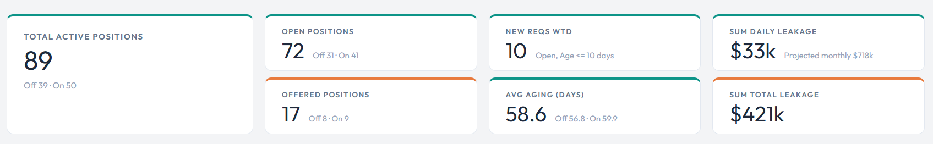
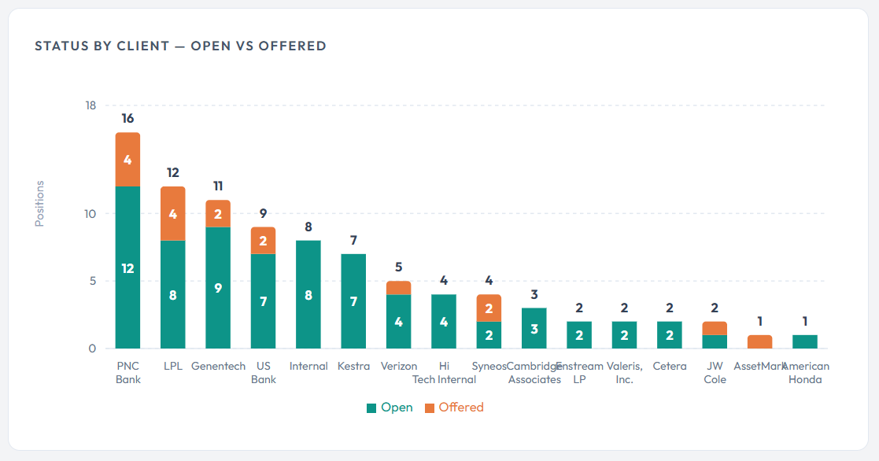
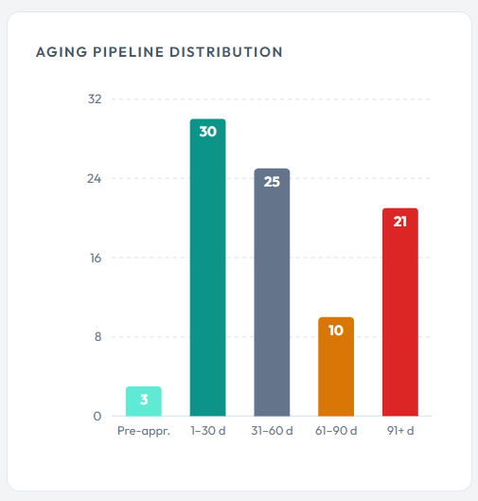
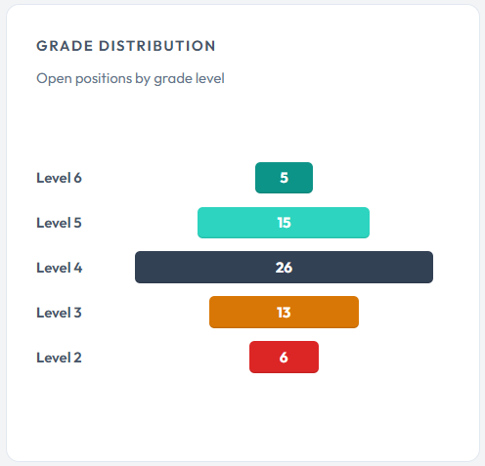
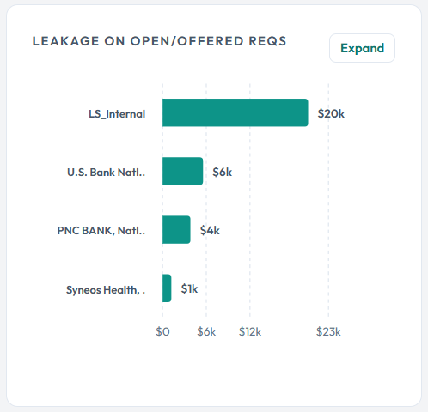
DASHBOARD
Executive view of recruiting health
Latest snapshots become KPIs, aging signals, client demand, and shore split.
Open split: Offshore 31 / Onshore 41 | Offered split: Offshore 8 / Onshore 9
TalentIQ dashboard showcase
3

Slide 4
DATA GOVERNANCE
TalentIQ
Controlled weekly intake keeps the dashboard credible
Uploads are period-tagged; history is preserved while the UI reads the latest snapshot.
TA data
exact date
MSD allocation
month
Bench IDs
ISO week
PostgreSQL
snapshots
Guardrails
Current local data
- Duplicate-period checks prevent accidental overwrite.
- Replace flow is explicit when a period already exists.
- Upload modal shows already-loaded periods before submission.
- Stored requisition rows: 3595
- Stored MSD allocation rows: 15269
- Stored bench ID rows: 180
- Installer creates tables and dependencies.
TalentIQ dashboard showcase
4

Slide 5
RECRUITMENT ANALYTICS
What the dashboard solves for Talent Acquisition and leadership
The dashboard converts requisition records into operational signals for follow-up.
Open and Offered tracking
Aging management
- Measures active demand and offer-stage conversion by latest TA snapshot.
- Buckets requisitions into pre-approved, 1-30, 31-60, 61-90, and 91+ day risk bands.
Client concentration
Onshore/offshore split
- Shows which client accounts are driving demand and require staffing focus.
- Separates demand by location model so matching uses the right delivery pool.
Leakage visibility
Grade distribution
- Estimates revenue exposure from delayed fulfillment.
- Surfaces level mix for open positions to align hiring and bench redeployment.
TalentIQ dashboard showcase
5

Slide 6
SKILL DEMAND
TalentIQ
Open positions become match-ready demand records
TalentIQ extracts role, client, priority, grade, skills, age, location, and LOB/vertical from TA data.
MATCH-READY
SKILLS
PRIORITY
GRADE
81
Parsed
Aging
+/- 2
open positions
Primary + L3
risk signal
compatibility
Position intelligence
Company context
- Only Open requisitions enter skill mapping.
- Skills are normalized from primary and L3 fields.
- Country becomes onshore/offshore context.
- Demand is no longer just a row in a workbook.
- Each position can be matched, filtered, exported, and explained.
TalentIQ dashboard showcase
6

Slide 7
BENCH RESOURCES
TalentIQ
A governed inventory of internal supply
Combines bench employee IDs with latest MSD allocation data and manual corrections.
MATCHED
97
bench resources
SOURCES
Upload + manual
Manual and file sources
tracked
- Manual ID entry supports incomplete source files.
- Inventory marks source as Manual or File Upload.
- Columns, filters, search, delete, and export support daily use.
Upload redirect
The upload flow includes a button that opens Skill Mapping > Bench Resources and focuses the manual employee ID section.
SNAPSHOT
Effective date
controlled updates
EXPORT
Excel
handoff
TalentIQ dashboard showcase
7

Slide 8
SKILL MAPPING
TalentIQ
How TalentIQ ranks internal candidates for open positions
The match engine combines skill fit, shore alignment, grade compatibility, and bench context.
Position
requirements
Same-shore
pool
Skill + grade
scoring
Ranked
candidates
Excel / AI
follow-up
Scoring logic
Company value
- Fuzzy skill comparison handles exact and partial matches.
- Confidence bands: High >= 80, Medium 60-79, Low 40-59.
- Grade compatibility allows nearby levels.
- Redeploy bench resources sooner.
- Reduce spreadsheet matching.
- Focus teams on highest-confidence staffing options.
TalentIQ dashboard showcase
8

Slide 9
AI ASSISTANCE
TalentIQ
LLM matching adds reasoning on top of structured scoring
TalentIQ can call OpenAI for explainable recommendations when an API key is configured.
Structured AI output
Governed calls
Cached results
- Summary
- Recommendation
- Top matches
- Resource-level rationale
- Candidate caps
- No-skill positions skipped
- Cost estimate before run
- Structured JSON response
- Cache key by position/resources
- Avoids repeated spend
- Supports rematch when inputs change
Use deterministic scoring for scale, then AI for nuanced shortlists and decision support.
TalentIQ dashboard showcase
9

Slide 10
RESOURCE SEARCH AND HISTORY
TalentIQ
A faster way to answer staffing follow-up questions
Search resources and inspect employee project history across uploaded MSD months.
Search capabilities
Operating questions answered
- Search all MSD resources by employee, skill, designation, client, or project.
- Inspect current allocation details, grade, LOB, vertical, and location.
- Reconstruct project history across uploaded months.
- Does this resource have relevant client experience?
- What has the employee worked on recently?
- Can the resource be shortlisted for an open demand?
Practical workflow: search, inspect history, shortlist, match, export.
TalentIQ dashboard showcase
10

Slide 11
ARCHITECTURE AND PORTABILITY
TalentIQ
Designed as a local company application with a reliable setup path
The start and setup scripts make the project transferable to another Windows machine.
React UI
localhost:5173
FastAPI
localhost:8000
PostgreSQL
talentiq DB
Portable installer
Database tables
- setup.bat configures DATABASE_URL and initializes tables.
- start.bat creates venv, installs dependencies, installs npm packages, and launches services.
- requisitions
- msd_allocations
- bench_employee_ids
- ai_match_cache
TalentIQ dashboard showcase
11

Slide 12
BUSINESS IMPACT
TalentIQ
What TalentIQ changes for the company
A shared operating rhythm for demand, supply, matching, and follow-through.
Leadership
Talent Acquisition
- Portfolio visibility into open demand, aging, client concentration, and staffing risk.
- Cleaner upload governance, faster pipeline review, and LOB-filtered requisition intake.
Delivery
Resource Management
- Better internal candidate discovery before escalating external hiring.
- Managed bench inventory, manual corrections, exports, and effective-date controls.
Recommended demo storyline: Upload data -> review dashboard -> inspect bench resources -> run skill mapping -> use AI shortlist -> export actions.
TalentIQ dashboard showcase
12

Slide 13
CLOSING MESSAGE
TalentIQ is a staffing decision system, not just a dashboard.
It connects company demand, available internal supply, skill evidence, and governed operations into one repeatable workflow.
Core promise
Next step:
Demo with live data and confirm rollout owners.
- Reduce manual reconciliation.
- Prioritize aging and high-value demand.
- Redeploy internal talent faster.
- Create a defensible weekly staffing rhythm.

