Slide 1
Azure-to-Terraform Migration (A2T)
Agentic AI–Driven Infrastructure Modernization

Slide 2
Problem Statement (A2T)
The client operates 200+ Azure subscriptions, spanning legacy and newly provisioned environments
Strategic goal is to govern all application (managed) infrastructure via Terraform Cloud
Migration requires repeated assessment, export, and refactoring across hundreds of subscriptions
Current manual approach is time‑consuming, error‑prone, and difficult to scale

Slide 3
Solution Overview (A2T)
Multi-agent, agentic AI pipeline for Azure-to-Terraform Cloud migration
Automated assessment, export, and refactoring Legacy and Modern Azure Environment
Built on Azure AI Foundry Agents and Workflows
Powered by MCP tools and containerized runtime
This is cloud‑agnostic and can be tailored for any public cloud provider, including Azure, AWS, and GCP.

Slide 4
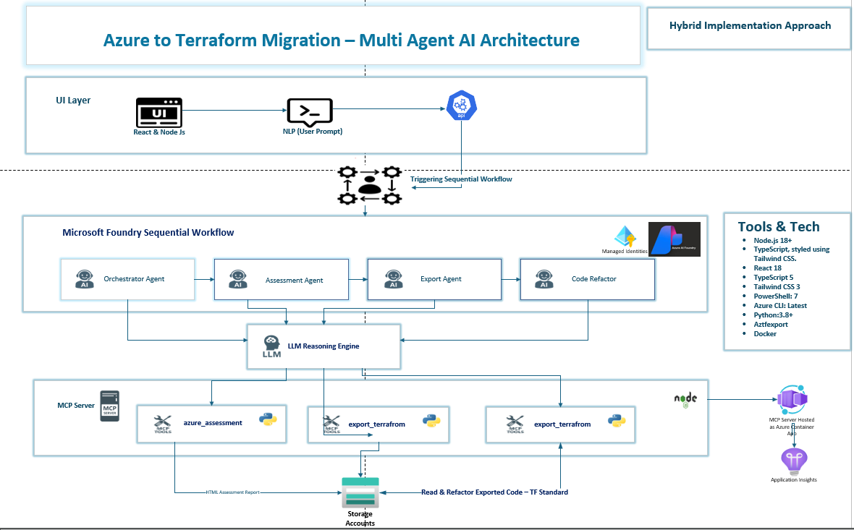
High Level Architecture Design

Slide 5
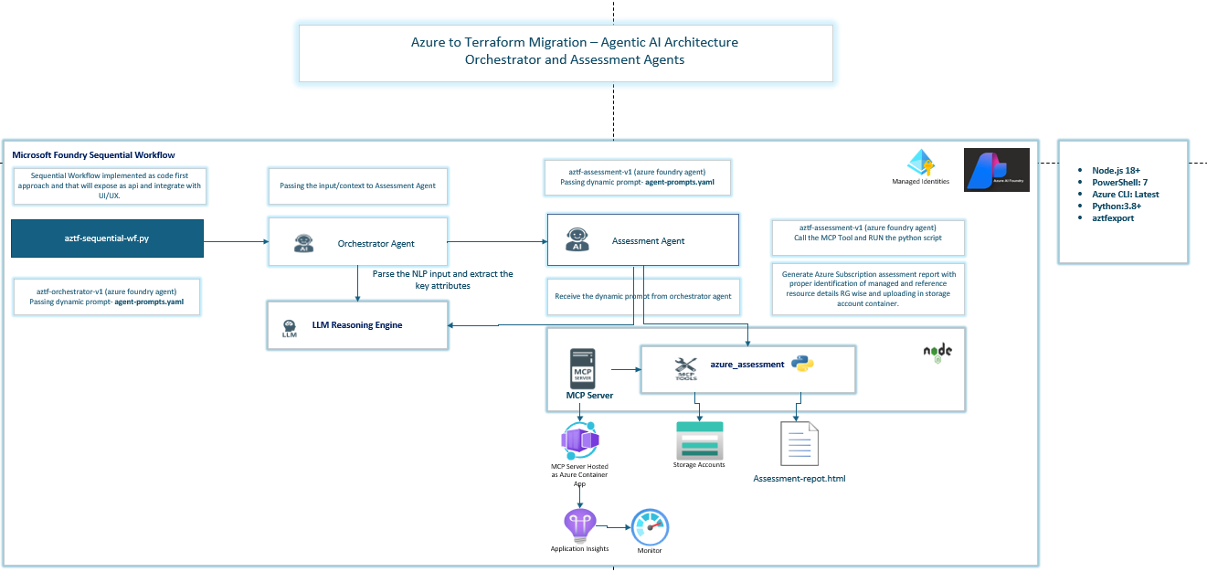
Low Level Architecture Design

Slide 6
Business Value
80–90% Faster Azure‑to‑Terraform Conversion (Primary KPI) Delivers a measurable reduction in infrastructure migration timelines by automating assessment, export, and refactoring—directly improving time‑to‑value and delivery velocity. HCL & Enterprise Terraform Standards Compliance (Quality KPI) Automatically enforces HCL best practices and enterprise Terraform standards, reducing configuration drift and improving IaC quality, consistency, and audit readiness. Secure‑by‑Default Architecture (Security KPI) Applies security controls such as private endpoints, managed identities, RBAC, and secure secrets handling by default—measurably lowering security risk and misconfiguration incidents. Repeatability & Scale Across Teams (Operational KPI) Enables consistent, repeatable migrations across teams, subscriptions, and environments—improving operational efficiency and platform scalability KPIs. Native Terraform Cloud Alignment (Governance KPI) Produces Terraform Cloud–ready artifacts, accelerating onboarding into governed workspaces with policy enforcement, versioning, and controlled execution—supporting governance and compliance KPIs.

Slide 7
Business Value
Easy‑to‑Use, NLP‑Based Experience (Adoption KPI) A natural language–driven interface allows users to initiate and guide migrations using simple prompts, reducing dependency on deep Terraform expertise and improving user adoption and productivity KPIs. Built‑In Observability & Cost KPIs Provides full observability across the agentic pipeline, including: Health KPIs for agent and workflow readiness Metrics KPIs for throughput, success rate, and execution time Distributed tracing for end‑to‑end visibility and faster troubleshooting Cost analysis KPIs for AI usage, migration runs, and optimization opportunities

Slide 8
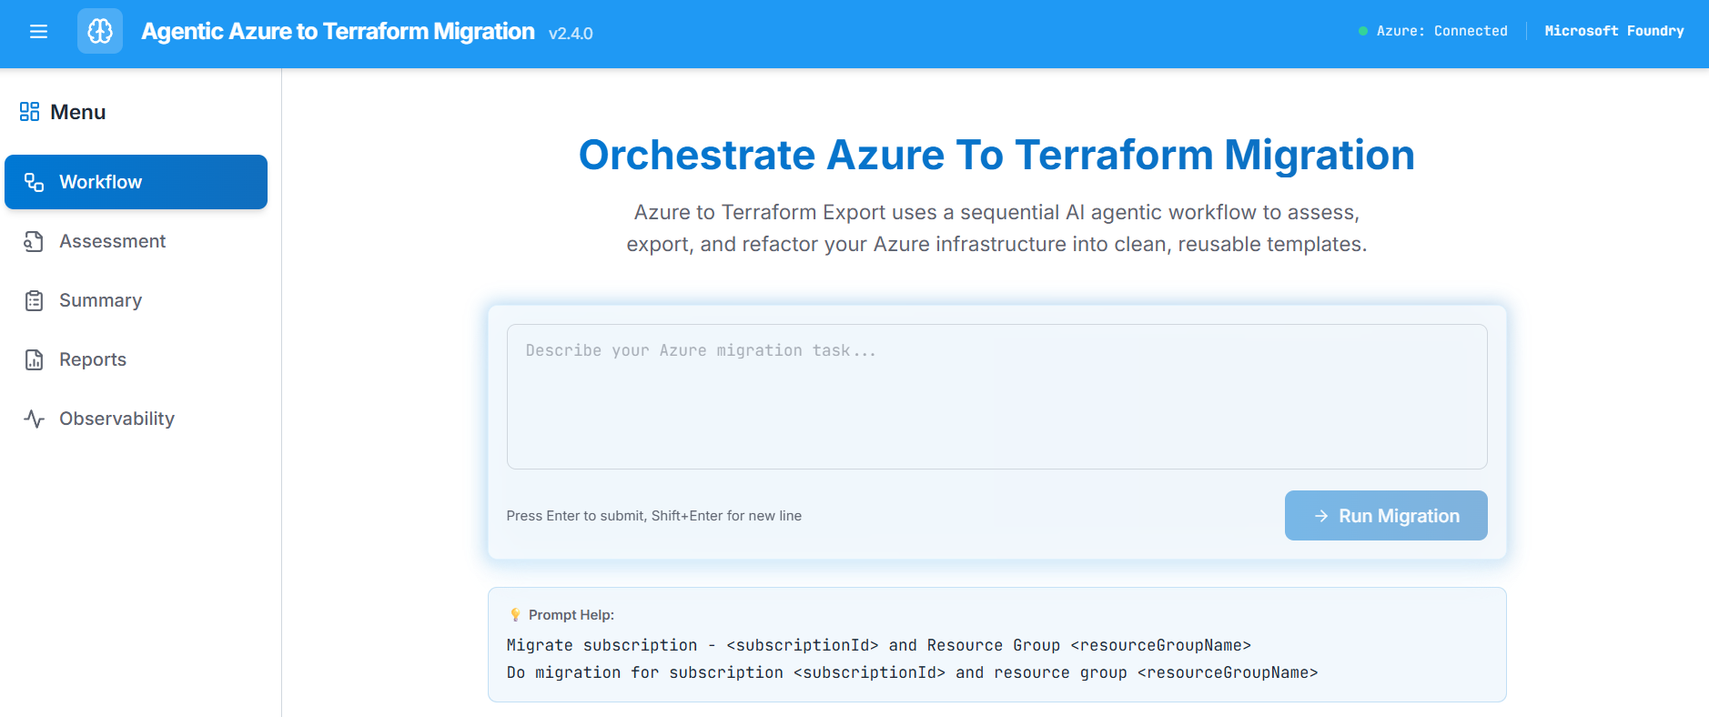
Demo

Slide 9
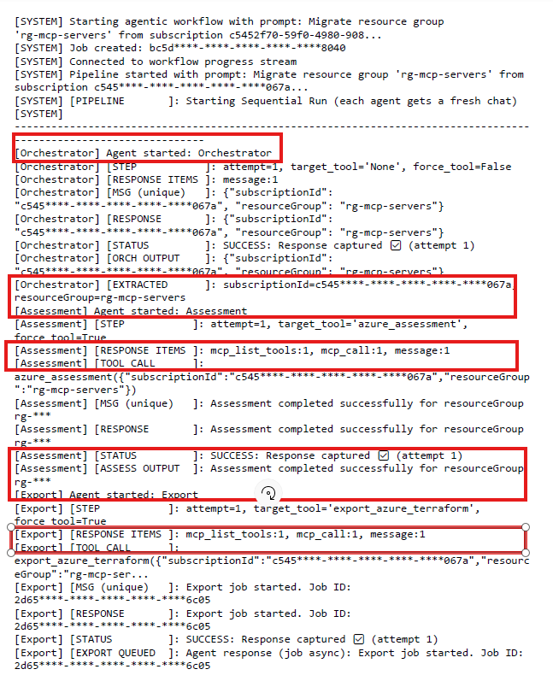
Demo – Agent Communication

Slide 10
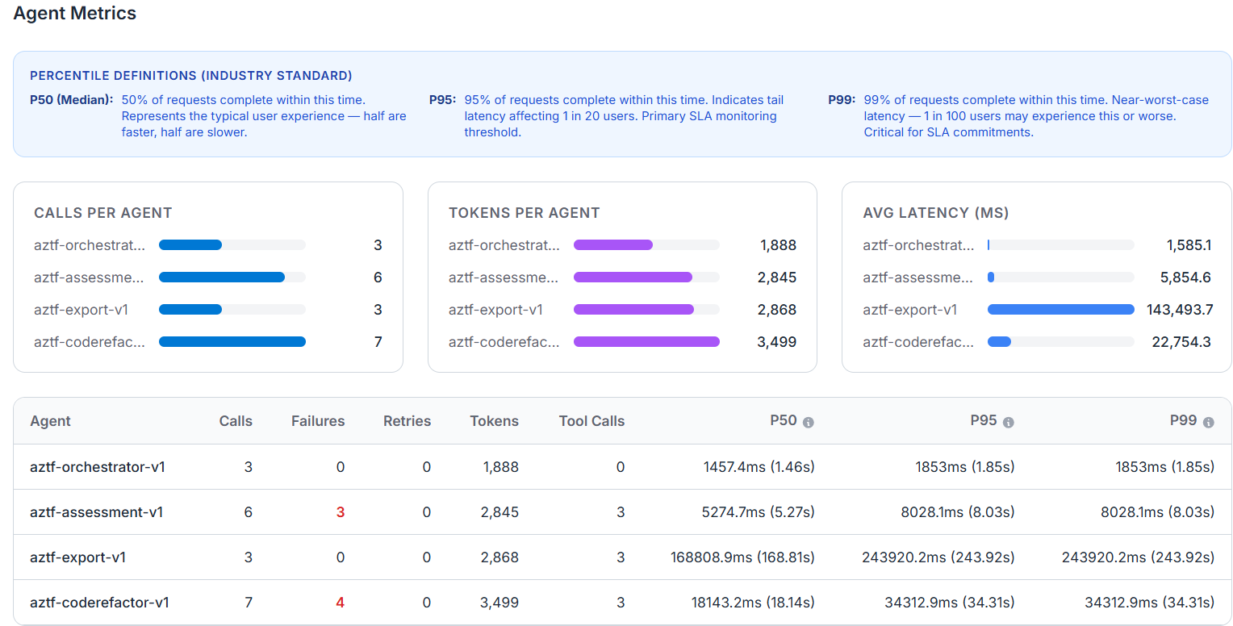
Demo – observability

Slide 11
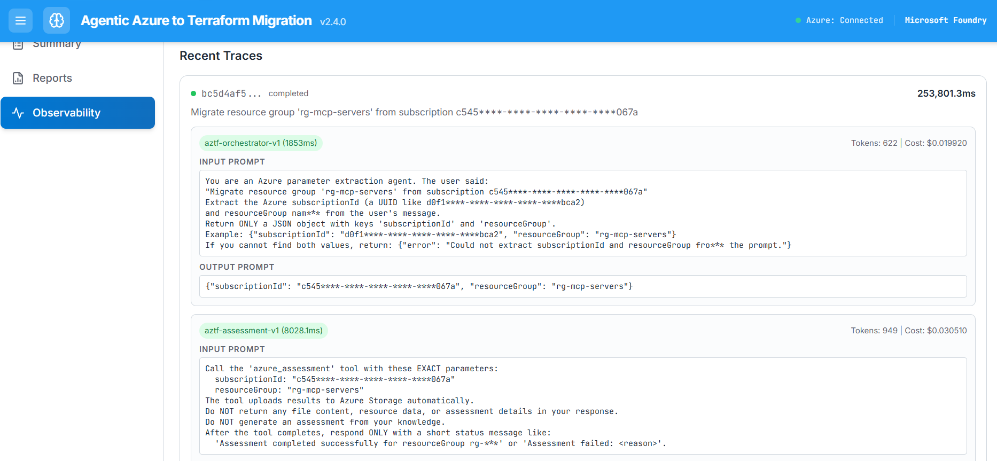
Demo – Trace

Slide 12
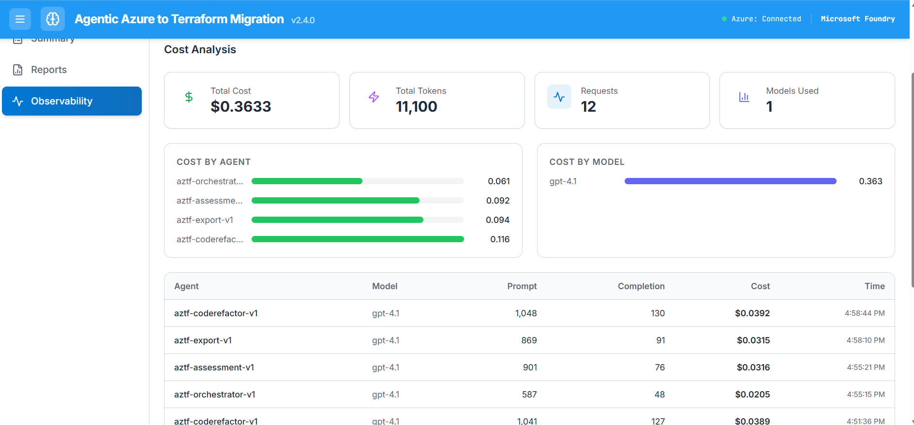
Demo – Cost Analysis

Slide 13
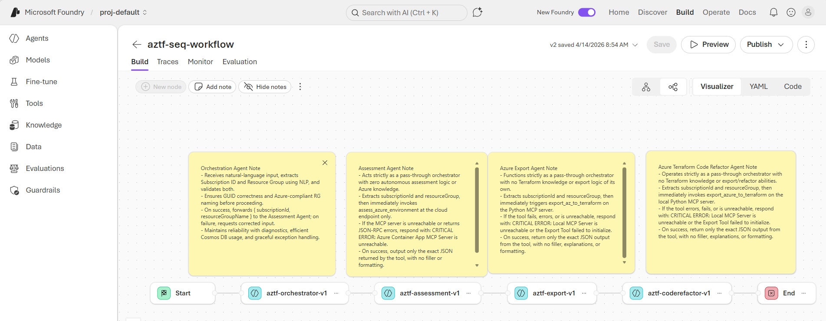
Microsoft Foundry View

Slide 14
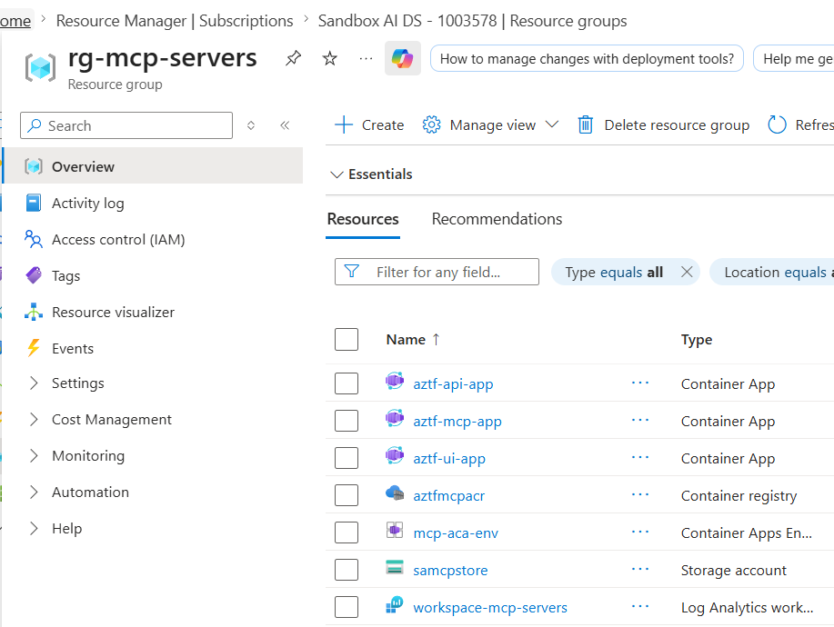
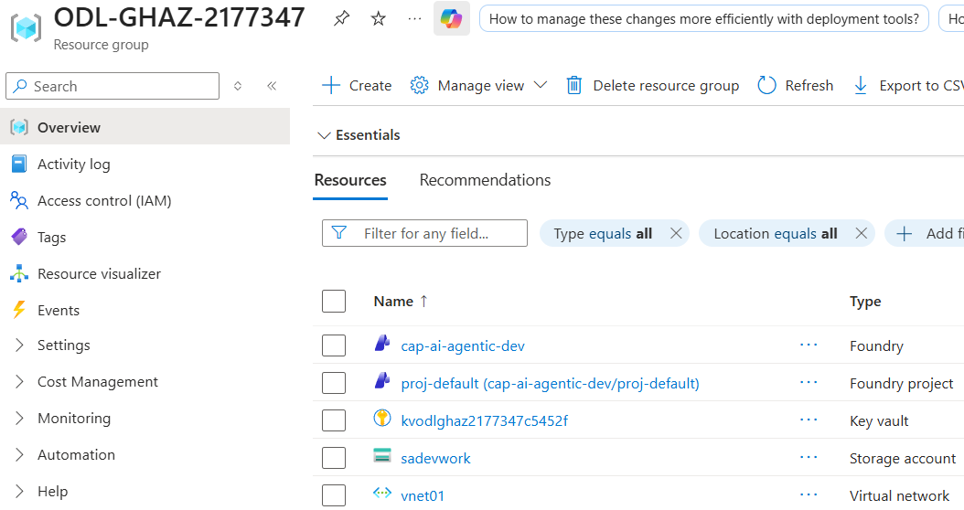
Azure Resources Overview

Slide 15

Thank You

Slide 16
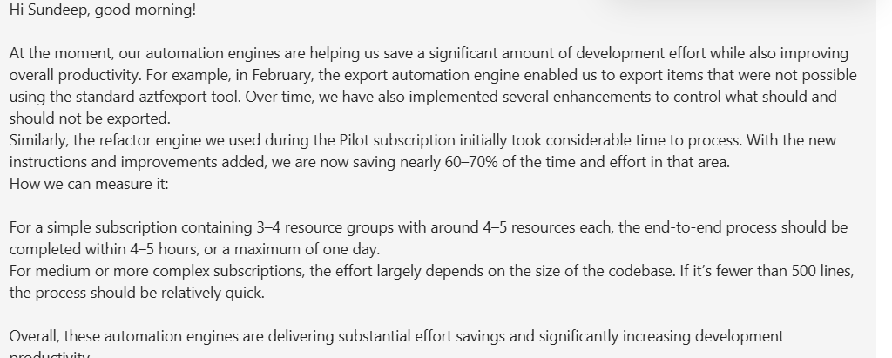
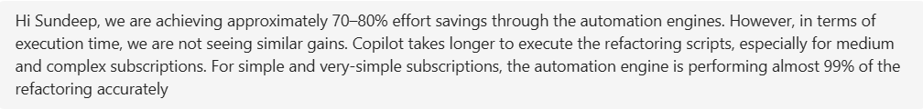
Testimonial

