Slide 1
Agentic Azure-to-Terraform Migration (A2T)
Agentic AI–Driven Infrastructure Modernization

Slide 2
Problem Statement (A2T)
Enterprise Azure‑to‑Terraform Migration Challenges
The client operates 200+ Azure subscriptions, spanning legacy and newly provisioned environments
Strategic goal is to govern all application (managed) infrastructure via Terraform Cloud
Migration requires repeated assessment, export, and refactoring across hundreds of subscriptions
Current manual approach is time‑consuming, error‑prone, and difficult to scale

Slide 3
Use Case (A2T)
Multi-agent, agentic AI pipeline for Azure-to-Terraform Cloud migration
Automated assessment, export, and refactoring Legacy and Modern Azure Environment
Built on Azure AI Foundry Agents and Workflows
Powered by MCP tools and containerized runtime
This solution can be used for other public cloud providers

Slide 4
Why Change Is Needed
Manual migration creates:
High developer work due to repetitive tasks
Inconsistent Terraform code and governance drift
Increased risk, cost, and slower delivery timelines
The scale of the environment demands a scalable, automated approach
A multi‑agent, skill‑based digital workforce is required to:
Reduce manual effort
Improve consistency and quality
Accelerate Azure‑to‑Terraform Cloud adoption

Slide 5
Outcome & Evaluation
User Impact:
Platform teams and developers save significant time by automating migration across 200+ Azure subscriptions
Innovation:
Multi-agent digital workforce using Azure AI Foundry and MCP tools
AI Fit:
Agentic AI is ideal for NLP-driven orchestration and code transformation
User Experience:
Simple, prompt-driven workflow with minimal manual intervention

Slide 6
Outcome & Evaluation
Responsible Design:
RBAC, secrets management, auditability, and deterministic tools enforced
Reusability (MCP):
Assessment, export, and refactor tools reusable across cloud automation use cases
KPI Impact:
50–70% faster migration cycles with improved IaC consistency

Slide 7
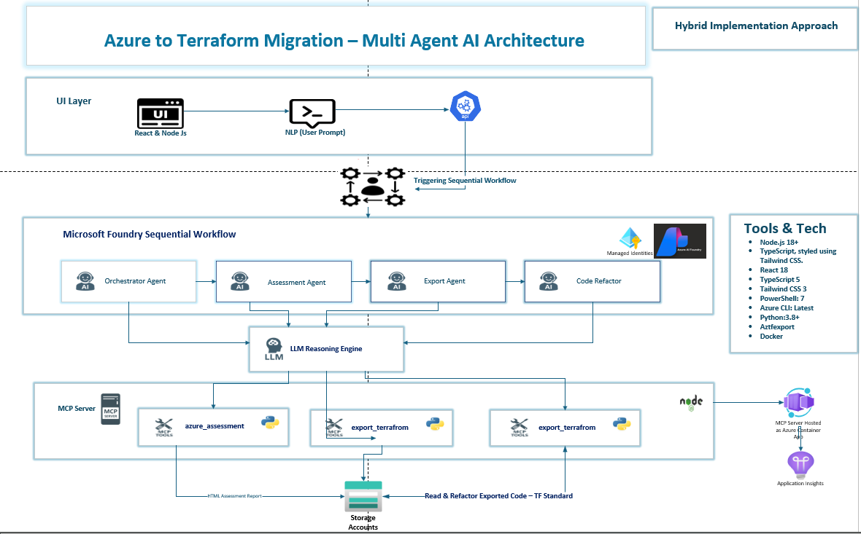
High Level Architecture

Slide 8
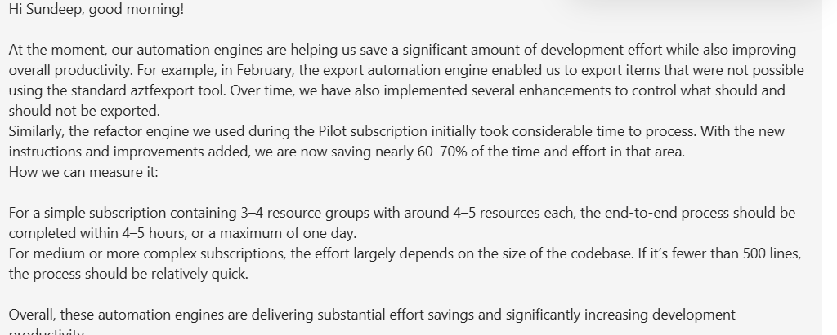
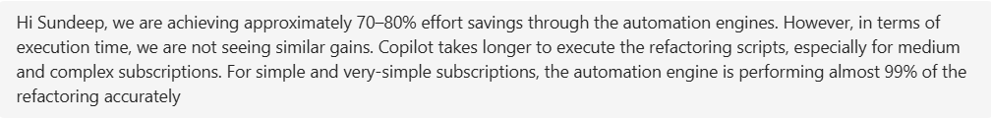
Testimonial

