Slide 1

Axis Insurance

Slide 2
Objective
Objective – Statistical Analysis of Business Data. Explore the dataset and extract insights from the data. The idea is for you to get comfortable with doing statistical analysis in Python.
You are expected to do the following:
Explore the dataset and extract insights using Exploratory Data Analysis.
Prove (or disprove) that the medical claims made by the people who smoke is greater than those who don't? [Hint- Formulate a hypothesis and prove/disprove it]
Prove (or disprove) with statistical evidence that the BMI of females is different from that of males.
Is the proportion of smokers significantly different across different regions? [Hint : Create a contingency table/cross tab, Use the function : stats.chi2_contingency()]
Is the mean BMI of women with no children, one child, and two children the same? Explain your answer with statistical evidence.
*Consider a significance level of 0.05 for all tests.

Slide 3
Data Information
Age - This is an integer indicating the age of the primary beneficiary (excluding those above 64 years, since they are generally covered by the government).
Sex - This is the policy holder's gender, either male or female.
BMI - This is the body mass index (BMI), which provides a sense of how over or under-weight a person is relative to their height. BMI is equal to weight (in kilograms) divided by height (in meters) squared. An ideal BMI is within the range of 18.5 to 24.9.
Children - This is an integer indicating the number of children / dependents covered by the insurance plan.
Smoker - This is yes or no depending on whether the insured regularly smokes tobacco.
Region - This is the beneficiary's place of residence in the U.S., divided into four geographic regions - northeast, southeast, southwest, or northwest.
Charges​ - Individual medical costs billed to health insurance
Key Points –
In the data set we have 1338 rows and 7 columns.
In the given dataset we do have duplicate values
No null values in the dataset
Insurance charges submitted by smokers and non smokers across regions were given

Slide 4
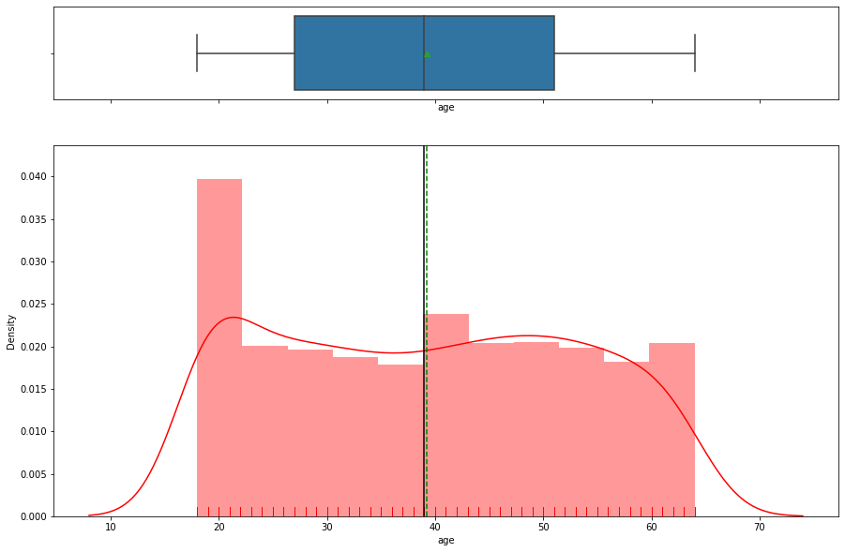
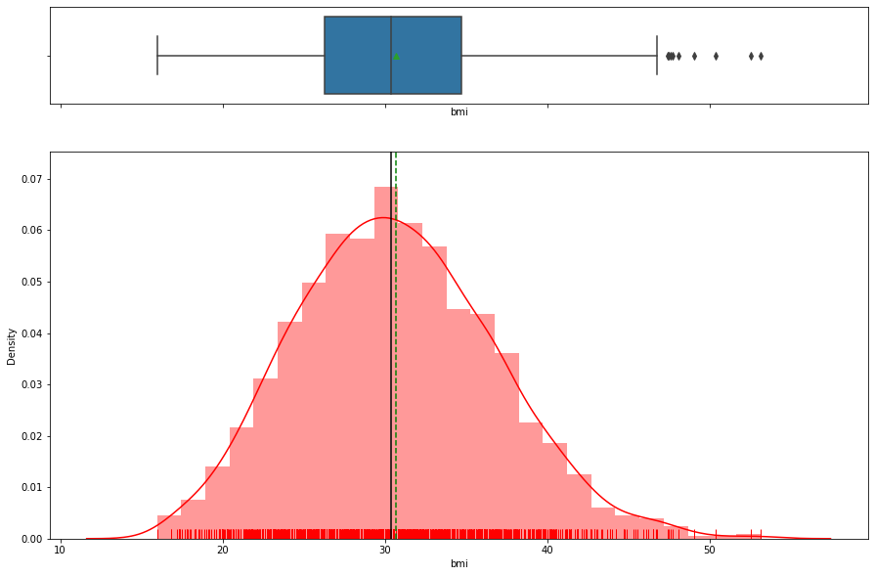
Exploratory Data Analysis Age BMI
- Data is uniformly distributed
- Mean and Median is almost same
- No skewness in the data , but couple of out layers we do have
- Maximum age is 64 and minimum is 18.
- it looks like uniform distribution.
- Mean and Median are almost same
- We do not have out layers in the data

Slide 5
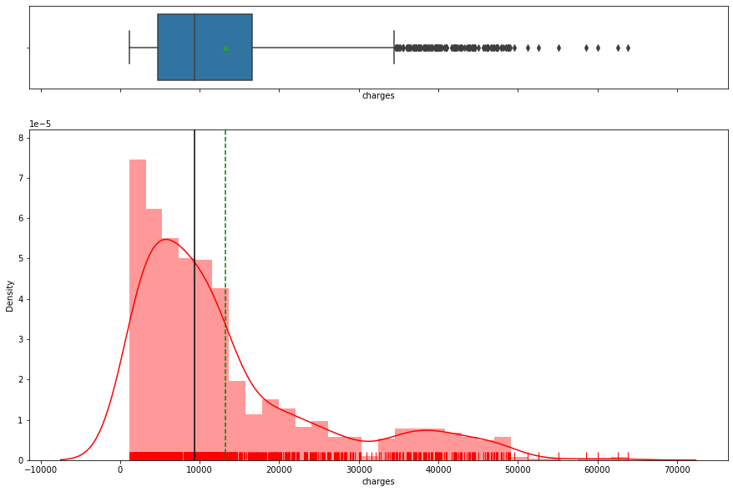
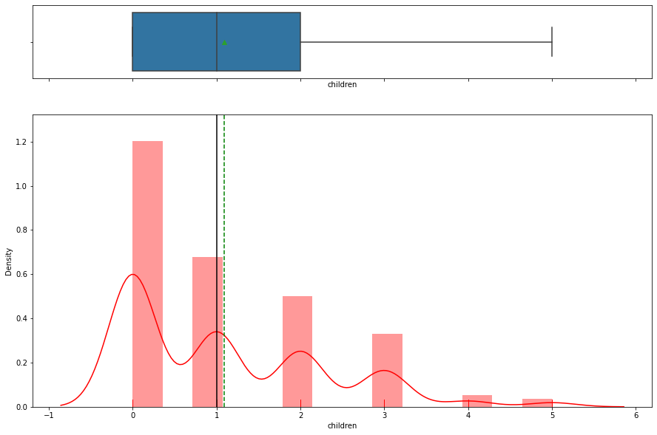
Exploratory Data Analysis Children Charges
- Majority of the people does not have children
- Max number of children is 5
- Data is not Normal distribution
- We could see lot of out layers from the box plot

Slide 6
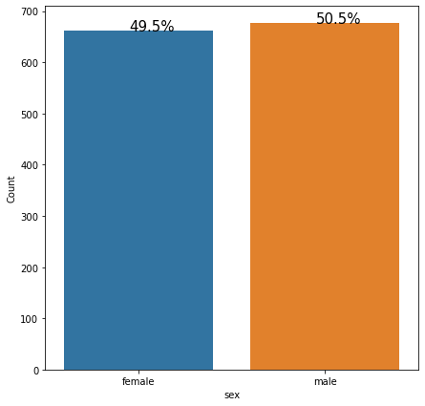
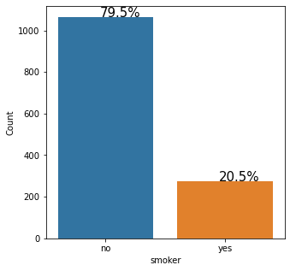
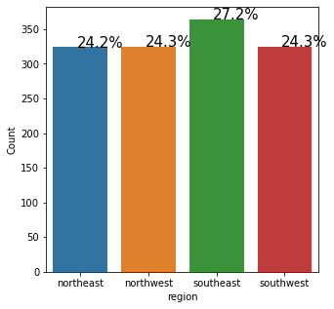
Exploratory Data Analysis Gender Smoking habit Region
Data elements are almost equally distributed across Male and Female
People who smoke are less when compared to who do not smoke
Southeast region has 27% which is highest , rest all the regions has almost same amount of data 24%

Slide 7
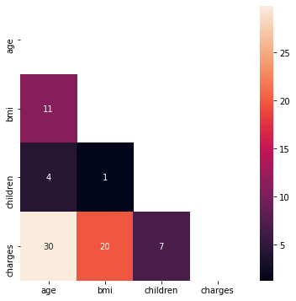
Exploratory Data Analysis - Corrrelation
As expected, Age and charges are correlated
BMI and charges are next correlated
No correlation between BMI and Children

Slide 8
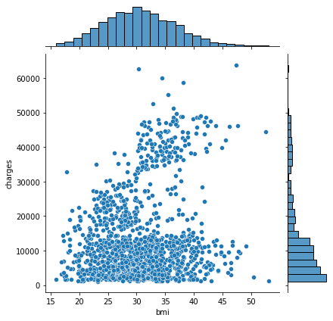
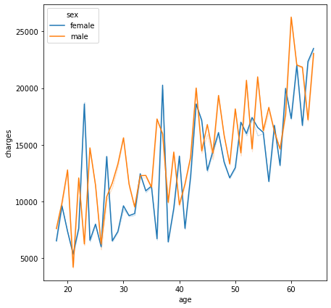
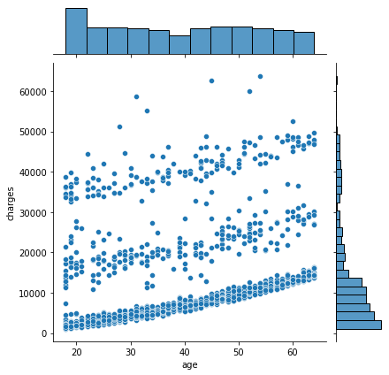
Exploratory Data Analysis Age vs Charges BMI vs Charges Age vs Charges
Both male and female filed charges , increased as the age is high.
Charges were filed by people across all BMI
Higher the age , more the charges are

Slide 9
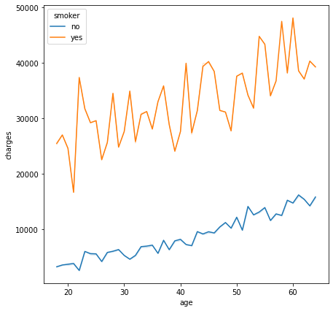
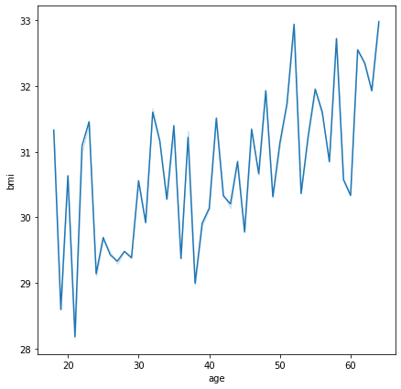
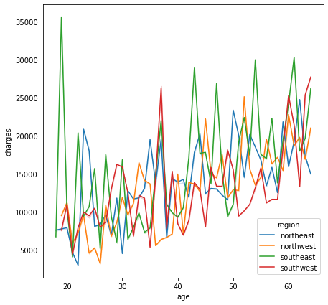
Exploratory Data Analysis Charges vs Age Age vs BMI Age vs Charges
- More charges were filed by people who smoke when compared to who do not
- More charges were filed by people from southeast
- More age , higher BMI

Slide 10
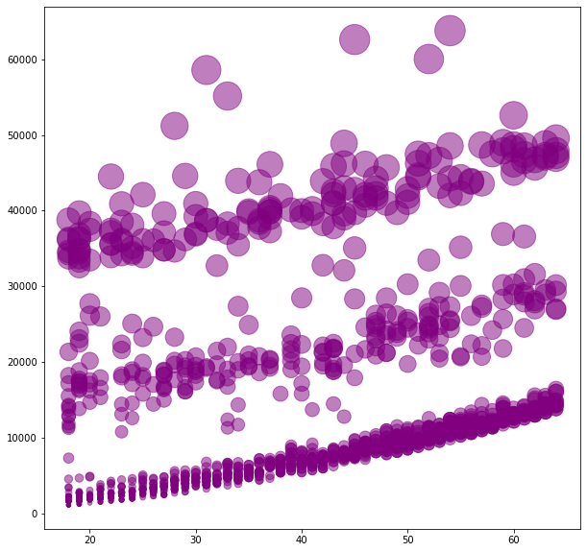
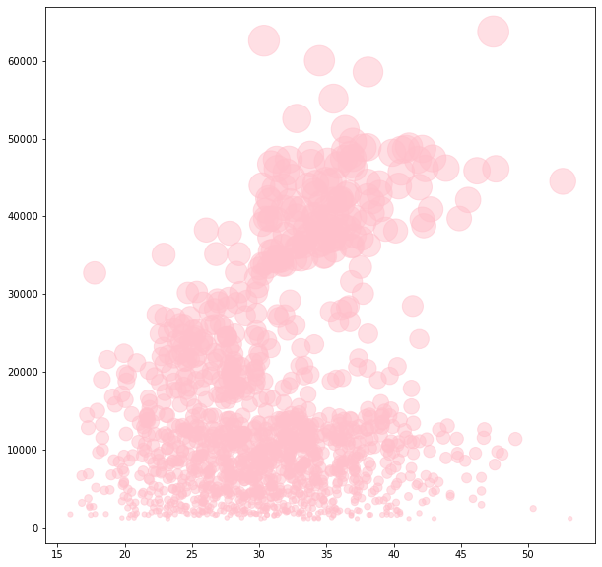
Exploratory Data Analysis Charges vs Age Charges vs BMI
As expected, Age increases, charges also increases.
Charges were filed by people across all ages

Slide 11
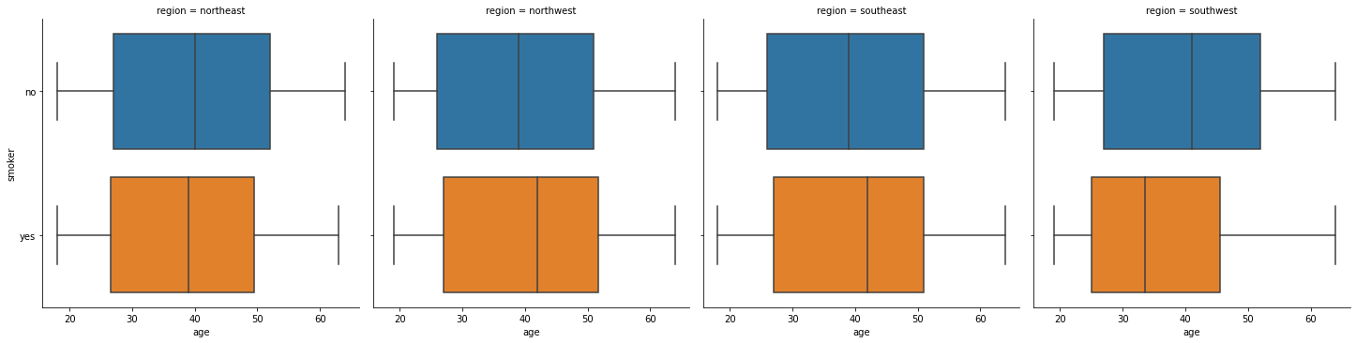
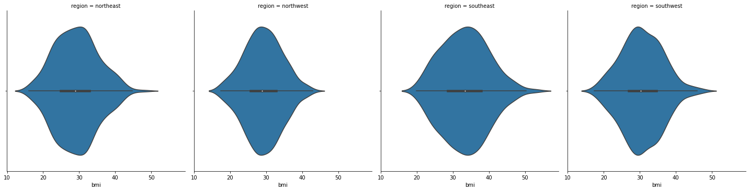
Exploratory Data Analysis
- Smoker has filed more charges
- More charges were filed by male

Slide 12
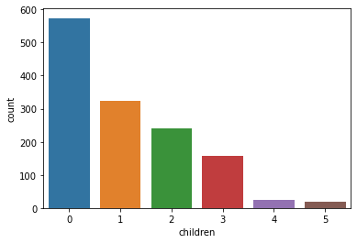
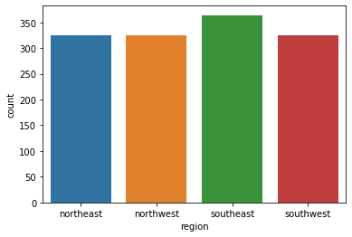
- Majority of people does not have children
- Data distribution is almost same across all the regions

Slide 13
Conclusion
- People who smoke are less when compared to who do not smoke
- As expected, Age and charges are highly correlated , BMI and charges are next correlated. We do not have any relation between BMI and Children
- Both male and female at higher age has filed more charges
- More charges were filed by people who smoke when compared to who do not
- Male has filed more charges
- Majority of people does not have children
- We do have skewness in charges
- Standard deviation for children is 1.2 which means to say data is normalized and skewness
- Max age is 64 and Min is 18
- Average age is 39 with average charge of 13270
- Maximum age is 64 and minimum is 18 and it looks like a uniform distribution with out any outliers.
- Max number of children is 5
Recommendations
People who smoke should come down , such that charges filed will also become less. Average changes filed is around 13K that should come down.
As the age increases smoking should be stopped.
More changes were field by Male when compared to female , So their smoking habit should be controlled.

Slide 14
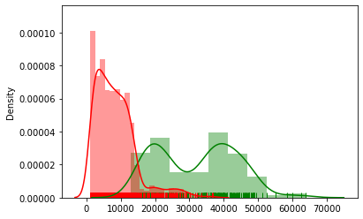
2 - Prove (or disprove) that the medical claims made by the people who smoke is greater than those who don't? [Hint- Formulate a hypothesis and prove/disprove it]
P value is - 8.271435842177219e-283
Mean charges of smokers is less than or equal to non-smokers(reject H0)

Slide 15
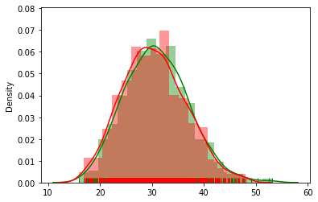
3 - Prove (or disprove) with statistical evidence that the BMI of females is different from that of males.
P value is - 0.089
BMI of Females differs significantly from that of Males

Slide 16
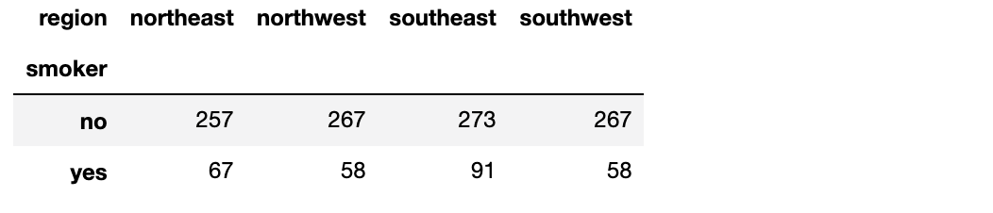
4 - Is the proportion of smokers significantly different across different regions? [Hint : Create a contingency table/cross tab, Use the function : stats.chi2_contingency()]
P value - 0.06
Conclusion - Proportion of smokers differs across different regions

Slide 17
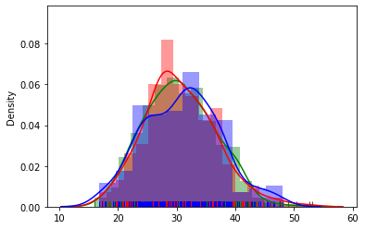
5 - Is the mean BMI of women with no children, one child, and two children the same? Explain your answer with statistical evidenc
Conclusion - BMI of Females differs significantly from that of Males

